Slide 1







Centre for New Methods in Computational Diagnostics and Personalised Therapy
on behalf of the CECM Project
Marian Bubak
Academic Computer Centre Cyfronet, Department of Computer Science,
AGH University of Science and Technology, Krakow, PL
Informatics Institute, University of Amsterdam, NL
http://dice.cyfronet.pl/; bubak@agh.edu.pl

Slide 2
Mission of CECM and CoE
This EU H2020 „Teaming for Excellence” project develops a Business Case to establish in Poland a European Centre of Excellence for computational medicine.
In silico (computational) medicine is the automated use of powerful computation to bring four key benefits to patients:
Personalised assessment, diagnosis and treatment, derived from imaging and other clinical data
New measures of disease (‘biomarkers’), computed from 3D models using FEA and CFD
Access to the entire knowledge-base of medical understanding, constantly updated
The accelerated introduction of new drugs and devices, using in silico development methods
FEA: Finite Element Analysis, the solving of complex problems by the assembly of many smaller, simpler solutions
CFD: Computational Fluid Dynamics, the use of Finite Element Analysis to describe fluid flow

Slide 3
Objectives of the New CoE
This EU H2020 „Teaming for Excellence” project develops a Business Case to establish in Poland a European centre of excellence for computational medicine.
Objective 1: Development of new computation-based solutions for diagnostics and therapy in daily healthcare.
Objective 2: Systematic involvement of regional biomed businesses, specialising in technologies and services for personalised medicine, in high-profile research projects and clinical adoption of their outcome.
Objective 3: Development of education initiatives to train knowledge workers with the skills in data analytics, simulation, and HPC/Big Data, to respond to the growing demand for skilled workforce in medical devices and bio-engineering.
Objective 4: Strong advancement of algorithms, models and technologies involved in personalised medicine, including design of holistic, replicable, generic framework for simulation-based Decision Support Systems (DSS) creation.

Slide 4
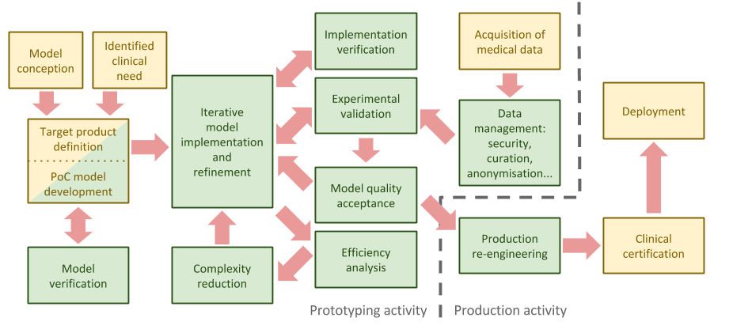
CoE Methodology

Slide 5
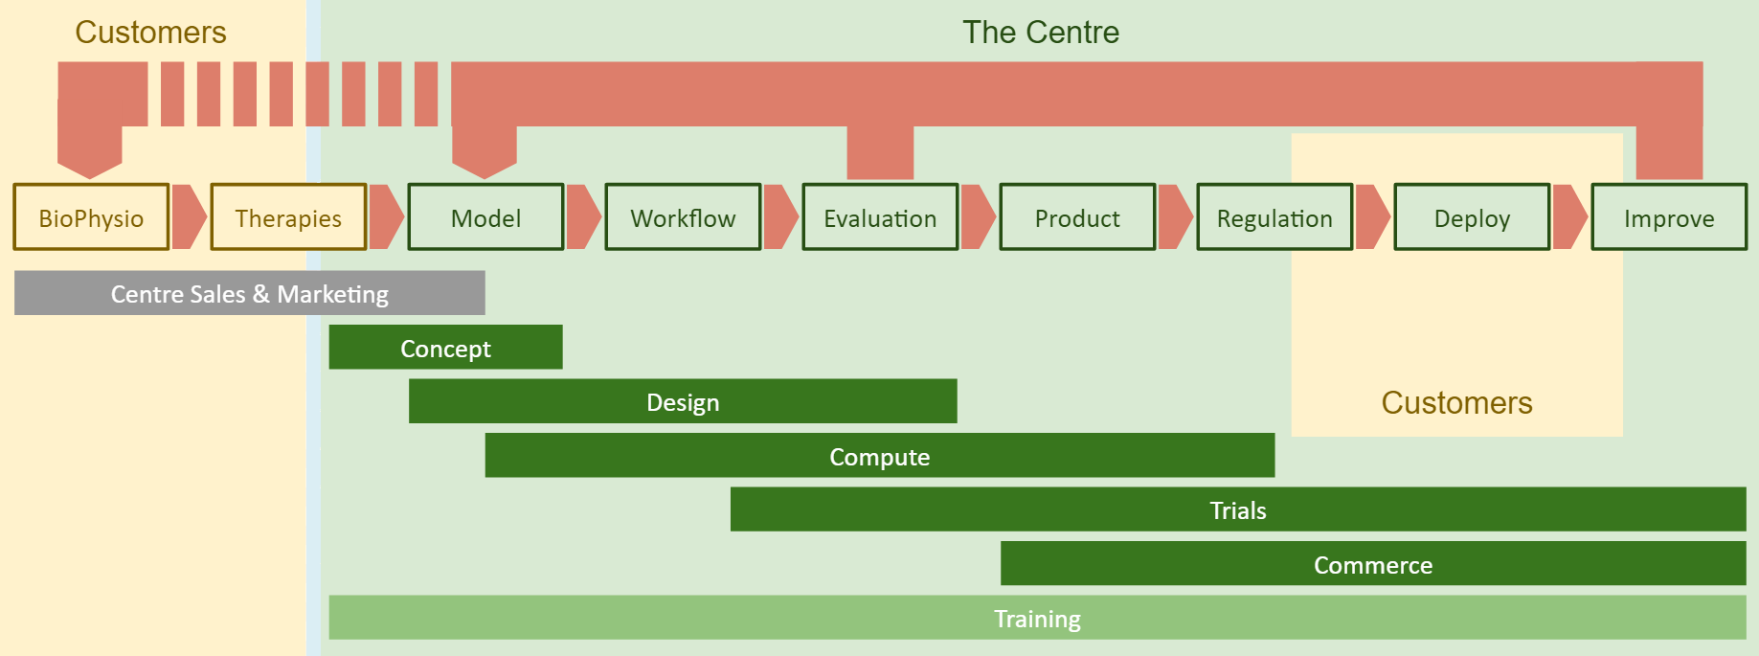
CoE Workflow
Centre’s Customers come from two distant sides of the value chain
The aim is a replicable, refined workflow, rather than a single system
Bridging the gap will locate the Centre as a crucial actor of the process
Re-iteration as an inherent excellence-building mechanism

Slide 6
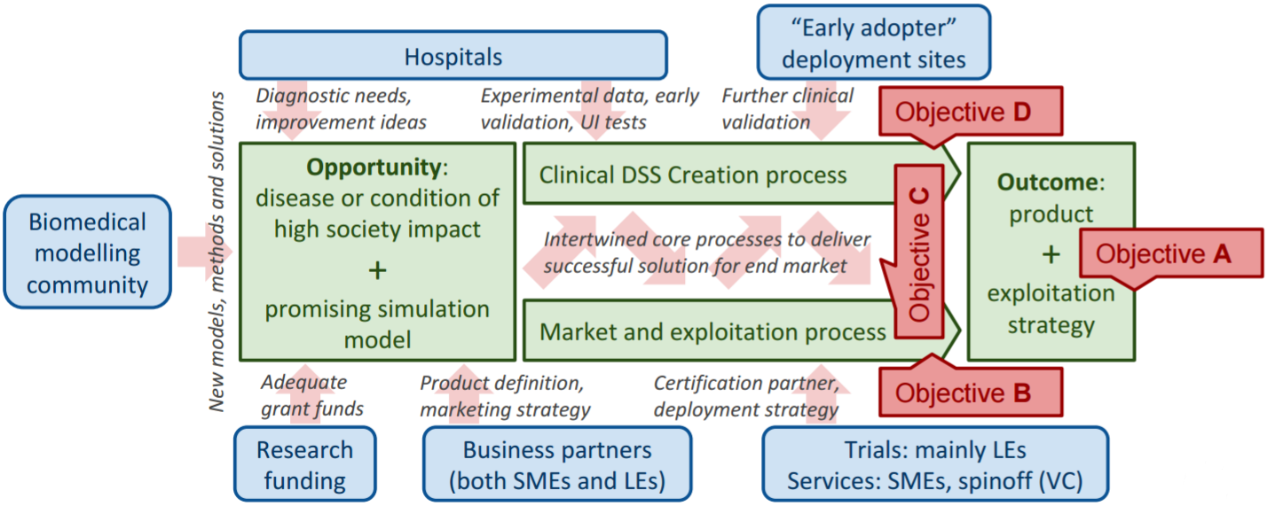
CoE Value Chain

Slide 7
International…
This is a multi-discipline challenge we plan to address with a unique collection of competences and resources from leading European science and innovation institutions representing all necessary domains:
University of Sheffield and Insigneo Institute – experts in translation of in silico modelling and simulations to clinics
Forschungszentrum Jülich – experts in modern HPC and data techniques, applied for science and industry
Fraunhofer ISI – experts in systemic multi-domain solutions and innovation in healthcare.
They will work together with Partners from Poland:
ACC Cyfronet AGH – local experts in simulation and provisioning computing infrastructure for science
Klaster LifeScience Kraków – Poland’s top cluster of industry, academia and hospitals for the life science domain.

Slide 8
…and Regional
Poland / Kraków are well positioned for a key role in computational medicine:
Kraków educates large numbers of medical and IT professionals
There is a high concentration of research hospitals in and around the city
The entrepreneurial community has entered a phase of rapid growth.
ACC Cyfronet AGH, the project leader:
Has a long record of efficient support for PL/EU computational scientists
Already hires personnel experienced in computational life science domain
Provides considerable set of hardware and software resources
Proved the capacity to act as a leader for large scientific projects.
NCBiR, the Polish National Centre for Research and Development (project coordinator) and Kraków region authorities are involved to achieve adequate alignment of our goals with local specialisations and development strategies.

Slide 9
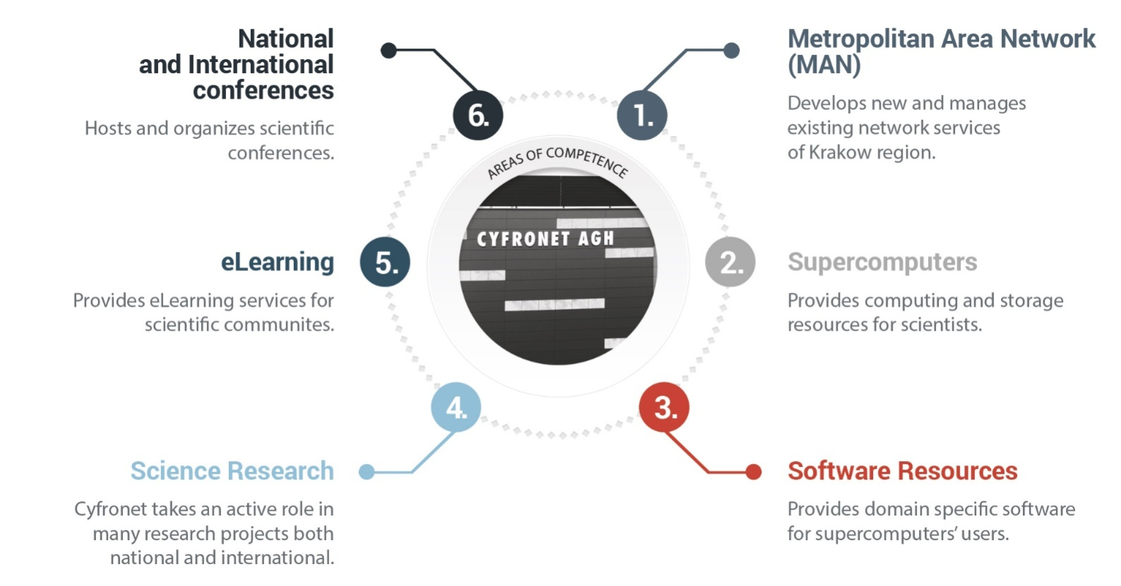
ACC Cyfronet AGH
The largest Polish Academic Computer Centre
40 years of experience in IT provisioning
An autonomous entity within AGH University of Science and Technology
Staff: >150, ca. 60 in R&D
Leader of the PLGrid: Polish Grid and Cloud Infrastructure for Science
NGI Coordination in EGI e-Infrastructure

Slide 10

















































ACC Cyfronet Projects and Collaborators

Slide 11










PLGrid Infrastructure
>7000 users, all 5 Polish Academic HPC centres integrated
Synergy between domain specific researchers and IT experts
Computing resources
5+ PFLOPS
130 000+ cores
Scientific Software
500+ applications, tools, libraries
http://apps.plgrid.pl
Tools for collaboration
project tracking (JIRA)
version control (Git)
teleconferencing (Adobe Connect)
Storage
60+ PB
fast scratch
distributed access
Computational Cloud
(based on OpenStack)

Slide 12
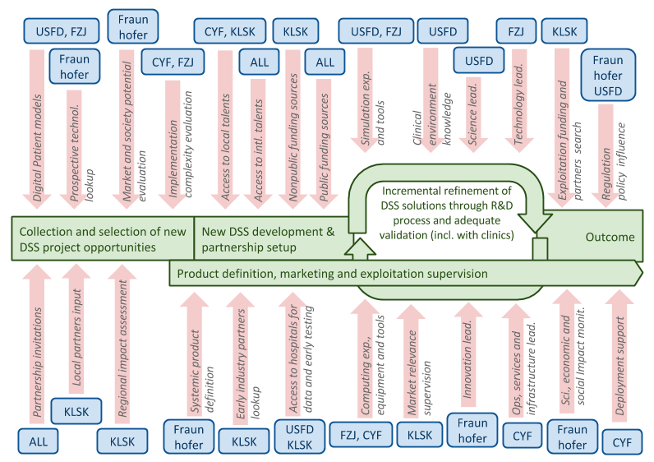
CECM Partnership

Slide 13
Potential Sources of Funding
Centre activity | Model and sources of funding
Opportunities and potential assessment | Initially by the Teaming Phase 2 EC Grant and Polish matching program, later by both public and industrial revenue streams.
DSS creation R&D | Research grants (both EU and PL) acquired for development of specific medical methods. Late-TRL projects will be covered by cooperation with industry.
Promotion, dissemination and impact maximisation | Individual projects’ dissemination and exploitation budgets. Limited Teaming Phase 2 funding is expected for some activities (e.g. managing technology transfer databases, organising showcases and workshops etc.).
Support: HPC, IT, HR, accounting, legal and similar. | Polish and regional structural funds (hardware, offices, etc.) and individual projects’ overhead (personnel). Our precise alignment with the national and regional Smart Specialisation is an important enabling factor .
Overall management and governing structure | Individual project management will be covered from the project’s management budgets. Management of the Teaming Phase 2 Project will be covered from the Teaming budget. IP management will be funded from revenue.

Slide 14
Summary
The CECM will exploit these advantages to build a world-class centre of excellence, attractive to foreign partners, and having a significant impact at both regional and national scales, with lasting benefits for pan-European society.
www.cyfronet.krakow.pl/en/
http://dice.cyfronet.pl/

