Slide 1

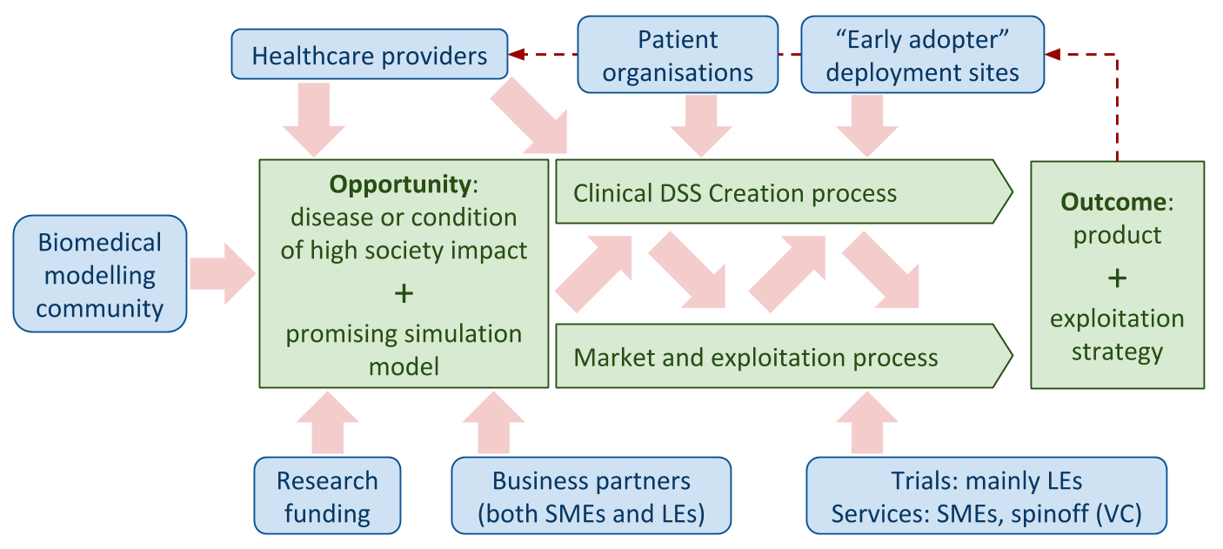





















A Centre for New Methods in Computational Diagnostics and Personalised Therapy
This EU H2020 ‘Teaming for Excellence’ project develops a Business Case to establish in Poland a European centre of excellence for computational medicine.
Objectives
Health: Development of new computation-based solutions for diagnostics and therapy in daily healthcare.
Technology: Systematic involvement of regional biomed businesses, specialising in technologies and services for personalised medicine, in high-profile research projects and clinical adoption of their outcome.
People: Development of education initiatives to train knowledge workers with the skills in data analytics, simulation, and HPC/Big Data, to respond to the growing demand for skilled workforce in medical devices and bio-engineering.
Science: Strong advancement of algorithms, models and technologies involved in personalised medicine, including design of holistic, replicable, generic framework for simulation-based Decision Support Systems (DSS) creation.
Impacts
Replace invasive diagnostics
Improve efficacy
Reduce secondary care costs
New Polish
high-tech start-ups
Replace indirect prognostics
Personalise therapies
Reducing impact of ageing
Externalise management
Digital Patient: subject-specific models as decision-support systems for personalised medicine
Manage multimorbidity
Affordable future
Optimise complex pathways
Create a Polish ISCT industry
Reduce innovation costs
Speed time-to-market
Treat rare conditions
Revitalise medical industry
Target rare/neglected disease
In Silico Clinical Trials: individualised computer simulation for the development or evaluation of new drugs or medical devices
Reduce, Refine, and Replace Animal Experimentation
More ethical research
Optimised regulatory pathways
Optimise management of chronic conditions
Reduce primary care costs, Improve quality of life
Empower participation
Democratisation of healthcare
Refine rural telemedicine
Improve access to care
Low-cost MedTech industry
Personal Health Forecasting: subject-specific models for the self-management of health
Personalise prevention
SHORT-TERM LONG-TERM
Consumer ISM market
Methodology
International Consortium and Environment
Collaboration:
Modellers + Healthcare Professionals → identify in silico opportunities
Innovation: New in silico solutions for
diagnostics and therapy in daily healthcare
Private Funds
Venture Capital
€ Public
€ Private
HPC skill
Healthcare Innovation
Hardware
The
Centre
An independent research foundation
In silico expertise
Comp Medicine skills
Modelling research
HPC Lab and hardware
Clinical Data
Human resources
Computer science research
Technology
Human resources
State-of-the-art: Advancement of algorithms, models and technologies
LifeSci/Med research
Clinical Data
Medical Labs
Human resources
Data and Trials
Education: knowledge transfer in health data analytics, modelling, HPC Foster: young Entrepreneurs → technical/commercial/financial skills
Exploitation: Regional biomed businesses
Industry
Human Resources: Key to Success
National and Regional Opportunities
Poland, and in particular Kraków, are well positioned to play a key role in computational medicine:
Kraków scientific community educates large numbers of medical and IT professionals, and routinely engages in interdisciplinary research with Europe’s world-leading in silico research community.
There are many research hospitals in and around the city.
The life science companies have entered a phase of rapid growth.
The project is coordinated by Polish National Centre for Research and Development, and Małopolska (Kraków) region authorities are strongly involved in, to achieve adequate alignment of the Centre’s goal with national and regional specialisations and development strategies.
International committees and management : excellence in talent acquisition
Int. Scientific Committee : Chaired by Marco Viceconti
13 members (UK, IT, DE, NL, US, PL)
Selects top candidates
Foundation Council
5 reps of Teaming partners (UK, DE, PL)
Concludes employment contracts
Search Committee: 6 members (UK, DE, PL)
Access to quality candidates
Centre’s Management : Led by Scientific Affairs Director Marian Bubak
Top international candidates for the Directorship, and Laboratory Leaders
Recruitment of Life Science and IT research and management staff
Track record (2017): 8 international CSOs/lab leaders recruited
Healthcare Informatics
Key Performance Indicators
Research groups
R&D personnel
New scientists
Foreign scientists
Publications
Data
Science
The
Centre
Modelling and Simulation
5
55
33
15
60
Algorithmic decision science
In silico techniques
Computer Science and HPC
Access to local and international Candidates for Middle and Junior Researcher positions
Contact: Marian Bubak, Academic Computer Centre Cyfronet, AGH University of Science and Technology, Kraków, Poland
bubak@agh.edu.pl, http://dice.cyfronet.pl/
Acknowledgements. This work is partly supported by the EU project CECM H2020 WIDESPREAD TEAMING PHASE 1 (contract number 763734).

