Slide 1

Running Workloads on the Prometheus Cluster with Singularity J. Kapała, J. Meizner, P. Nowakowski, P. Wójtowicz, and M. Bubak
PROviding Computing solutions for ExaScale ChallengeS
ACC Cyfronet AGH, Krakow, Poland

Slide 2
Our motivation: 5 use cases
PROCESS = PROviding Computing solutions for ExaScale ChallengeS
Health
Content-based search and classification (Haute Ecole Specialisee De Suisse Occidentale, Switzerland)
Astronomy
Square Kilometre Array SKA (eScience Center, Netherlands)
Computation using data from the LOFAR telescope (now in operation), technology preparation for the SKA challenges (when available)
Risk Management
Supporting innovation based on global disaster risk data (Ludwig-Maximilians-Universität Muenchen, Germany)
Originally planned for the UN provided datasets, due to external factors will shift to different yet similar datasets
Airlines Operations
Agriculture
Ancillary pricing for airline revenue management (Lufthansa Systems GMBH & CO KG , Germany)
Agro-Copernicus (Ludwig-Maximilians-Universität Muenchen, Germany)
Medical use-case utilizing AI on CPUs and GPUs for cancer diagnostic based on imaging data
Business use case for building models enabling revenue optimization and real-time calculations of prices
Agricultural simulations utilizing date from the part of Copernicus dataset collected from the Sentinel satellites
All but one of the cases (risk management) are already fully integrated with the PROCESS platform
Notes:
HES-SO = Haute Ecole Specialisee De Suisse Occidentale
SKA -> planned for 2027 – much larger data volumes
-> we need to say that disaster case is not our fault (UN decision) and that UC1 and UC2 are on Premetheus, UC4 is planned for it and UC5 will not be there only for legal reasons (closed LRZ-only licensing)

Slide 3
Our goals
Our main goal is to build a computing platform which:
Scales well on the current resources, as attested to by benchmarks on Prometheus and SuperMUC-NG
Is capable of far greater scalability according to best possible estimations – we are aiming towards excascale
Allows straightforward adaptation of pre-existing use case code developed on different distributions and software stacks
Provide a homogeneous deployment mechanism on highly heterogeneous infrastructures (multiple HPC sites, cloud)
Smoothly integrates with the storage infrastructure developed primarily by the University of Amsterdam

Slide 4
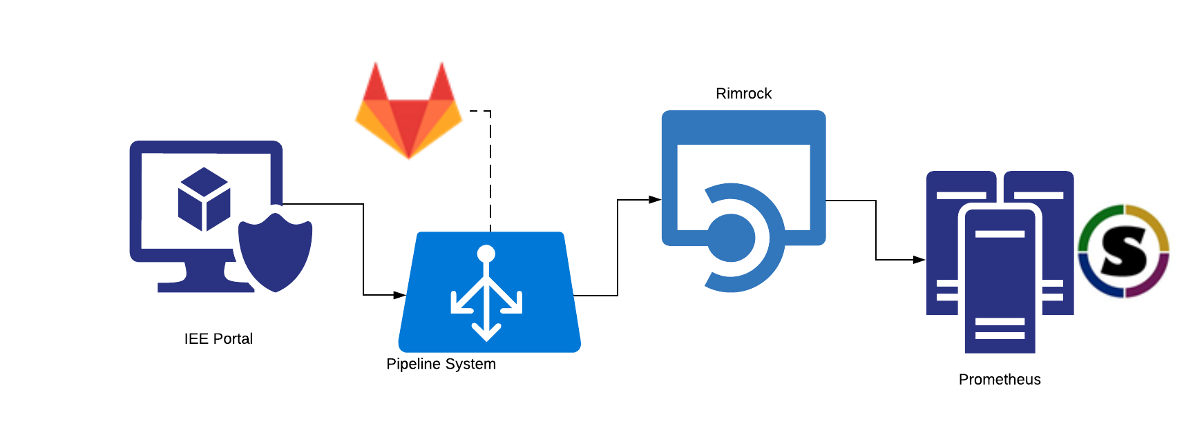
General architecture overview
User defines pipeline and its steps in the Interactive Execution Environment (IEE) via the Web
IEE presents a computation which is ready for execution, or starts it automatically
Pipeline steps are executed, with Singularity steps scheduled as jobs via Rimrock on HPC
HPC (e.g. Prometheus) queues jobs (SLURM) and runs them when resources are available
Inside each job, the appropriate code launches Singularity with the right options

Slide 5
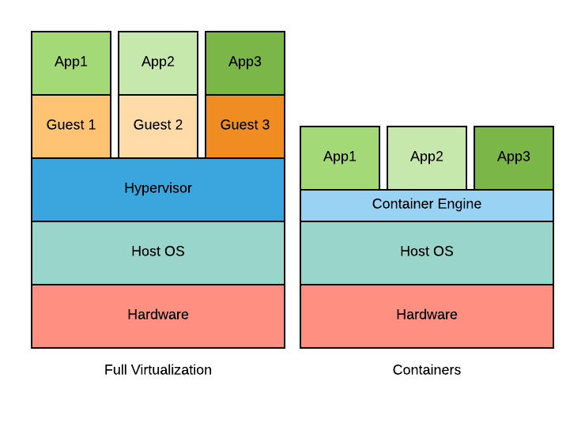
Why Singularity?
Why containers?
Small footprint
Less overhead
Quick launch
Manageable images
Why Singularity?
Built for HPC
Integrated with SLURM
Unprivileged / secure
Support for MPI and GPU

Slide 6
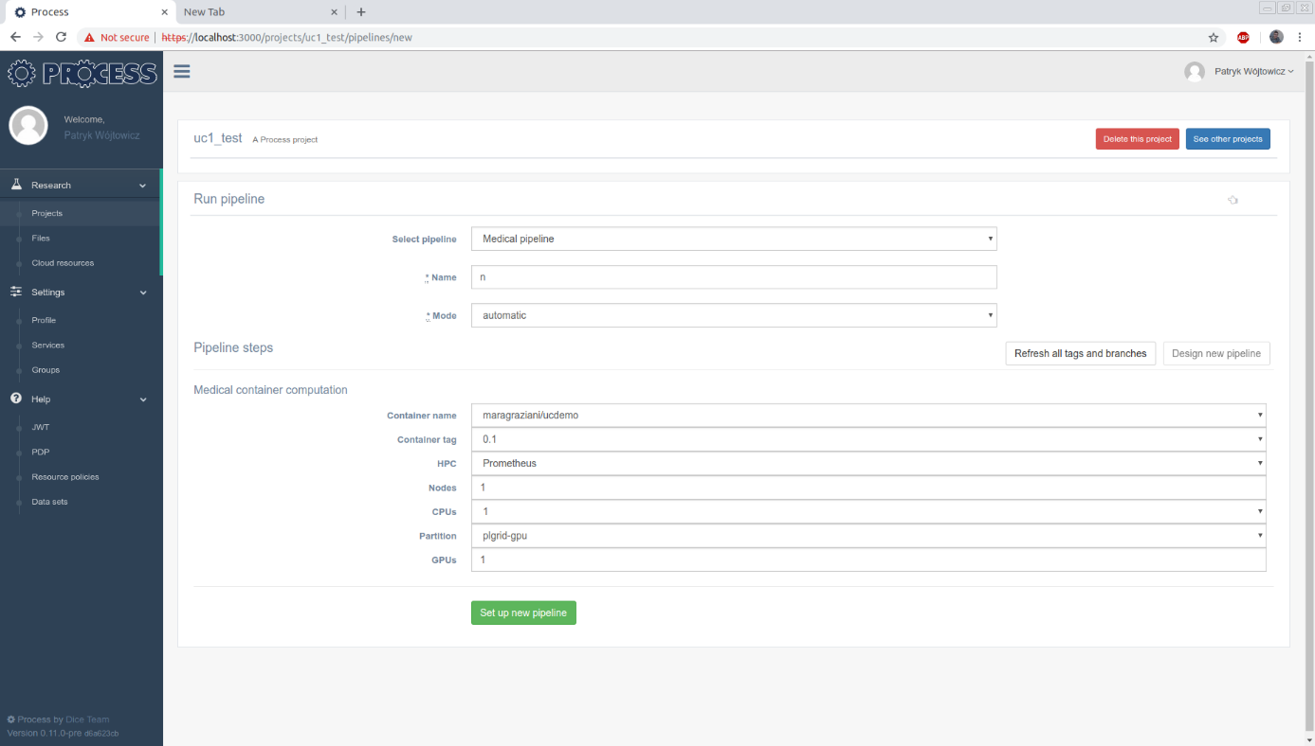
Inside IEE – pipeline setup
Generic
settings
Use case
specific
settings

Slide 7
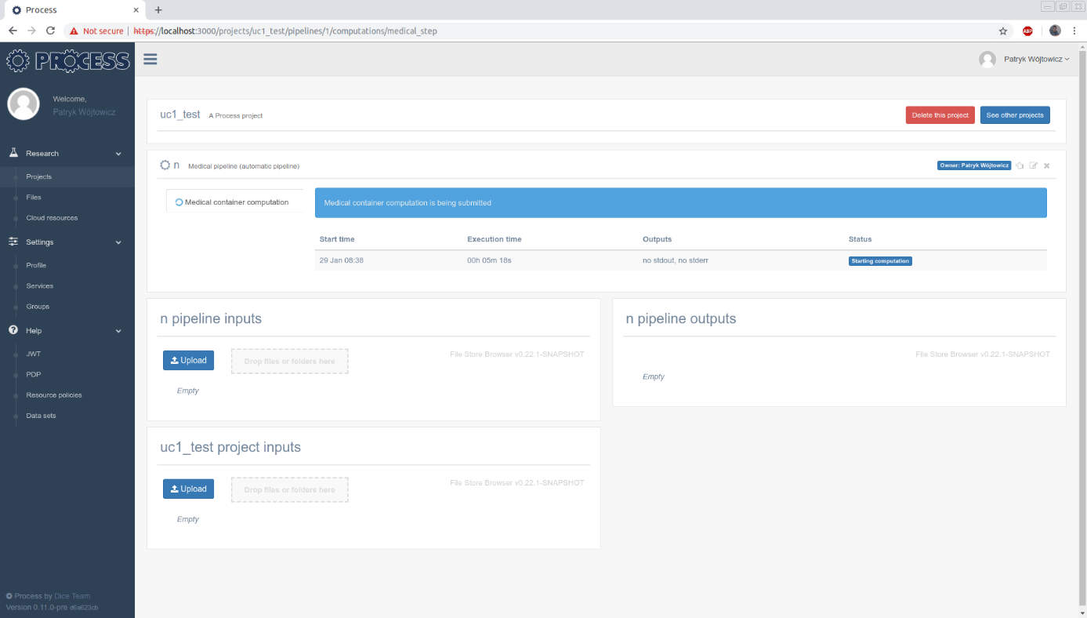
Inside IEE – pipeline execution
Pipeline has
started
automatically
Integrated
data platform

Slide 8
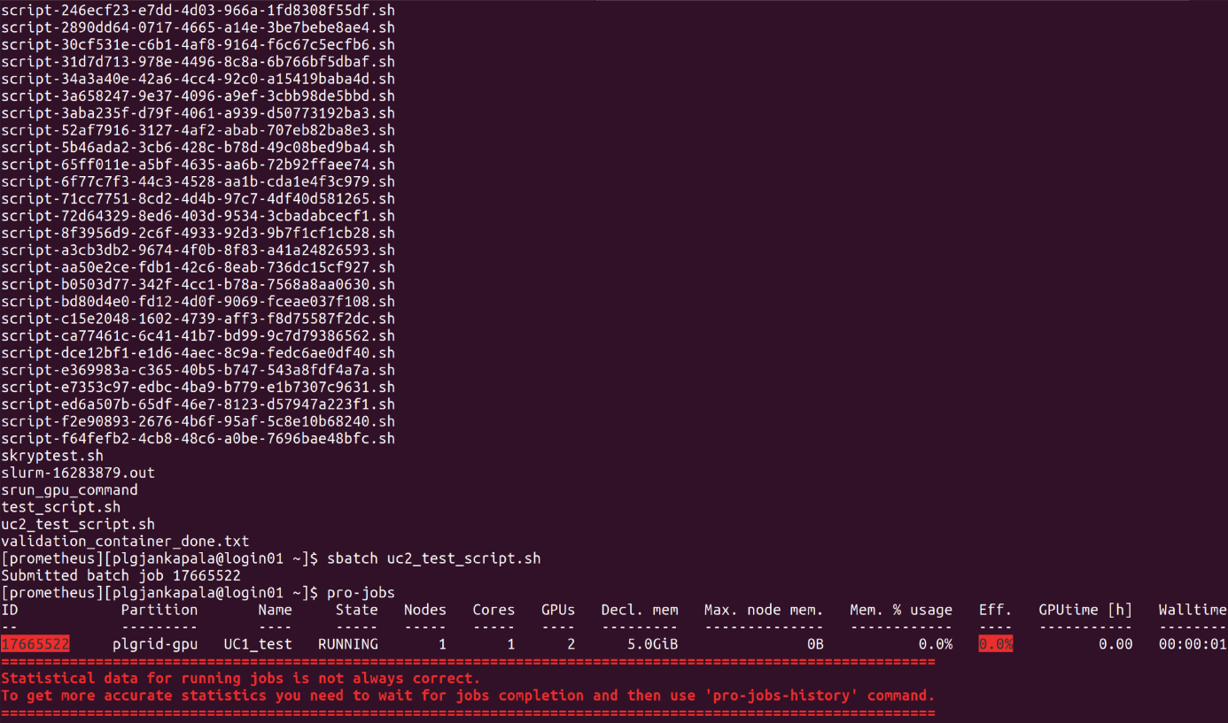
Running jobs on Prometheus
Rimrock
autogenerates
and runs scripts
Manual script
execution
(for testing)
Container run
as SLURM job
(here, on GPU)

Slide 9
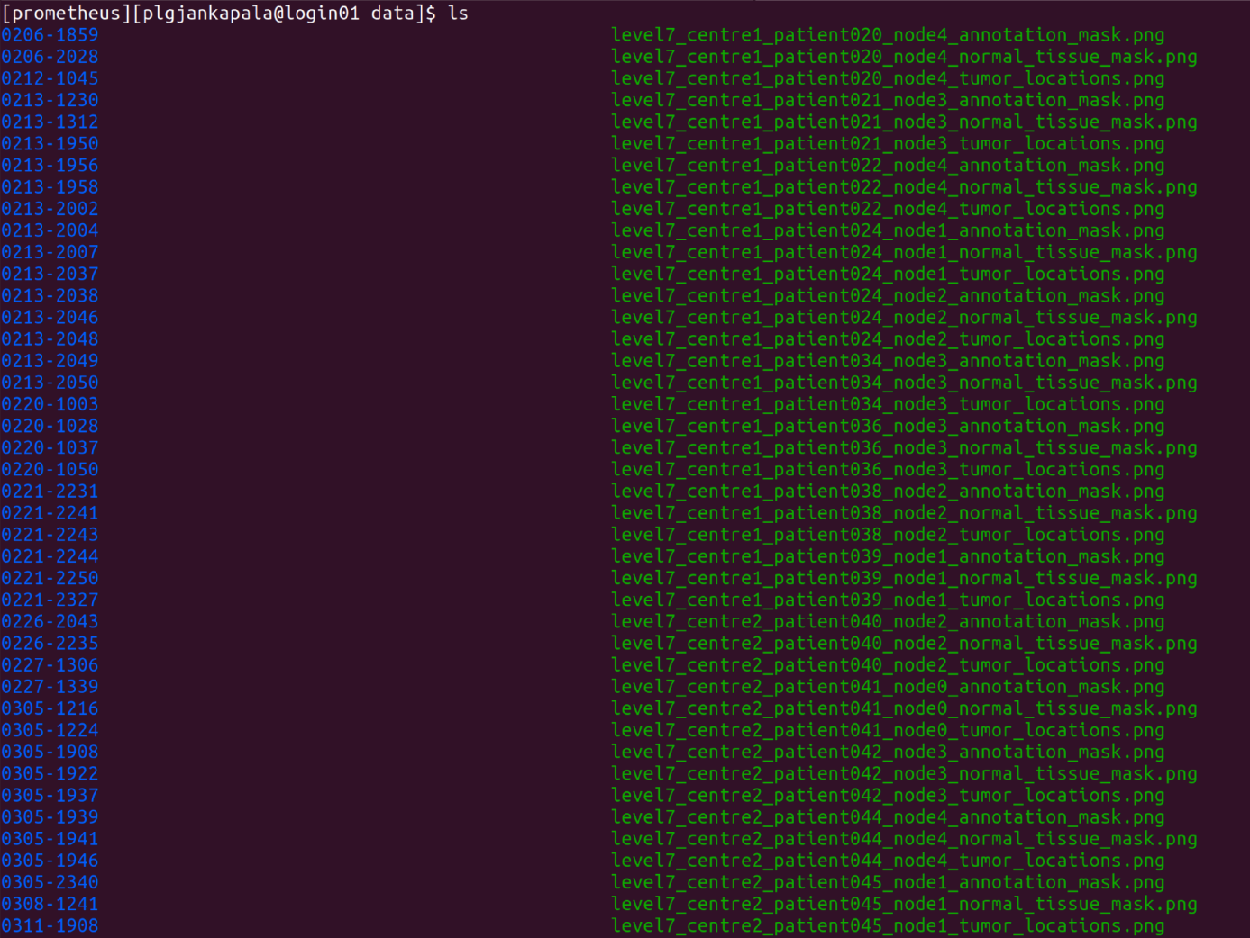
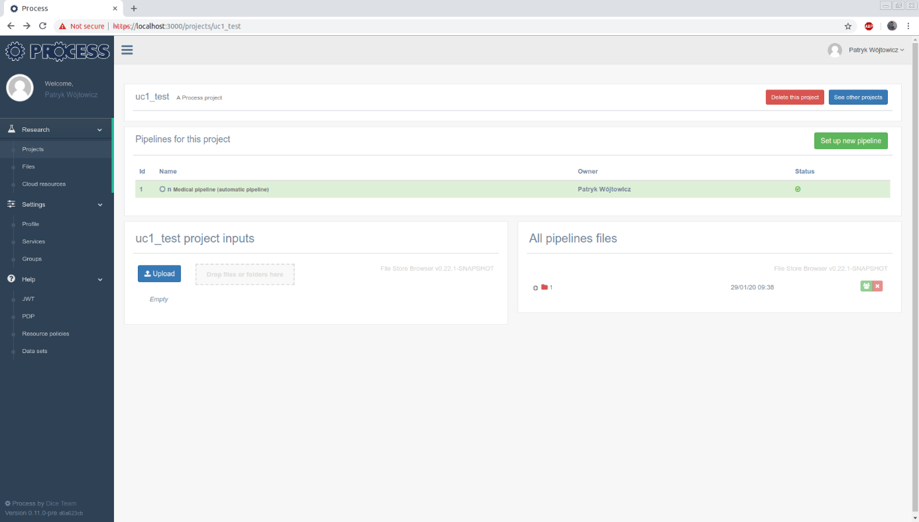
Output data flow
Once the job finishes, output data is stored in a predefined location (left)
This location is available to the container using a mechanism called “binding”
The data is staged out to the location available from the IEE (bottom)
It may also be moved to a different site using the LOBCDER component

Slide 10
GPU Support in Singularity
Medical use case developed by HES-SO requires GPUs
Access to GPUs in virtualized environments has always posed some challenges
For the most popular container engine (Docker) a middleware layer called nvidia-docker is used
Singularity has this layer built in and requires only an additional switch (--nv)
We were able to successfully run Singularity on the Prometheus GPU partition (on a single node)

Slide 11
MPI and other upcoming extensions
In the future we are going to:
Provide integration for all current use cases that may be run at ACC Cyfronet AGH
Provide a mechanism for better integration with external portals – such as the LOFAR portal via an API
Enable multi-node Singularity jobs not only for loosely coupled cases, but also for tightly coupled ones using MPI
Enable running parts of use cases on multiple HPC sites (e.g. Cyfronet and LRZ) where tight integration is not required

Slide 12

See more at our sites
http://dice.cyfronet.pl
http://www.process-project.eu
PROCESS H2020 Project 777533
This research was supported in part by PL-Grid Infrastructure
We would like to thank
Maciej Czuchry, Łukasz Flis, Patryk Lasoń, Marek Magryś, Maciej Pawlik and Klemens Noga
for help with making use of the HPC resources at Cyfronet in an efficient way

