Slide 1



Towards a Universal Platform for Large Scale Simulations on Prometheus
M. Bubak^{1,2}, M. Kasztelnik², J. Meizner², P. Nowakowski^{1,2}, T. Gubała^{1,2}, and M. Malawski^{1,2}
¹Sano Centre for Computational Medicine - https://sano.science ²ACC Cyfronet AGH - http://dice.cyfronet.pl/

Slide 2
Model Execution Environment - motivation
Repeatability – same team, same experimental setup; a researcher can reliably repeat own computation
Replicability – different team, same experimental setup; an independent group can obtain the same result using the author’s own artifacts
Reproducibility – different team, different experimental setup; an independent group can obtain the same result using artifacts which they develop completely independently.

Slide 3
Model Execution Environment - goal
Organize research
Our goal is to deliver a set of tools (integrated with Prometheus and the PLGrid Infrastructure) and best practices to execute case-centric calculations in a structured and well organized way
This asks for
Model versioning
Structured, case-centric storage for input and output data (both file based and tabular data)
Organized, repeatable set of calculations which recognize particular model versions
Proposed solution
Pipelining system – each pipeline is a well-defined set of computations (running sequentially or in parallel)
Pipeline definitions are generic, but each execution occurs in the context of specific input data
Each computation (called a pipeline step) inside a pipeline involves execution on HPC resources, of a specific model, in a specific version (selected from the GitLab repository)
Pipelines can also be executed automatically, as long as input data constraints are satisfied
MEE provides a user interface and a REST API for running and monitoring pipelines

Slide 4
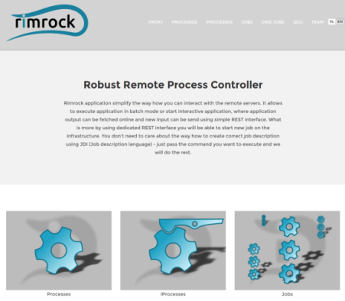
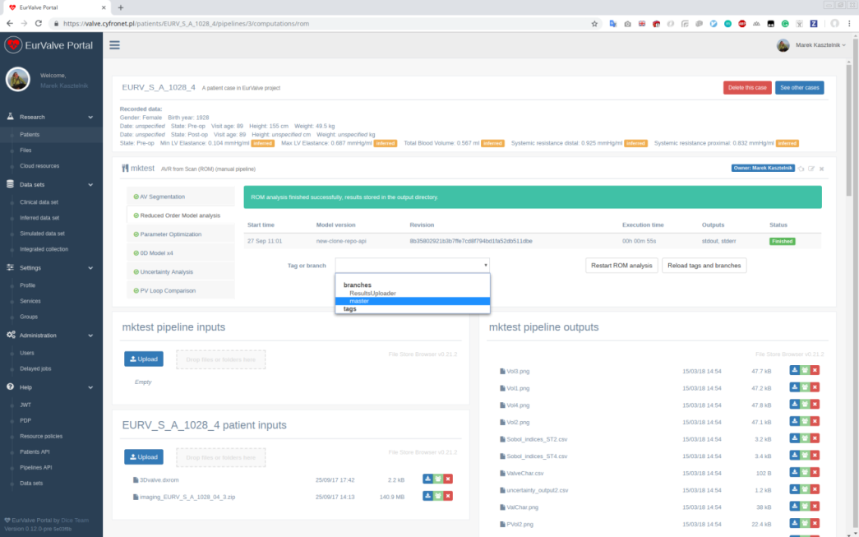
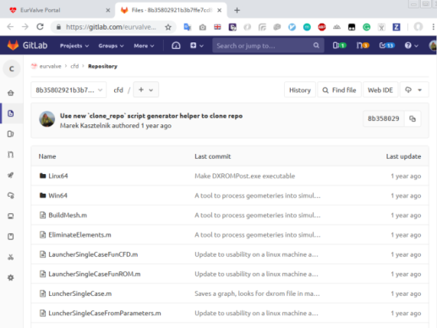
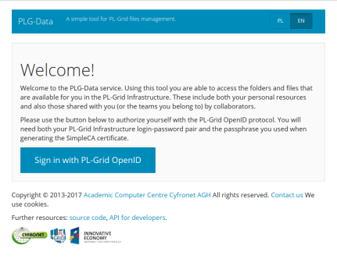
Model Execution Environment – what it looks like
In the PRIMAGE project (and earlier in the EurValve project) focus is on executing complex simulations for specific patients, each of which is represented by a set of data. Running a simulation involves selecting a specific model pipeline (including its version) and providing input data.
Patient and relevant clinical data
Run
Browse inputs
and outputs
Select model version

Slide 5
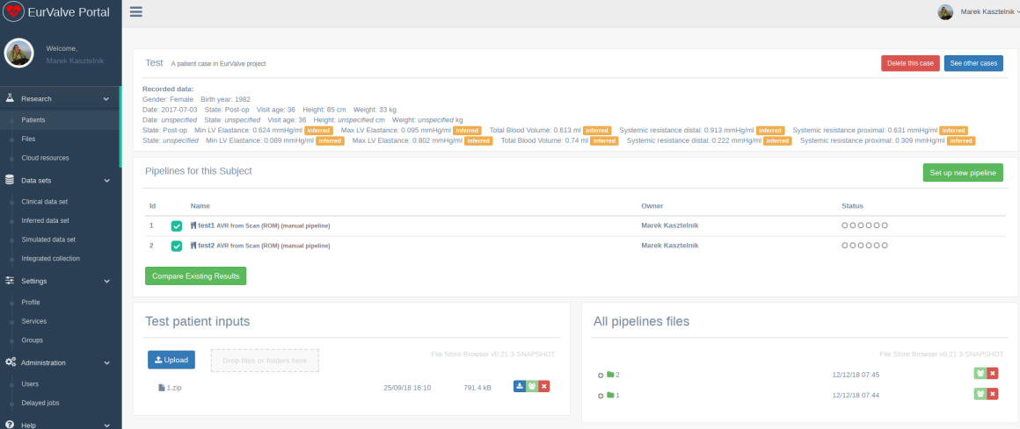
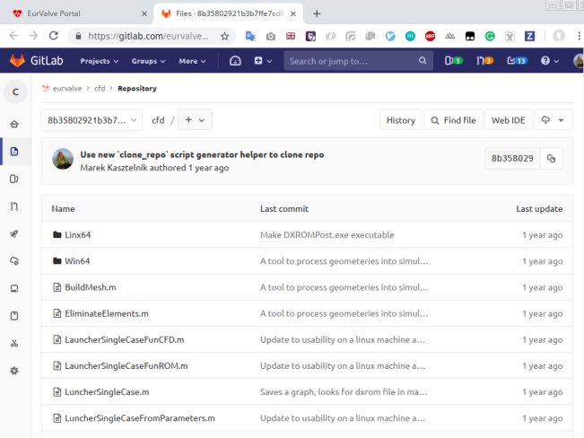
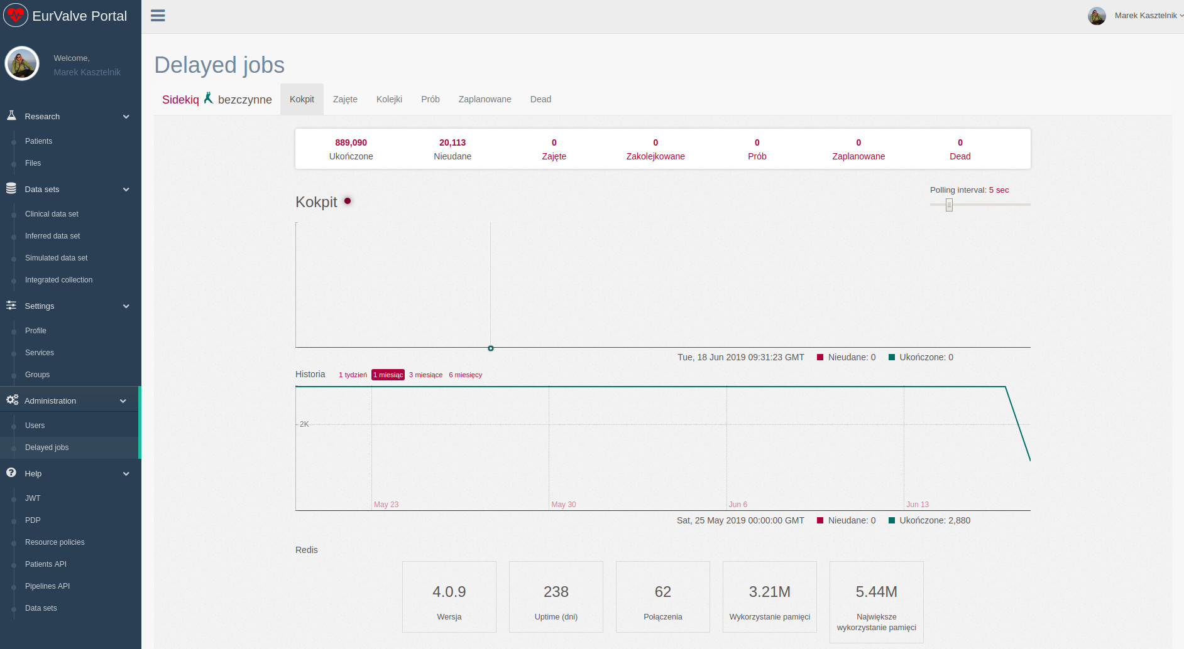
Model Execution Environment – classes of users
End Users – want to run already prepared pipelines to obtain results significant from the scientific point of view
Model Providers – providing domain knowledge and preparing application modules and scripts that may be run on the infrastructures
Administrators and Operators – may perform management tasks such as granting/revoking access to the platform or tweaking pipeline templates

Slide 6
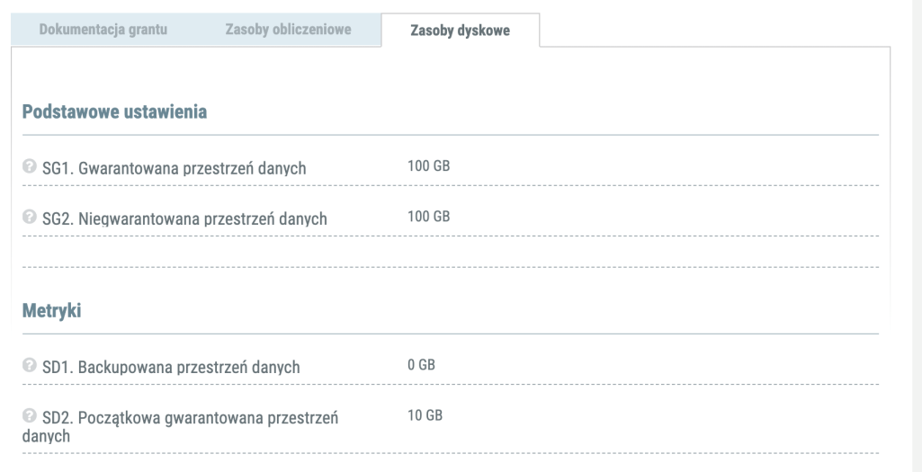
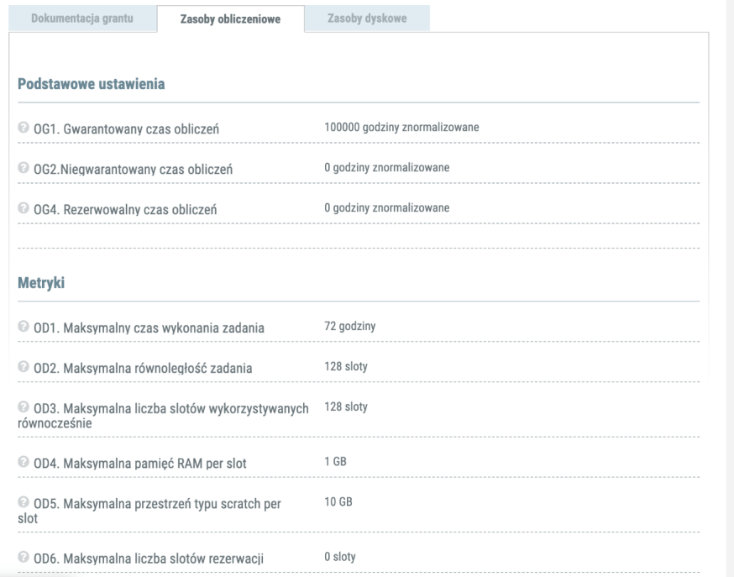
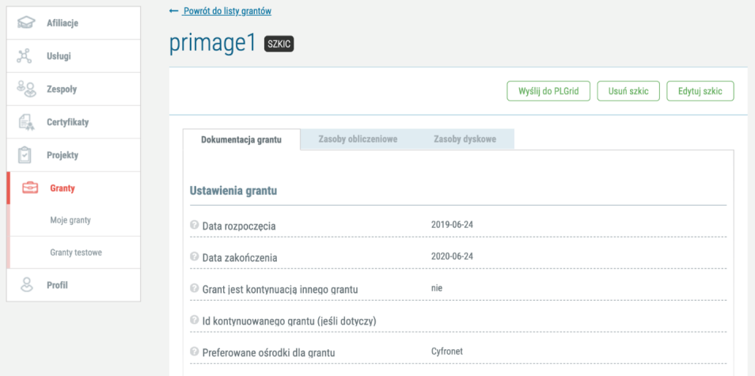
Model Execution Environment - HPC Computational grant
In order to perform a simulation on Prometheus (PLGrid) the following elements are needed:
computational grant i.e. each project in which MEE is applied has its own dedicated pool of computational grants which may be managed independently
PLGrid account
valid affiliation

Slide 7
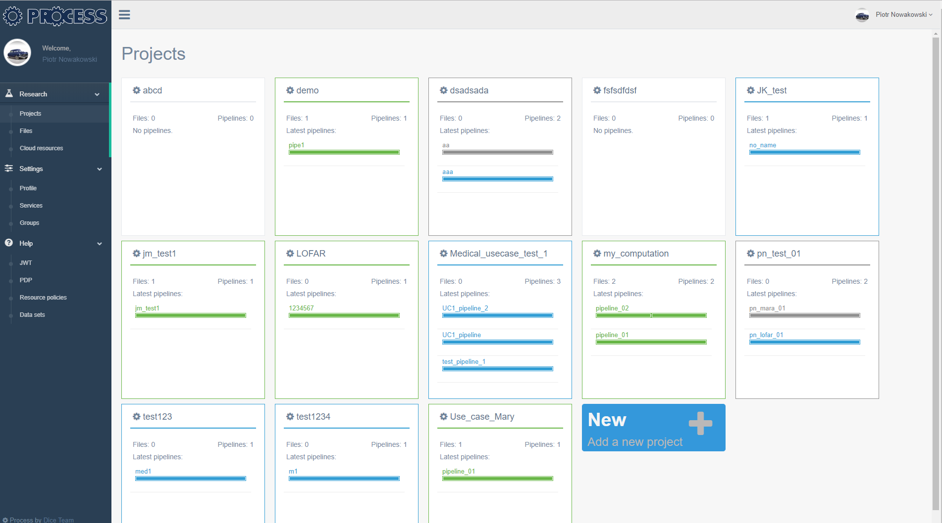
Model Execution Environment – distributed computing in PROCESS
MEE is also being extended in the context of the PROCESS project to enable distributed computing in a pre-exascale environment composed of multiple computing sites with varying access mechanisms
Development environment available at https://process-dev.cyfronet.pl
Integrated security provided by PLGrid, with the ability to store multiple certificates facilitating submission of jobs to several different clusters (including the Prometheus cluster)
Support for container-based pipeline steps using Singularity, as well as for custom pipeline steps which are accessed through proprietary APIs
Extended management options for date input, output and staging

Slide 8


Model Execution Environment – exascale learning on medical images
The representative PROCESS use case involves training ANNs for decision support systems using high-quality medical datasets. This involves massive input datasets and complex GPU-based processing.
A simple yet effective pipeline is enacted by the PROCESS infrastructure on each participating compute site, enabling deployment of containers, automatic marshalling of input data and stage-out of results. PROCESS takes care of supervising computations in an HPC environment.
Requested dataset is uploaded to HPC environments where computations are to take place
Multiple containers can be deployed to process data. This deployment is managed by the PROCESS infrastructure.
Data stage-in
Computation
Data stage-out
Computation
Computation
Results can be uploaded to centralized data repositories
Computation

Slide 9
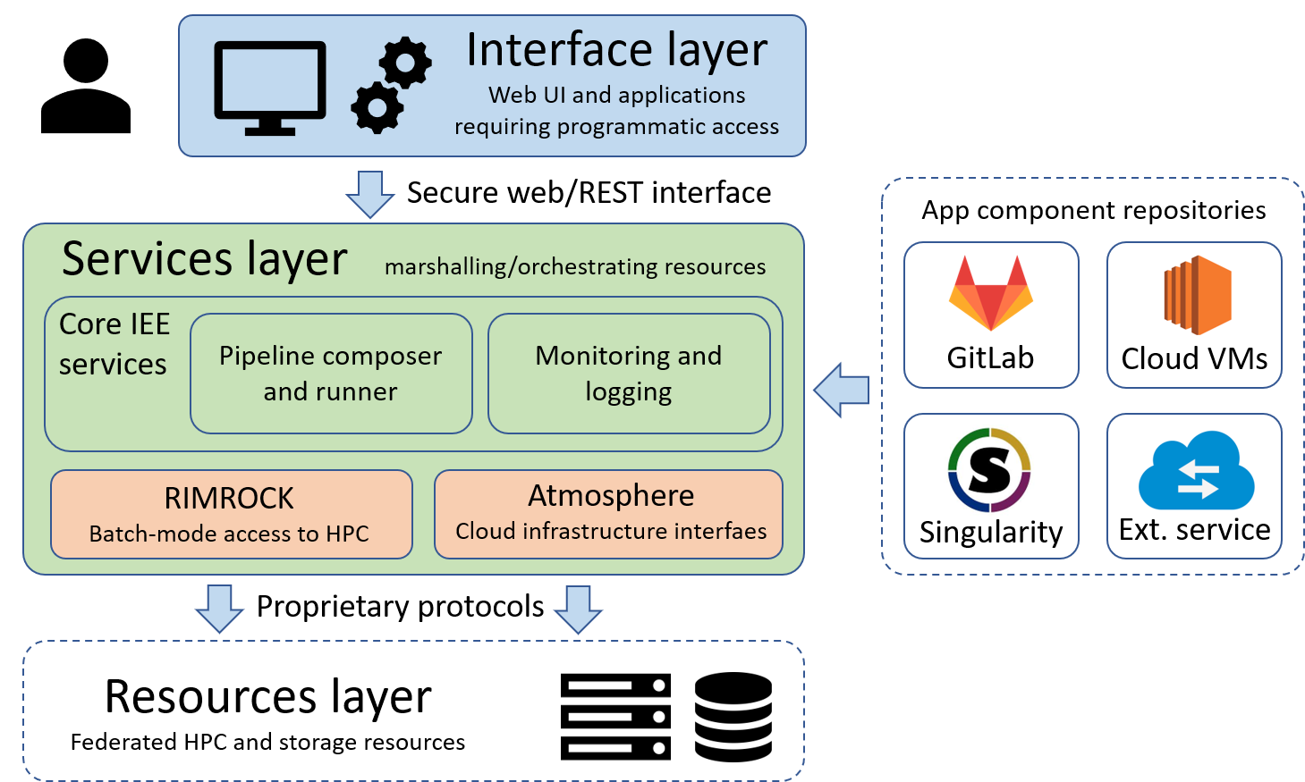
Model Execution Environment – managing container-based steps
The PROCESS infrastructure expands the available set of technologies in which pipeline steps may be implemented by adding support (among others) for container-based steps where the application payload is provided by developers in the form of a prepackaged container.
User accesses WebUI
Service layer is used to:
select inputs
choose code version
prepare and run computations
Computations are scheduled on HPC via RIMROCK
Computations may assume the form of Singularity containers
A dedicated container repository is built into the platform

Slide 10
Model Execution Environment - demo
>>DEMO<<
https://www.youtube.com/watch?v=NU2wSQFVI1g

Slide 11
Model Execution Environment – thank you!
Thanks to the MEE Platform
one can now do science much more easily
on the PL-Grid infrastructure and Prometheus !!!
https://sano.science http://dice.cyfronet.pl

