Slide 1



PROCESS ACC Cyfronet AGH, Krakow, Poland
Marian Bubak, Jan Meizner, Piotr Nowakowski
http://dice.cyfronet.pl/

Slide 2
AGH University of Science and Technology
One of the top technical universities in Poland
Established in 1913 (re-established in 1919)
16 faculties, 36 000 students; 4 000 employees
Main research areas:
Information Technology
New Materials and Technologies
Environmental and Climate Change
Energy and its Sources
Electrical and Mechanical Engineering in Mining
Exact and Natural Sciences
Socio-Economic Sciences and Humanities
Main source of skilled knowledge workers for Kraków and Małopolska
http://www.agh.edu.pl/en

Slide 3
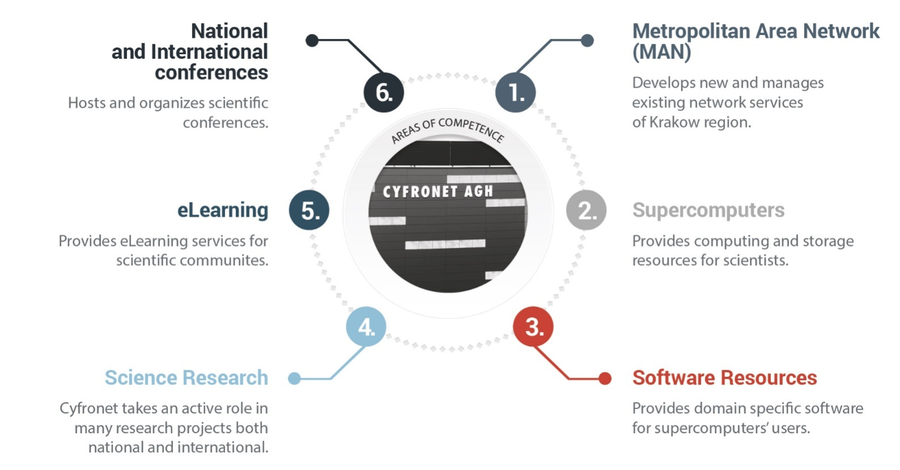
ACC Cyfronet AGH
The largest Academic Computer Centre in Poland; established in 1973
44 years of experience in IT provisioning for scientific communities
Autonomous entity of the AGH University of Science and Technology
Staff: about 100 (incl. 50 R&D staff)
Leader of PLGrid: Polish Grid and Cloud Infrastructure for Science
http://www.cyfronet.krakow.pl/en/

Slide 4











PLGrid Infrastructure
>7 000 users, all five Polish academic HPC centres integrated
Synergy between domain-specific researchers and IT experts
Computing resources
5+ PFLOPS
130 000+ cores
Scientific Software
500+ applications, tools, libraries
http://apps.plgrid.pl
Tools for collaboration
project tracking (JIRA)
version control (Git)
teleconferencing (Adobe Connect)
Storage
60+ PB
fast scratch
distributed access
Computational Cloud
(based on OpenStack)

Slide 5



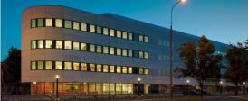

DICE Team – area of research
Investigation of methods for complex scientific collaborative applications
Elaboration of environments and tools for eScience
Integration of large-scale distributed computing infrastructures
Knowledge-based approach to services, components, and their composition
AGH University of Science and Technology (1913, 1919)
16 faculties, 36 000 students, 4 000 employees
http://www.agh.edu.pl/en
Academic Computer Centre
CYFRONET AGH (1973)
150 employees
http://www.cyfronet.pl/en/
Faculty of Computer Science, Electronics and Telecommunications (2012)
2 000 students, 200 employees
http://www.iet.agh.edu.pl/
Other 15 faculties
http://dice.cyfronet.pl
Department of Computer Science AGH (1980)
1 000 students, 80 employees
http://www.ki.agh.edu.pl/uk/index.htm

Slide 6
DICE Team skillset and EU projects
Interactive compute- and data-intensive applications, knowledge-based workflow composition, programming models | CrossGrid, K-Wf Grid, CoreGRID | 2002-2008
Script-based composition of applications, GridSpace Virtual Laboratory | ViroLab, GREDIA | 2006-2009
Federating cloud resources for VPH compute- and data-intensive applications, DataNet – metadata models | VPH-Share, PL-Grid | 2009-2015
Common Information Space for Early Warning Systems, big data storage and access, analysis tools | UrbanIFlood, ISMOP | 2009-2016
Computational strategies, software and services for distributed multiscale simulations | MAPPER | 2010-2013
Executable Papers; 1st prize in Elsevier competition at ICCS2011 (Elsevier follow-up project) | Collage | 2011-2013
Optimization of workflow applications on cloud resources | PaaSage | 2013-2016
Infrastructure for large-scale simulations in medicine | EurValve | 2016-2019
Establishment of a new CoE in computational, personalised medicine (diagnostics and therapy) | CECM, Teaming Phase1 | 2017-2018
http://dice.cyfronet.pl/ ; http://dice-cyfronet.github.io/#history

Slide 7
Cyfronet AGH: Personnel and roles
# | Key Person | Role | Activities
1 | Marian Bubak Katarzyna Rycerz | JRA 3 Leader | Coordination of research tasks and project planning Timely initiation, steering and verifying of reporting Compiling the mid-term and the final deliverables Coordination of technical presentations Risk management
2 | Jan Meizner | Task JRA2.3 | Coordination of federated metadata storage service development
3 | Piotr Nowakowski | Task JRA 3.1 | Coordination of interactive execution environment development
4. | Bartosz Wilk | Task JRA 3.2 | Coordination of benchmarking and monitoring services development
5 | Maciej Pawlik | Task JRA 3.2 | Benchmarking and monitoring services development

Slide 8
Cyfronet role by WP
# | WP | PM | Our PM | Our Activities
1 | WP3 NA2: Motivation, Future Requirements, and Emerging Opportunities | 35 | 5 | Leading Task NA2.3 Continuous requirement gathering
2 | WP4 JRA1: Design and Architecture | 24 | 4 | Contribution to: Designing the PROCESS architecture Architecture evaluation through prototyping Publication, dissemination and promotion of PROCESS architecture
3 | WP5 JRA2: Extreme Large Data Service-oriented Infrastructure | 53 | 10 | Leading Task JRA2.3 Federated Metadata storage service for extreme data application
4 | WP6 JRA3: Extreme Large Computing Service-oriented Infrastructure | 61 | 27 | Leading the work package Leading Task Task JRA3.1 Interactive execution environment Leading Task JRA3.2 Benchmarking and monitoring services
5 | WP7 JRA4 Service Orchestration and User Interfaces | 38 | 5 | Contribution to service deployment and orchestration
6. | WP8 SA1 Validation | 31 | 3 | Contribution to preparation of use cases for validation
7 | WP9 NA3 Dissemination, Engagement and Exploitation | 41 | 4 | Contribution to dissemination activities

Slide 9
Cyfronet role by deliverable
# | Deliverable | Title | Month due | Responsible person
1 | D3.1 | Performance modelling and prediction | 15
2 | D4.4 | Updated report on architecture evaluation and dissemination | 24
3 | D6.1 | First prototype | 12
4 | D7.1 | Beta release of the data service | 27

Slide 10
http://www.cyfronet.krakow.pl/en/
http://dice.cyfronet.pl/

