Slide 1
A hybrid platform for exascale multidisciplinary scientific applications Marian Bubak, Piotr Nowakowski, Jan Meizner, Martin Bobák, Ondrej Habala, Ladislav Hluchý, Viet Tran, Adam S. Z. Belloum, Reginald Cushing, Maximilian Höb, Dieter Kranzlmüller, Jan Schmidt
PROviding Computing solutions for ExaScale ChallengeS
Supercomputing Frontiers Europe 2020, 23-25 March 2020, Warsaw, PL

Slide 2
Vision, principles, concept, and goals
Vision
As the result of research we will deliver a comprehensive set of mature services prototypes and tools specially developed to enable extreme scale data processing in both scientific research and advanced industry settings
Principles
Leapfrog beyond the current state of the art
Ensure broad research and innovation impact
Support the long tail of science and broader innovation
Concept
A user-friendly modular exascale service platform to combine data and computational services on top of European research infrastructures – HPC and Clouds alike
Goals
Mature, modular, generalizable Open Source solutions for user friendly exascale data
Exascale learning on medical image data
Low Frequency Array / Square Kilometer Array
Supporting innovation based on global disaster risk data
Ancillary pricing/airline revenue management
Agro-Copernicus (correlating data between simulation and observation)

Slide 3
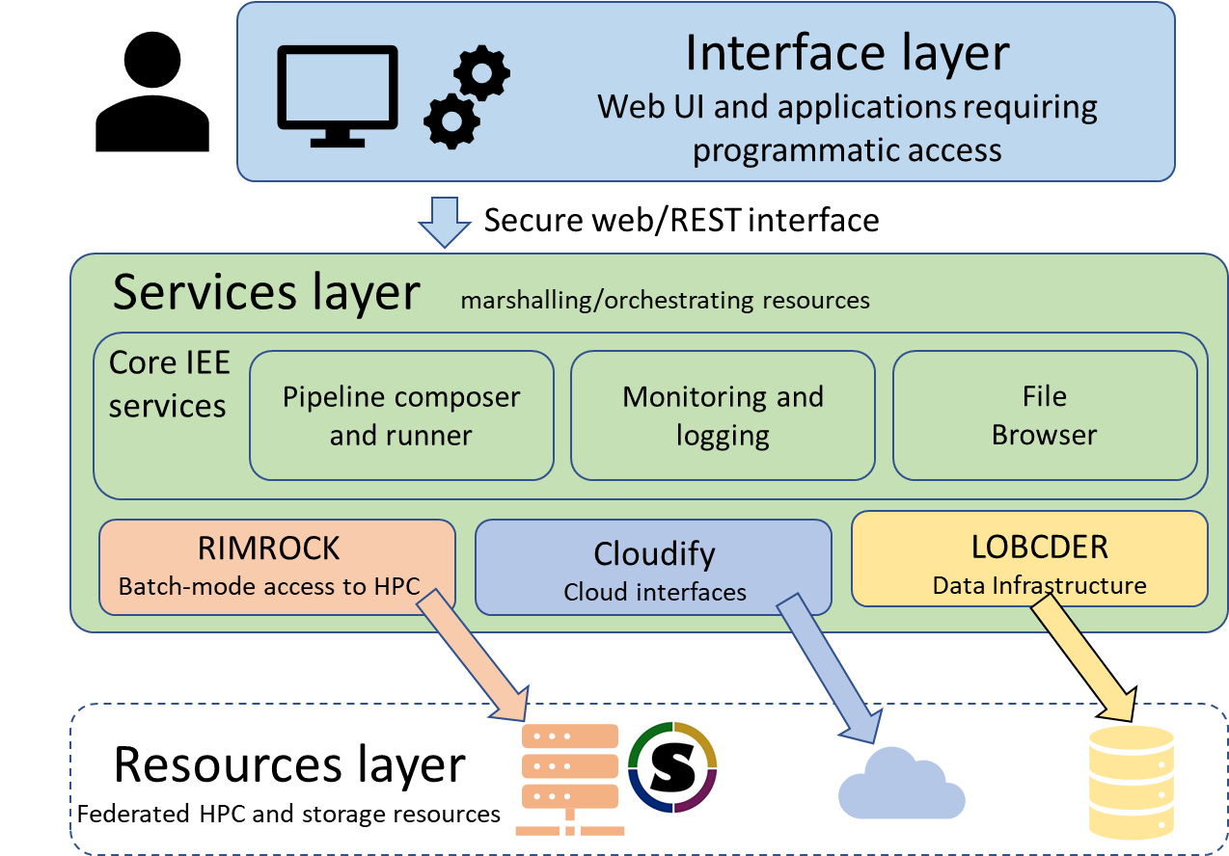
Extreme large scale computing services
“Focus on services and forget about infrastructures” idea
Analysis, data mining, pattern recognition, etc.
Heterogeneous research datasets
Support HPC and cloud-based computations
Utilize Docker, Singularity or Charliecloud
Follows simplified workflow:
User defines pipeline/steps in IEE via UI
IEE reads a computation for execution or starts it automatically (as requested)
Pipeline steps are executed – containers are scheduled as HPC jobs via Rimrock
HPC queues and executes jobs (SLURM)
Jobs run embedded containers with appropriate options
Data transfers are also handled automatically by the LOBCDER

Slide 4
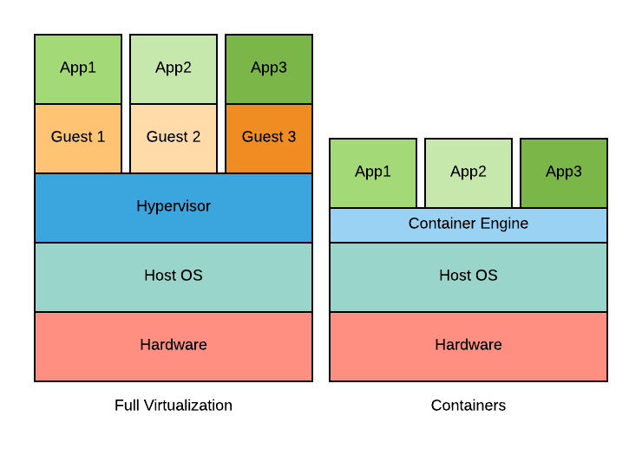
Status of the platform
Current status of the PROCESS platform
integrated solution
running use cases on heterogeneous e-infrastructures
support for a range of core technologies (HPC, Cloud)
applications containerized for portability
multiple geographical locations
Containers: small footprint, low overhead, quick launch, manageable images
Singularity: built for HPC, support for SLURM, unprivileged, support for MPI and GPUs
References
M. Bobak, A. S. Z. Belloum, P. Nowakowski, J. Meizner, M. Bubak, M. Heikkurinen, O. Habala, and L. Hluchý, “Exascale computing and data architectures for brownfield applications,” in Fuzzy Systems and Knowledge Discovery (FSKD), 2018 14th International Conference on. IEEE, 2018, pp. 461 – 468.
M. Bobak, A. S. Z. Belloum, R. Cushing, J. Meizner, P. Nowakowski, V. Tran, O. Habala, J. Maassen, B. Somosköi, M. Graziani, M. Heikkurinen, M. Höb, J. Schmidt, L. Hluchý, “Reference exascale architecture”, 15th International Conference on eScience, San Diego, USA
Docker, https://www.docker.com/
Singularity, https://sylabs.io/singularity/
Charliecloud, https://hpc.github.io/charliecloud/
The PL-Grid National Computing Infrastructure, www.plgrid.pl
Future work
streamlining data transfers across technologies and sites
concurrent execution of applications on multiple sites
supporting a multi-node MPI on Singularity (with Horovod)
scaling up pipelines to run on SuperMUC-NG (TOP500 #9)
improving interface between IEE and the LOFAR portal

Slide 5
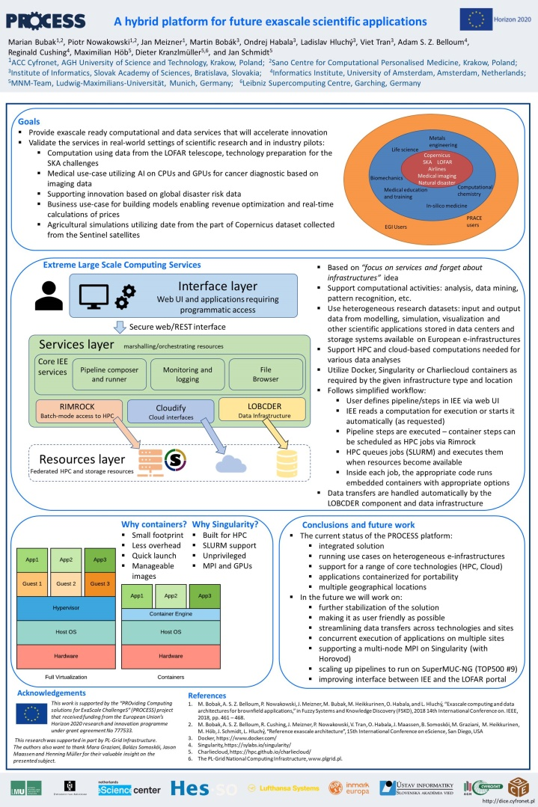


http://www.process-project.eu
http://dice.cyfronet.pl
This work is supported by the “PROviding Computing solutions for ExaScale ChallengeS” (PROCESS) project that received funding from the European Union’s Horizon 2020 research and innovation programme under grant agreement No 777533.
This research was supported in part by PL-Grid Infrastructure.
The authors also want to thank Mara Graziani, Balázs Somosköi, Jason Maassen and Henning Müller for their valuable insight on the presented subject.

