Slide 1
PROCESS - H2020 Project 777533 Work Package WP6 JRA3
Extreme Large Computing
Service-oriented Infrastructure
Marian Bubak, Jan Meizner, Piotr Nowakowski
ACC Cyfronet AGH, Krakow, PL
http://dice.cyfronet.pl/

Slide 2
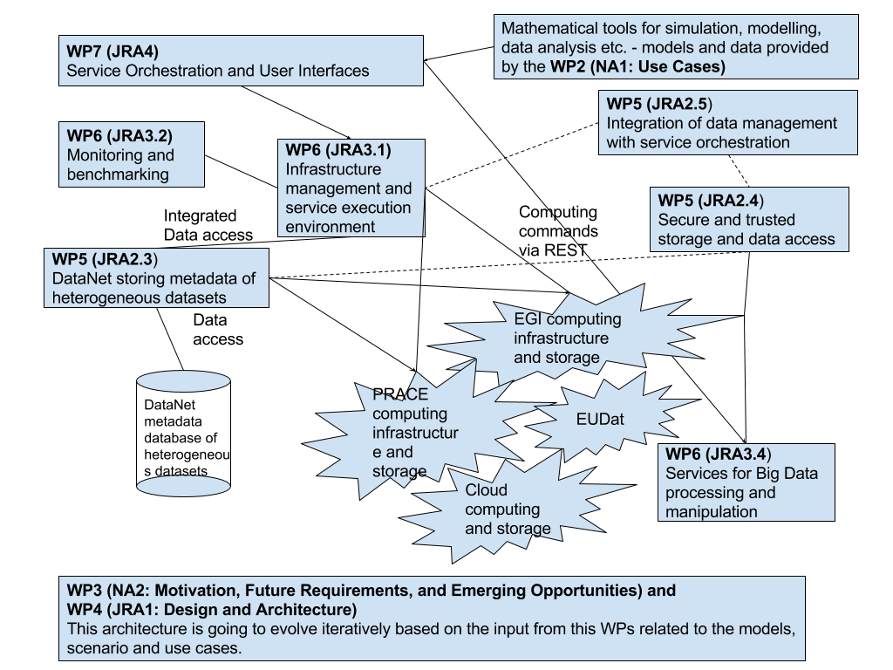
WP6 JRA3 Vision
Notes:
Add WP2,WP7…and other technical ?

Slide 3
WP6 JRA3: Objectives
Objective 1
Deliver a set of services supporting computation activities (e.g. analysis, data mining, pattern recognition) that use heterogeneous research datasets i.e. input and output data from modelling, simulation, visualisation and other scientific applications stored in data centers and on storage systems available on European e-infrastructures.
Objective 2
Support HPC computations needed for various data analyses
Objective 3
Deliver services for benchmarking and monitoring computational tools developed in this Work Package.
Objective 4
Build on the set of services that have already reached TRL 6 and will be brought up to TRL 8.

Slide 4
WP6 JRA3: Task Summary
Task | CYF | LMU | UvA | NLESC | UISAV | Description
JRA3.1 | x | x | x |  |  | Interactive execution environment
JRA3.2 | x | x | x |  |  | Benchmarking and monitoring services
JRA 3.3 |  | x | x | x |  | An approach to programming multi-core architecture
JRA 3.4 | x |  |  |  | x | Services for Big Data processing and manipulation

Slide 5
Task JRA3.1: Interactive execution environment [CYF, UvA, LMU]
Task Overview
Interactive execution environment that will be based on the “focus on services and forget about infrastructures” concept
An interface to implement, test and reuse mathematical methods and tools for data analysis on heterogeneous infrastructures
Based on experience from developing the Collage and Rimrock solutions
Integrated with notebooks such as Jupyter with a view towards a common interface for collaborative preparation and open publication of mathematical tools as executable chunks of code
Provides access to cloud infrastructures

Slide 6
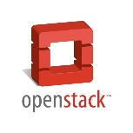




JRA3.1 Interactive Execution Environment – conceptual view
Computational resource (private cloud)
Template repository
PROCESS UI Host
Worker nodes
Computational resource (public cloud)
Template repository
PROCESS Services Host
Secure RESTful API
Worker nodes
Controller logic and low-level infrastructure interfaces
Computational resource (computing cluster)
Computational nodes
A means of implementing the “focus on services and forget about infrastructures” concept
Provides two ways of accessing the underlying computational resources: through a user-friendly GUI and programatically, via a dedicated RESTful API
Can be embedded in any external environment (such as Jupyter) via API integration
Interfaces computational clouds and traditional HPC (batch job submission) using Rimrock and public cloud access libraries, as appropriate.

Slide 7
JRA3.1 Interactive Execution Environment – core features
Registration and administrative management of computational resources
Deployment of computational tasks on the available resources
Infrastructure monitoring services
User-friendly access to PROCESS datasets
Security management (users, groups, roles)
Administrative services (billing and logging)
Integration with external tools via standardized APIs

Slide 8
Exploitable technologies
Atmosphere
Comprehensive execution system for services deployed in hybrid, heterogeneous clouds
Interfaces both public and private cloud resources
Compatible with a wide range of cloud middleware suites and commercial vendors
Provides a technology-agnostic UI and RESTful APIs
Rimrock
RESTful interface facilitating deployment of jobs on computational clusters and grids
Compatible with PBS, SLURM, GLite and QCG
Supports file stage-in/stage-out using GridFTP
Enabled development of HPC applications with minimum effort related to infrastructure management and service execution

Slide 9
Task JRA3.2: Benchmarking and monitoring services [CYF, UvA, LMU]
Task Overview
Framework for benchmarking and monitoring performance of services developed in this task
Solution tailored to the particular needs of PROCESS computations, based on a general solution
Collecting performance data using state-of-the-art tools for distributed systems, such as Netlogger, Zabbix, Zipkin and Graphite
Querying and processing distributed databases and search engines, together with visualization dashboards such as Grafana, ElasticSearch, Logstash and Kibana
Processing extremely large metric data sets as well as discrete event information

Slide 10
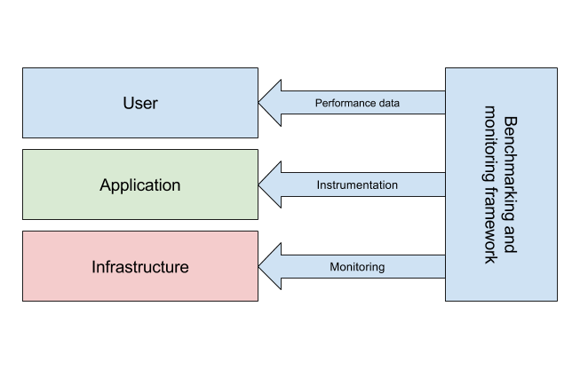
JRA3.2: Benchmarking and monitoring services – conceptual view
A framework for benchmarking and monitoring services will be provided
The solution will be tailored to the computational workload requirements of those services
Specifically, the platform will enable:
collection of performance data
instrumentation of applications
Infrastructure monitoring

Slide 11
JRA3.2: Benchmarking and monitoring services – core features
Registration and de-registration of services in/from the monitoring and benchmarking system
Management of services being monitored/benchmarked and relevant details (metrics, triggers, events, graphs, etc.)
Integration with the project security system to control access
Enabling integration with external project components

Slide 12
Task JRA2.3: Federated Metadata storage service for extreme data application [CYF, UvA, HESSO]
Task Overview
Metadata storage for research datasets distributed across infrastructures
DataNet service (deployed and used in the PLGrid Infrastructure) will be used as the basis for this task
Interoperability via well-defined protocols currently used by various storage systems running in European e-Infrastructures:
GridFTP
General-purpose REST protocols

Slide 13
JRA2.3: Federated Metadata storage service for extreme data application – conceptual view
Service storing metadata
Metadata model
Metadata repository
Users querying
Metadata
A platform that would define the metadata for a wide range of project use cases
Streamlined process of metadata handling across all phases: specification, collection, storage, access and sharing
Access to metadata exposed via common protocols (such as REST)

Slide 14
JRA2.3: Federated Metadata storage service for extreme data application – core features
Designing metadata models
Providing metadata repositories tailored for application requirements
Ensuring straightforward access to the repository
Enable operations on stored metadata (e.g. querying)
Provide mechanisms to ensure secure access and processing of stored metadata, as well as integration with the PROCESS security solutions

Slide 15
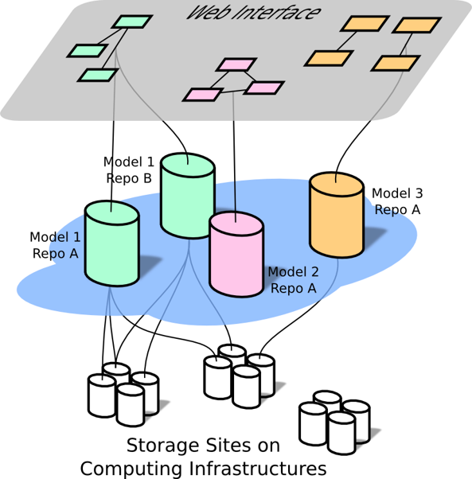
DataNet – web-based metadata management platform
Provides means for ad-hoc metadata model creation and deployment of the corresponding storage facilities
Constitutes a research space for metadata model exchange and discovery with associated data repositories with access restrictions in place
Supports different types of storage sites and data transfer protocols
Supports the exploratory paradigm by making the models evolve together with data
Web interface used to create, extend and discover metadata models
Model repositories with access from computing nodes through REST interfaces
Data items from Storage Sites linked from the model repositories

Slide 16
WP6: Main Questions (1/2)
# | Questions to other WPs | To be answered by…
1 | Can you define a set of functional and non-functional requirements associated with PROCESS use cases? | WP2
2 | We need a detailed flow of computations and data between the software components: workflow graph, data flows, number of runs involved etc. | WP2
3 | What are the data and metadata characteristics of the use case you are responsible for? | WP2
4 | Please estimate the computational requirements of your use case (e.g. runtime for a given number of nodes/cores). | WP2
5 | Do you expect metadata produced by your use case to follow a fixed schema, or is the schema going to evolve? | WP2

Slide 17
WP6: Main Questions (2/2)
# | Questions to other WPs | To be answered by…
6 | Are there any existing applications for your use case? If so, what types of metadata do they use? | WP2
7 | Please describe your idea for secure storage of data in the project. | WP5 (UVA)
8 | Please provide more details regarding plans for integration of data management with service orchestration. | WP5 (UISAV)
9 | Please provide your requirements related to the integration of WP6 components with the UI developed by WP7. | WP7
10 | What security solutions are integrated with your preexisting components? | ALL

Slide 18



http://www.cyfronet.krakow.pl/en/
http://dice.cyfronet.pl/

