Slide 1

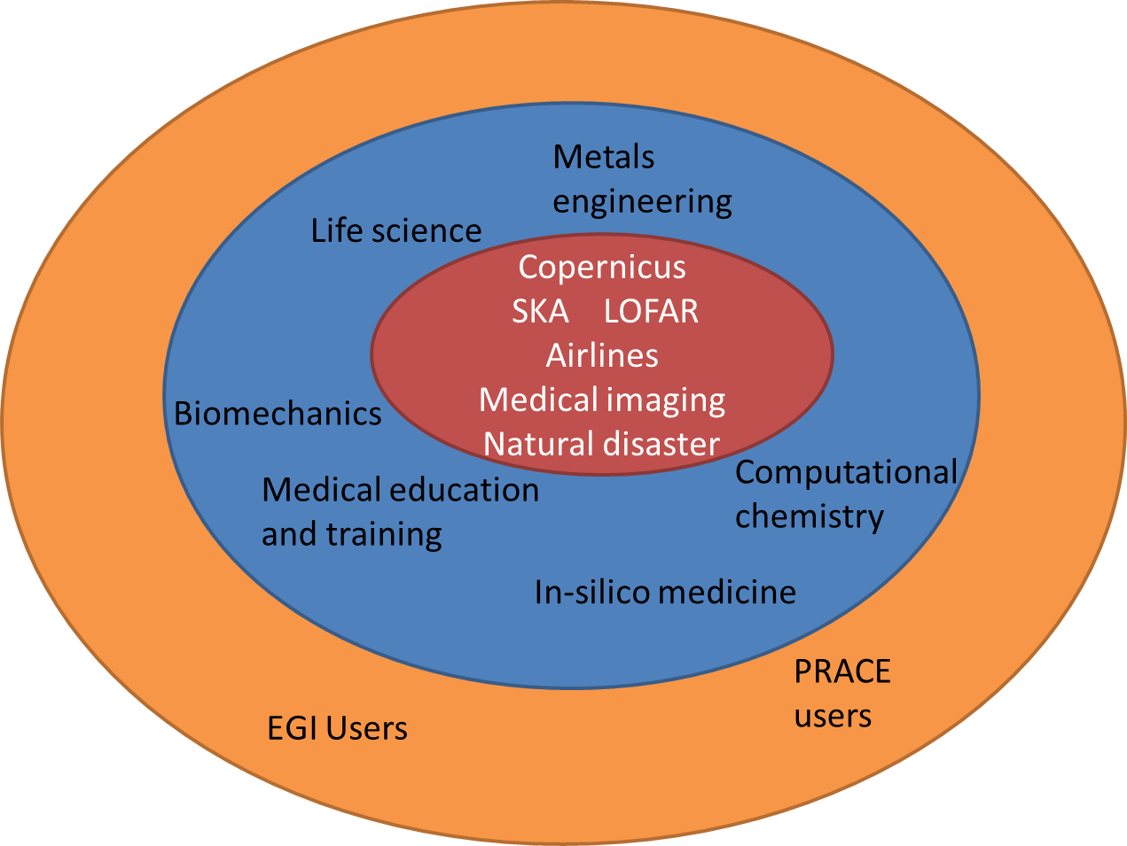
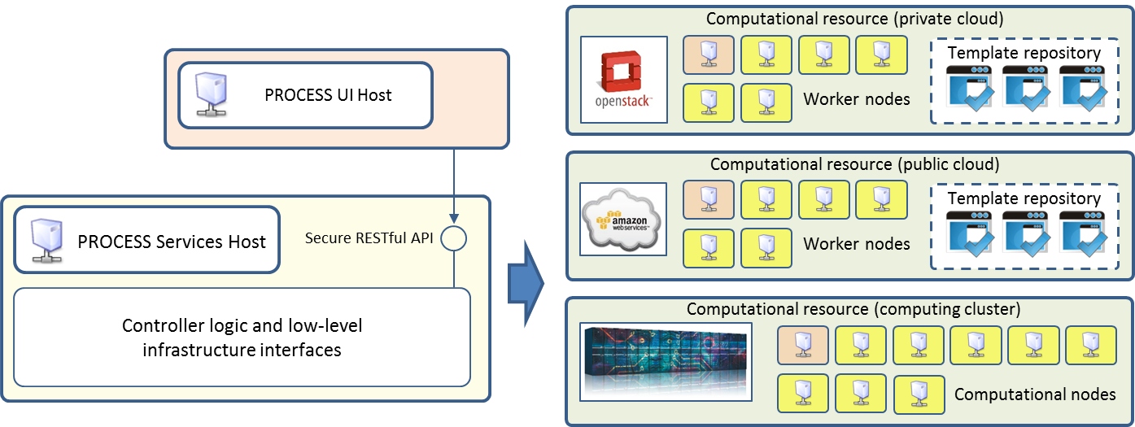



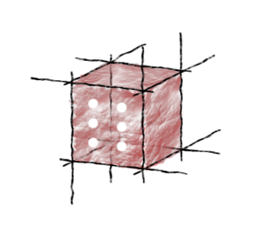


A Survey of Interactive Execution Environments
for Extreme Large-Scale Computations
Katarzyna Rycerz¹, Piotr Nowakowski², Jan Meizner², Bartosz Wilk², Jakub Bujas¹, Łukasz Jarmocik¹, Michał Krok¹, Przemysław Kurc¹, Sebastian Lewicki¹,
Mateusz Majcher¹, Piotr Ociepka¹, Lukasz Petka¹, Krzysztof Podsiadło¹, Patryk Skalski¹, Wojciech Zagrajczuk^{1,} Michał Zygmunt¹, and Marian Bubak^{1,2}
¹Department of Computer Science, AGH University of Science and Technology, al. Mickiewicza 30, 30-059 Kraków, Poland
²Academic Computer Centre Cyfronet AGH, Nawojki 11, 30-950, Kraków, Poland
Goals
To provide exascale ready computational and data services that will accelerate innovation
To validate the services in real-world settings, both in scientific research and in industry pilot deployments:
Square Kilometre Array – a large radiotelescope project
medical informatics
airline revenue management
open data for global disaster risk reduction
agricultural analysis based on Copernicus data
Extreme Large Computing Services
Based on “focus on services and forget about infrastructures” idea
Support computational activities: analysis, data mining, pattern recognition, etc.
Use heterogeneous research datasets (input and output data from modelling, simulation, visualization and other scientific applications stored in data centers and on storage systems available on European e-infrastructures)
Support HPC and cloud based computations needed for various data analyses
Survey of interactive execution environments
Focus on:
integration of scripting notebooks with HPC infrastructures to support building extreme large computing services
extension mechanisms required to add support specific to exascale processing of large data sets
ability to mix multiple languages in one document
integration with cloud infrastructures
Name | Large data set support | Integration with Cloud/HPC infrastructures | Extension mechanisms
R Notebook | using additional custom libraries (e.g. for Apache SPARK) | using custom libraries communicating with HPC queuing systems (e.g. SLURM) | It is possible to develop custom engines for languages which are not natively supported.
DataBricks | the whole platform is based on Apache SPARK | Available only on Amazon Web Services or Microsoft Azure | almost none
Beaker | using additional custom libraries | no specific support for HPC; Docker version available | Users can add Beaker support for unsupported languages via a dedicated API.
Jupyter | using additional custom libraries | no mature solution for HPC; Docker version available | Additional languages can be supported by writing a new Jupyter kernel.
Cloud Datalab | support for Google data services (e.g. BigQuery, Cloud Machine Learning Engine, etc.) | restricted to the Google Cloud platform | limited
Zeppelin | native support for Apache Spark | can be run on HPC using connection to the YARN cluster | support for additional languages can be added
Summary
DataBricks and Cloud Datalab must be run on specific cloud resources
Zeppelin and DataBricks are based on Apache SPARK, which potentially limits their usage to that platform
R Notebooks seems promising; however, some important features are only available with a commercial version of Rstudio
BeakerX (successor to Beaker) and Cloud Data are based on the Jupyter solution
Jupyter seems to be a suitable base for developing extreme large computing environments
References
Ciepiela, E., Harężlak, D., Kasztelnik, M., Meizner, J., Dyk, G., Nowakowski, P. and Bubak, M., 2013. The collage authoring environment: From proof-of-concept prototype to pilot service. Procedia Computer Science, 18, pp.769-778.
Beaker Notebook webpage http://beakernotebook.com/features
Databricks webpage https://databricks.com/product/databricks
4. Datalab webpage https://cloud.google.com/datalab/
5. Jupyter webpage http://jupyter.org/
6. Rstudio webpage https://www.rstudio.com
7. Zeppelin web page https://zeppelin.apache.org/
http://dice.cyfronet.pl
Funding by EU H2020 grant 777533.

