Slide 1


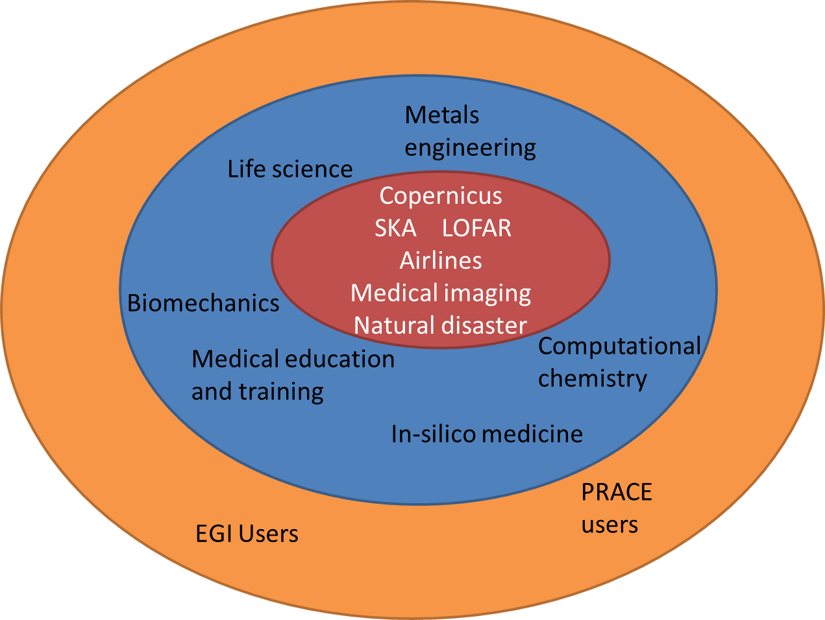
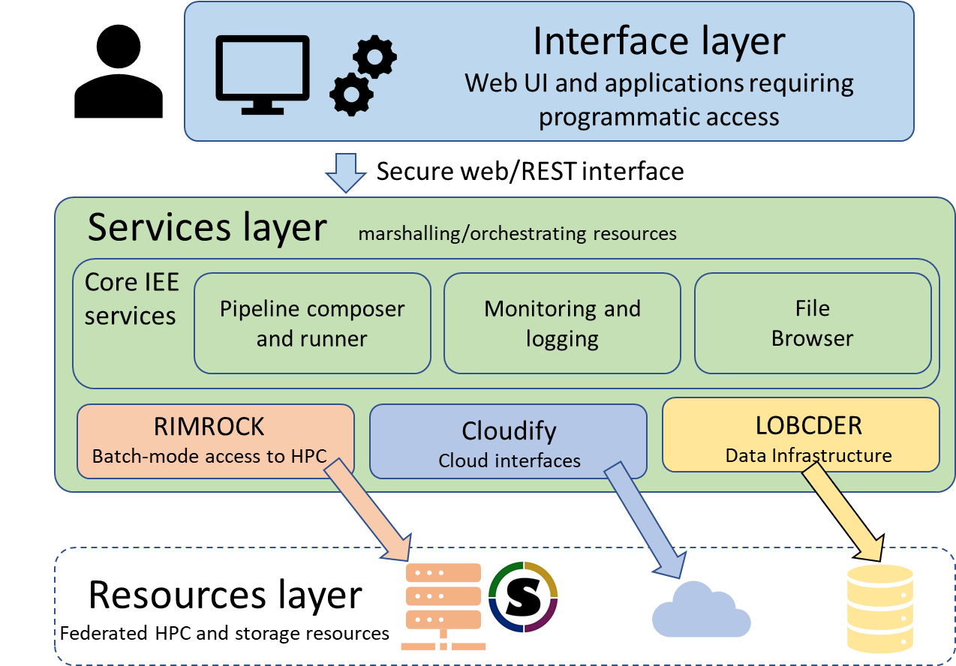
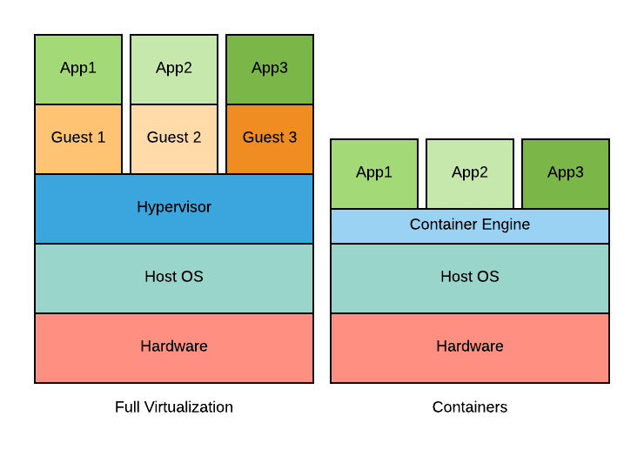











A hybrid platform for future exascale scientific applications
Marian Bubak^{1,2}, Piotr Nowakowski^{1,2}, Jan Meizner¹, Martin Bobák³, Ondrej Habala³, Ladislav Hluchý³, Viet Tran³, Adam S. Z. Belloum⁴,
Reginald Cushing⁴, Maximilian Höb⁵, Dieter Kranzlmüller^{5,6}, and Jan Schmidt⁵
¹ACC Cyfronet, AGH University of Science and Technology, Krakow, Poland; ²Sano Centre for Computational Personalised Medicine, Krakow, Poland;
³Institute of Informatics, Slovak Academy of Sciences, Bratislava, Slovakia; ⁴Informatics Institute, University of Amsterdam, Amsterdam, Netherlands;
⁵MNM-Team, Ludwig-Maximilians-Universität, Munich, Germany; ⁶Leibniz Supercomputing Centre, Garching, Germany
Goals
Provide exascale ready computational and data services that will accelerate innovation
Validate the services in real-world settings of scientific research and in industry pilots:
Computation using data from the LOFAR telescope, technology preparation for the SKA challenges
Medical use-case utilizing AI on CPUs and GPUs for cancer diagnostic based on imaging data
Supporting innovation based on global disaster risk data
Business use-case for building models enabling revenue optimization and real-time calculations of prices
Agricultural simulations utilizing date from the part of Copernicus dataset collected from the Sentinel satellites
Extreme Large Scale Computing Services
Based on “focus on services and forget about infrastructures” idea
Support computational activities: analysis, data mining, pattern recognition, etc.
Use heterogeneous research datasets: input and output data from modelling, simulation, visualization and other scientific applications stored in data centers and storage systems available on European e-infrastructures
Support HPC and cloud-based computations needed for various data analyses
Utilize Docker, Singularity or Charliecloud containers as required by the given infrastructure type and location
Follows simplified workflow:
User defines pipeline/steps in IEE via web UI
IEE reads a computation for execution or starts it automatically (as requested)
Pipeline steps are executed – container steps can be scheduled as HPC jobs via Rimrock
HPC queues jobs (SLURM) and executes them when resources become available
Inside each job, the appropriate code runs embedded containers with appropriate options
Data transfers are handled automatically by the LOBCDER component and data infrastructure
Why containers?
Small footprint
Less overhead
Quick launch
Manageable images
Why Singularity?
Built for HPC
SLURM support
Unprivileged
MPI and GPUs
Conclusions and future work
The current status of the PROCESS platform:
integrated solution
running use cases on heterogeneous e-infrastructures
support for a range of core technologies (HPC, Cloud)
applications containerized for portability
multiple geographical locations
In the future we will work on:
further stabilization of the solution
making it as user friendly as possible
streamlining data transfers across technologies and sites
concurrent execution of applications on multiple sites
supporting a multi-node MPI on Singularity (with Horovod)
scaling up pipelines to run on SuperMUC-NG (TOP500 #9)
improving interface between IEE and the LOFAR portal
Acknowledgements
References
M. Bobak, A. S. Z. Belloum, P. Nowakowski, J. Meizner, M. Bubak, M. Heikkurinen, O. Habala, and L. Hluchý, “Exascale computing and data architectures for brownfield applications,” in Fuzzy Systems and Knowledge Discovery (FSKD), 2018 14th International Conference on. IEEE, 2018, pp. 461 – 468.
M. Bobak, A. S. Z. Belloum, R. Cushing, J. Meizner, P. Nowakowski, V. Tran, O. Habala, J. Maassen, B. Somosköi, M. Graziani, M. Heikkurinen, M. Höb, J. Schmidt, L. Hluchý, “Reference exascale architecture”, 15th International Conference on eScience, San Diego, USA
Docker, https://www.docker.com/
Singularity, https://sylabs.io/singularity/
Charliecloud, https://hpc.github.io/charliecloud/
The PL-Grid National Computing Infrastructure, www.plgrid.pl.
This work is supported by the “PROviding Computing solutions for ExaScale ChallengeS” (PROCESS) project that received funding from the European Union’s Horizon 2020 research and innovation programme under grant agreement No 777533.
This research was supported in part by PL-Grid Infrastructure.
The authors also want to thank Mara Graziani, Balázs Somosköi, Jason Maassen and Henning Müller for their valuable insight on the presented subject.
http://dice.cyfronet.pl

