Slide 1


Compute Platform Jan Meizner¹, Marian Bubak^{1,2}, Jan Kapała¹ , Piotr Nowakowski¹, Patryk Wójtowicz¹
¹ACC Cyfronet AGH, Kraków, Poland
²Department of Computer Science, AGH University of Science and Technology
http://dice.cyfronet.pl/

Slide 2
Motivation and objectives
The PROCESS project aims to:
Pave the way towards exascale by providing scalable platform
Enable deployment of services on heterogenous infrastructures
Support different domains of science and business
Our objective is to:
Build the Container based platform based on Singularity
Integrate the HPC resources across multiple countries
Provide effortless user experience via the WebUI

Slide 3
Project Use Cases
Health
Content-based search and classification
Astronomy
Square Kilometre Array SKA
STICHTING NETHERLANDS ESCIENCE CENTER (NL)
Risk Management
Supporting innovation based on global disaster risk data
LUDWIG-MAXIMILIANS-UNIVERSITAET MUENCHEN (DE)
Airlines Operations
Agriculture
Ancillary pricing for airline revenue management
Agro-Copernicus
HAUTE ECOLE SPECIALISEE DE SUISSE OCCIDENTALE (CH)
LUFTHANSA SYSTEMS GMBH & CO KG (DE)
LUDWIG-MAXIMILIANS-UNIVERSITAET MUENCHEN (DE)

Slide 4
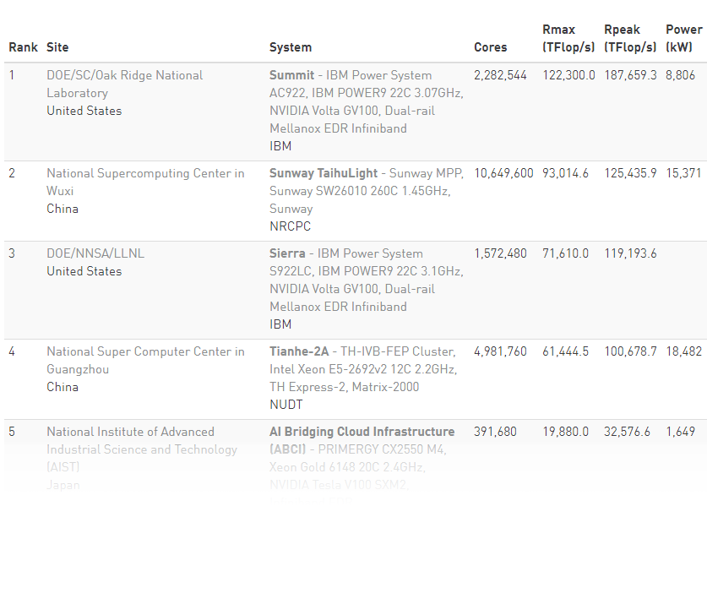
Why pooling resources?
No single HPC system capable of exceeding exaflop for generic computations
Fastest known: < 0.2 Eflop/s
1-5 still way bellow 1 Eflop/s
We may need to pool resources of multiple Centers
Has been done for years but we want to:
Enable running single computation on multiple sites
Provide support for non-IT scientists to prepare/run codes on such massive scale

Slide 5
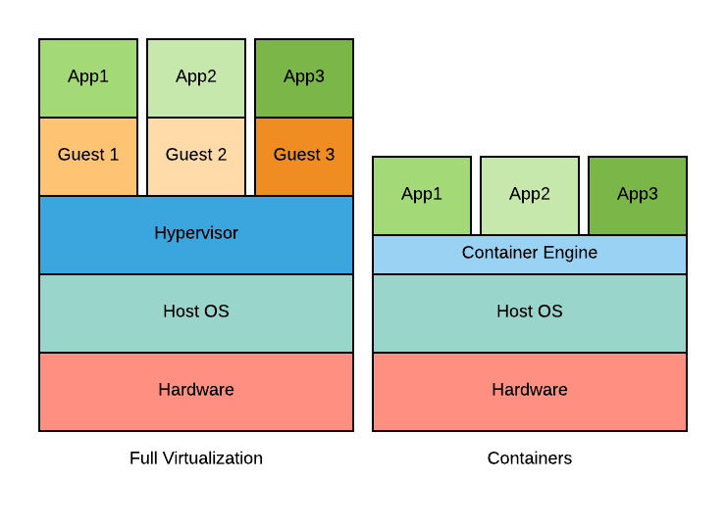
Why Singularity?
Why container ?
Small footprint
Less overhead
Quick launch
Manageable images
Why Singularity?
Built for the HPC
Integrated with SLURM
Unprivileged / secure
Support for MPI, GPU, …

Slide 6
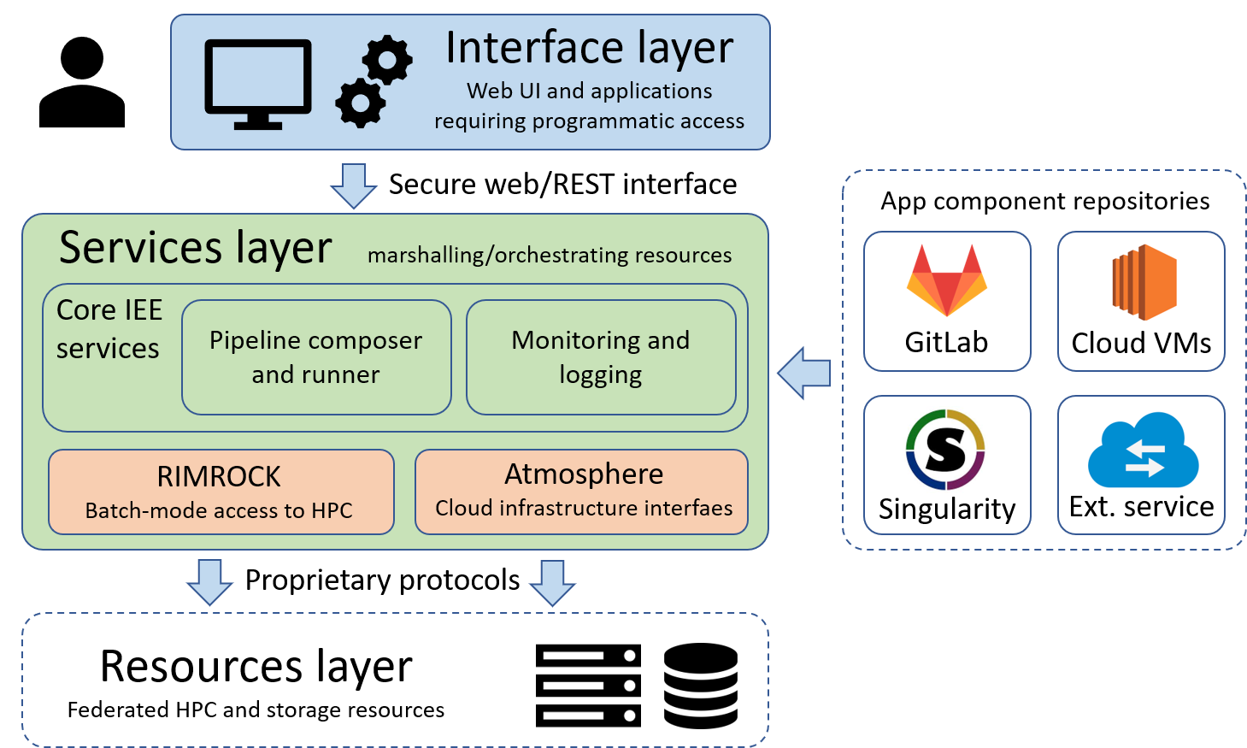
PROCESS Platform Architecture
User accesses WebUI
Service layer is used to:
select inputs
choose code version
prepare and run computations
Computations are scheduled on the HPC via RIMROCK
Computations may be in form of classical scripts or Singularity (new)

Slide 7
Conclusions and Further Plans
Conclusions:
New type of the pipeline step based on the Singularity containers was created for the Interactive Execution Environment
It enables execution of user provided applications on the HPC
Tested on the HPC system at Cyfronet (CPU and GPU)
Future plans:
Extending solution for other Clusters in PROCESS (in Germany, Slovakia and the Netherlands)
Enable running same computation on multiple sites
Handle site-to-site communication
Add support for the private and public clouds

Slide 8
See more at our sites
http://dice.cyfronet.pl
http://www.process-project.eu
PROCESS H2020 Project 777533

Slide 9
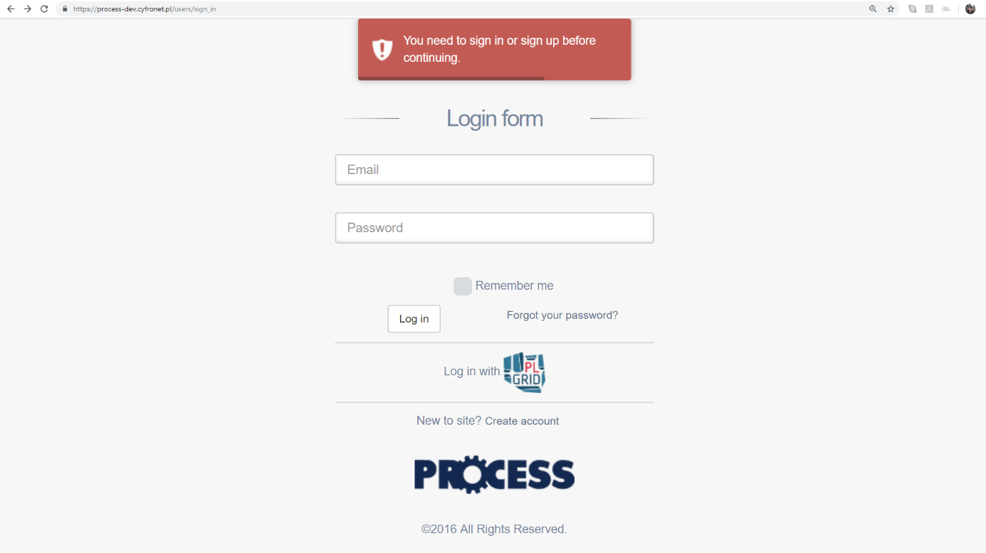
Singularity Step (1/5)
1
SIGN-IN
2
DASHBOARD
3
CREATE PROJECT
4
5
CREATE PIPELINE
RUN COMPUTATION

Slide 10
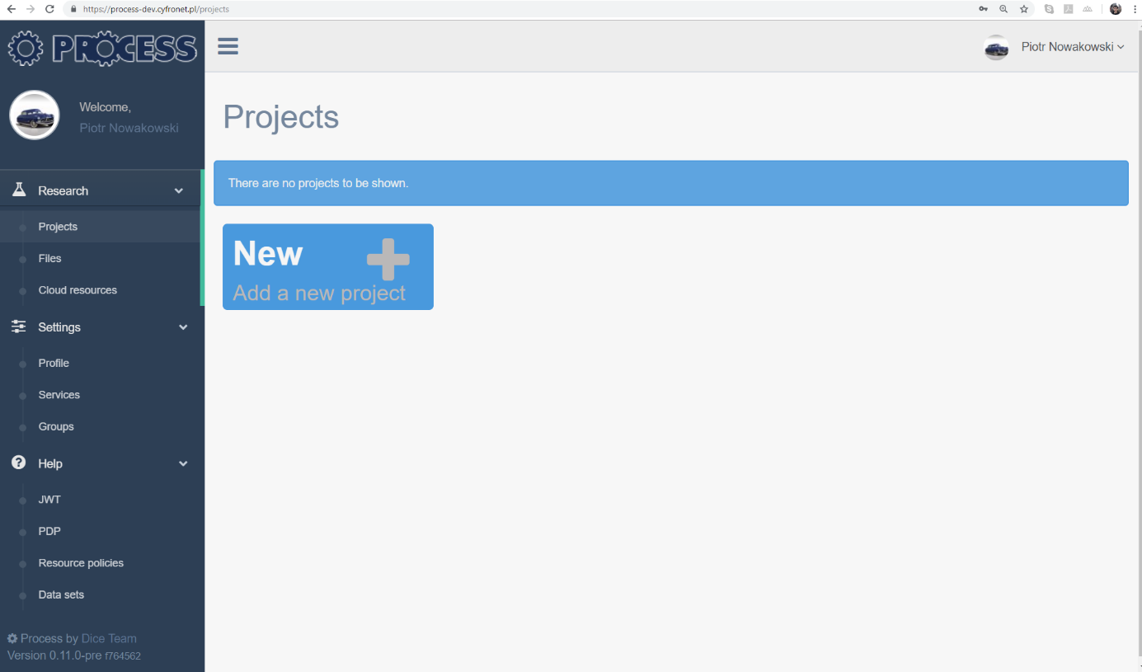
Singularity Step (2/5)
1
SIGN-IN
2
DASHBOARD
3
CREATE PROJECT
4
5
CREATE PIPELINE
RUN COMPUTATION

Slide 11
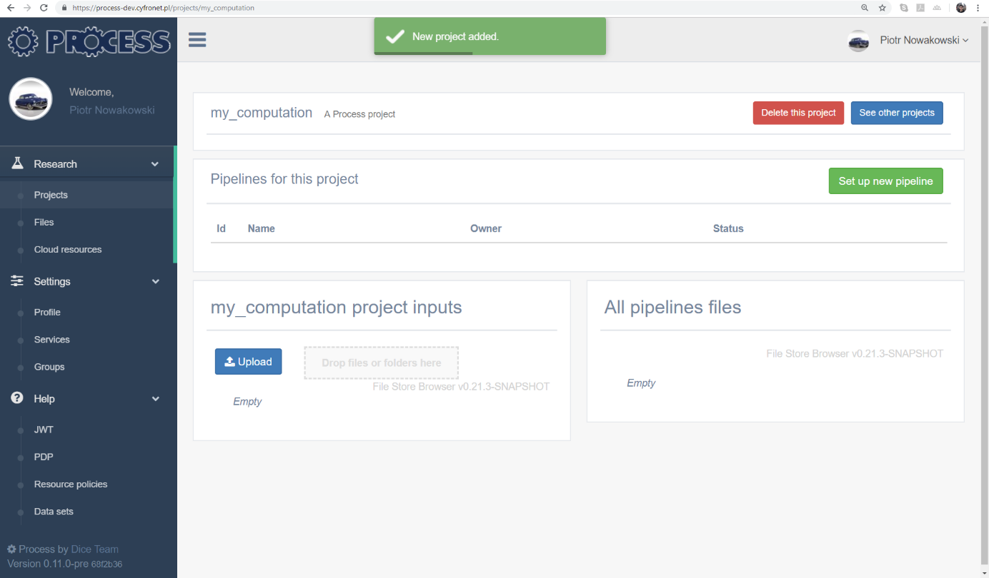
Singularity Step (3/5)
1
SIGN-IN
2
DASHBOARD
3
CREATE PROJECT
4
5
CREATE PIPELINE
RUN COMPUTATION

Slide 12
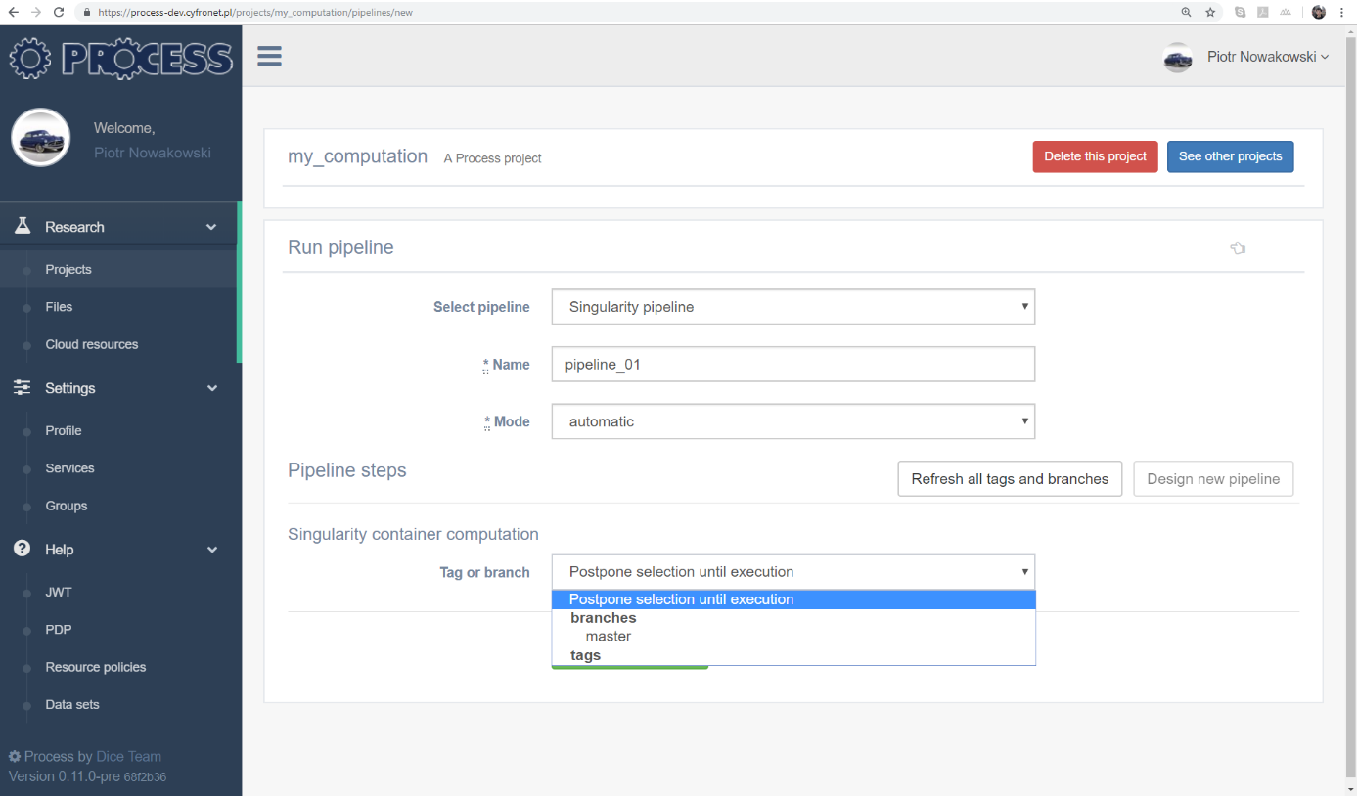
Singularity Step (4/5)
1
SIGN-IN
2
DASHBOARD
3
CREATE PROJECT
4
5
CREATE PIPELINE
RUN COMPUTATION

Slide 13
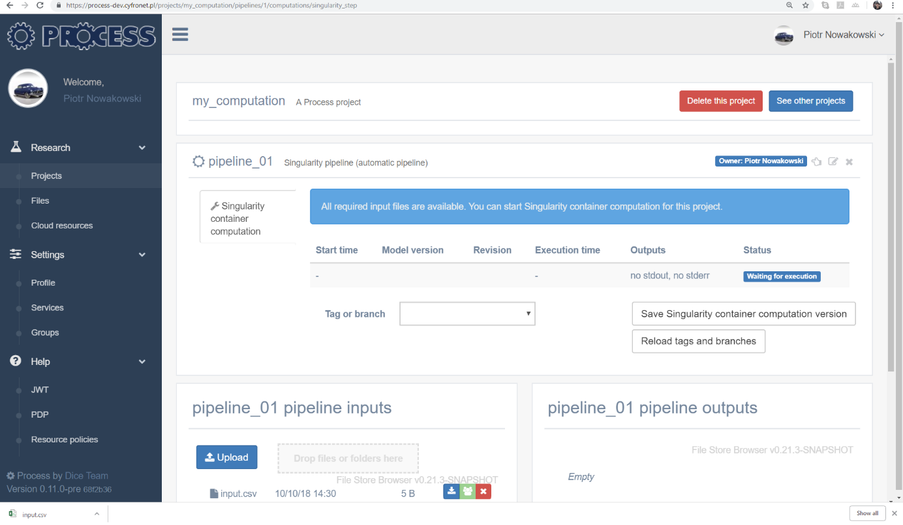
Singularity Step (5/5)
1
SIGN-IN
2
DASHBOARD
3
CREATE PROJECT
4
5
CREATE PIPELINE
RUN COMPUTATION

