Slide 1

Processing Complex Medical Workflows in the EurValve Environment
Marian Bubak^{1,2}, Tomasz Gubala¹, Rod Hose³, Marek Kasztelnik¹,
Maciej Malawski^{1,2}, Jan Meizner¹, Piotr Nowakowski¹, Steven Wood⁴
¹ACC Cyfronet AGH, Krakow, Poland
²Department of Computer Science, AGH, Krakow, Poland
http://dice.cyfronet.pl/
³Dept Infection, Immunity & Cardiovascular Disease, University of Sheffield, UK
⁴Sheffield Teaching Hospital, NHS Foundation Trust, UK
https://www.primageproject.eu/

Slide 2
Outline
Motivation: towards a decision support systems (DSS) for valvular deseases
Requirements for processing patient cases in a research environment
Architecture of the Model Execution Environment (MEE)
Implementation of the MEE
MEE in operation: patient pipeline
MEE in operation: PRIMAGE applications
Summary

Slide 3
From Research Environment to DSS
Research Computing Infrastructure
Development of models for DSS
Clinical Computing Environment
Real-time Multiscale Visualization
Model Execution Environment
Data Collection and Publication Suite
DSS Execution Environment
ROM
0-D Model
Patient Data
ROM
3-D Model
Model A
Images
Population data
Security System
Model B
HPC Cluster
Cloud
Infrastructure Operations
Data Source 1
Data Source 2
Workstation
Provide elaborated models and data for DSS

Slide 4
Pipelines for heart models
Data and action flow consists of:
full CFD simulations based on segmented heart images (computed using an external service)
Reduced Order Model + interpolation to model the heart without the need for HPC resources in a clinical scenario
Reduced Order Model (ROM)
Parameterized input shape
Response surface
Full CFD simulation (ANSYS)
Heart model
ROM interpolation
OD model
Pressure drop parabola params

Slide 5
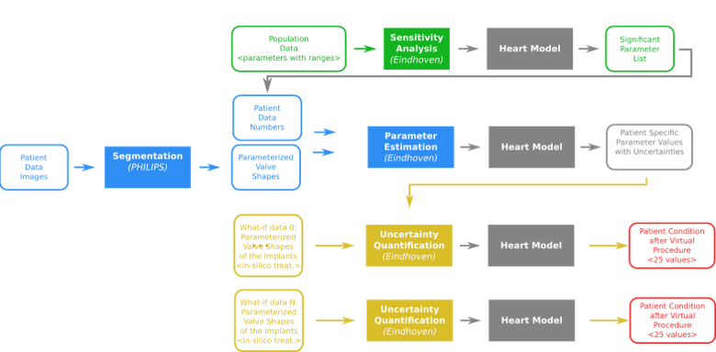
Pipelines for sensitivity analysis
The EurValve Decision Support System is based on identification of parameters to which the simulation is sensitive, and works by running 0D models for individual patients based on precomputed valve shapes and measured values of sensitive parameters (for a set of treatment variants).

Slide 6
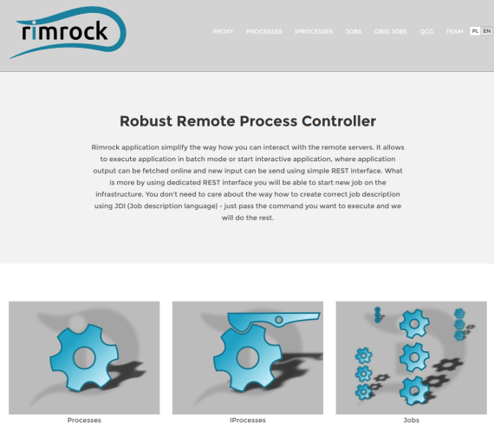
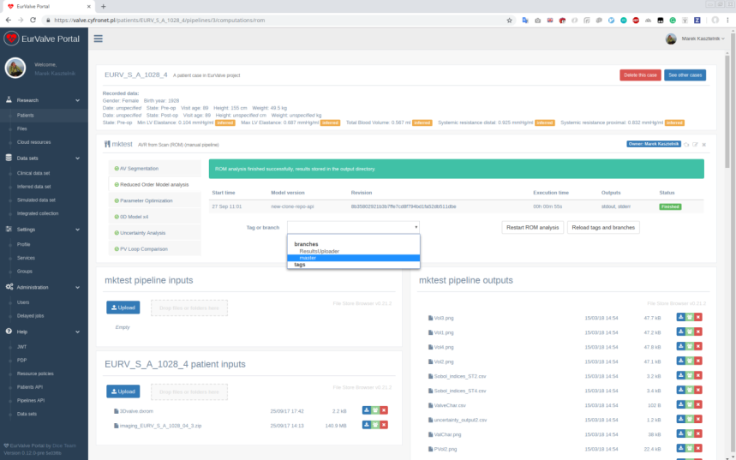
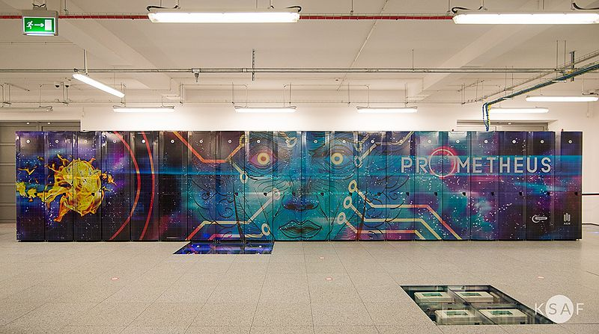
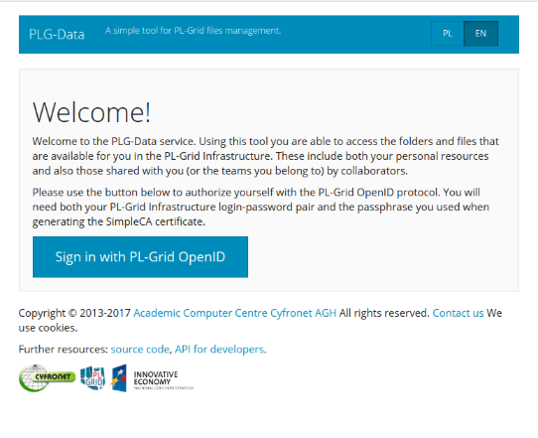
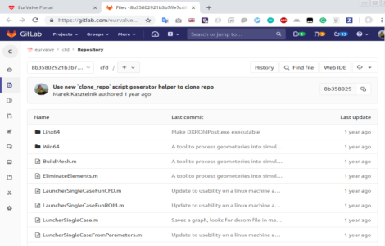
Processing patient cases – conceptual framework
Five main elements required when processing patient cases:
HPC infrastructure -> Prometheus cluster
Running jobs on Prometheus via REST API -> Rimrock
Managing data stored on Prometheus via REST API -> PLGData
Model repository and versioning -> GitLab
Managing model execution on patient data -> MEE
2
5
1
3
4

Slide 7
Motivation: reproducibility
Repeatability – same team, same experimental setup; a researcher can reliably repeat own computation
Replicability – different team, same experimental setup; an independent group can obtain the same result using the author’s own artifacts
Reproducibility – different team, different experimental setup; an independent group can obtain the same result using artifacts which they develop completely independently.

Slide 8
The Model Execution Environment (MEE)
MEE integrates the capabilities of the research branch of EurValve and is used to compute models for the clinical environment (i.e. for DSS)
MEE can be accessed from a dedicated GUI (the EurValve Portal), through a RESTful API or through a comman-line interface, depending on the researcher’s preferences.
Computational tasks can be run on HPC resources or in a cloud environment as appropriate.
A uniform security layer is provided.
API – Application Programming Interface
REST – Representational state transfer
Rimrock – service used to submit jobs to HPC cluster
Atmosphere – provides access to cloud resources
git – distributed revision control system

Slide 9

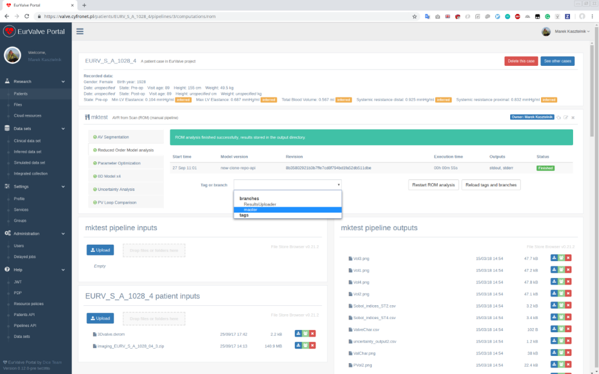


Model Execution Environment – operation
Integrated with PLGrid infrastructure (automatic proxy generation)
Can submit job to the Prometheus cluster
Enables file upload and download to/from Prometheus storage
Connected with GitLab repositories for model versioning and provenance
Run
Browse inputs
and outputs
Select model version

Slide 10
Core features of MEE
Reproducibility, versioning, pipeline documentation
Automation of simulation pipelines with a human in the loop for:
New models, new versions of models,
New users
Data persistence
Basic provenance features
Helpful visualization of simulation flow and results
Portability

Slide 11
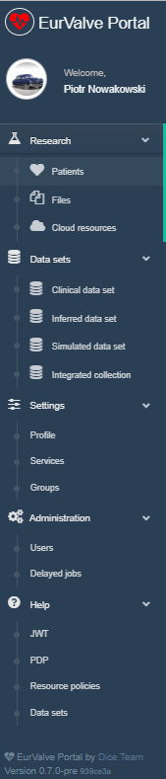
MEE feature set
Model Execution Environment:
Patient case pipeline integrated with File Store and Prometheus supercomputer
File Store for data management
Cloud resources based on Atmosphere cloud platform
Data sets
Structural access to patient databases
Query interfaces for real, simulated and inferred data
Security configuration
Service management – for every service dedicated set of policy rules can be defined
User Groups – can be used to define security constraints
REST API
Creating a new user session – as a result, new JWT (JSON Web Token) tokens are generated for credential delegation
PDP – Policy Decision Point: check if user has access to concrete resource
Resource policies – add/remove/edit service security policies
Notes:
11

Slide 12
MEE extensibility
Additional modules can be implemented:
As applications deployed on the Prometheus supercomputer
As external services communicating with the platform via its REST interfaces
As virtual machines deployable directly in the Cyfronet cloud via the Atmosphere extension of the MEE
Encapsulating pipeline steps as HPC tasks:
Scripts are run on the Prometheus supercomputer via the Rimrock extension
Files uploaded to the FileStore (e.g. using MEE GUIs) can be accessed on Prometheus nodes via curl, leveraging the WebDAV interface provided by FileStore
Any result files can also be uploaded directly to FileStore from the Prometheus computational nodes
External tools can be used to monitor job completion status e.g. by periodically scanning FileStore content
Notes:
12

Slide 13
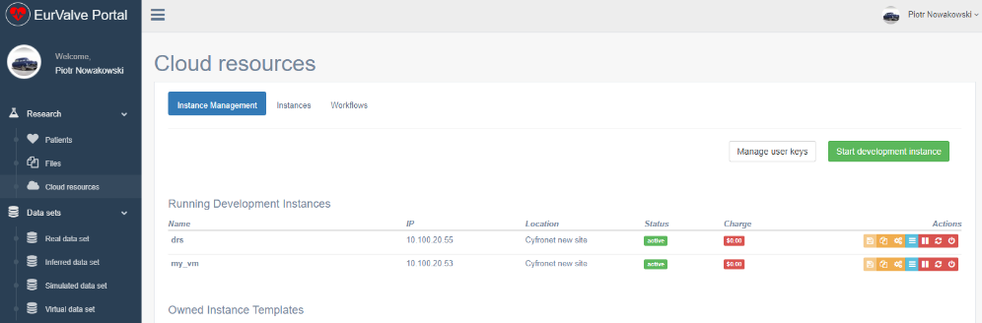
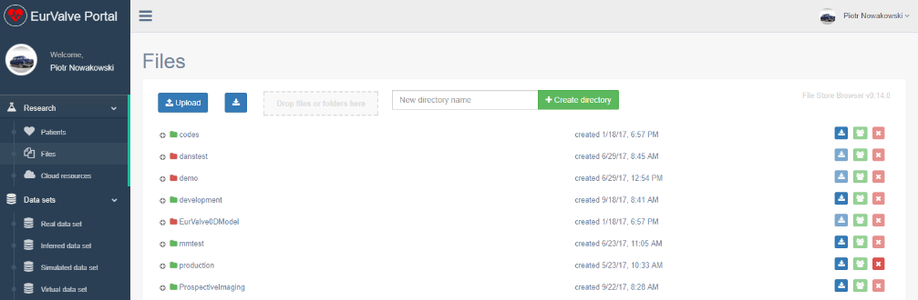
Generic MEE tools
Cloud resources
Based on Atmosphere cloud platform
Can start/stop/suspend virtual machine on cloud infrastructure
Can save running existing machine as template
(Future) can share templates with other users
File Store
Basic file storage for the project
Ability to create new directories and upload/download files
Can share directories with other users or groups of users
Can be mounted locally using WebDav clients
The File Browser GUI can also be embedded in other views
Notes:
13

Slide 14
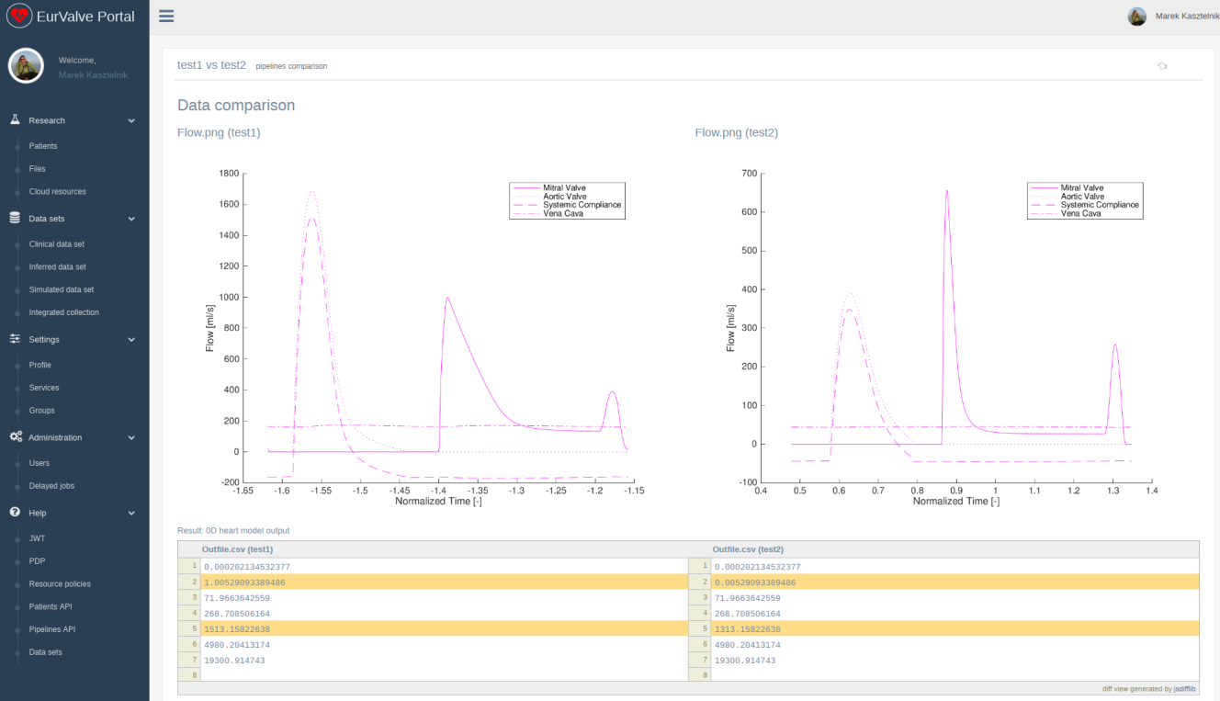
Comparing pipeline results
Result comparison feature
Run a pipeline multiple times for varying datasets
Compare the outcomes and identify differences
Helpful GUI for side-by-side comparisons
Supports textual and graphical visualization of results
Notes:
14

Slide 15
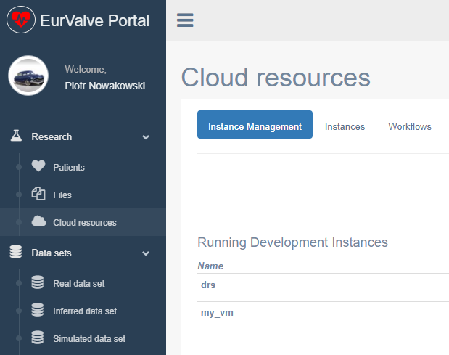







Cloud access via Atmosphere
Secure RESTful API
(Cloud Facade)
Atmosphere host
Atmosphere Core
Communication with underlying computational clouds
Launching and monitoring service instances
Billing and accounting
Logging and administrative services
Atmosphere Registry (AIR)
user accounts
available cloud sites
services and templates
Access to cloud resources
The Atmosphere extension provides access to cloud resources in the EurValve MEE
Applications can be developed as virtual machines, saved as templates and instantiated in the cloud
The extension is available directly in the MEE GUI and through a dedicated API
Atmosphere is integrated with EurValve authentication and authorization mechanisms
Notes:
15

Slide 16
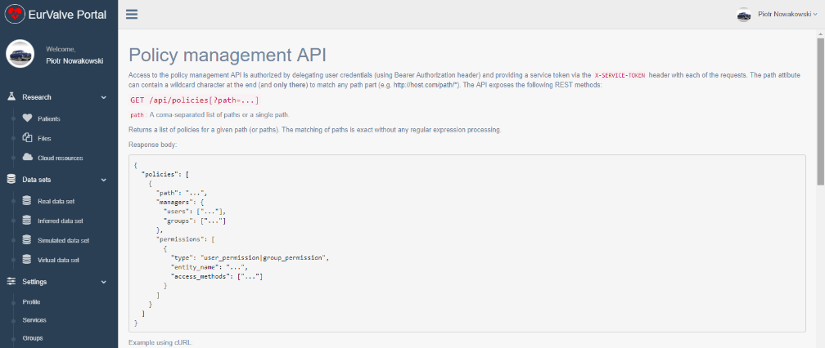
Accessing MEE via REST API
Generate user JWT Token
User (or other service) can retrieve new JWT token by passing username and password
JWT token can be used for user credential delegations by external EurValve services
PDP API
Check if user has right to access a specific resource
Resource policy management
Create/edit/delete local policies by external EurValve service on user behalf
Currently integrated with File Store
Initial ArQ integration tests underway
Notes:
16

Slide 17
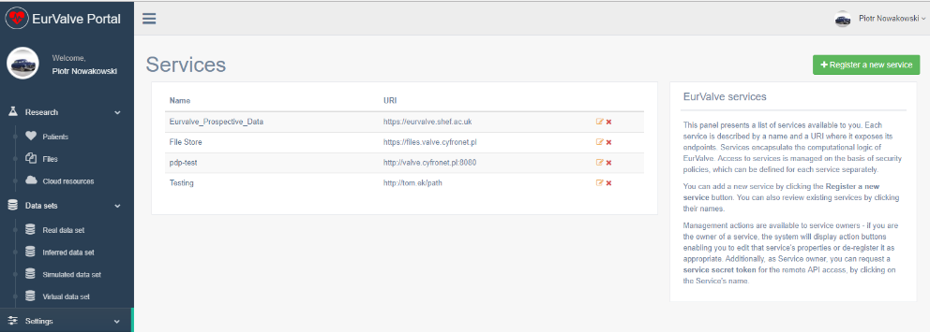
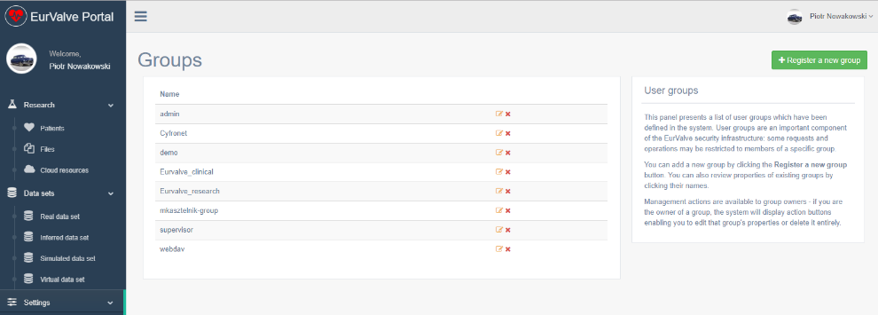
MEE security management UIs
Services
Basic security unit where dedicated security constraints can be defined
Two types of security policies:
Global – can be defined only by service owner
Local – can be created by the service on the user’s behalf
Groups
Group users
Dedicated portal groups:
Admin
Supervisor – users who can approve other users in the portal
Generic groups:
Everyone can create a group
Groups can be used to define security constraints
Notes:
17

Slide 18
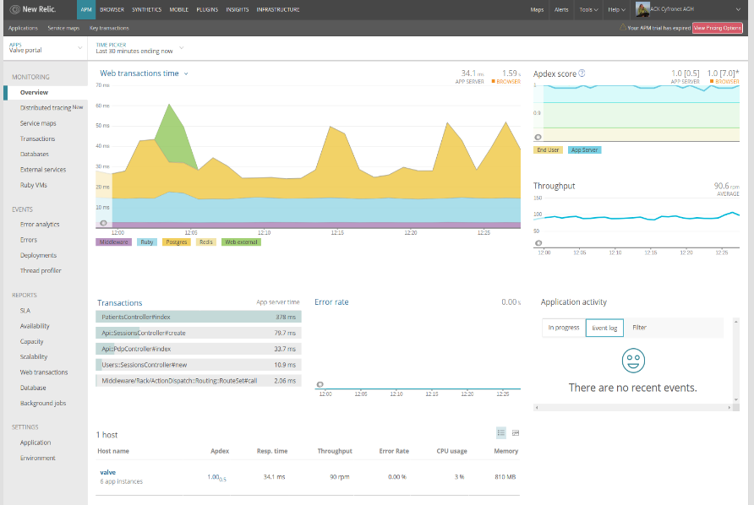
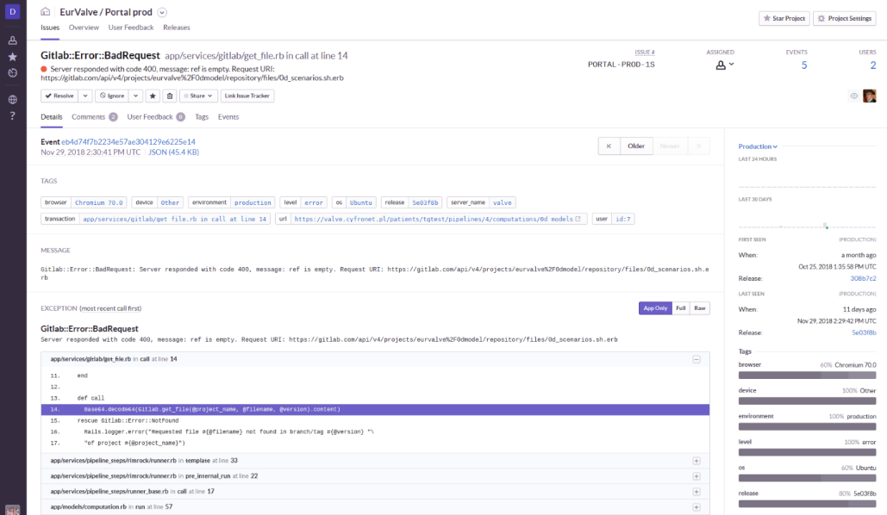
Platform availability monitoring
Monitoring services
NewRelic and Sentry used to monitor platform availability
Detect application errors as well as infrastructural failures
Alert administrators of any anomalous conditions
Notes:
18

Slide 19
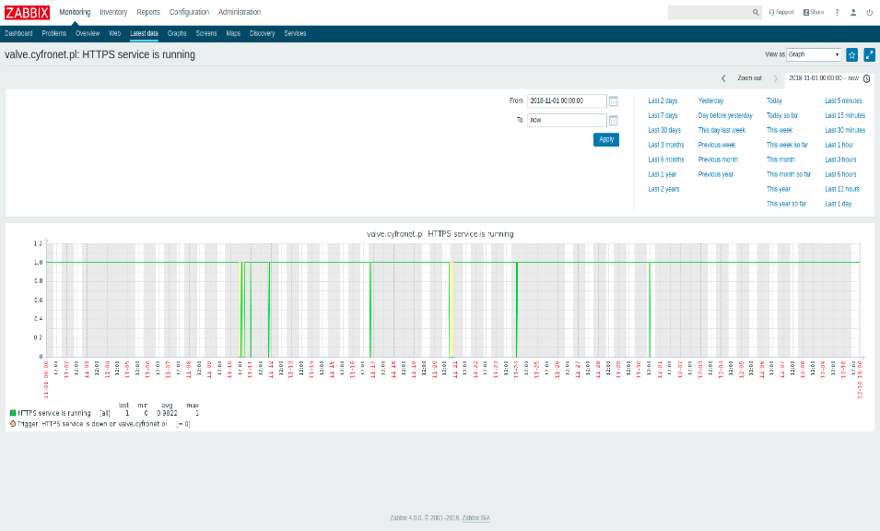
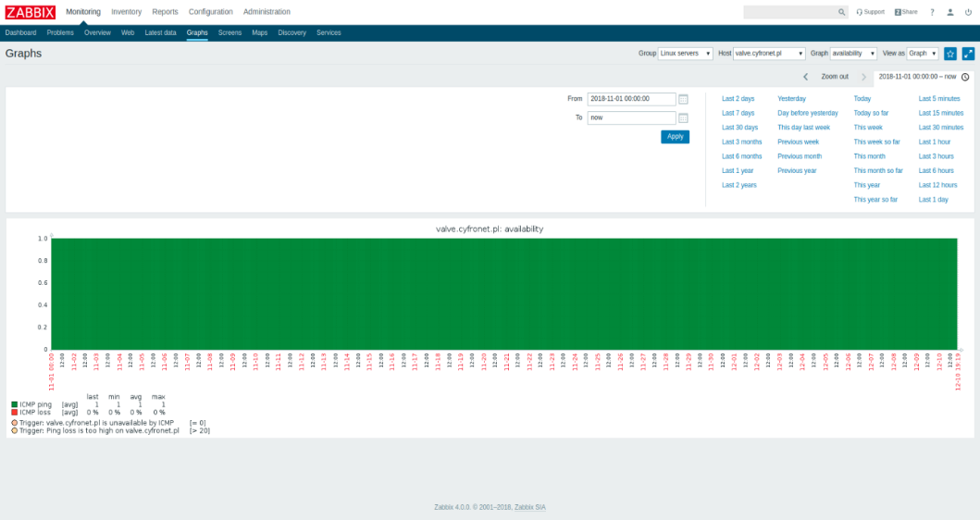
Platform responsiveness monitoring
Monitoring services
Zabbix is used to monitor responsiveness, service uptime and utilization data
The monitoring service also evaluates the risk of failures caused by exhaustion of hardware resources
As with Sentry/NewRelic, alerts can be dispatched to system administrators
Notes:
19

Slide 20
The Patient Case Pipeline: an EurValve workflow
Segmentation – to start this calculation, a zip archive with a dedicated structure needs to be created and transferred into the File Store input directory. Next, the output directory needs to be monitored for computation output.
Reduced Order Model analysis – based on the results of the segmentation step, a ROM simulation is executed and its results uploaded to the File Store.
Parameter Optimization – a technical step which prepares suitable parameters for the 0D model sequence
0D model sequence – runs four versions of the 0D model analysis for various input datasets
Uncertainty Quantification – Matlab script which can include the 0D Heart Model. It will be executed on the Prometheus supercomputer, where input files will be transferred automatically from the File Store. Results are transferred back from Prometheus to the File Store.
Output visualization – produces actionable visualization of the 0D model output data based on File Store contents.
Patient Case Pipeline high-level building blocks:
Service-driven computation (such as Segmentation) – use case: upload file to remote input directory, monitor remote output directory for results; data is processed by an external service
Scripts started on Prometheus supercomputer – use case: transfer script and input files from File Store to the cluster, run job, monitor job status, once the job has completed – transfer results from the cluster to File Store (examples: 0D Heart Model, Uncertainty Quantification, CFD simulation)
Notes:
20

Slide 21
Further evolution of the environment – PRIMAGE workflows
PRedictive In-silico Multiscale Analytics to support cancer personalized diaGnosis and prognosis (PRIMAGE)
to develop an environment for predictive, personalized medicine, focused on cancer treatment
Data infrastructures, imaging biomarkers and models for in-silico medicine research will be validated in the context of two pediatric cancers: Neuroblastoma, the most frequent solid cancer of early childhood, and Diffuse Intrinsic Pontine Glioma, the leading cause of brain tumor-related death of children
PRIMAGE technological platform, to be delivered by several partners, will combine containerisation techniques with deployment of in-silico codes and machine learning models to various computing cloud and HPC supercomputing resources
Computational workflows will be grouped in pipelines to reflect clinical practice and requirements as closely as possible
Pipelines will include computational steps, running sequentially or in parallel, using various computational infrastructures, some of which will use containers where beneficial

Slide 22
Containers in PRIMAGE
Data lake
Molecular models
Classifier models
Images
Lab tests
Tissue models
Cancer growth model
Forms
Image analysis
Pipeline flow definition maps programs into in-silico clinical pipeline steps
Others…
Others…
Biomarkerdetection
Pool of models,
algorithms…
HPC cluster
Executed pipeline steps are scheduled to adequate computing resources
Required data is fetched to running pipeline steps
Pipeline flow #1
Pipeline flow #2
Computational cloud
In both cases (cloud, HPC) containerisation techniques (Docker, Singularity) are applied when it
is useful
Pipeline flow #3

Slide 23
Computations performed
In the scope of the EurValve project, the Model Execution Environment and the underlying computational infrastructure – including the Prometheus cluster at ACC Cyfronet AGH – was used to develop the Reduced Order Model and perform patient simulations.
The EurValve research environment was used to process computational workflows for 67 retrospective patient cases. Multiple simulations were carried out for each patient, resulting in a total of over 300 thousand CPU-hours facilitated by the HPC resources at ACC Cyfronet AGH.
Patient data and simulation results are stored in 72,953 files using 265GB of disk storage.
Tabular Data Store:
Clinical data items: 357 records with 305 data items each
Simulated results: 1457 records with 78 data items each
All of the above is managed and accessible through the MEE – see the demonstration at http://www.eurvalve.eu/index.php/eurvalve-video/.

Slide 24
MEE: HPC grant usage
Overall, we applied for 5 computation grants and consumed 305,000 CPU hours:
Grant name | Start date | End date | Requested CPU hours | Consumed CPU hours
EurValve 1 | 12.01.2016 | 12.01.2017 | 25000 | 22869
EurValve 2 | 17.02.2016 | 17.02.2017 | 500000 | 38018
EurValve 3 | 22.02.2017 | 22.02.2018 | 150000 | 94279
EurValve 4 | 05.03.2018 | 05.03.2019 | 150000 | 150000
EurValve 5 | 01.02.2019 | 30.06.2019 | 150000
Computational grants
Required to carry out computations on Cyfronet/PLGrid resources
Negotiated by Cyfronet on behalf of the EurValve consortium on an annual basis
Consumed by running pipelines and processing patient data in MEE
Free of charge („payment” is remitted in the form of publications which acknowledge PLGrid/Cyfronet contributions)
Notes:
24

Slide 25
MEE services at Cyfronet
EurValve Project Website at Cyfronet AGH
URL: http://dice.cyfronet.pl/projects/details/EurValve
EurValve Portal
URL: https://valve.cyfronet.pl
Registration at: https://valve.cyfronet.pl/users/sign_up
EurValve File Store
URL (docs): https://files.valve.cyfronet.pl
WebDAV endpoint (portal account required): https://files.valve.cyfronet.pl/webdav

Slide 26
Recorded demos of MEE
Logging in to EurValve and PLGrid systems – https://youtu.be/4I907aAOCvU
File Store Browser – https://youtu.be/-6fXG0am6iE
Distributed Cloud File Store – https://youtu.be/FTF-QaI5ZZQ
Services, security, restricted access – https://youtu.be/-6fXG0am6iE
Cloud Resource Access – https://youtu.be/A4wkxFCRLak
Patient case
https://youtu.be/SIwpxdoQYWw (patient case)
https://youtu.be/j0Nu-E-0elE (pipeline diff)
Integration of computational services – https://youtu.be/SIwpxdoQYWw

Slide 27
In summary...
We are observing an evolution of computational paradigms: physical computers -> cloud VMs -> containers (much lighter than clouds) -> serverless -> serverless containers (e.g. AWS Fargate, Google Serverless Containers).
The consequence is an increasing number of abstraction layers.
Further development of MEE includes:
Pipeline execution management: organizes set of models into a single sequential execution pipeline with files as the main data exchange channel
Model development organization through structuralization
Retention of execution and development history
Computation execution diff: an adequate tool for model developers to compare two different model executions, revealing any changes along with their impact on results
Dedicated comparison software for specific types of results
Easier problem detection and manual validation
Multiorganizational support: capability to switch between workbenches belonging to different organizations/projects which make use of MEE, and to run pipelines independently within the context of each organization.

Slide 28






http://dice.cyfronet.pl https://www.primageproject.eu/ http://www.process-project.eu http://www.eurvalve.eu http://www.vph-share.eu https://sano.science

