Slide 1

In quest for reproducibility of medical simulations on e-infrastructures
Marian Bubak^{1,2}, Tomasz Gubala², Marek Kasztelnik²,
Maciej Malawski¹, Jan Meizner², Piotr Nowakowski²
bubak@agh.edu.pl
¹Department of Computer Science, AGH Krakow, Poland
²ACC Cyfronet AGH, Krakow, Poland
http://dice.cyfronet.pl/

Slide 2
Our research interests
Trends
Enhanced scientific discovery is becoming collaborative and analysis-focused; in-silico experiments are becoming more and more complex
Available compute and data resources are distributed and heterogeneous
Modelling of complex collaborative scientific applications
domain-oriented semantic descriptions of modules, patterns and data to automate composition of applications
Studying the dynamics of distributed resources
investigating temporal characteristics, dynamics, and performance variations to run applications with the desired quality of service
Modelling and designing a software layer to access and orchestrate distributed resources
mechanisms for aggregating multi-format/multi-source data into a single coherent schema
semantic integration of compute/data resources
Data-aware mechanisms for resource orchestration
enabling reusability based on provenance data

Slide 3
DICE Team skillset
Interactive compute- and data-intensive applications, knowledge-based workflow composition, programming models | CrossGrid, K-Wf Grid, CoreGRID | 2002-2008
Script-based composition of applications, GridSpace Virtual Laboratory | ViroLab, GREDIA | 2006-2009
Federating cloud resources for VPH compute- and data-intensive applications, DataNet – metadata models | VPH-Share, PL-Grid | 2009-2015
Common Information Space for Early Warning Systems, big data storage and access, analysis tools | UrbanIFlood, ISMOP | 2009-2016
Computational strategies, software and services for distributed multiscale simulations | MAPPER | 2010-2013
Executable Papers; 1st prize in Elsevier competition at ICCS2011 (Elsevier follow-up project) | Collage | 2011-2013
Optimization of workflow applications on cloud resources | PaaSage | 2013-2016
Computing solutions for exascale challenges | PROCESS | 2017-2020
Environment for large-scale simulations in medicine | EurValve PRIMAGE | 2016-2019 2018-2022
Business plan of a Centre of Excellence for New Methods in Computational Diagnostics and Personalised Therapy (Teaming Phase 1) | CECM | 2017-2018

Slide 4
Outline
Motivation: reproducibility
Simulation on HPC cluster
Cloud federation for sharing
Singularity for exascale
Containers for medical applications
Containers and software development
Next: serverless solutions?
Summary

Slide 5
Motivation: from research to DSS
Research Computing Infrastructure
Development of models for DSS
Clinical Computing Environment
Real-time Multiscale Visualization
Model Execution Environment
Data Collection and Publication Suite
DSS Execution Environment
ROM
0-D Model
Patient Data
ROM
3-D Model
Model A
Images
Population data
Security System
Model B
HPC Cluster
Cloud
Infrastructure Operations
Data Source 1
Data Source 2
Workstation
Provide elaborated models and data for DSS

Slide 6
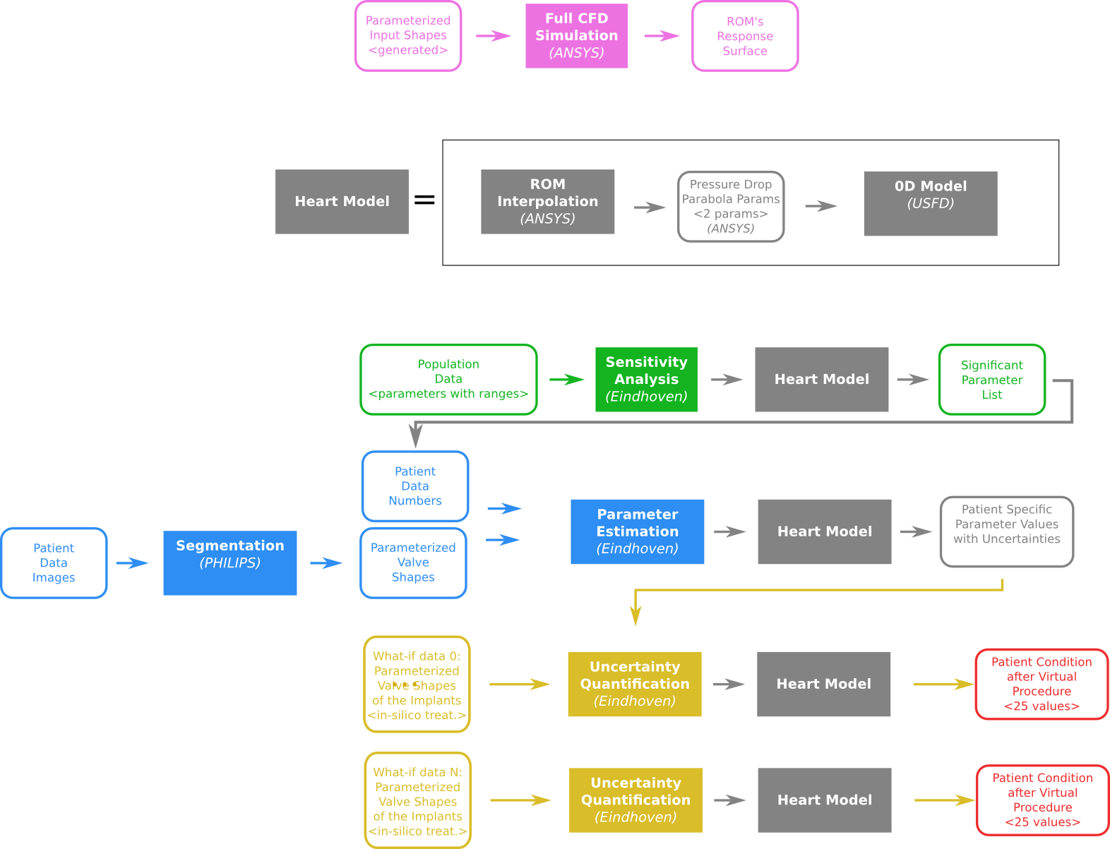
EurValve action and data flow
Data and action flow consists of:
full CFD simulations
sensitivity analysis to acquire significant parameters
parameter estimation based on patient data
uncertainty quantification of various procedures
The flow of CFD simulations and sensitivity analysis is part of clinical patient treatment

Slide 7
Motivation: reproducibility
Repeatability – same team, same experimental setup; a researcher can reliably repeat own computation
Replicability - different team, same experimental setup; an independent group can obtain the same result using the author’s own artifacts
Reproducibility - different team, different experimental setup; an independent group can obtain the same result using artifacts which they develop completely independently.

Slide 8
EurValve Model Execution Environment
API – Application Programming Interface
REST – Representational state transfer
Rimrock –
a service used to submit jobs to HPC cluster
Atmosphere – provides access to cloud resources
git – a distributed revision control system

Slide 9
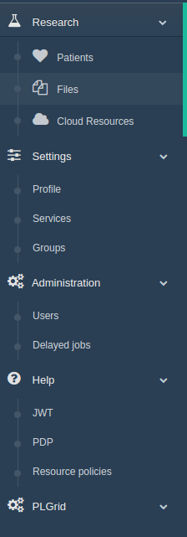
MEE implementation
Model Execution Environment:
Patient case pipeline integrated with File Store and Prometheus supercomputer
File Store browser for data management
Cloud resources based on Atmosphere cloud platform
Security configuration
Service management – for every service a dedicated set of policy rules can be defined
User Groups – can be used to define security constraints
REST API
Creating a new user session – as a result, new JWT tokens are generated for credential delegation
PDP – check if a user has access to concrete resource
Resource policies – add/remove/edit service security policies
Notes:
9

Slide 10
MEE usage statistics
Model Execution Environment
2 environments (production https://valve.cyfronet.pl and development https://valve-dev.cyfronet.pl)
25 releases (13 feature-rich, 12 bugfix releases)
357 feature and bug issues solved, 413 merge requests merged
Uptime: 99.92%
File Store
2 environments (production https://files.valve.cyfronet.pl and development https://files.valve-dev.cyfronet.pl)
36 releases (22 feature-rich, 14 bugfix releases)
129 feature and bug issues solved, 126 merge requests merged
Uptime: 98.87%

Slide 11
Classes of users
End Users – want to run already prepared pipelines to obtain results significant from the scientific point of view
Model Providers – providing domain knowledge and preparing scripts that may be run on the infrastructures
Service Providers – able to register their services and configure access to them which is then managed via the Policy Decision Point (PDP) component of the MEE,
Administrators and Operators – may perform management tasks such as granting/revoking access to the platform or tweaking basic policies.

Slide 12

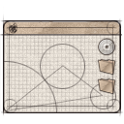


Typical users of the cloud platform
Install any scientific
application in the cloud
Access available
applications and data
in a secure manner
End user
Developer
Application
Managed application
Cloud infrastructure
for e-science
Manage cloud
computing and storage
resources
Administrator
Install/configure each application service (which we call a Cloud Service or an Atomic Service) once – then use them multiple times in different workflows;
Direct access to raw virtual machines is provided for developers, with multitudes of operating systems to choose from (IaaS solution);
Install whatever you want (root access to cloud Virtual Machines);
The cloud platform takes over management and instantiation of Cloud Services;
Many instances of Cloud Services can be spawned simultaneously;
Large-scale computations can be delegated from the PC to the cloud/HPC via a dedicated interface.

Slide 13


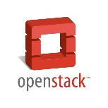



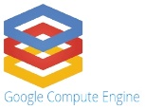

VPH-Share federated cloud
VPH-Share cloud site at CYF
VPH-Share services host
portal.vph-share.eu
Template repository
Worker nodes
VPH-Share cloud site at UNIVIE
Core Services Host
vph.cyfronet.pl
Secure RESTful API
(Cloud Facade)
Template repository
Worker nodes
Atmosphere-VPH
Amazon EC2 VPH-Share site
Atmosphere core (internal dependency)
Template repository
Worker nodes
RackSpace VPH-Share cloud account
Amazon EC2 CISTIB site
Template repository
Template repository
Worker nodes
Worker nodes
Google Compute VPH-Share cloud account
MS Azure VPH-Share cloud account
Template repository
Template repository
Worker nodes
Worker nodes

Slide 14
VPH-Share cloud platform in numbers
Five cloud IaaS technologies (OpenStack, EC2, MS Azure, RackSpace, Google Compute)
Seven distinct cloud sites registered with the VPH-Share infrastructure
Over 250 Atomic Services available
Approximately 100 service instances operating on a daily basis
Over 1 million files transferred
Notes:
Slide Objectives:
Speaking Points:

Slide 15








Modular, sustainable cloud platform
VPH-Share services host
portal.vph-share.eu
PLGrid GUI host
cloud.plgrid.pl
ISMOP GUI host
moc.ismop.edu.pl
Atmosphere-VPH
Atmosphere-PLGrid
Atmosphere-ISMOP
Authentication and authorization logic
Metadata Store integration
Authentication and authorization logic
Support for PLGrid network features
Authentication and authorization logic
ISMOP workflow mangement support
Atmosphere core
Communication with underlying computational clouds
Launching and monitoring service instances
Creating new service templates
Billing and accounting
Logging and administrative services
User accounts
Cloud sites
Cloud services
Atmosphere is envisioned as a generic solution embeddable in various usage contexts. It consists of a core (also called the Atmosphere Engine) which implements features common to all potential use cases, and a set of extensions each of which is suited to a specific project and encapsulates the corresponding functionality.
Notes:
Slide Objectives:
Speaking Points:

Slide 16
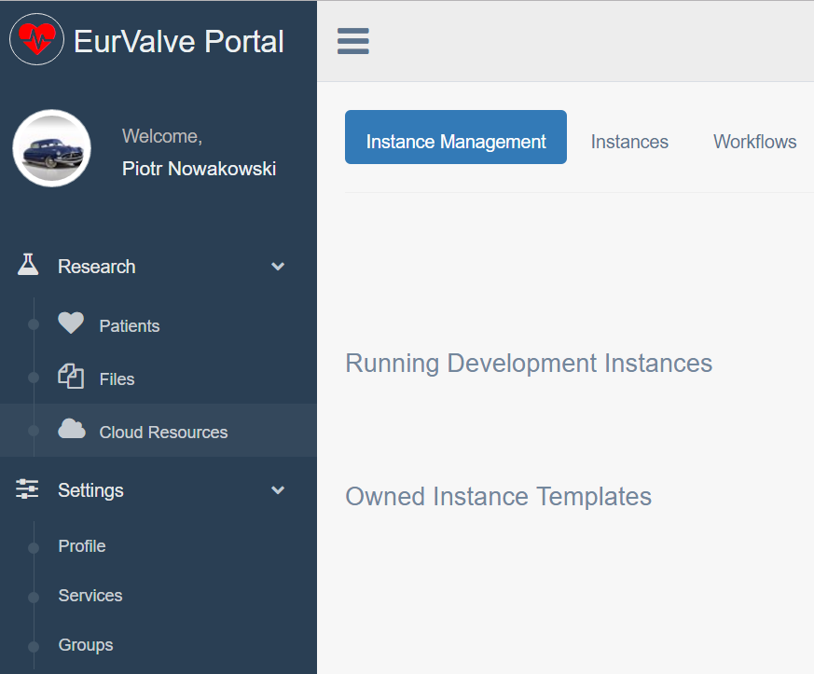

MEE - cloud access via Atmosphere
Secure RESTful API
(Cloud Facade)
Atmosphere host
Atmosphere Core
Communication with underlying computational clouds
Launching and monitoring service instances
Billing and accounting
Logging and administrative services
Atmosphere Registry (AIR)
user accounts
available cloud sites
services and templates
Access to cloud resources
The Atmosphere extension provides access to cloud resources in the EurValve MEE
Applications can be developed as virtual machines, saved as templates and instantiated in the cloud
The extension is available directly in the MEE GUI and through a dedicated API
Atmosphere is integrated with EurValve authentication and authorization mechanisms
Notes:
16

Slide 17
Towards exascale – PROCESS EU project
The PROCESS project aims to:
Pave the way towards exascale by providing a scalable platform
Enable deployment of services on heterogeneous infrastructures
Support multiple domains of science and business
The proof-of-concept objective is to:
Build a container-based platform based on Singularity
Integrate HPC resources across multiple countries
Provide effortless user experience via a WebUI

Slide 18
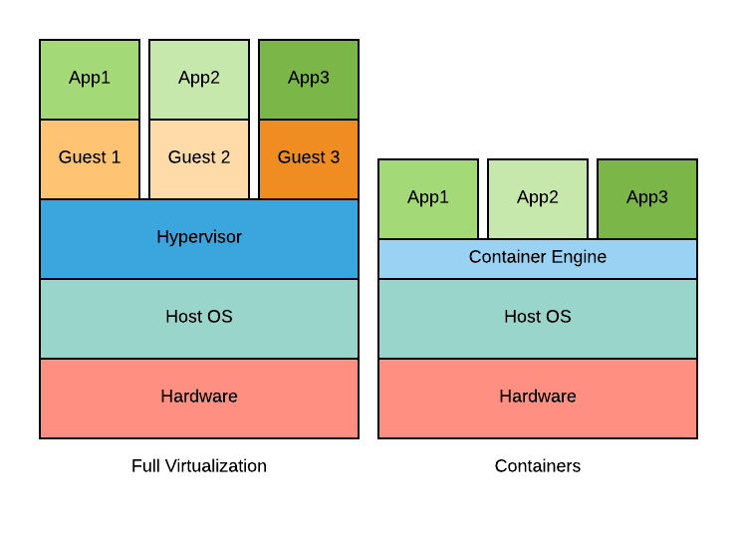
PROCESS: computational platform
Why containers?
Small footprint
Less overhead
Quick launch
Manageable images
Why Singularity?
Built for HPC
Integrated with SLURM
Unprivileged / secure
Support for MPI, GPU, …

Slide 19
Why Singularity?
Singularity is designed with four principles in mind:
Reproducible software stacks – easily verifiable via checksum
Mobility of compute – transfer of the container must work with standard tools
Compatibility with complicated architectures – compatible with existing HPC software
Security model – allow untrusted user run untrusted container
In terms of reproducible research:
Container represented as a single file that can be copied and shared
Suitable for research work – MPI support, GPU and accelerators support
Validation of correctly reproduced environment via checksum
Replicable environment via shareable recipe or image

Slide 20
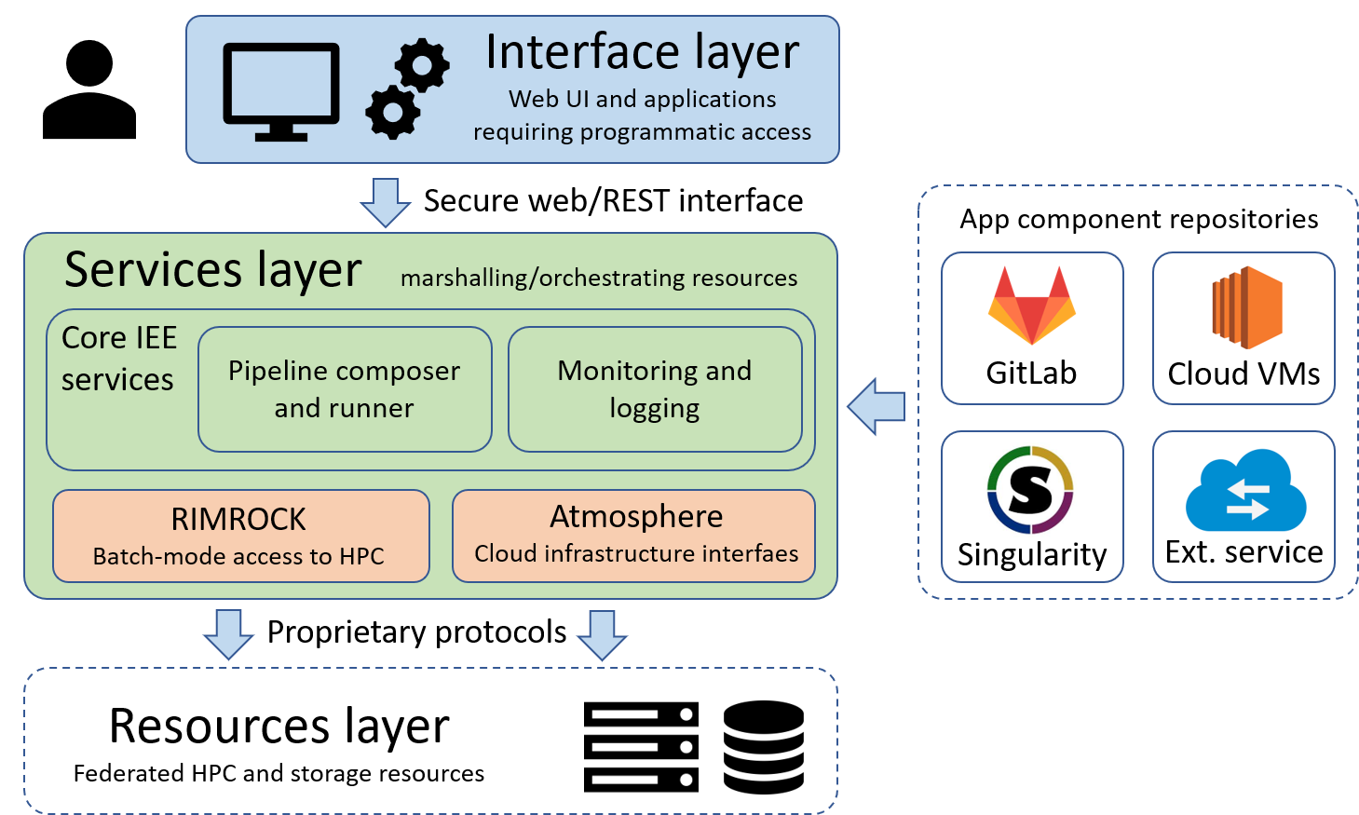
PROCESS: managing container-based applications in a HPC environment
User accesses WebUI
Service layer is used to:
select inputs
choose code version
prepare and run computations
Computations are scheduled on HPC via RIMROCK
Computations may assume the form of classic scripts or Singularity containers
A dedicated container repository is built into the platform

Slide 21
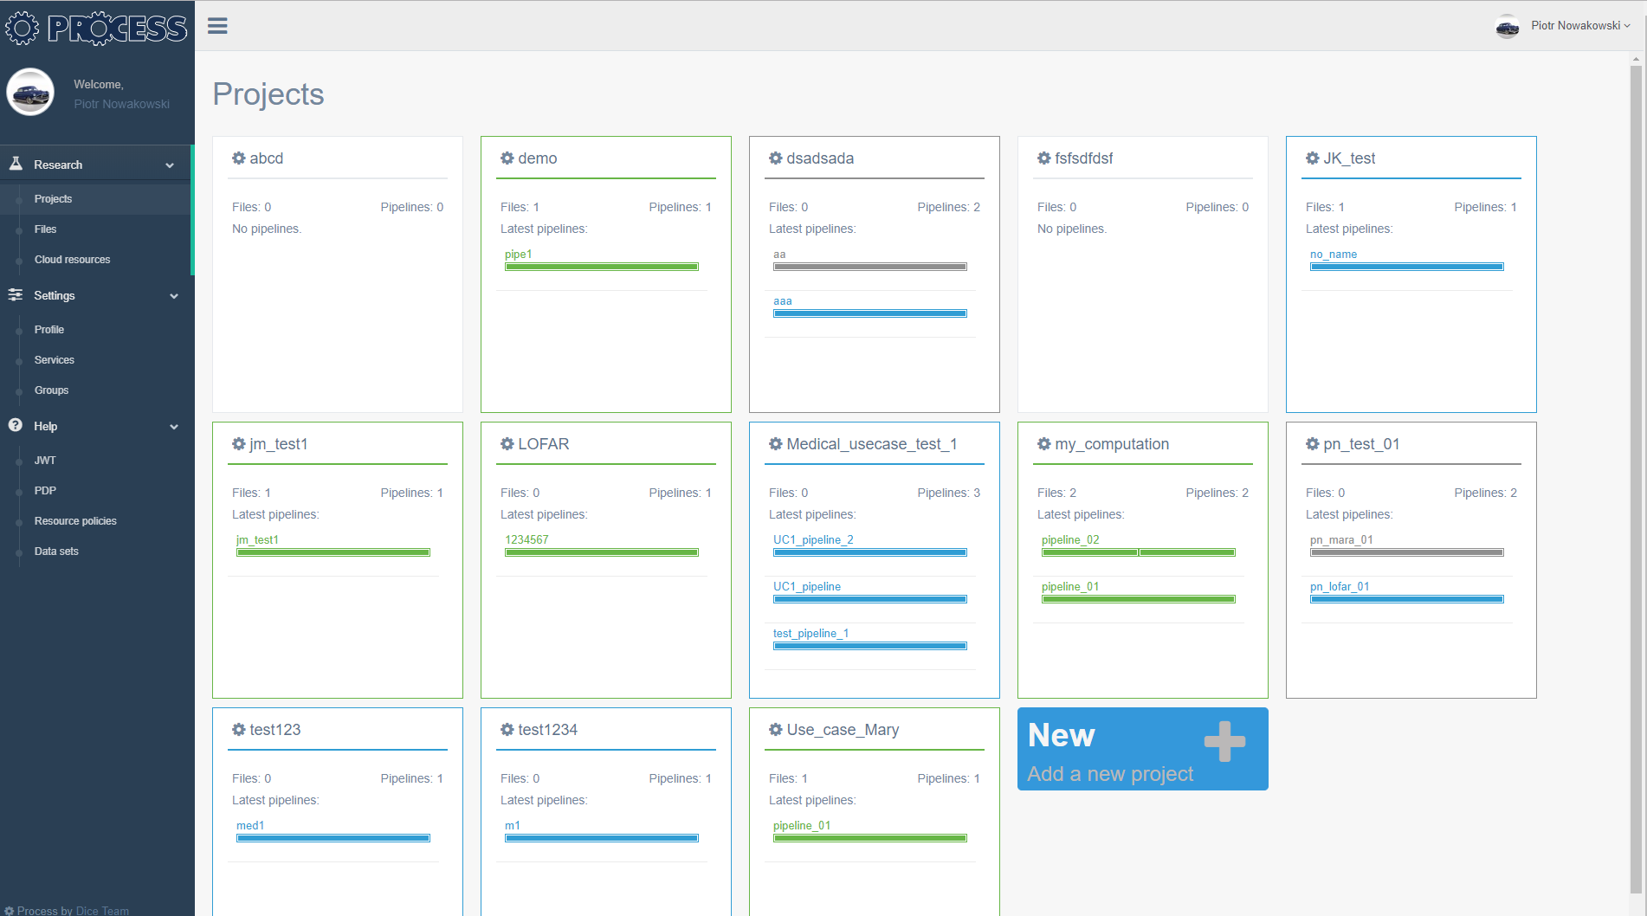
PROCESS platform – implementation
Development environment available at https://process-dev.cyfronet.pl
Integrated security provided by PLGrid (with certificate delegation enabling submission of jobs to Prometheus cluster)
A range of prototype use cases encapsulated in containers and deployed as pipelines
Supports composable pipelines consisting of multiple steps, each of which is backended by a dedicated container

Slide 22


Sample PROCESS pipeline – exascale learning on medical image data
The representative use case involves training ANNs for decision support systems using high-quality medical datasets. This involves massive input datasets and complex GPU-based processing.
A simple yet effective pipeline is enacted by the PROCESS infrastructure on each participating compute site, enabling deployment of containers, automatic marshalling of input data and stage-out of results. PROCESS takes care of supervising computations in a HPC environment.
Requested dataset is uploaded to HPC environments where computations are to take place
Multiple containers can be deployed to process data. This deployment is managed by the PROCESS infrastructure.
Data stage-in
Computation
Data stage-out
Computation
Computation
Results can be uploaded to centralized data repositories
Computation

Slide 23
Complex simulations for medicine – PRIMAGE project
PRedictive In-silico Multiscale Analytics to support cancer personalized diaGnosis and prognosis (PRIMAGE)
to develop an environment for predictive, personalized medicine, focused on cancer treatment
Data infrastructures, imaging biomarkers and models for in-silico medicine research will be validated in the context of two pediatric cancers: Neuroblastoma, the most frequent solid cancer of early childhood, and Diffuse Intrinsic Pontine Glioma, the leading cause of brain tumor-related death of children
PRIMAGE technological platform, to be delivered by several partners, will combine containerisation techniques with deployment of in-silico codes and machine learning models to various computing cloud and HPC supercomputing resources
Computational workflows will be grouped in pipelines to reflect clinical practice and requirements as closely as possible
Pipelines will include computational steps, running sequentially or in parallel, using various computational infrastructures, some of which will use containers where beneficial

Slide 24
Containers in PRIMAGE
Data lake
Molecular models
Classifier models
Images
Lab tests
Tissue models
Cancer growth model
Forms
Image analysis
Pipeline flow definition maps programs into in-silico clinical pipeline steps
Others…
Others…
Biomarkerdetection
Pool of models,
algorithms…
HPC cluster
Executed pipeline steps are scheduled to adequate computing resources
Required data is fetched to running pipeline steps
Pipeline flow #1
Pipeline flow #2
Computational cloud
In both cases (cloud, HPC) containerisation techniques (Docker, Singularity) are applied when it
is useful
Pipeline flow #3

Slide 25
Containerisation to simplify code development (1/2)
We use GitLab.com to store our code and Gitlab CI/CD to build, test, release and deploy it into development and production environments
Inside the repository a dedicated build configuration definition is stored. It contains information about the required Docker image and a script which should be executed inside the image
Following each new commit, merge, branch or tag an automatic pipeline is triggered. It executes the following steps:
download and start the selected Docker image
inside the running container, the repository is cloned and its test/release/deploy script is executed

Slide 26
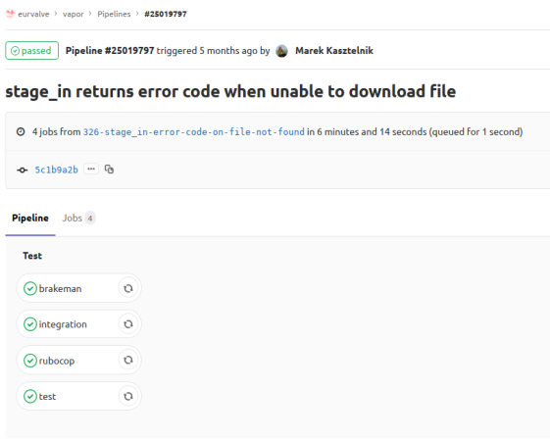
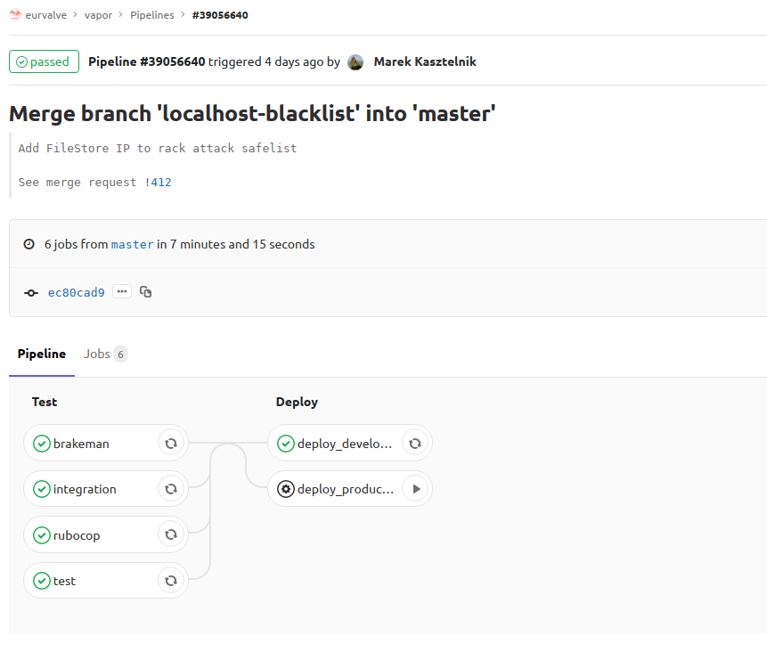
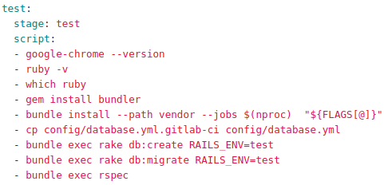
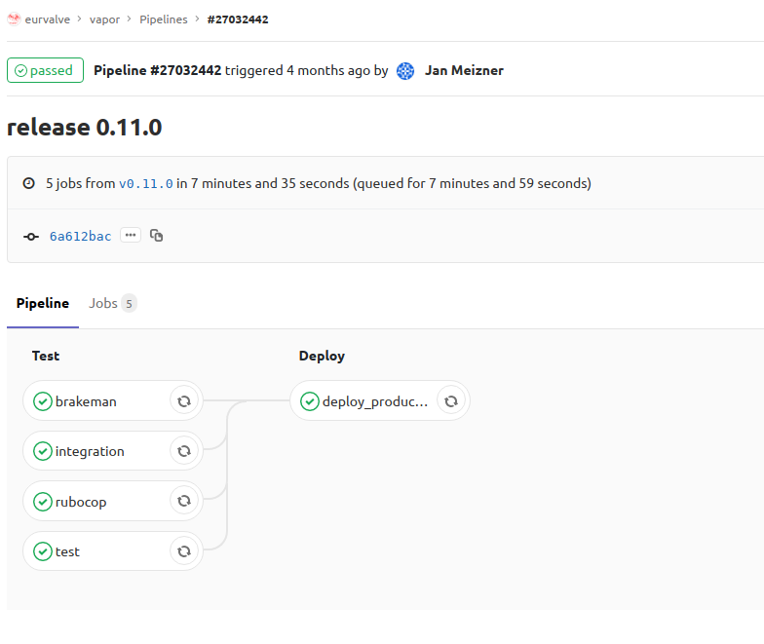
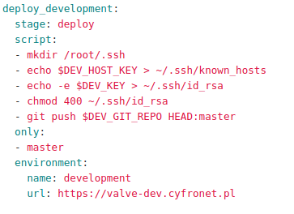
Containerisation to simplify code development (2/2)

Slide 27


Serverless infrastructures
History:
1980s – servers,
2000s – servlets,
2020+ - serverless
Serverless – no traditional VMs (servers)
Composing of applications from existing cloud services
Typical example: web browser or mobile device interacting directly with the cloud
Cloud Functions (Function-as-a-Service)
Run a custom code on the cloud infrastructure
Examples:
AWS Lambda, Google Cloud Functions, IBM, Azure
Containers and FaaS convergence: containerized functions on Kubernetes
Functions
F 1
F 2
F K
Containers
C 1
C 2
C N
Virtual Machines
VM
Short-lived – up to 15 minutes per task
Stateless
Fine-grained pricing
Per 100 ms * GB

Slide 28
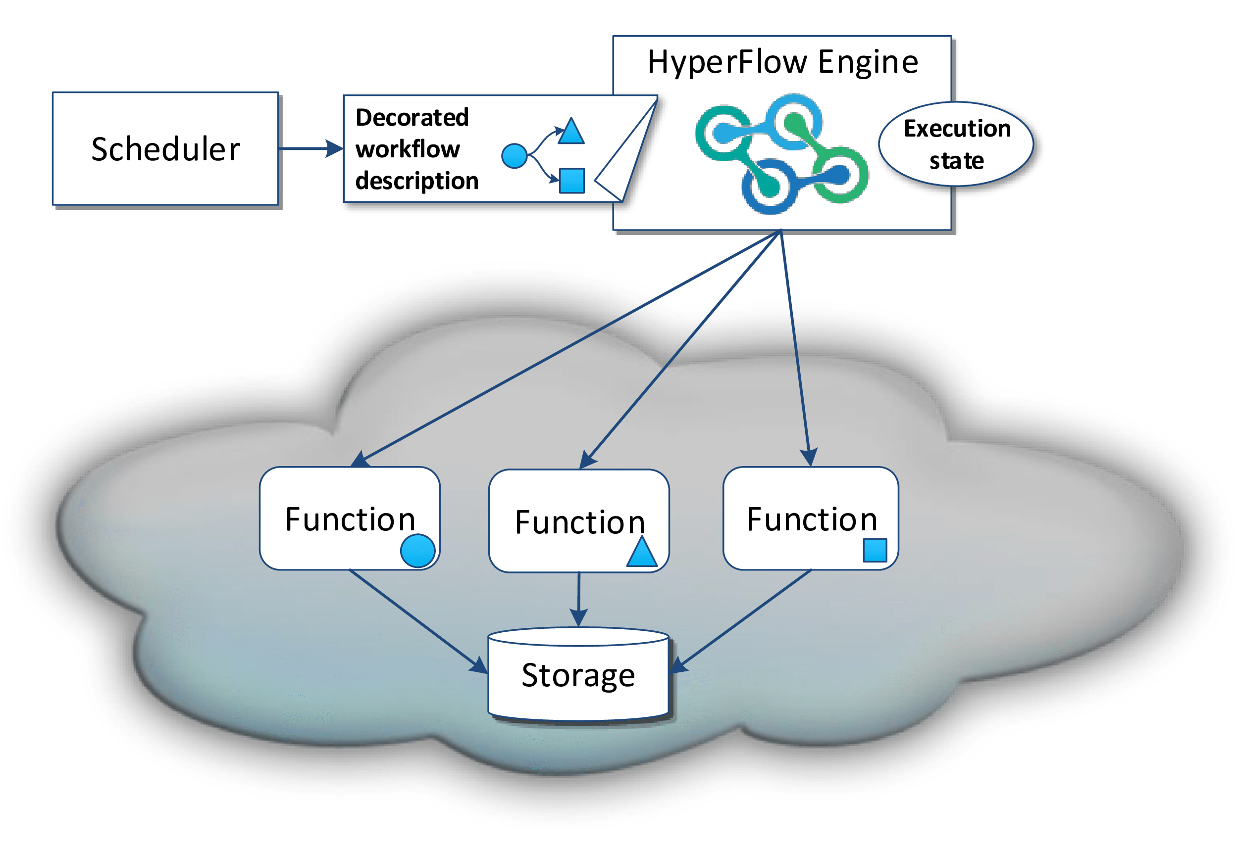
Scheduling and execution model
HyperFlow on Serverless:
AWS, Google, IBM
Benchmarking of cloud functions:
AWS, Google, Azure, IBM
Future work:
MEE + Containers + Serverless = HPC FaaS
Cloud Marketplace for BioMed Functions (VPH-Share 2.0?)
?
M. Malawski, A. Gajek, A. Zima, and K. Figiela. Serverless execution of scientific workflows: Experiments with hyperflow, aws lambda and google cloud functions, FGCS 2018
K. Figiela, A. Gajek, A. Zima, B. Obrok, M. Malawski: "Performance Evaluation of Heterogeneous Cloud Functions", Concurrency and Computation Practice Experience, 2018
http://cloud-functions.icsr.agh.edu.pl/
Notes:
Jak się taski komunikują między sobą - poprzez S3

Slide 29
Summary
We observe an evolution:
physical computer
cloud - relatively heavy solution
containers - much lighter than cloud
serverless
serverless containers, e.g. AWS Fargate, Google Serverless Containers
It should be useful (elastic) for 4 classes of users
Consequences of increasing number of abstraction layers

Slide 30





http://dice.cyfronet.pl https://www.primageproject.eu/ http://www.process-project.eu http://www.eurvalve.eu http://www.vph-share.eu

