Slide 1






ACC Cyfronet AGH, Krakow, PL
Distributed Computing Environments Team in PRIMAGE
Marian Bubak | ACC Cyfronet AGH
19-20/12/2018
http://dice.cyfronet.pl/
H2020 EU PROJECT | Topic SC1-DTH-07-2018 | GA: 826494

Slide 2

AGH University of Science and Technology
One of the top technical universities in Poland
Established in 1913 (re-established in 1919)
16 faculties, 36 000 students; 4 000 employees
Main research areas:
Information Technology
New Materials and Technologies
Environmental and Climate Change
Energy and its Sources
Exact and Natural Sciences
Socio-Economic Sciences and Humanities
Electrical and Mechanical Engineering in Mining
Main source of skilled knowledge workers for Kraków and Małopolska
http://www.agh.edu.pl/en

Slide 3
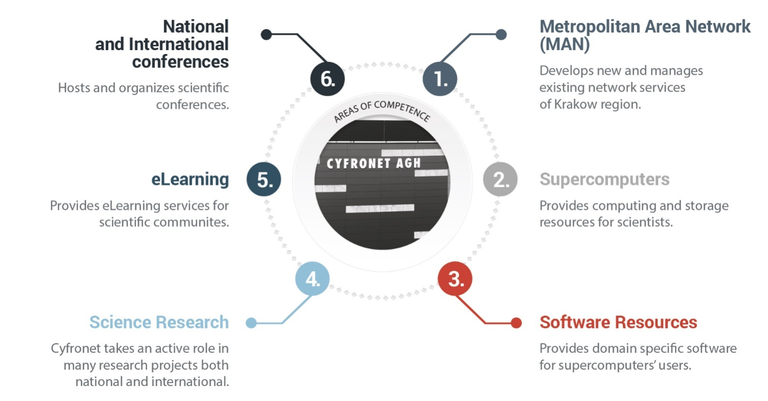
ACC Cyfronet AGH
The largest Academic Computer Centre in Poland; established in 1973
45 years of experience in IT provisioning for scientific communities
Autonomous entity of the AGH University of Science and Technology
Staff: about 150 (incl. 60 R&D staff)
Leader of PLGrid: Polish Grid and Cloud Infrastructure for Science
http://www.cyfronet.krakow.pl/en/

Slide 4










PLGrid Infrastructure
>7 000 users, all five Polish academic HPC centres integrated
Synergy between domain-specific researchers and IT experts
Computing resources
5+ PFLOPS
130 000+ cores
Scientific Software
750+ applications, tools, libraries
http://apps.plgrid.pl
Storage
60+ PB
archives
backups
distributed access
fast scratch filesystems
Tools for collaboration
project management (JIRA)
version control (Git)
teleconferencing (Adobe Connect)
Computational Cloud
(PaaS based on OpenStack)

Slide 5



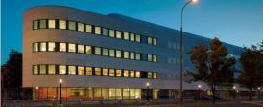

DICE Team – area of research
Investigation of methods for complex scientific collaborative applications
Elaboration of environments and tools for eScience
Integration of large-scale distributed computing infrastructures
Knowledge-based approach to services, components, and their composition
AGH University of Science and Technology (1919)
16 faculties, 36 000 students, 4 000 employees
http://www.agh.edu.pl/en
Academic Computer Centre
CYFRONET AGH (1973)
150 employees
http://www.cyfronet.pl/en/
Faculty of Computer Science, Electronics and Telecommunications (2012)
2 000 students, 200 employees
http://www.iet.agh.edu.pl/
Other 15 faculties
http://dice.cyfronet.pl
Department of Computer Science AGH (1980)
1 000 students, 80 employees
http://www.ki.agh.edu.pl/uk/index.htm

Slide 6
DICE Team skillset – EU projects
Interactive compute- and data-intensive applications, knowledge-based workflow composition, programming models | CrossGrid, K-Wf Grid, CoreGRID | 2002-2008
Script-based composition of applications, GridSpace Virtual Laboratory | ViroLab, GREDIA | 2006-2009
Federating cloud resources for VPH compute- and data-intensive applications, DataNet – metadata models | VPH-Share, PL-Grid | 2009-2015
Common Information Space for early warning systems, big data storage and access, analysis tools | UrbanIFlood, ISMOP | 2009-2016
Computational strategies and services for distributed multiscale simulations | MAPPER | 2010-2013
Executable Papers; 1st prize in ICCS2011 competition; Elsevier project | Collage | 2011-2013
Optimization of workflow applications on cloud resources | PaaSage | 2013-2016
Infrastructure for large-scale simulations in medicine | EurValve | 2016-2019
Business plan of a Centre of Excellence for New Methods in Computational Diagnostics and Personalised Therapy (Teaming Phase 1) | CECM | 2017-2018
Computing solutions for exascale challenges | PROCESS | 2017-2020
http://dice.cyfronet.pl/; http://dice-cyfronet.github.io/#history

Slide 7
Cyfronet role by WP
# | WP | Our PM | Our Activities
2 | COMPUTING INFRASTRUCTURES | 31.5 | Leading T2.3 HPC resources for PRIMAGE simulations Leading T2.5 User interfaces and APIs Contribution to: T2.4 PRIMAGE middleware layer
3 | DATA REPOSITORIES | 10 | Contribution to: T3.4 Database for clinical data
5 | MULTISCALE MODELS | 9 | Leading T5.6 Integration with the HPC execution environment Contribution to: T5.5. Computational efficiency & scalability
1 | CLINICAL SCENARIOS AND USER REQUIREMENTS | 7 | Contribution to: T1.2 and T1.3
7 | PLATFORM INTEGRATION | 12 | Contribution to: T7.1 and T7.3
8 | CLINICAL VALIDATION | 4 | Contribution to: T8.5
9 | COMMUNICATION, DISSEMINATION AND EXPLOITATION PLAN | 7 | Contribution to: T9.1-T9.5
10 | PROJECT MANAGEMENT | 1 | Contribution to: T10.1-T10.4

Slide 8
Cyfronet role by deliverables
# | Deliverable | Title | Month due
1 | D2.1 | Description of available HPC resources, UI/API components access procedures | 2
2 | D2.4 | Deployment of an intermediate version of the Model Execution Environment | 24
3 | D2.6 | Deployment of the final, refined version of the Model Execution Environment | 36

Slide 9
Cyfronet: Personnel and roles
# | Key Person | Role | Activities
1 | Marian Bubak | Coordinator of PRIMAGE at Cyfronet 10.1-10.4; 9.1-9.5 | Coordination of research and development activities. Timely initiation, steering and verifying of reporting. Compiling the mid-term and final progress report. Authoring and co-authoring of publications.
2 | Marek Kasztelnik | Task leader: 2.5, 5.6 | Contributing to project architecture definition; coordinating daily development activities at Cyfronet; implementation of project components; authoring and co-authoring of publications.
3 | Tomasz Gubała | Task leader: 2.3; Active in 2.4, 5.5 | Contributing to project architecture definition; implementation of project components; authoring and co-authoring of publications.
4 | Jan Meizner | Active in 3.4 | Development activities and maintenance of hardware infrastructure at Cyfronet; authoring and co-authoring of publications.
5 | Piotr Nowakowski | Active in 7.1, 7.3 | Development activities related to integration of resources and middleware; authoring and co-authoring of publications.
6 | Maciej Malawski | Active in 1.2, 1.3, 8.5 | Quality and progress oversight; authoring and co-authoring of publications.

Slide 10
http://dice.cyfronet.pl/
Marian Bubak | bubak@agh.edu.pl

