Slide 1






T2.3 (M1-M48) HPC Resources for PRIMAGE Simulations
Marek Kasztelnik, Tomasz Gubała, Marian Bubak | Academic Computer Centre Cyfronet AGH, Kraków, Poland
12/12/2018
http://dice.cyfronet.pl/
H2020 EU PROJECT | Topic SC1-DTH-07-2018 | GA: 826494

Slide 2

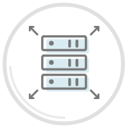










PLGrid Infrastructure
>7 000 users, all five Polish academic HPC centres integrated
Synergy between domain-specific researchers and IT experts
Computing resources
5+ PFLOPS
130 000+ cores
Scientific Software
500+ applications, tools, libraries
http://apps.plgrid.pl
Storage
60+ PB
archives
backups
distributed access
fast scratch filesystem
Tools for collaboration
project tracking (JIRA)
version control (Git)
teleconferencing (Adobe Connect)
Computational Cloud
(PaaS based on OpenStack)

Slide 3
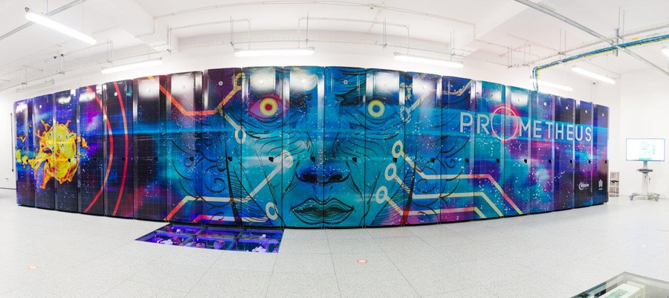
Primary HPC Resources for PRIMAGE
Prometheus cluster (fair-shared with other users)
Available though PL-Grid (Polish Grid Infrastructure)
2.4 PFlops computing power, 10 PB of disk, 282 TB of memory, Infiniband FDR 56 Gb/s
2160 regular nodes (24 Xeon 2.5 GHz cores, 128 GB RAM)
72 GPGPU nodes (24 Xeon 2.5 GHz cores, 128 GB RAM, 2 Nvidia K40 XL cards)
3 BigMem nodes (12 Xeon 3.4 GHz cores, 768 or 1536 GB RAM)
A lot of software modules and licenses (e.g. Ansys, Matlab):
Module/package browser available at: https://apps.plgrid.pl/
Possibility to set up dedicated license server if PRIMAGE acquires additional, dedicated licences
PLGrid-provided licences are available on the fair-share use basis
Support for MPI, Singularity and RSM (Ansys)

Slide 4
HPC Resources: Procedure
Procedure and requirements
PRIMAGE users who want to use HPC need to register in PLGrid Infrastructure (https://portal.plgrid.pl/)
User manual: https://docs.cyfronet.pl/display/PLGDoc/User+Manual
Exact instructions on how to affiliate oneself inside PLGrid will be provided by Cyfronet
PRIMAGE project needs to negotiate a computing grant (number of CPU hours, storage, etc.)
Cyfronet will do it, but first we need to learn:
Your approximate CPU/disk consumption requirements in the first PRIMAGE year
Any special requirements? (GPGPUs, BigMem jobs, or jobs expected to execute longer than 72h)
Negotiated annually, can be renewed and/or extended if we run out of resources
All published PRIMAGE research supported by such computational grant should be co-authored by Cyfronet
Basic mode of use: SSH and Slurm (queuing system) for submitting jobs
Manual: https://kdm.cyfronet.pl/portal/Prometheus:Podstawy (in PL only, apologies)
Advanced modes, UIs and APIs: in the following presentation (T2.5)
All on-cluster data are accessible only to members of the PRIMAGE
A dedicated PLGrid group (plggprimage) was setup and we control who belongs to it
Group storage separation is secured with on the OS/POSIX file access rights level

Slide 5
http://dice.cyfronet.pl/
Marek Kasztelnik | m.kasztelnik@cyfronet.pl

