Slide 1






T2.5 (M1-M48) (HPC) User Interfaces and APIs
Marek Kasztelnik, Tomasz Gubała, Marian Bubak | Academic Computer Centre Cyfronet AGH, Kraków, Poland
12/12/2018
http://dice.cyfronet.pl/
H2020 EU PROJECT | Topic SC1-DTH-07-2018 | GA: 826494

Slide 2
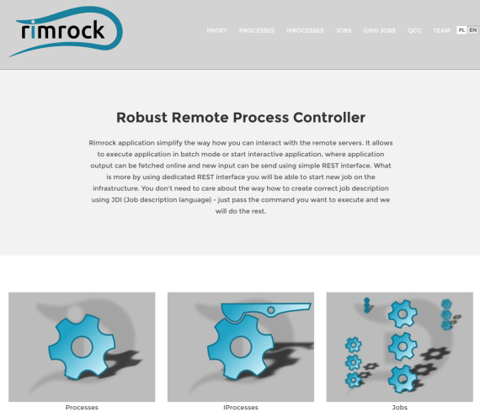
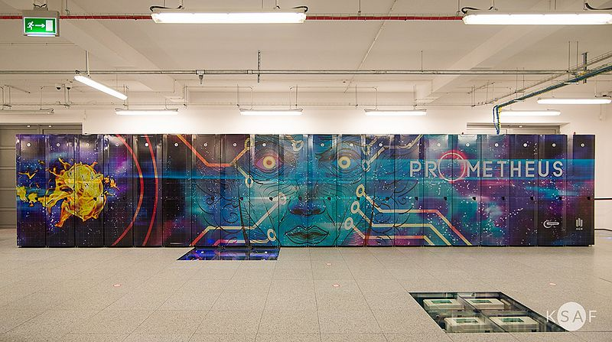
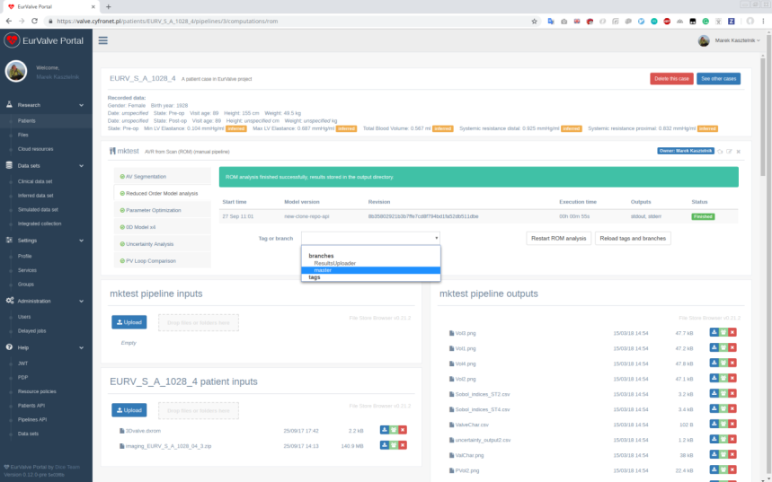
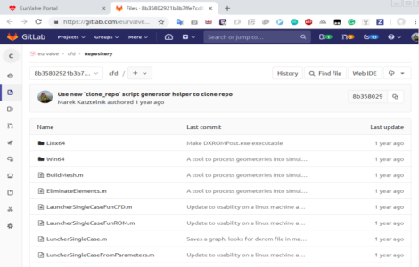
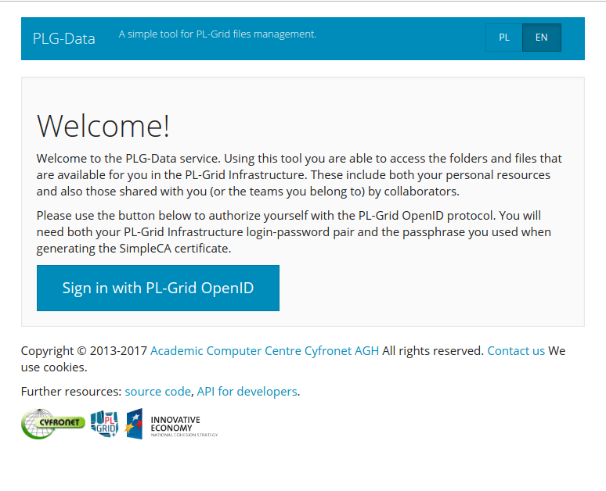

T2.5 User Interfaces and APIs
Goal: run models on HPC, browse models, inputs and outputs
5 main elements:
Infrastructure -> Prometheus (T2.3)
Run jobs on Prometheus using a REST API -> Rimrock (https://submit.plgrid.pl)
Manage data stored on Prometheus using Web and/or a REST API -> PLGData (https://data.plgrid.pl)
Models repository and versioning -> GitLab
Organize model execution on patient data -> Model Execution Environment (MEE)
2
1
5
4
3

Slide 3
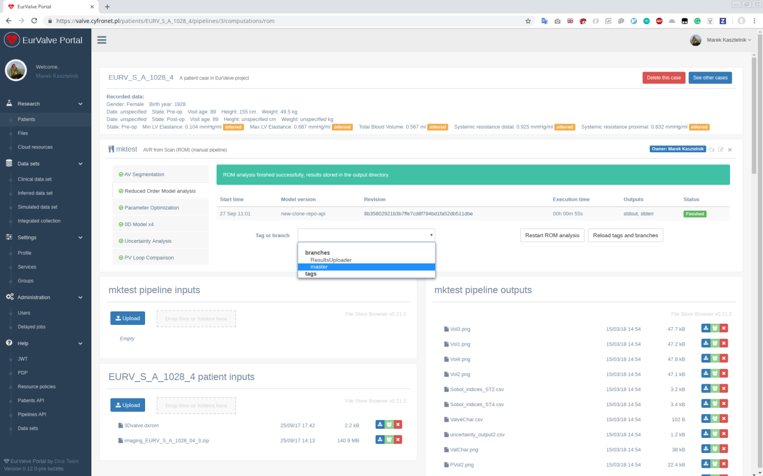
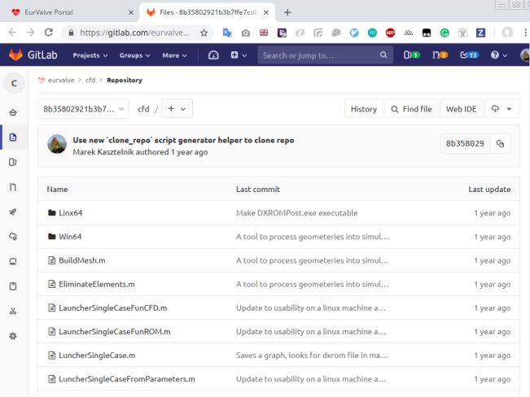
T2.5 Model Execution Environment
Organize research on patient data
Integrated with PLGrid infrastructure (automatic execution on the HPC cluster and data management)
Give possibilities to upload and download files to/from Prometheus storage
But can be integrated for PRIMAGE with other file storage infrastructure (cloud)
Connected with GitLab repositories for model versioning
Simulations are organised in pipelines (more on them in the WP5 presentation)
Patient and relevant clinical data
Run
Browse inputs
and outputs
Select model version

Slide 4
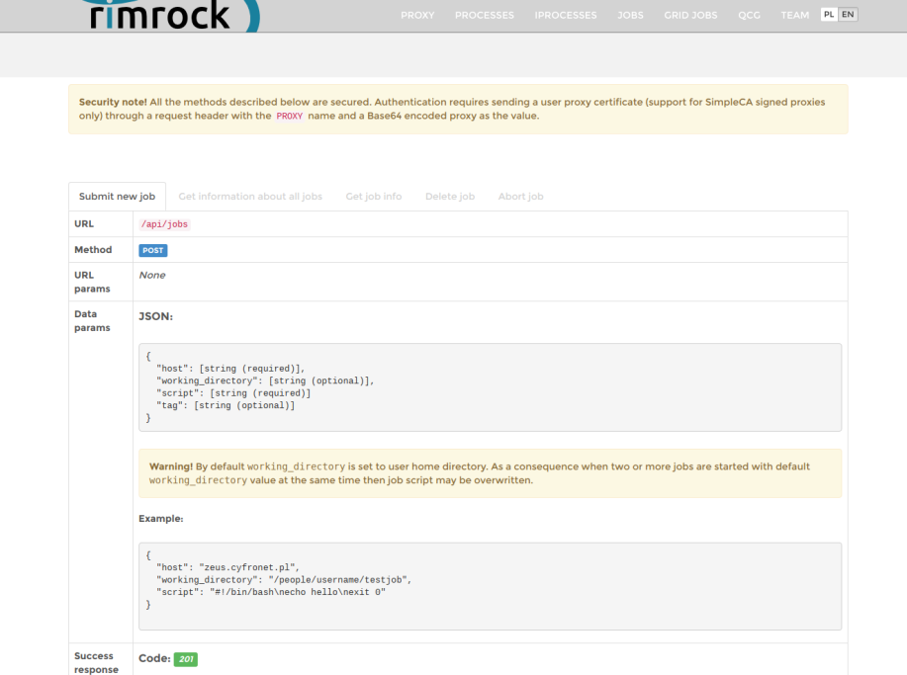
T2.5 Rimrock – Robust Remote Process Controller
Submit Prometheus Computations using REST API
Possibility to submit and monitor Slurm jobs executing on the Prometheus supercomputer using a REST API
Secured by PLGrid authentication and authorisation framework
Example - submit a job to Prometheus using the curl tool:
proxy="`cat {path-to-proxy-file} | base64 | tr -d '\n'`“
curl -k -X POST --data '{"host":"prometheus.cyfronet.pl", "script":"#!/bin/bash\n#SBATCH -A {grantid}\n echo hello\n exit 0"}' \--header "Content-Type:application/json" --header "PROXY:$proxy" https://submit.plgrid.pl/api/jobs
In PRIMAGE the MEE environment will do this on your behalf

Slide 5
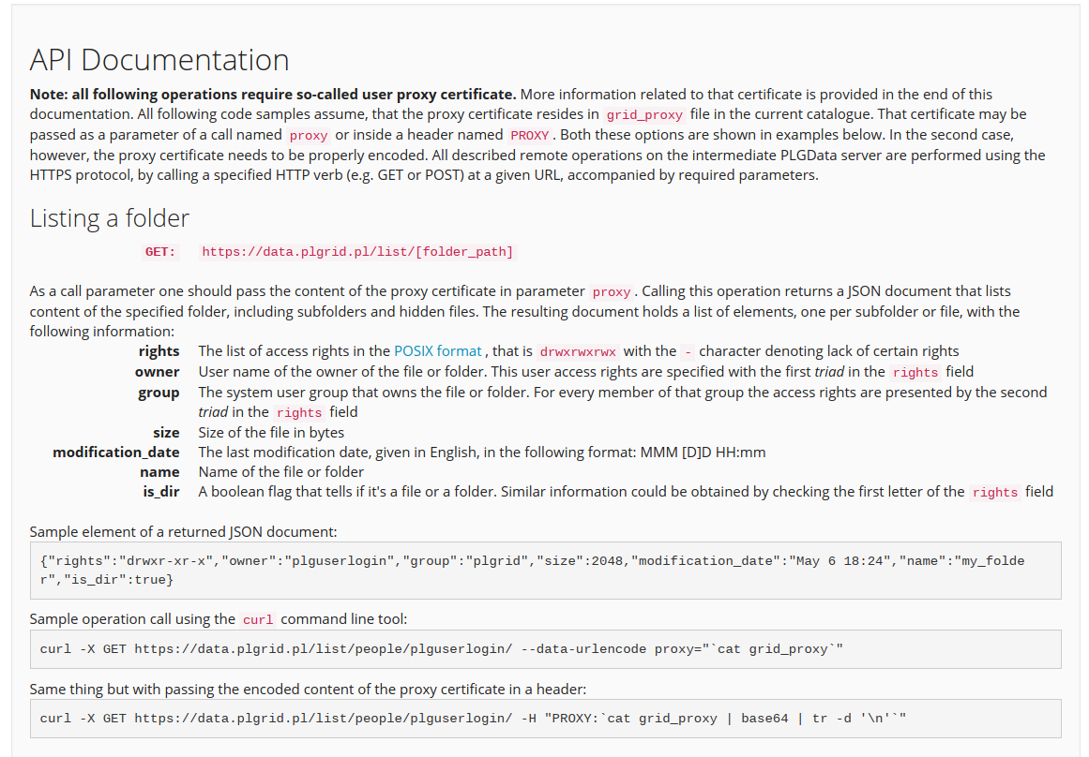
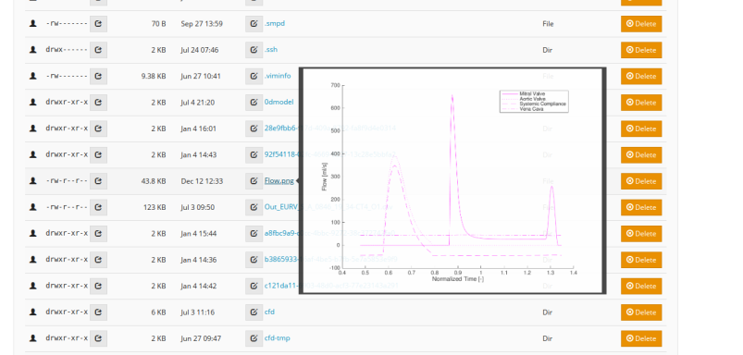
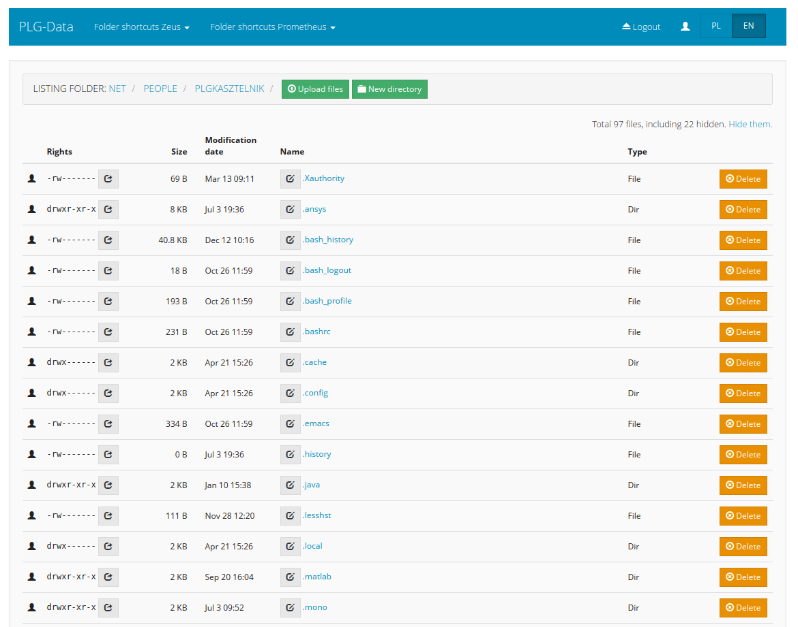
T2.5 PLGData – Browse Prometheus files
Prometheus web file browser and a REST API
Possibility to create, delete, rename and change access rights to files on the HPC cluster file system using a Web UI and a REST API
Secured by PLGrid authentication and authorisation framework
Example - download a file from Prometheus:
curl -X GET https://data.plgrid.pl/download/people/plguserlogin/graph.png --data-urlencode proxy="`cat grid_proxy`"

Slide 6
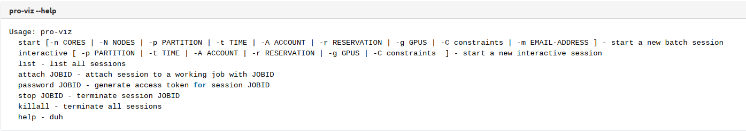
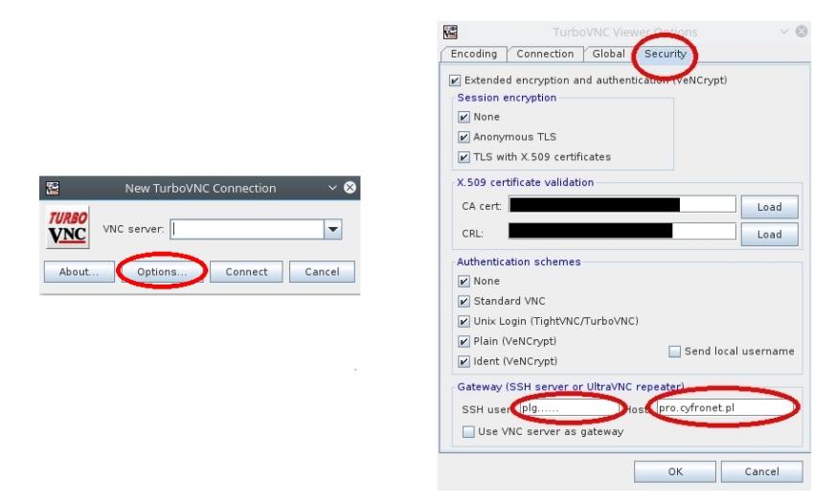
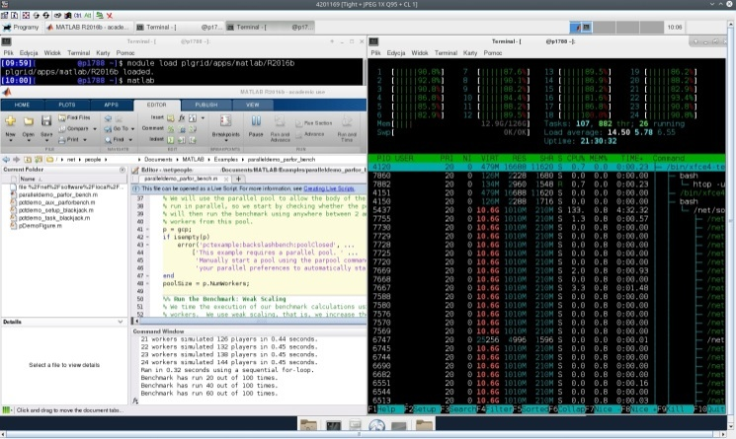
T2.5 Graphical User Interface for Prometheus Jobs
Additional Option: using a GUI inside a running Prometheus job
Prometheus supports starting Graphical User Interfaces from inside of a running Slurm job (e.g. Matlab UI or Ansys RSM):
Load the “pro-viz”module
Start a new job using “pro-viz” command (not supported yet by Rimrock)
Use VNC to start Graphical User Interface on job resources
Supported applications:
Ansys RSM
Ansys Electronic Desktop (Maxwell)
Matlab
Mathematica

Slide 7
http://dice.cyfronet.pl/
Marek Kasztelnik | m.kasztelnik@cyfronet.pl

