Slide 1









T5.6 (M13-M48) Integration with the HPC Execution Environment
Marek Kasztelnik, Tomasz Gubała, Marian Bubak | Academic Computer Centre Cyfronet AGH, Kraków, Poland
12/12/2018
H2020 EU PROJECT | Topic SC1-DTH-07-2018 | GA: 826494

Slide 2

T5.6 Vision
Organize research on patient data
Our goal is to deliver a set of tools (integrated with Prometheus and PLGrid Infrastructure) and best practices to execute patient-centric calculations in a structured and well organized way
This asks for
Model versioning
Structured, patient-centric storage for input and output data (both file based and tabular data)
Organized, repeatable set of calculations which recognize particular model versions
Proposed solution
Pipelining system – each pipeline is a well-defined set of computations (running sequentially or in parallel)
Pipeline definitions are cross-cohort, but particular pipeline execution is per patient
Each computation (called a pipeline step) inside a pipeline is e.g. an execution, on the HPC cluster, of a specific model, in a specific version (selected from the GitLab git repository)
The dedicated GitLab repository will be prepared for PRIMAGE on the gitlab.com service
Pipelines can also be executed automatically provided input data constraints are satisfied
MEE provides a user interface and a REST API for running and monitoring pipelines
Input and output data browsing will be provided in cooperation with the data cloud partner

Slide 3
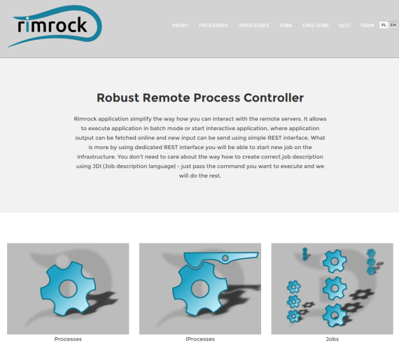
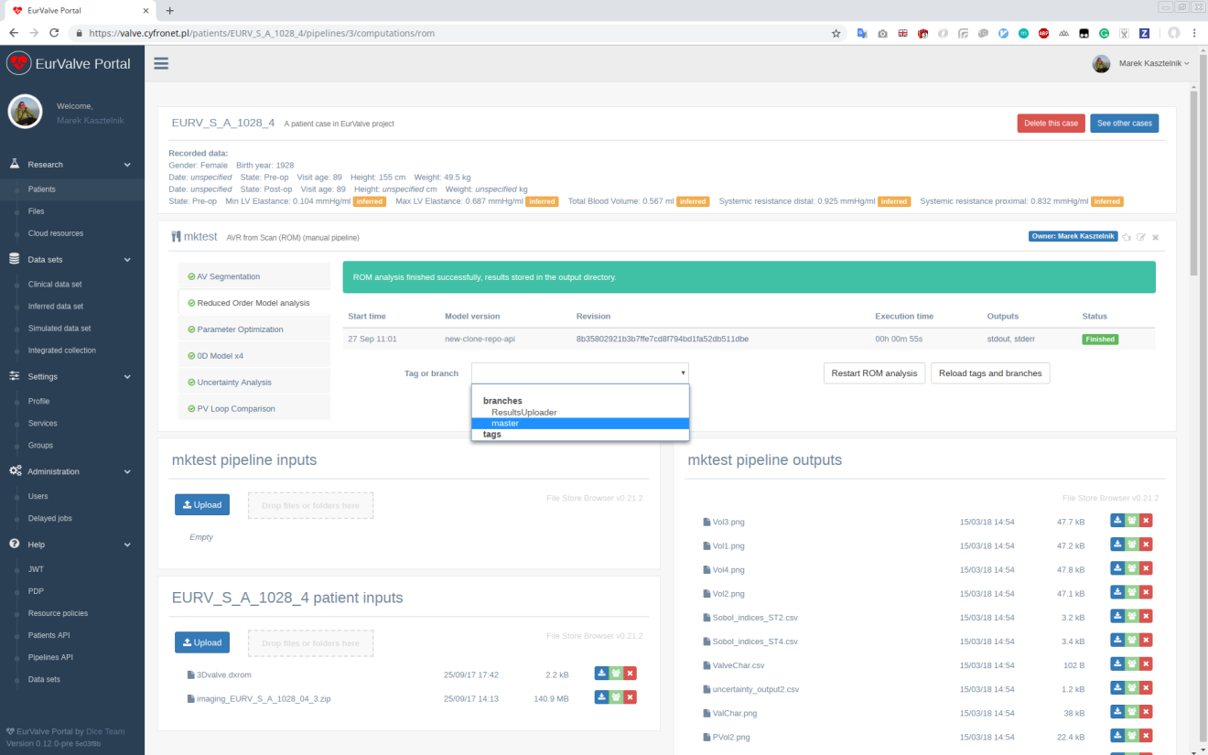
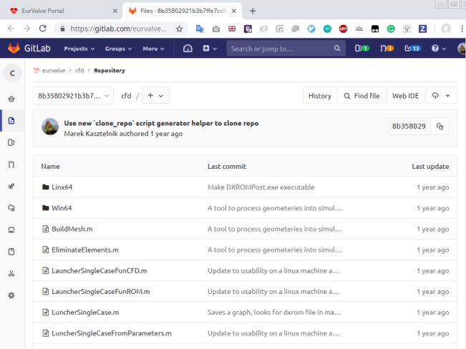
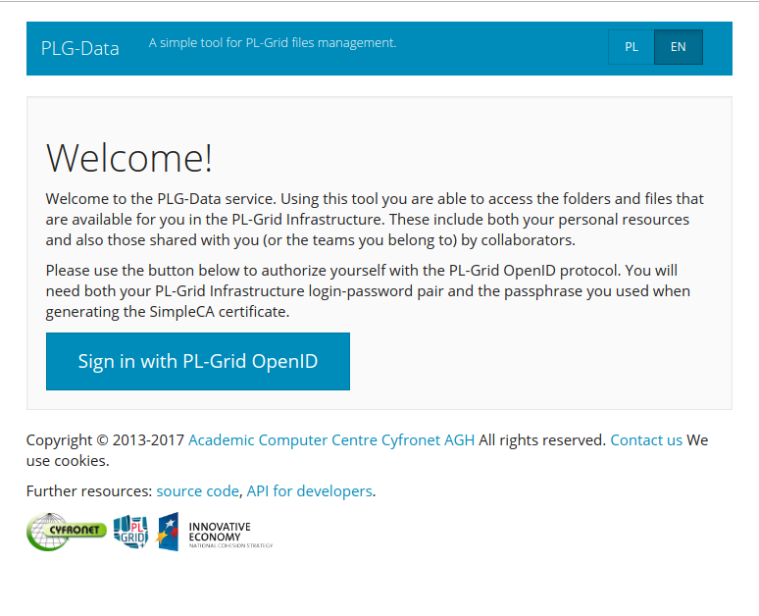
T5.6 Model Execution Environment
Organize research on patient data
Integrated with PLGrid infrastructure (automatic execution on the HPC cluster and data management)
Give possibilities to upload and download files to/from Prometheus storage
But can be integrated for PRIMAGE with other file storage infrastructure (cloud)
Connected with GitLab repositories for model versioning
Simulations are organised in pipelines (more on them in the WP5 presentation)
Patient and relevant clinical data
Run
Browse inputs
and outputs
Select model version

Slide 4
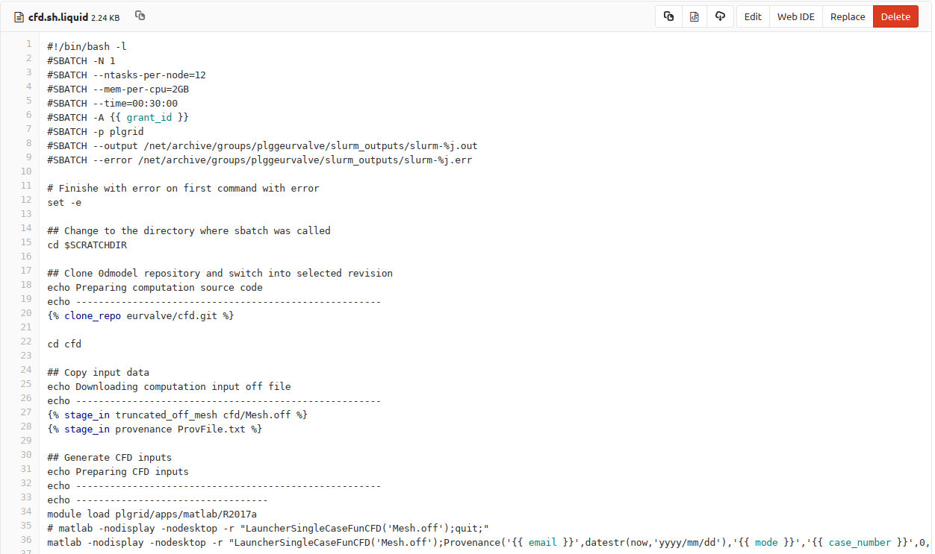
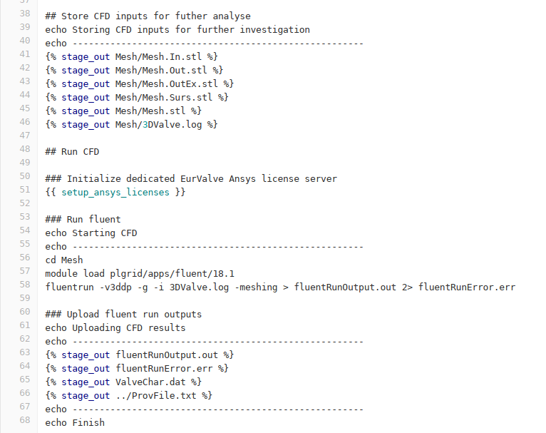
T5.6 Pipeline Step (Computation)
HPC Computation Execution Template
MEE will insert important data (grant_id, email…) and will provide useful helpers (stage_in, stage_out, clone_repo…)
for a computation script.
0. Job resources specification
4. Upload results
1. Get model with in selected version
2. Get pipeline input data
3. Run model

Slide 5
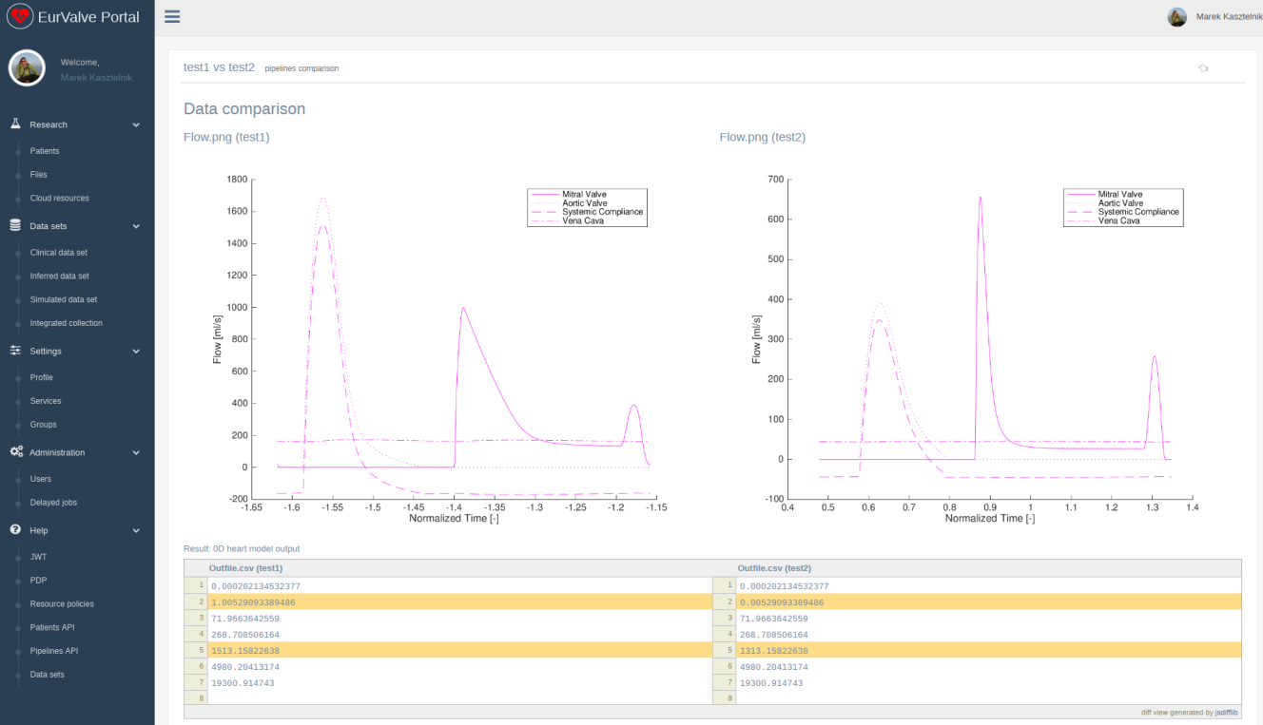
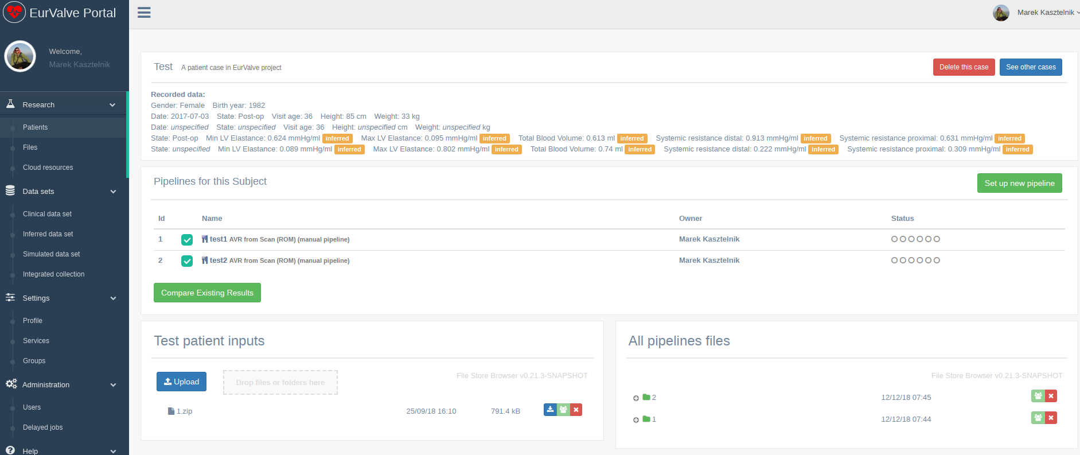
T5.6 How Cyfronet will help in WP5?
Integration
User registration in PLGrid, activation of the HPC cluster access, PRIMAGE HPC group management
Negotiation and management of suitable annual computational grants with the PLGrid operations centre
Support for Model Execution Environment (MEE), Rimrock, PLGdata, and all required PRIMAGE-specific integrations
Assistance for PRIMAGE users with submitting jobs using Slurm
MEE integration with cloud databases (jobs submitted to Prometheus should fetch data from external services)
Setup of GitLab model repositories
Configuration of PRIMAGE dedicated pipelines in MEE
Compare two pipelines results
MEE functionality sample: comparing side-by-side outputs of two pipeline executions (with e.g. different model versions)

Slide 6
http://dice.cyfronet.pl/
Marek Kasztelnik | m.kasztelnik@cyfronet.pl

