Slide 1

Running application on HPC with Model Execution Environment
Presenter: Marek Kasztelnik
(Cyfronet)

Slide 2


T 5.6: Integration with HPC - 𝅘𝅥𝅮 The road so far 𝅘𝅥𝅮
PRIMAGE PLGrid group created with dedicated storage
primage1 CPU computation grant (valid from 23.06.2019 to 24.06.2020)
primage1gpu GPU computation grant (valid from 21.07.2019 to 22.07.2020)
MEE beta released at the end of 2019
MEE demos:
During Valencia consortium meeting: run computation pipeline on patient data: https://www.youtube.com/watch?v=NU2wSQFVI1g
Yesterday we presented how organization management looks like in Model Execution Environment: https://youtu.be/VfQoQhx26Y0
PRIMAGE Project – GA: 826494

Slide 3
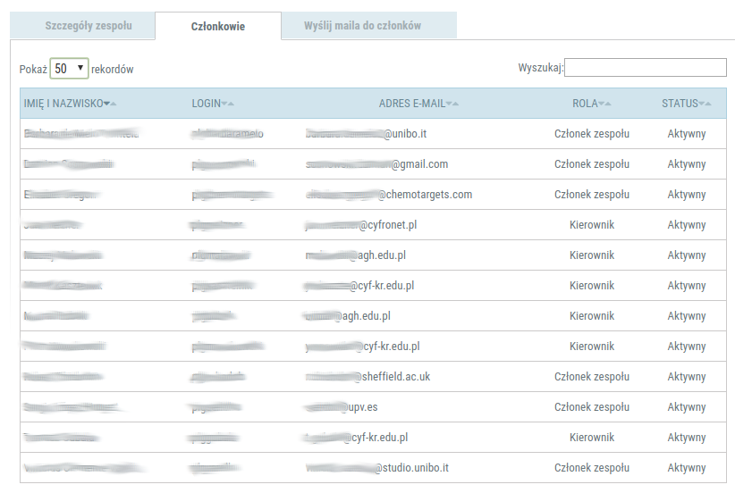
T 5.6: PLGrid PRIMAGE group
Statistics:
Cyfronet - 7 members
Unibo - 2 members
Chemotargets - 1 member
Sheffield - 1 member
PRIMAGE Project – GA: 826494

Slide 4
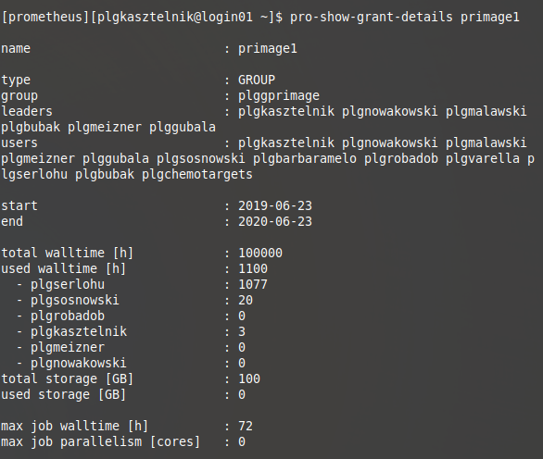
T 5.6: PLGrid primage1 grant usage
Statistics:
Grant usage 1.1%
Most active organization: UPV (Sergio experiments during his internship in Kraków)
This grant will end at 23.06.2020. We need information what are your needs for the next year
PRIMAGE Project – GA: 826494

Slide 5
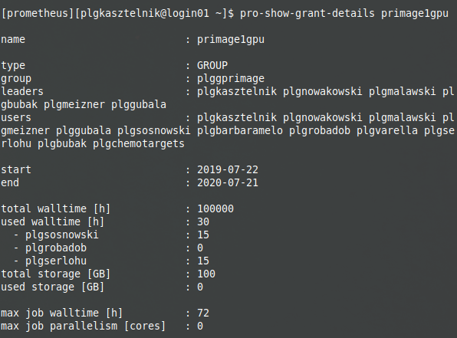
T 5.6: PLGrid primage1gpu grant usage
Statistics:
Grant usage 0.03%
Most active organization: UPV (Sergio experiments during his internship in Kraków)
This grant will end at 21.07.2020. We need information what are your needs for the next year
PRIMAGE Project – GA: 826494

Slide 6
T 5.6: Integration with HPC - goal
Organize research on patient data
Our goal is to deliver a set of tools (integrated with Prometheus and PLGrid Infrastructure) and best practices to execute patient-centric calculations in a structured and well organized way
This asks for
Model versioning
Structured, patient-centric storage for input and output data (both file based and tabular data)
Organized, repeatable set of calculations which recognize particular model versions
Proposed solution
Pipelining system – each pipeline is a well-defined set of computations (running sequentially or in parallel)
Pipeline definitions are cross-cohort, but particular pipeline execution is per patient
Each computation (called a pipeline step) inside a pipeline is e.g. an execution, on the HPC cluster, of a specific model, in a specific version (selected from the GitLab git repository)
Pipelines can also be executed automatically provided input data constraints are satisfied
MEE provides a user interface and a REST API for running and monitoring pipelines
PRIMAGE Project – GA: 826494

Slide 7
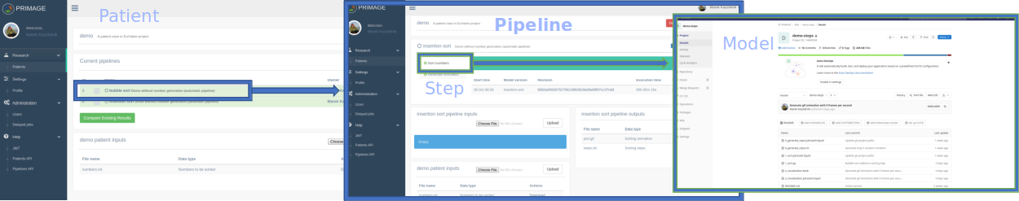
T 5.6: Integration with HPC - Model Execution Environment
Model Execution Environment - quick recap:
It is integrated with PLGrid storage
Uses computation grant negotiated for PRIMAGE project
Easy input/output upload/download to/from Prometheus supercomputer
One click start of the calculations on Prometheus supercomputer
Easy job status monitoring (no need to ssh to the cluster)
Calculation scripts are versioned and stored in https://gitlab.com
Preliminary version of result comparison tool
PRIMAGE Project – GA: 826494

Slide 8
T 5.6: Plans
Collaboration with Sheffield to run their model on Prometheus
Integrate Sheffield model with MEE
Collaboration with Ansys to setup Ansys license server for the PRIMAGE project
Negotiate new CPU and GPU grants for the PRIMAGE project according to reported needs
Collaboration with UNIBO to run multiscale orchestrator on Prometheus
PRIMAGE Project – GA: 826494

