Slide 1

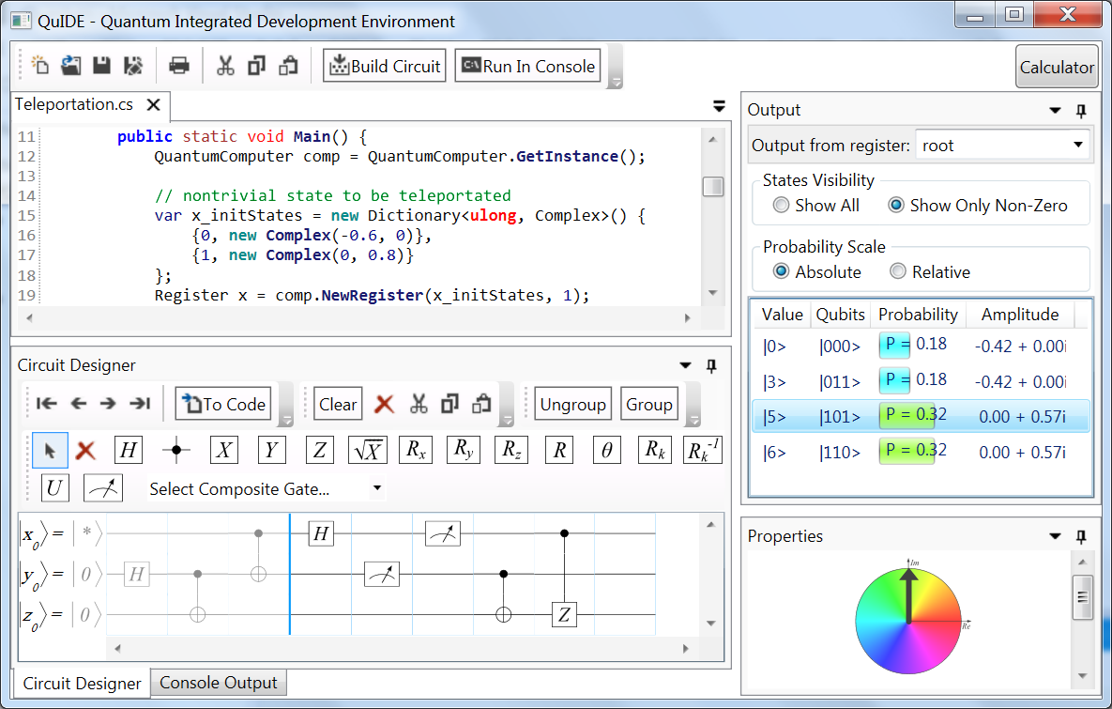
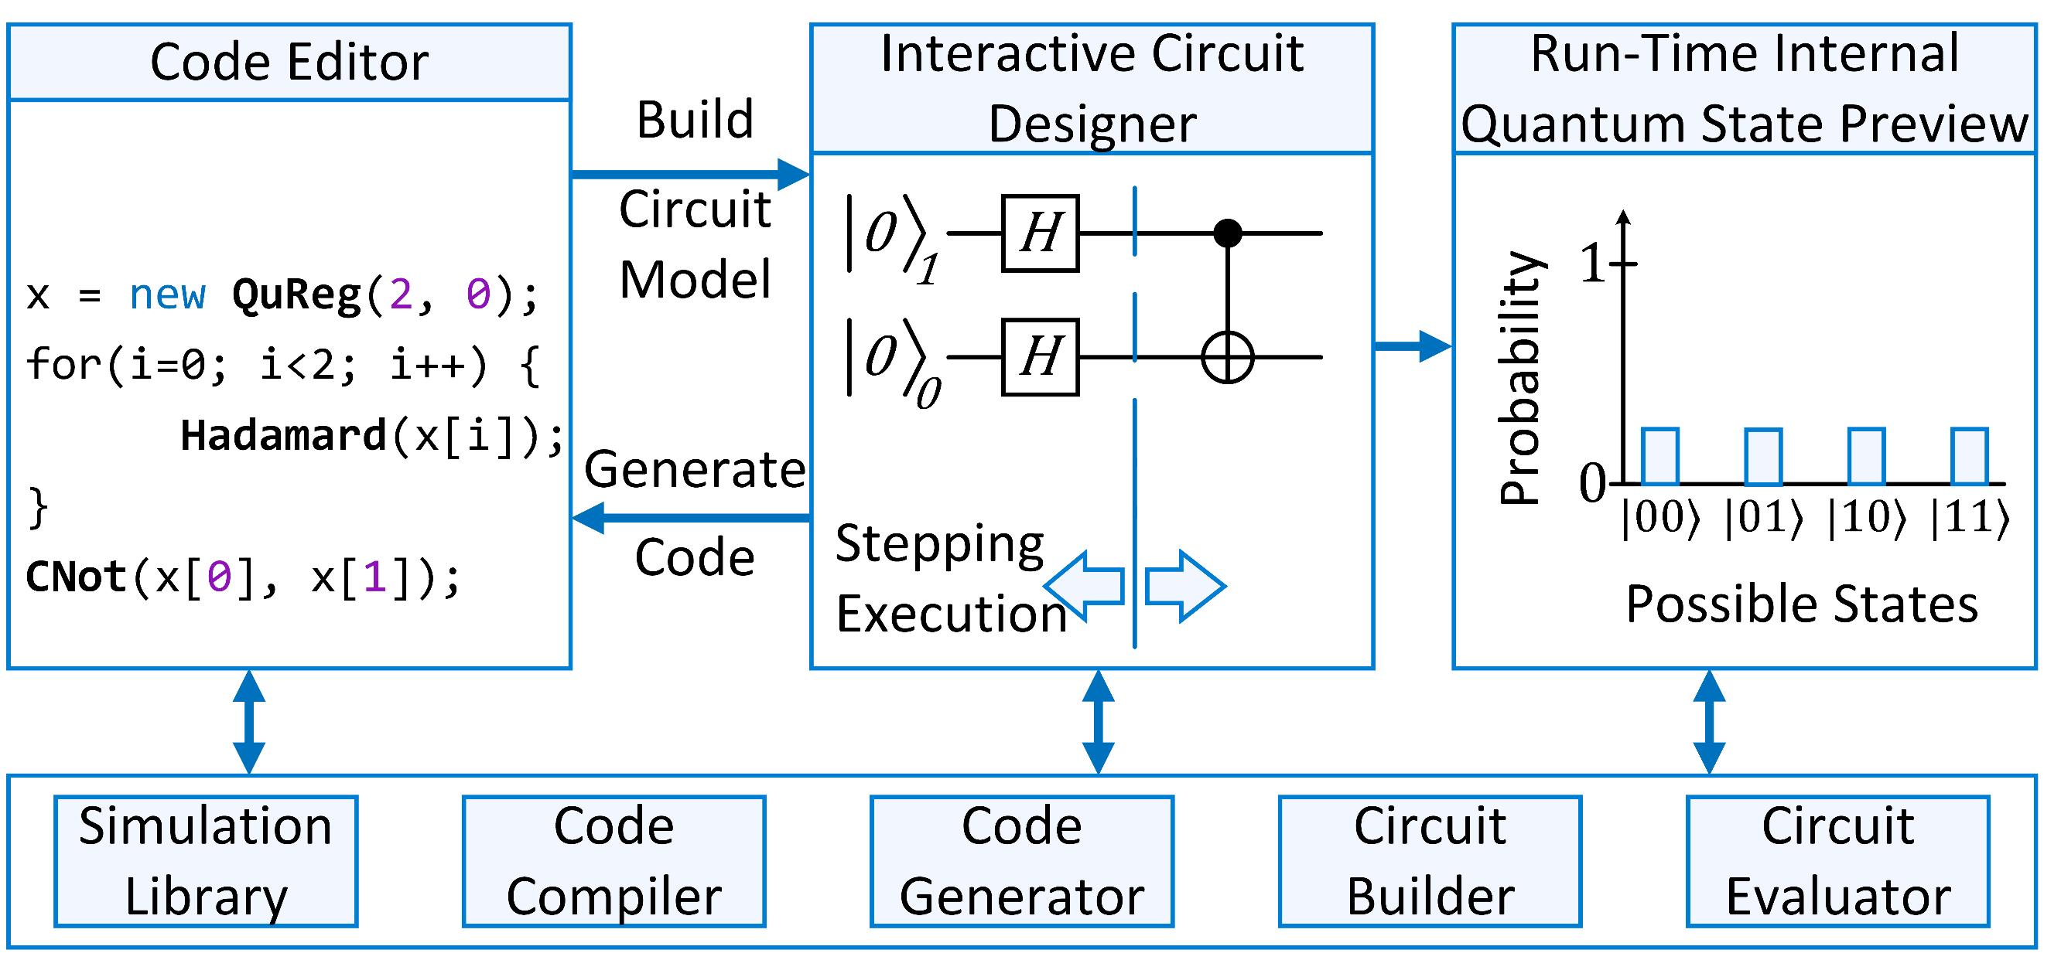
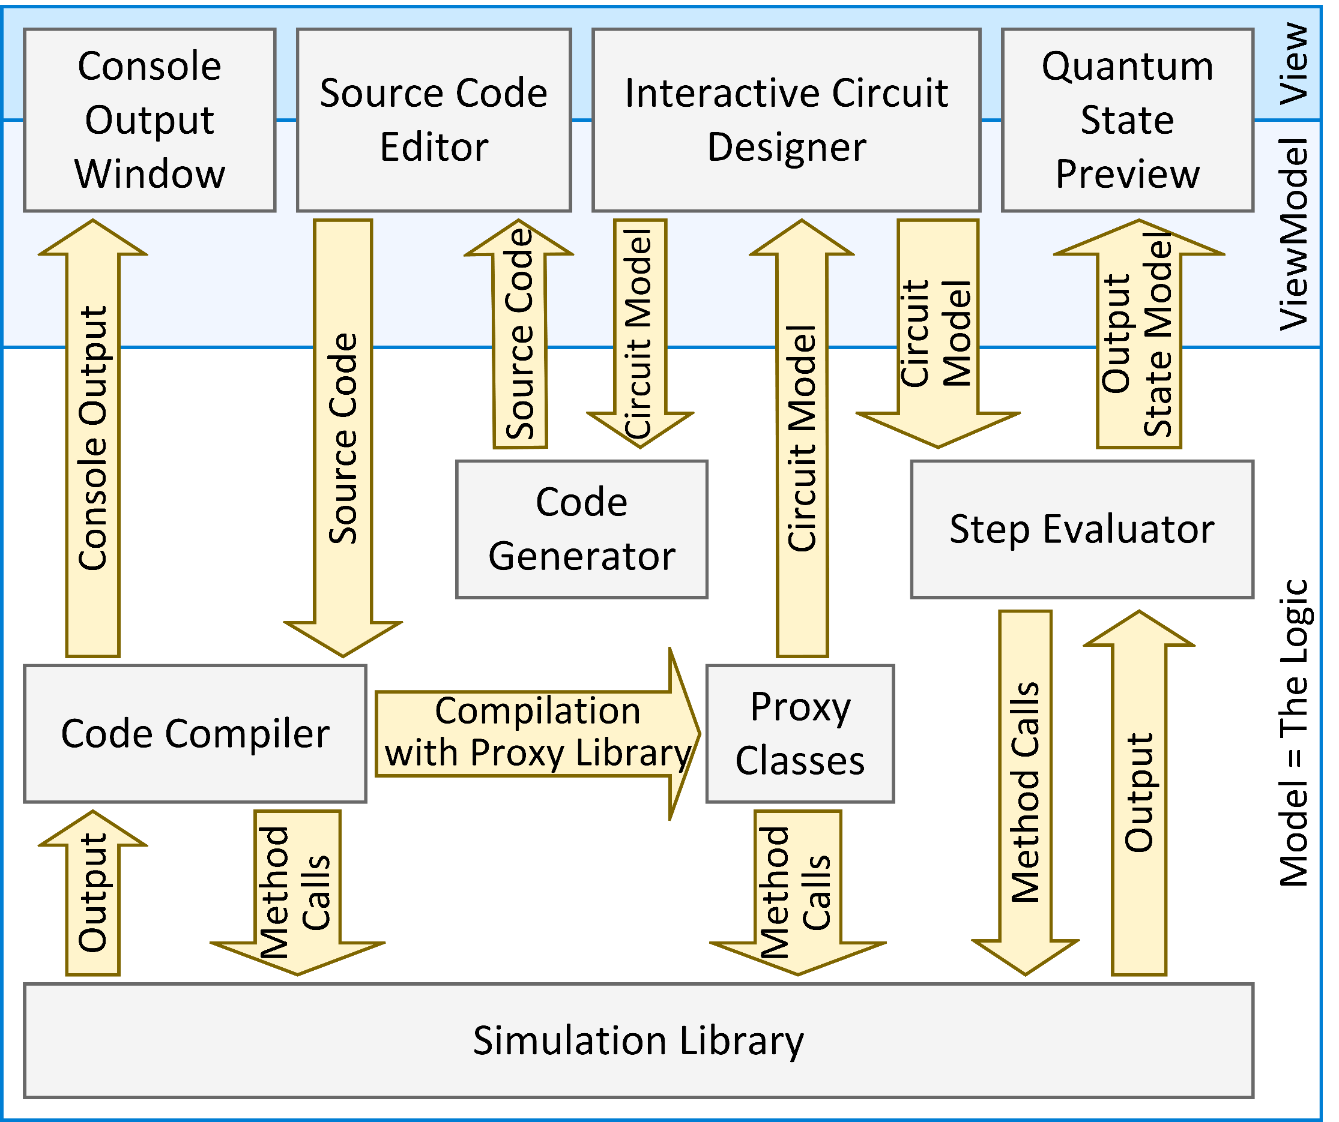




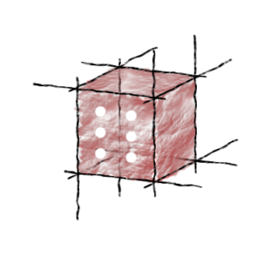

A Novel Environment for Simulation of Quantum Computing
Joanna Patrzyk (1), Bartłomiej Patrzyk (1), Katarzyna Rycerz (1,2), Marian Bubak (1,2,3)
AGH University of Science and Technology, Institute of Computer Science AGH, Department of Computer Science, al. Mickiewicza 30, 30-059 Kraków, Poland
ACC Cyfronet AGH, Nawojki 11, 30-950,Kraków, Poland
University of Amsterdam, Institute for Informatics, Faculty of Science, Science Park 904, 1098XH Amsterdam, The Netherlands
QuIDE – Quantum IDE
QuIDE User Interface
Building and analysing quantum circuits and algorithms via source code and graphically
step-by-step execution with the step back option
preview of the actual internal quantum state
1
2
Run-Time Preview of the internal quantum state
Source Code Editor
3
4
5
6
7
Architecture of QuIDE
Interactive Circuit Designer
Console Output Tab
users can generate the quantum circuit from the source code (1) as well as the source code from the circuit (4)
the quantum circuit can be executed in the console (2) or evaluated step-by-step in the Run-Time Preview (3)
the quantum gates in the circuit can be grouped into composite gates (6), which can be then ungrouped (5)
a big set of predefined composite gates is available (7)
Simulation of Shor’s Algorithm
QuIDE Performance
Shor’s Algorithm enables to factor numbers on quantum computer in polynomial time – it could thus compromise the RSA cryptosystem. Two optimization variants of the algorithm were implemented and compared.
10000
1000
100
10
1
0.1
Shor’s Algorithm
Step 1
Register Preparation
Step 2
Quantum Modular Exponentiation
Step 3
Quantum Fourier Transform
0 5 10 15 20 25 30
Implemented optimization variants:
1st Variant (7L + 3 qubits)*
2nd Variant (2L + 3 qubits)*
With Classical Adder
Standard QFT
With QFT Adder
Semiclassical QFT
QuIDE Usability Evaluation
*L – number of bits of factored number
Quantum Modular Exponentiation with QFT Adder and Semiclassical QFT with single control qubit
QuIDE was used during the Quantum Computation classes at DCS AGH
The students assessed the usability with the System Usability Scale
QuIDE was compared to libquantum
50.67
75.13
Official project website: http://www.quide.eu/
B. Patrzyk, J. Patrzyk, K. Rycerz, M. Bubak. Simulation of Shor’s algorithm optimization variants (in preparation)
P. W. Shor. Polynomial-time algorithms for prime factorization and discrete logarithms on a quantum computer. SIAM J. Comput., 26(5):1484–1509, October 1997. ISSN 0097-5397.
R. Feynman, P. W. Shor. Simulating physics with computers. SIAM Journal on Computing, 26:1484–1509, 1982.
This study was partly supported by the AGH grant no 11.11.230.124 and also by Domain-oriented services and resources of Polish Infrastructure for Supporting Computational Science in the European Research Space – PLGrid Plus project no POIG.02.03.00-00-096/10
INNOVATIVE ECONOMY
NATIONAL COHESION STRATEGY
The work was co-funded by the European Regional Development Fund as part of the Innovative Economy program.
http://dice.cyfronet.pl
EUROPEAN UNION
EUROPEAN REGIONAL
DEVELOPMENT FUND

