Slide 1

Security
in
Virtual Laboratory System
Master of Science Thesis
Jan Meizner
Supervisor: dr inż. Marian Bubak
Consultancy: dr inż. Maciej Malawski

Slide 2
Outline
ViroLab as an example of a virtual laboratory.
Motivation and goals.
Security related algorithms, standards, protocols and frameworks.
Threat model and requirements.
Security system architecture.
How ShibIdpCliClient works.
Validation and evaluation.
Conclusions and further work.

Slide 3
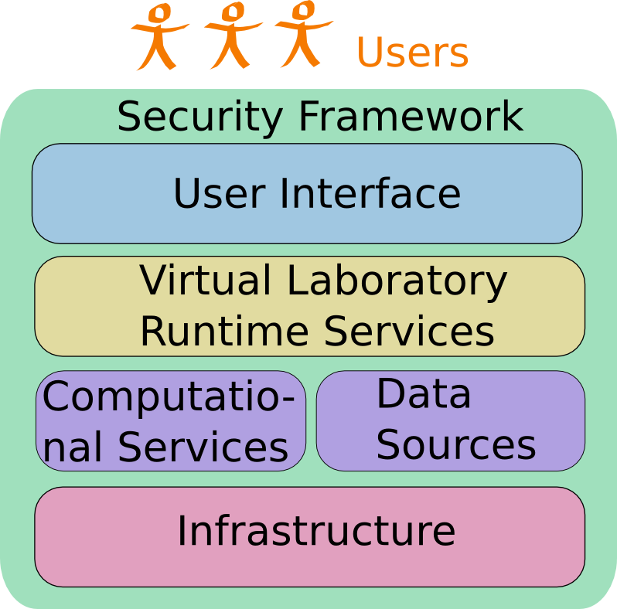
The ViroLab
Virtual laboratory – software enabling creating in-silco experiments.
Various types of users (computer scientists, virologists, doctors).
VL runtime system:
  uses computational services and data sources running on the Grid infrastructure,
  provides access via dedicated interfaces.

Slide 4
Motivation for the work
Necessity for complex federated security solution for the ViroLab.
Solution must be user-friendly.
Need for integration with external partners security components created for the Web part.
Requirement to adapt Shibboleth to make it feasible for non-Web solutions.

Slide 5
Goals
Analysis of existing security solutions and frameworks.
Identification of elements that might be useful in creation of the complete solution.
Creation of a formal threat model for the infrastructure.
Enumeration system requirements.
Discussion of the system architecture.
Design and implementation of following system components: ShibIdpClient, ShibIdpCliClient, MOCCA Shibboleth Authenticator, Policy Distribution Point (PDistP), its client and administrator panel.
Perform system validation and evaluation.

Slide 6
Algorithms, solutions and frameworks
Cryptographic algorithms: Symmetric (AES) and asymmetric (RSA) encryption, key-exchange (Diffie-Helman), cryptographic hashes (SHA1, SHA2), Keyed-Hash Message Authentication Code (HMAC-SHA1)
Standards and protocols: Public Key Infrastructure, Public-key certificates, Transport Layer Security, Security Assertion Markup Language
Frameworks: GSI (certificates based solution), Shibboleth (federated SSO and attribute based authorization provider), GridShib and ShibGrid (integration of GSI services with Shibboleth), OpenID (identity management solution)

Slide 7
Threat model
Security requirements – authentication, credential delegation, authorization, confidentiality, integrity, availability and non-repudiation.
Assets protected by the system: medical databases, users databases, experiments, results as well as computers and network resources.
Threats against the assets: databases theft or modification, using computational or network resources for criminal purposes (password cracking, network attacks like DDoS).
Possible attacks (like eavesdropping, man-in-the-middle, users passwords cracking, phishing or other social engineering techniques, pharming).

Slide 8
Chosen solution
As a predefined constraint solution must be compatible with Shibboleth.
It was decided that it is feasible to just adapt Shibboleth framework, without introducing other frameworks.
Adaptation required creation of following tools:
  ShibIdpClient and ShibIdpCliClient,
  Shib Authenticator for MOCCA/H2O,
  Policy Distribution Point for MOCCA.

Slide 9
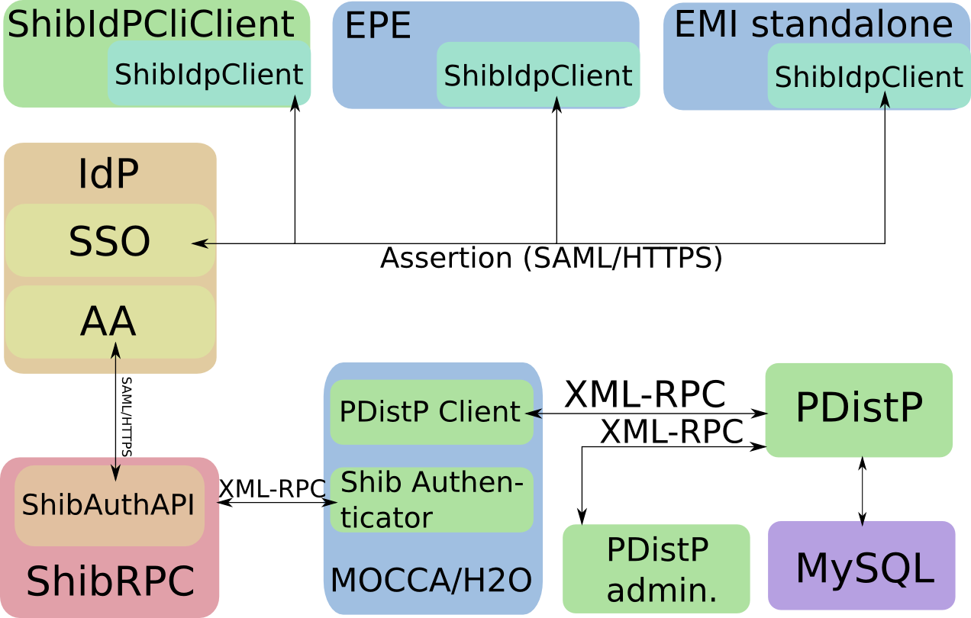
General architecture
IdP – Shibboleth Identity Provider consistent of Single Sign-On and Attributes Authority.
ShibIdpClient – allows handle acquisition.
Shib Authenticator – provides Shibboleth protected access to MOCCA/H2O.
PDistP – distributes local MOCCA policies.
Solution integrates custom elements with the IdP either directly using SAML protocol (ShibIdpClient) or indirectly through third party component (ShibAuthAPI/ShibRPC) using XML-RPC protocol (MOCCA/H2O authenticator)‏

Slide 10
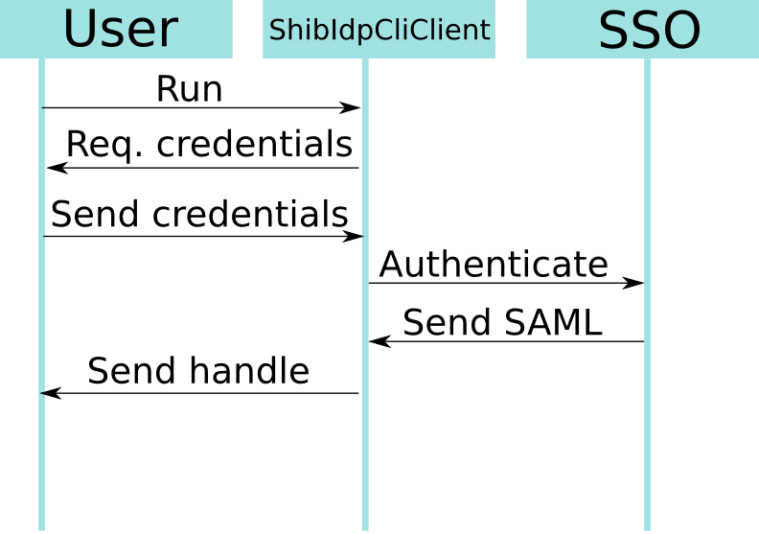
ShibIdpCliClient
1. Run - run the software.
2. Req. credentials – ask user for credentials.
3. Send credentials - user gives his/her credentials.
4. Authenticate - client authenticates to the SSO.
5. Send SAML - SSO sends back SAML.
6. Send handle - client extracts handle from the assertion.

Slide 11
System validation
Automatic security auditing has been performed on key system components:
  ShibIdpClient was provided with combinations of valid and invalid credentials and SSO certificates, only combination of valid credentials and certificate yielded proper handle,
  Shib Authenticator was provided with combinations of valid/invalid handles, and attributes trusted/untrusted by ShibRPC or MOCCA policies, just combination of valid handle for user with attributes trusted by both entities allowed access,
  Policy Distribution Point was validated by successfully verifying that authentication method would not accept invalid credentials and that authorization mechanism would prevent anyone to run restricted methods without valid Session ID identifying user with role appropriate for the method.

Slide 12
Performance evaluation
Test environment consists of two identical servers connected with LAN, that had following specification:
  CPU: 2xIntel Xeon 5150 (2.66 GHz)‏
  Physical RAM: 4 GB
  SWAP: 8 GB
  Connectivity: 1 GBit Ethernet

Slide 13
Performance evaluation
Each key component was evaluated:
  ShibIdpClient allows requesting handle valid for 8 hours in less then 1s
  MOCCA authenticator uses up about 700 ms to authorize the user
  Execution of remote PDistP method takes less then 100 ms
Those results are well within acceptance tolerance, especially taking into account complicated nature of this processes.

Slide 14
Validation of the Integration
Following components integration validation were successfully performed:
  ShibIdpClient with ShibIdpCliClient, EPE and standalone version of EMI
  MOCCA Authenticator with MOCCA/H2O
  Policy Distribution Point Client with MOCCA
  Policy Distribution Point with its client
  Policy Distribution Point with administrator panel.

Slide 15
Conclusions
Goals planned before creation of this work has been fully achieved:
  security solutions and frameworks (PKI, TLS, SAML,GSI, Shibboleth ShibGrid, GridShib and OpenID) were analyzed,
  elements that might be useful for creation of the complete solution were identified (direct Shibboleth use or using GridShib),
  formal threat model was created,
  system requirements were enumerated (including authentication, authorization, credential delegation, confidentiality, integrity, user friendliness and scalability),
  architecture of the system were discussed and described in the thesis and on this presentation,
  ShibIdpClient, ShibIdpCliClient, MOCCA Shibboleth Authenticator, PDistP, its client and administrator’s panel were designed and implemented,
  validation and evaluation have been performed.

Slide 16
Future work
The work will be continued to:
  augment solution with new functionality like fully automated method of updating ShibIdpClient trusted certificates and configuration,
  add support for newest third-party software (like Shibboleth 2.0),
  adapt the software to support security for VL part of the PL-Grid infrastructure.

Slide 17
Web Sites
http://www.virolab.org/
http://virolab.cyfronet.pl/
http://dcl.mathcs.emory.edu/h2o
http://mocca.icsr.agh.edu.pl/

