Slide 1

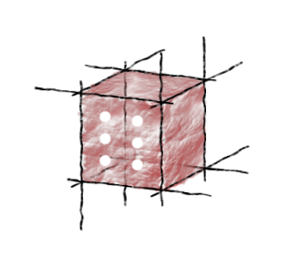


The Collage Authoring Environment: a Platform for Executable Publications
Piotr Nowakowski, Eryk Ciepiela, Tomasz Bartyński, Grzegorz Dyk, Daniel Harężlak, Marek Kasztelnik, Joanna Kocot, Maciej Malawski and Jan Meizner
ACC CYFRONET AGH
Kraków, Poland

Slide 2
Presentation outline
Problem description
Outline of our solution
Collage from the end user’s perspective
Conducting computational experiments
Declaring executable content
Embedding executable content in a research paper
Publishing and accessing the paper
Some technical information
Discussion

Slide 3


The gist of the problem
Modern computational science revolves around massive volumes of data and complex algorithms to process said data (case in point: a single proteomics study on which our team currently collaborates with the Jagiellonian University Medical College is expected to generate and reprocess 15 TB of data).
Traditional means of publishing scientific results – i.e. the research paper – is woefully incompatible with this type of research. It does not lend itself to publishing and sharing large volumes of data. Ultimately, the publication cannot stand on its own merits – there is no way to verify the published research basing on the publication alone.
Here’s what I found out:
Protein folding conforms to Gauss’ „fuzzy oil drop” model.
Here’s how I figured it out:
I have discovered a truly marvelous algorithm proving this, which this paper is too short to contain!
So instead I’ll just say that I downloaded some data from PDB, wrote a bunch of Python scripts, set up a custom database and crunched the numbers. Here’s the Gnuplot diagram showing my results. By the way, I can’t give you my actual data (because there’s too much of it) or the application (because you won’t be able to install it), so I guess you’ll just have to trust me on this one…
Here’s what I found out:
e^{-iπ} = 1
Here’s how I figured it out:
According to Euler [1]
e^{ix} = cos x + i sin x
Since
cos π = -1 and sin π = 0
it follows that
e^{iπ} + 1 = 0
and hence e^{-iπ} = 1
Traditional
researcher
Modern
computational
scientist

Slide 4
Some observations…
Computational science often involves the generation of one-off applications and temporary data which is subsequently used to obtain publishable results.
Validating such software is a crucial part of ensuring that the reported results remain trustworthy.
However, computational scientists are not IT professionals. Producing publishable software involves great effort, which is not usually budgeted for in the course of scientific research (or indeed considered part of it).
Thus, the best-case scenario is that the IT tools used to generate scientific results remain unverifiable. The worst-case scenario is that they’re flawed and produce bogus results (which are, again, unverifiable in any meaningful way).
Well, we have this Ruby application my grad students developed, but you don’t really expect me to write a user interface for it…?
Here’s the list of libraries our software requires to work…
Hmm, I didn’t expect the user could enter a negative value in this field…
What’s a DDoS attack…?
Modern
computational
scientist

Slide 5
So, what are we trying to accomplish?
The goal of Collage is to enable authors of scientific papers to embed executable content in their publications;
The environment is aimed at scientific disciplines which make heavy use of computational technologies (including molecular biology, genomics, virology etc.);
…however, the Collage platform is generic and may be adopted in any area of science where there is need to conduct computations or browse large result spaces.

Slide 6
Our concept in a nutshell
Collage works by allowing authors to embed pieces of interactive content (called assets) in online research publications;
Interactive content may directly exploit the code which was used to obtain the published results;
Publications can be viewed online, with interactive content available to authorized users (Collage manages user authorization and data encryption during transfer);
Execution of interactive code is performed by a dedicated computing backend, which can further delegate computations to HPC resources and data repositories;
Ouptut can be updated automatically whenever the experiment is reenacted. Collage supports graphical visualization of experiment results (diagrams, images etc.)
Access experiment code snippets and execute them on the fly
Provide arbitrary input data using interactive forms
Review results of computations
(including images), automatically
updated during execution

Slide 7

Collage from the end user’s perspective
Collage follows the standard research-publish-review model, well known to computational scientists;
A dedicated Experimentation UI (Web-based IDE) is presented to the researcher, enabling iteractive development of experiments and providing access to computational resources;
Once completed, the experiment can be directly used to provide interactive content to the reader, via the separate Authoring UI;
Both Uis can be secured against unauthorized access, according to policies defined by the publisher. All data is transmitted securely, with the use of encrypted protocols.
Computational scientist
(publication author)
Reader
(incl. reviewers)
1. Conduct
research
3. Review
publication
2. Publish
results
Experimentation UI
Iteratively develop
experiments and perform
computations
Interface HPC resources
Tag assets for publication
Authoring UI
Prepare publications
Embed interactive assets
Authorize readers
Display publications and mediate interactivity

Slide 8
Collage servers and interfaces
Experimentation UI
Authoring UI
Collage Server
Also called the experiment workbench server;
Acts as a gateway between the end user and the underlying computational resources (called experiment hosts);
Serves all dynamic content;
Controls execution of experiments;
Experiment developers are mapped to user accounts on the Collage Server;
Publisher Server
Serves the executable paper, which includes the framework of the publication and all of its static content;
Can be based on any Web authoring software, the only requirement being the ability to embed arbitrary HTML code in the document;
Follows a separate authorization policy.

Slide 9
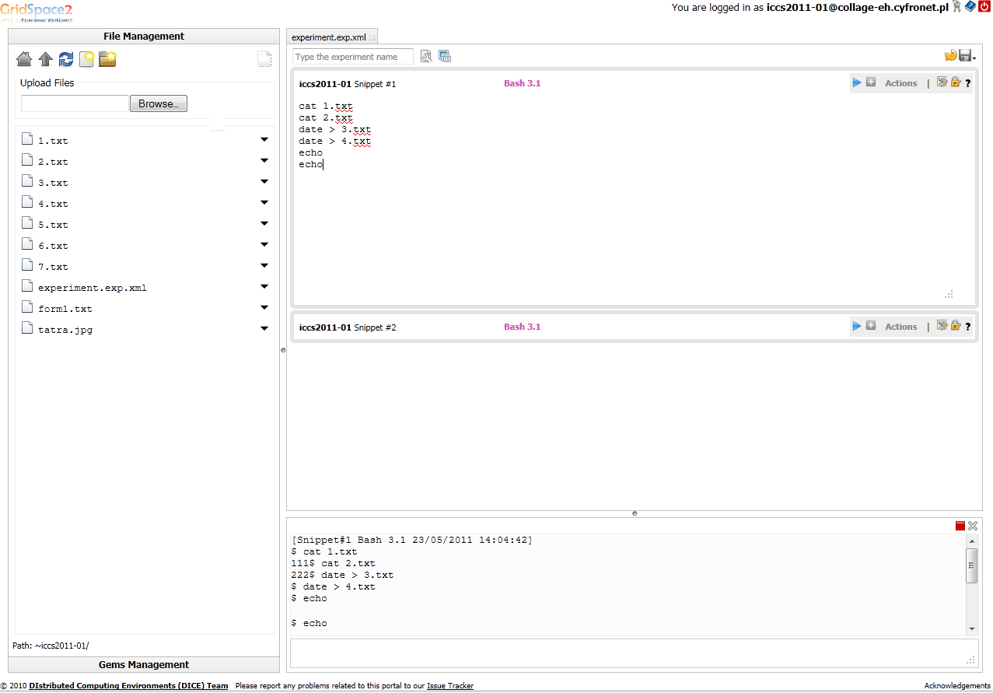
The Experimentation UI
The Experimentation UI, based on the GridSpace Experiment Workbench, is a full-fledged IDE where experiments can be developed and executed with the use of a Web interface;
Each experiment consists of snippets, which can be expressed in any programming language supported by the experiment host;
The Workbench can be used to access and manage files stored in the developer’s home directory on the experiment host;
The UI provides facilities for sharing and embedding experiments, storing and accessing confidential data and declaring assets which can be embedded in the publication.
File management utilities
Snippet management panel
Developer console
Snippet code window
User account management
Interpreter selector

Slide 10
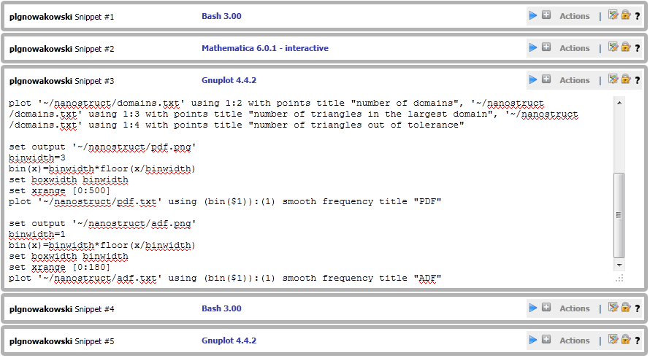
Writing experiments
Snippets #1 and #2
Snippet management panel
Select interpreter
Manage assets and secrets
Execute snippet
Add/remove snippets
Merge snippets
Snippet #3 (code)
Snippets #4 and #5
Writing experiments is as simple as typing (or pasting) executable code in the Experiment Workbench editor, which is part of the Experimentation UI;
The Experiment Workbench server (Collage Server) can communicate with multiple experiment hosts. Depending on the configuration of the experiment host, a variety of interpreters are available, including general-purpose programming languages (Ruby, Python, Perl), shell scripting (including interactive shell sessions) and custom tools (such as Mathematica, Matlab etc.);
Any tool which offers a command-line interface can be used as a Collage interpreter. Additional interpreters are easy to set up, once they have been installed on the experiment host;
Snippets can be executed sequentially or individually, to support exploratory programming.

Slide 11
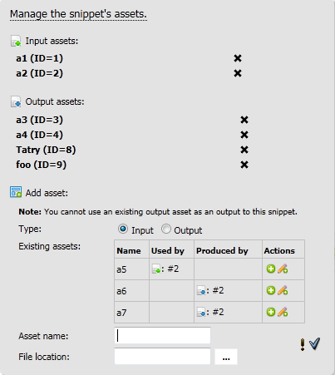
Declaring assets
Assets are the primary mechanism by which a Collage publication can be enriched with interactive elements. Assets are meant to be embedded in HTML documents;
Each snippet may declare one or more assets, including input assets (required by the snippet to perform its calculations) and output assets (visualizations of output data). Each asset is mapped to a file on the Collage experiment host;
Assets can be reused – for instance, multiple snippets may rely on the same input asset, while an output asset of one snippet can serve as input for another snippet;
Declaring and managing assets has no impact on experiment code: Collage does not alter the syntax of the programming languages used to develop snippets.
Assets already declared for this snippet
Declaring a new asset (includes all assets already declared within the experiment)

Slide 12
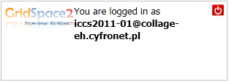
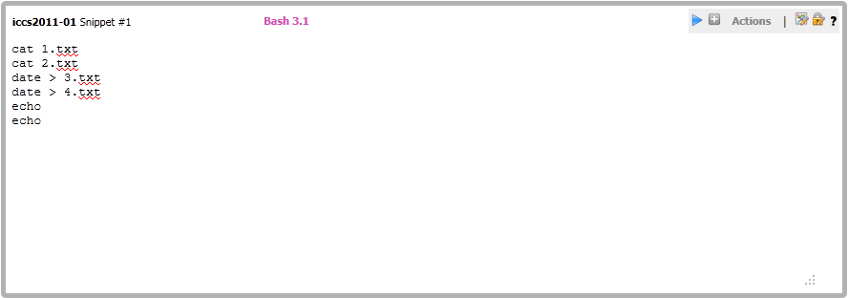
Types of Collage assets (1/2)
Master asset (1 per experiment)
Must be embedded in the Executable Paper in order to allow access to other assets;
Handles user login and authorizes access to interactive content.
Snippet assets (1 per snippet)
Contain snippet code and enable viewers to modify/execute this code on the Experiment Host;
Executing a snippet automatically updates all output assets which depend on that snippet;
Embedding snippet assets in Executable Papers is not mandatory (users may also invoke operations by manipulating input assets).

Slide 13
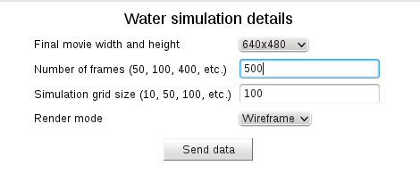
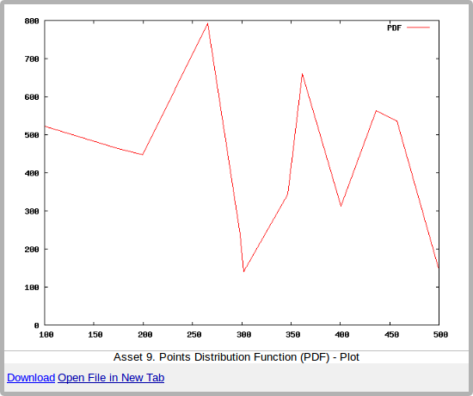
Types of Collage assets (2/2)
Input assets (snippet-specific)
Provide input data for snippets, required to perform computations;
Embedding this type of asset in the Executable Paper enables the reader to feed custom data into the experiment;
In addition to being able to upload files to the experiment host, Collage also provides a convenient Web form mechanism through which input assets may request data in a user-friendly manner.
Output assets (snippet-specific)
Represent the results of computations performed by snippets;
Embedding this type of asset in the Executable Paper enables the reader to view and download experiment output;
Output assets are refreshed whenever the snippets on which they depend are executed by the reader.

Slide 14
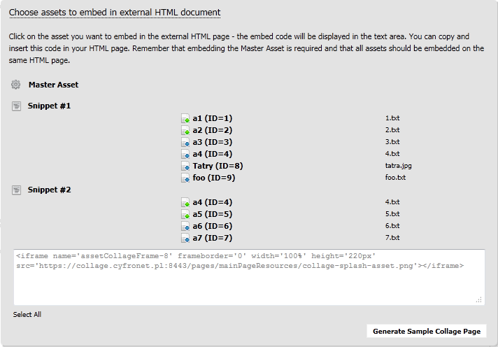
Publishing assets
The Experimentation UI provides a convenient mechanism by which assets can be embedded in an external publication (such as the Executable Paper);
For each asset, the UI generates suitable HTML embed code. Inserting this code into your publication enables it to visualize the selected asset;
The embed code may be customized (for instance, the author may change the default width and height of the asset);
While Collage comes with a preinstalled Authoring UI based on the WordPress CMS system, any authoring software may be used to prepare executable papers – as long as it enables users to embed custom HTML code in their publications.
Assets declared by this experiment
(click asset to view its embed code)
Embed code for selected asset
Generate sample document with all assets

Slide 15
Embedding assets – a detailed view
The asset embed code instructs the Publisher Server to inject an IFrame element into the document being generated;
The payload (content) of this element is served by the Collage Server – thus the publication becomes a Web mashup. In this way asset windows can access files and experiments stored on the Experiment Host;
Different management options are exposed by the IFrame, depending on the type of asset being visualized;
As IFrames may communicate with one another, it is possible to refresh output assets when the snippet upon which they are based finishes executing. This is handled automatically by the Collage Server.
IFrame widget
Asset payload
(served by the
Collage Server via SSL)
Download Upload Open

Slide 16


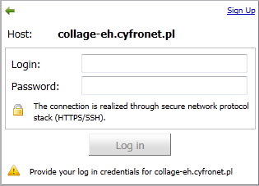
Interacting with an Executable Paper – a detailed view (1/2)
The static content of the Executable Paper can be served by the Publisher Server without Collage Server involvement;
Dynamic content is served by the Collage Server directly (bypassing the Publisher Server);
Publisher and HPC provider roles are decoupled and follow mutually independent access policies (including authentication, authorization, accounting etc.) Access to static content is controlled by the Publisher Server while access to interactive elements requires a Collage Server account.
1a. Reader navigates to URL which houses the publication
Publisher Server
1b. Publisher Server displays the static content of the publication, with placeholder graphics for each asset
2. Reader uses the pre-embedded Master Asset to authenticate self with the Collage Server
3. Collage Server responds by refreshing experiment assets and populating them with initial values specified by the experiment developer
Collage Server

Slide 17

Interacting with an Executable Paper – a detailed view (2/2)
The user may interact with each asset by using the controls provided by the asset’s IFrame (which is specific to the type of asset being visualized);
Interaction is backended by the Collage Server which may delegate requests to HPC resources (where available);
Assets are automatically refreshed without reloading the entire Executable Paper.
4. Reader clicks „Execute” in snippet asset window, or submits a Web form with input data
5. Execution request is handled by Collage Server
Collage Server
6. Execution request may optionally be forwarded to attached HPC resources. Collage provides a mechanism to securely store user credentials required for access
7. Once execution completes, Collage Server automatically populates the relevant output assets
8. Output data may also be downloaded by the user
HPC Resources

Slide 18
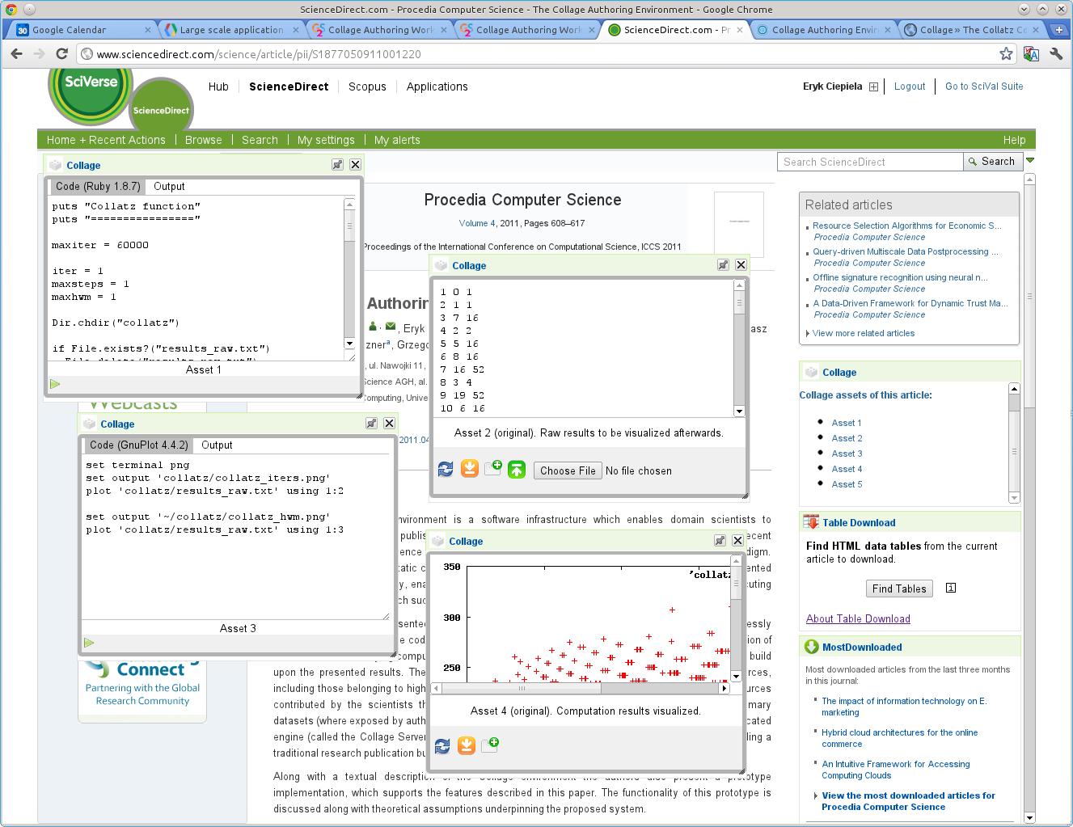
SciVerse Integration

Slide 19
For further information…
For information regarding the pilot deployment of Collage, visit http://collage.elsevier.com
A more detailed introduction to Collage (including user manuals and sample papers) can be found at http://collage.cyfronet.pl

