Slide 1
Multiscale Programming and Execution Tools in the MAPPER project
K. Rycerz, E.Ciepiela, G.Dyk, T.Gubała, D.Harężlak, J.Meizner, M.Bubak
21.09.12
CYFRONET

Slide 2
Plan
Objectives and Requirements
Idea of Multiscale Programming and Execution Tools
Summary of efficiency evaluation
Short example based on Irrigation Canal application (thanks to B. Chopard and M. Ben Belgacem from University of Geneva)

Slide 3
Relevant Workshop Topics
Multi-scale simulations with workflows
Interoperability of workflows and distributed computing infrastructures
Sharing workflows within and among communities
Uptake and sustainability of workflows and workflow systems

Slide 4
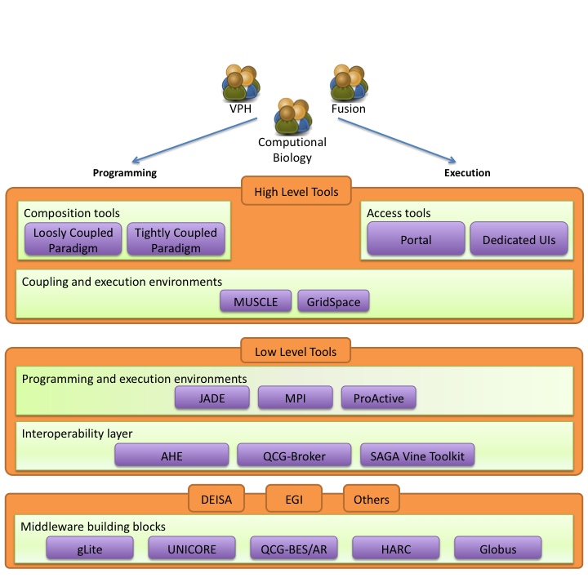
Objectives
Design and implement an environment for composing multiscale simulations from single scale models
encapsulated as scientific software components
distributed in various European e-Infrastructures
supporting loosely coupled and tightly coupled paradigm
Support composition of simulation models:
using scripting approach
by reusable “in-silico” experiments
Allow interaction between software components from different e-Infrastructures in a hybrid way.
Measure efficiency of the tools

Slide 5
Requirements Analysis
Focus on multiscale applications that can be described as a set of connected, but independent single scale modules and mappers (converters)
Support describing such applications in uniform (standardized) way to:
analyze application behavior
support switching between different versions of the modules with the same scale and functionality
support building different multiscale applications from the same modules (reusability)
Support computationally intensive simulation modules
requiring HPC and/or Grid resources,
often implemented as parallel programs
Support tight (with loop), loose (without loop) or hybrid (both) connection modes

Slide 6
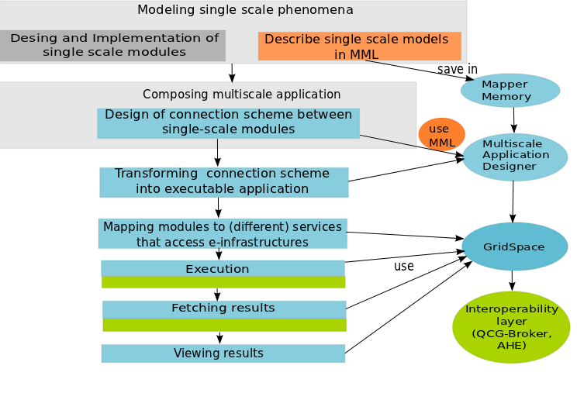
Building and Executing Multiscale Application
Process of constructing multiscale application consists of different steps
Most of these steps can be facilitated by:
common Multiscale Description Language (MML) – orange
UvA, Amsterdam
programming and execution tools – blue
CYFRONET, Krakow
services accessing e-infrastructure – green
QCG: PSNC, Poznan
AHE: University College London

Slide 7
Overview of Tools Architecture
MAPPER Memory (MaMe) a semantics-aware persistence store to record metadata about models and scales
Multiscale Application Designer (MAD) visual composition tool transforming high level MML description into executable experiment
GridSpace Experiment Workbench (EW) execution and result management on e-infrastructures via interoperability layers
Provenance – recording, storing and querying provenance of experiment results

Slide 8
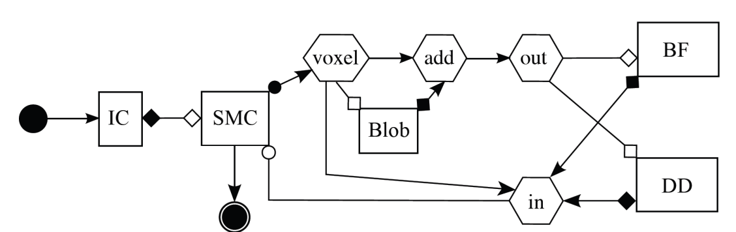
Multiscale Modeling Language
Uniformly describes multiscale models and their computational implementation on abstract level
Two representations: graphical (gMML), textual (xMML)
Includes description of
scale submodules
scaleless submodules (so called mappers and filters)
ports and their operators (for indicating type of connections between modules)
coupling topology
Implementation
Developed by Joris Bordorff and Alfons Hoekstra from UvA, Amsterdam, The Netherlands
Submodel execution loop in pseudocode
f := finit /*initialization*/
t := 0
while not EC(f, t):
Oi(f, t) /*intermediate observation*/
f := S(f, t) /*solving step*/
t += theta(f)
end
Of(f, t) /*final observation*/
Corresponding symbols in gMML
Of
finit
Oi
S
undefined

Slide 9
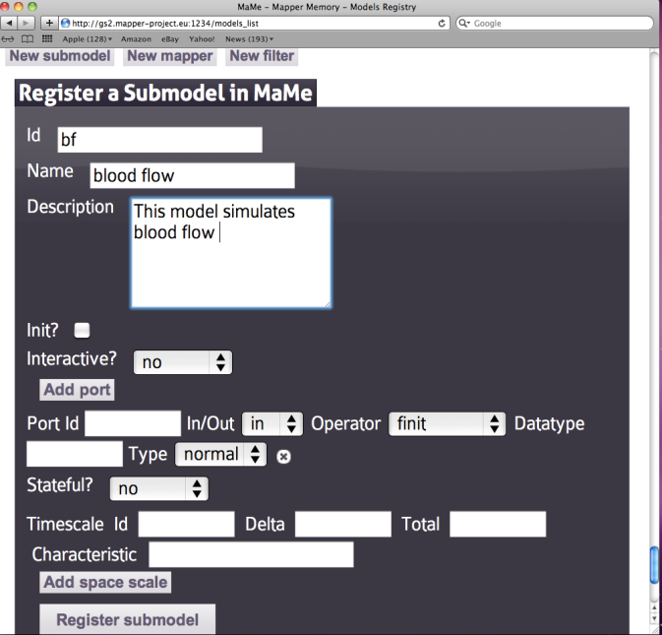
Mapper Memory (MaMe)
Semantics-aware persistence store
Records MML-based metadata about models and scales
Supports exchanging and reusing MML metadata for
other MAPPER tools via REST interface
human users within theConsortium via dedicated Web interface
Ports and their operators

Slide 10
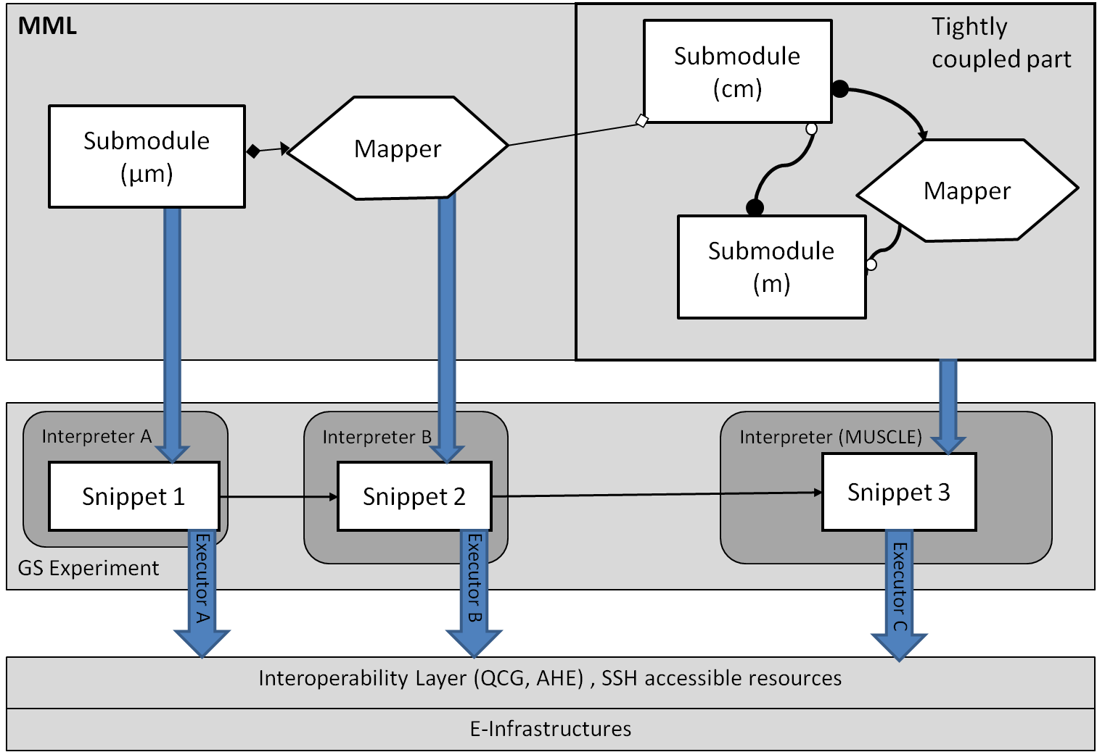
MultiscaleApplication Designer (MAD)
Supports composing multiscale applications from submodels and mappers registered in MaMe
Inport/export coupling topology represented in gMML to/from XMML file
Transforms high level MML description into executable experiment for GridSpace Experiment Workbench
MAD

Slide 11
GridSpace Experiment Workbench
Supports execution and result management of infrastructure independent experiments
Experiment - application composed of code fragments called snippets, expressed in:
general-purpose scripting programming languages(Bash, Ruby, Perl etc.)
domain-specific languages (CxA in MUSCLE, Large-scale Atomic/Molecular Massively Parallel Simulator (LAMMPS), Car-Parrinello Molecular Dynamics (CPMD), Matlab etc.)
Snippets are evaluated by respective programs called interpreters
Executors- responsible for snippets execution on various computational resources – servers, clusters, grid via
direct SSH on UserInterface (UI) machine
Interoperability layer (QCG, AHE)
Each snippet of the same experiment can be executed on different resource

Slide 12
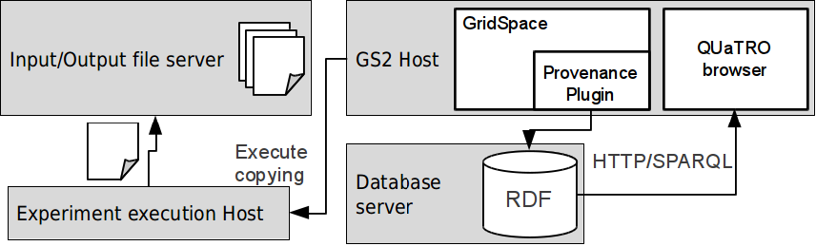
Provenance
Experiment start, stop and snippet start/stop events tracked
Provenance data stored in RDF database; OPMV-based ontology used
Input/output files of snippets are copied and snapshots are created – experiment result history
Provenance data browser – extensive querying capabilities

Slide 13
Tools usage by applications
Application | Tools Used | Description
Instent Restenosis 3D | MaMe, MAD, EW | modules registered in MaMe, application composed by MAD is executed in EW
Clay-polymer Nanocomposites | MaMe, MAD, EW | modules registered in MaMe, application composed by MAD is executed in EW
Irrigation Canals | MaMe, MAD, EW | modules registered in MaMe, application composed by MAD is executed in EW
Gene Regulatory Networks | MaMe, MAD | some modules registered in MaMe, MML of application is composed by MAD
Transport Turbulence Equilibrium | MaMe | some modules registered in MaMe

Slide 14
Efficiency Evaluation
Number of registered single-scale models:20 single-scale models, 25 mappers and two filters already registered in models registry (MaMe) coming from almost all MAPPER applications as well as test application (see http://gs2.mapper-project.eu/mame)
Successful tutorial on MAPPER seasonal school available on http://www.mapper-project.eu/web/guest/mad-mame-ew
Number of new scientific results from applications created by the tools:
M. Ben Belgacem et al. "Coupling method for building a network of irrigation canals on distributed computing environment" to be published in Proceedings of 10th International Conference on Cellular Automata for Research and Industry, ACRI 2012, Santorini Island, Greece, September 24-27, 2012. Series: Lecture Notes in Computer Science, Vol. 7495
Joris Borgdorff et al.: A Distributed Multiscale Computation of a Tightly Coupled Model Using the Multiscale Modeling Language. Procedia CS 9: 596-605 (2012)
D. Groen et al.: A Distributed Infrastructure for Multiscale Biomedical Simulations, accepted by the Virtual Physiological Human Conference 2012.
J. Suter et al.: Distributed Multiscale Simulations of Clay-Polymer Nanocomposites, Materials Research Symposium, San Francisco, United States of America, April 2012.
Katarzyna Rycerz at al..: An Environment for Programming and Execution of Multiscale Applications submitted to TOMACS journal (in review).

Slide 15
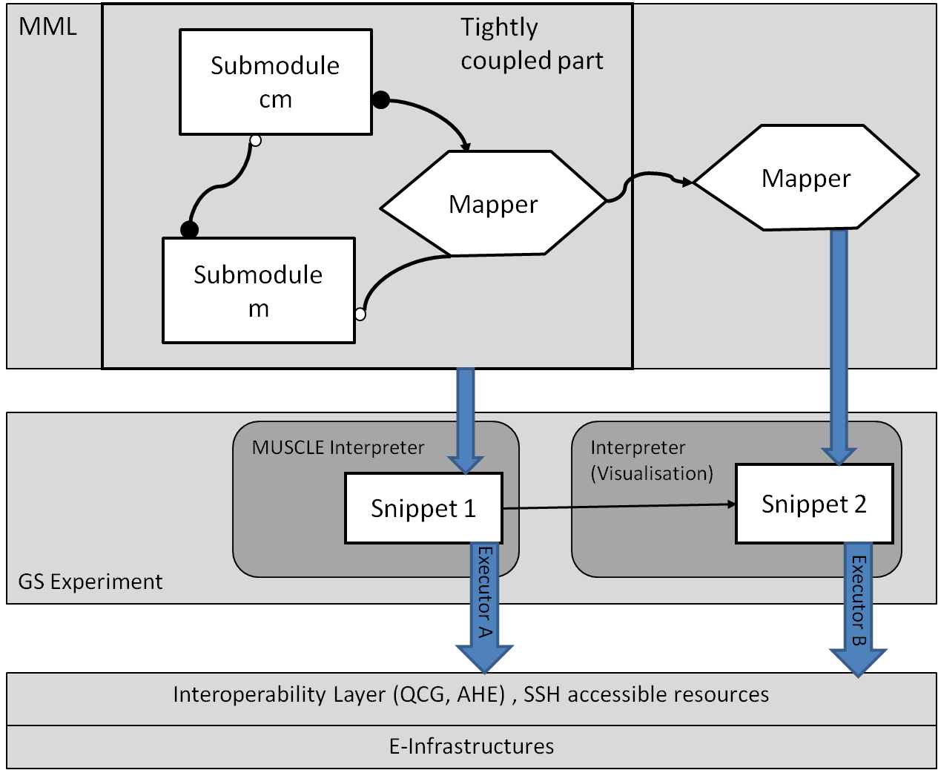
Example Use Case Canal Application
Tightly coupled Java based canal simulation using MUSCLE
Stand-alone canal visualizer and movie maker
# declare kernels which can be launched in the CxA
cxa.add_kernel(’submodel_instance1, ’my.submodelA’)
cxa.add_kernel(’submodel_instance2’, ’my.submodelB’)
…
# configure connection scheme of the CxA
cs = cxa.cs
# configure unidirectional connection betweenkernels
cs.attach ’ submodel_instance1’=> ’submodel_instance2’ do
tie ’portA’, ’portB’
…..
end
…

Slide 16
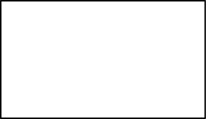
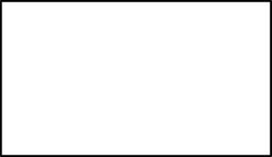
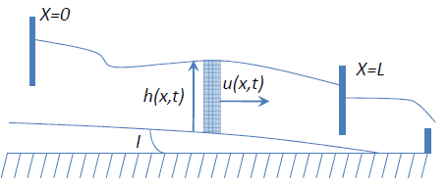
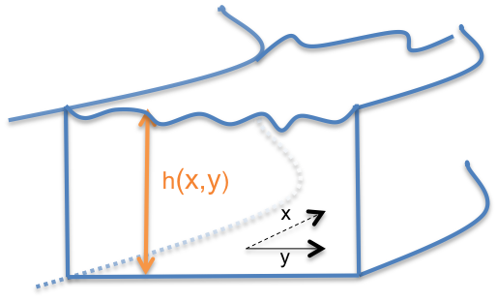


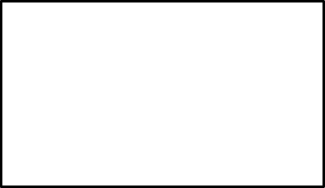
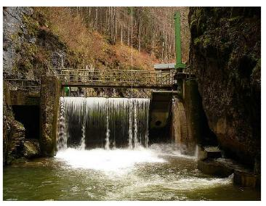
Water Model of DifferentScales (MML submodels)
CxA coupling
LB models for long canal reaches .
LB-Shallow Water 1D
The water height varies with respect to X and Y.
LB-Shallow water 2D
CxA coupling
CxA coupling
LB-Free Surface 3D
- Flow around gates/transport of sediments
It requires supercomputing capabilities
taken from: Pham van Thang et al. Journal of Computational Physics,229(19) :7373-7400, 2010.

Slide 17
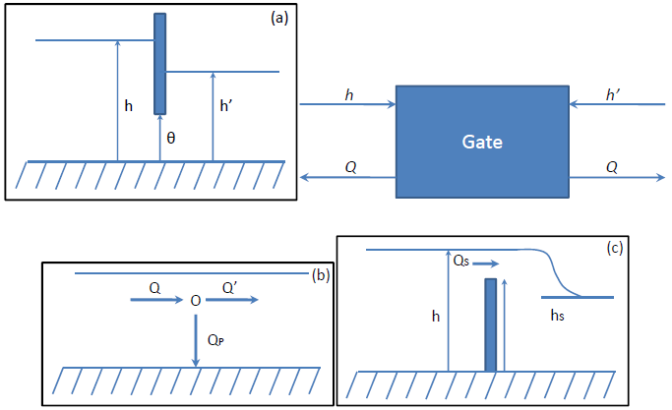
Junctions Types for Shallow water 1D
(a) Gate
(b) Pump
(c) SpillWay
Example schema
Sw1D_1B
Fin1
Fout1
Fin_1
Sw1D_2B
Fout_1
Fin1
Fout1
Sw1D_1B
Fin
Fout
Gate
Spill-Way
Fin
Fout
Fin2
Fout2
Fin_nx
Fout_nx
Fin2
Fout2

Slide 18
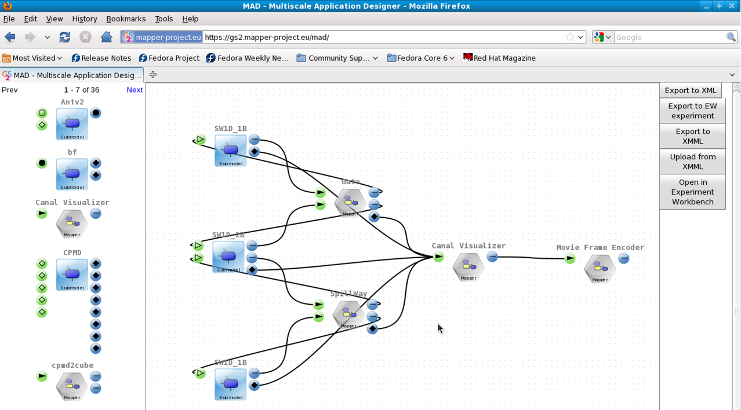
Canal Application in Multiscale Application Designer (MAD)

Slide 19
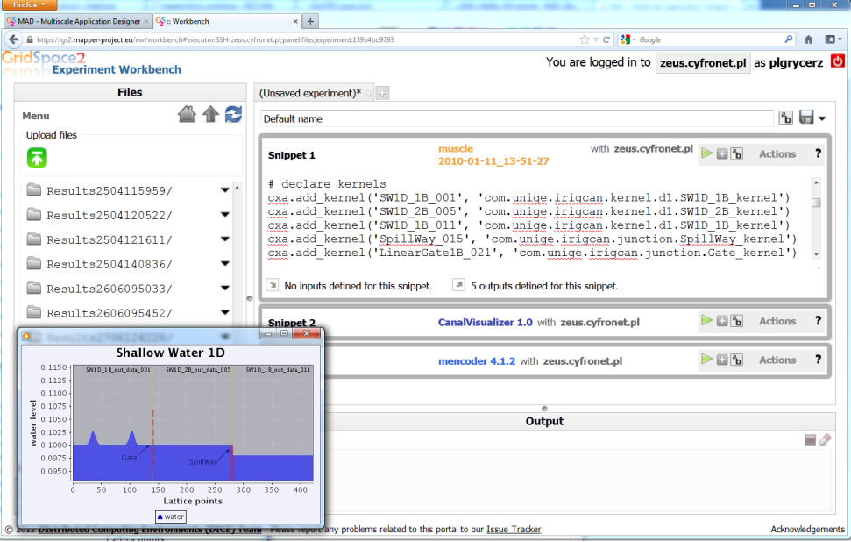
Canal Application in Experiment Workbench

Slide 20
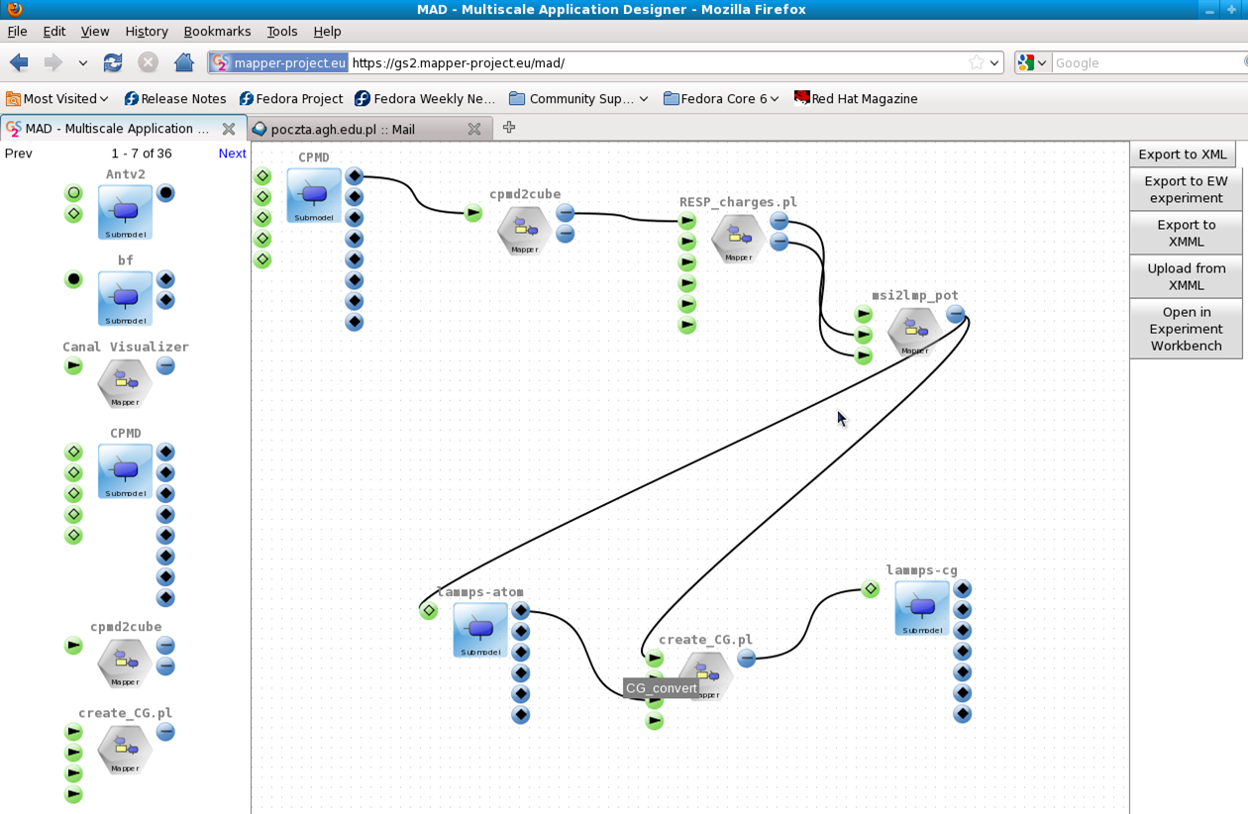
Loosely Coupled Example - Nano Polymer Simulation in MAD

Slide 21
Summary: Relevant Workshop Topics
Multi-scale simulations with workflows
loosely, tightly and hybrid type of processing
Interoperability of workflows and distributed computing infrastructures
Infrastructure independent GridSpace Experiment
Sharing workflows within and among communities
MAPPER Memory for storing information models and application structure
Web based interface of all tools => accessibility
Sharing experiments in GridSpace Experiment Workbench
Uptake and sustainability of workflows and workflow system
Reusability of modules
Reusability of connection scheme

Slide 22
See also:
http://dice.cyfronet.pl
http://dice.cyfronet.pl/projects/details/Mapper
E. Ciepiela et al.: Exploratory Programming in the Virtual Laboratory, Proceedings of the International Multiconference on Computer Science and Information Technology p. 621–628, 2010
K. Rycerz and M. Bubak: Component Approach to Distributed Multiscale Simulations, SIMULTECH 2011, Noordwijkerhout, pp. 122-127, The Netherlands, 29-31 July, 2011
K. Rycerz et al.: An Environment for Programming and Execution of Multiscale Applications, ACM Transactions on Modeling and Computer Simulation, in review

