Slide 1
Programming and Execution of Multiscale Applications on Distributed Infrastructures
Katarzyna Rycerz(1,2), Eryk Ciepiela(2), Tomasz Gubala(2,3), Daniel Harezlak(2),
Joanna Kocot(2), Grzegorz Dyk(2), Jan Meizner(2) and Marian Bubak (1,2,3)
(1) AGH University of Science and Technology, Department of Computer Science, Krakow, Poland
(2) ACC CYFRONET AGH, Krakow, Poland
(3) Informatics Institute, University of Amsterdam, The Netherlands
http://dice.cyfronet.pl
Cracow Grid Workshop
7-9 Nov 2011

Slide 2
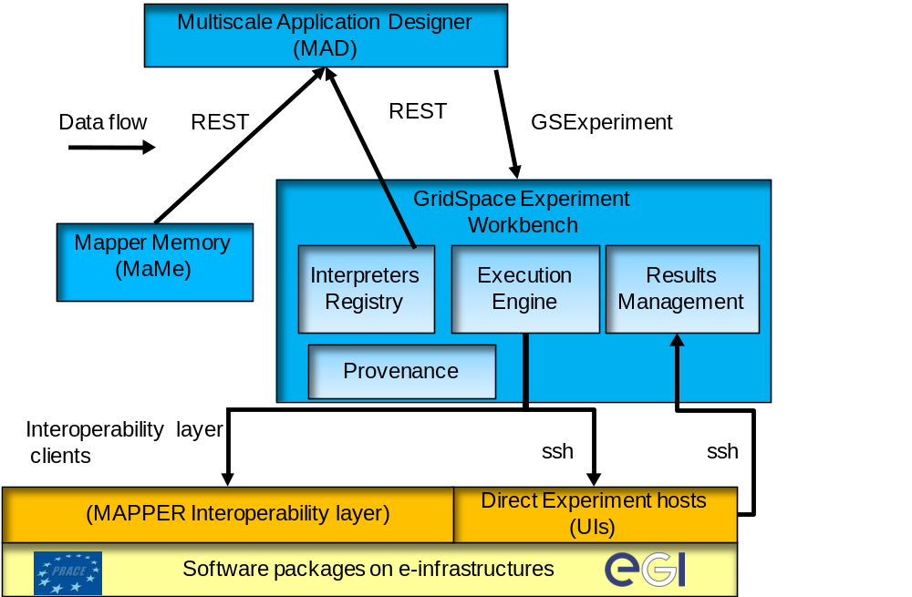
Objectives & Architecture
Objective: Support composition and execution of multiscale applications:
built from single scale models and implemented as scientific software components
distributed in various European e-Infrastructures
with structure described in Multiscale Modelling Language (MML) including: single scale sub-modules, converters and their coupling topology
Tools:
Mapper Memory (MaMe) - a semantic-aware persistence store for models and scales metadata
Multiscale Application Designer (MAD) - a user-friendly visual composition tool transforming high level MML description into executable GridSpace experiment
GridSpace Experiment Workbench (EW) – for experiments execution and result management on e-infrastructures via interoperability layer
Cracow Grid Workshop ’11 , Krakow, 7-9 Nov 2011

Slide 3
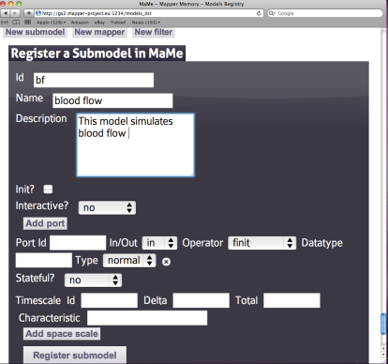
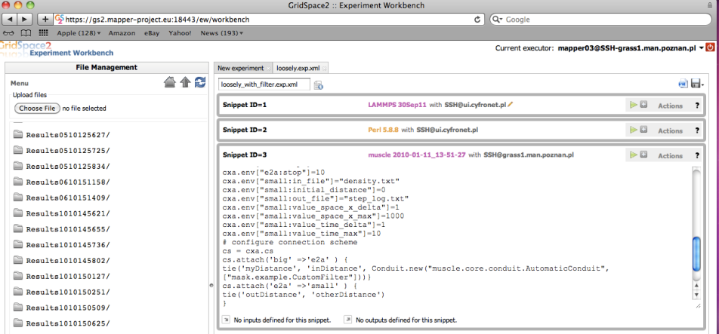
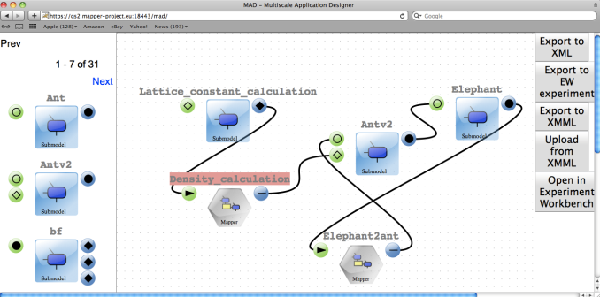
Multiscale Tools Usage
Register modules in MaMe gs2.mapper-project.eu/mame
Compose Application in MAD gs2.mapper-project.eu/mad
Execute experiment in GridSpace EW gs2.mapper-project.eu/ew
View Results in GridSpace EW
More on our poster and website:
http://dice.cyfronet.pl/
Cracow Grid Workshop ’11 , Krakow, 7-9 Nov 2011

