Slide 1
Programming and Execution of Multiscale Applications
K. Rycerz, D.Harężlak, G.Dyk, E.Ciepiela, T.Gubała, J.Meizner, M.Bubak
22.10.12
CYFRONET

Slide 2
Plan
Objectives and Requirements
Overview Multiscale Programming and Execution Tools
Tools efficiency evaluation
Short demo based on Irrigation Canal application (thanks to B. Chopard and M. Ben Belgacem from University of Geneva)

Slide 3
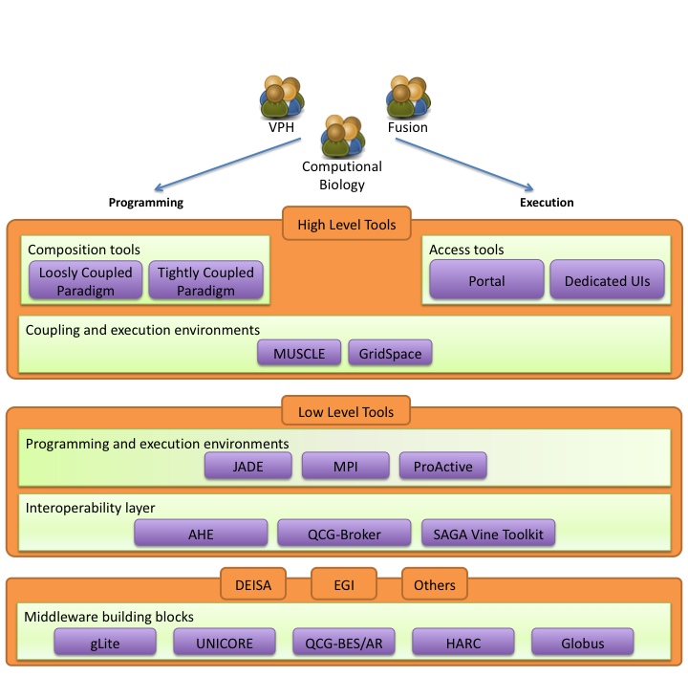
Objectives
Design and implement an environment for composing multiscale simulations from single scale models
encapsulated as scientific software components
distributed in various European e-Infrastructures
supporting loosely coupled and tightly coupled paradigm
Support composition of simulation models:
using scripting approach
by reusable “in-silico” experiments
Allow interaction between software components from different e-Infrastructures in a hybrid way.
Measure efficiency of the tools

Slide 4
Requirements Analysis
Focus on multiscale applications that can be described as a set of connected, but independent single scale modules and mappers (converters)
Support describing such applications in uniform (standardized) way to:
analyze application behavior
support switching between different versions of the modules with the same scale and functionality
support building different multiscale applications from the same modules (reusability)
Support computationally intensive simulation modules
requiring HPC and/or Grid resources,
often implemented as parallel programs
Support tight (with loop), loose (without loop) or hybrid (both) connection modes

Slide 5
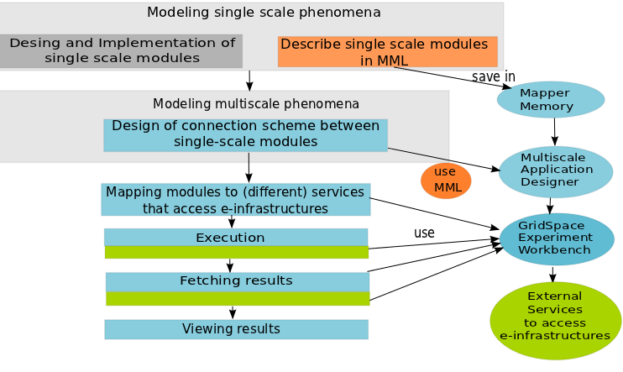
Building and Executing Multiscale Application
Process of constructing multiscale application consists of different steps
Most of these steps can be facilitated by:
common Multiscale Description Language (MML) - orange
programming and execution tools - blue
services accessing e-infrastructure - green

Slide 6
Overview of Tools Architecture
MAPPER Memory (MaMe) a semantics-aware persistence store to record metadata about models and scales
Multiscale Application Designer (MAD) visual composition tool transforming high level MML description into executable experiment
GridSpace Experiment Workbench (EW) execution and result management on e-infrastructures via interoperability layers
Provenance – recording, storing and querying provenance of experiment results

Slide 7
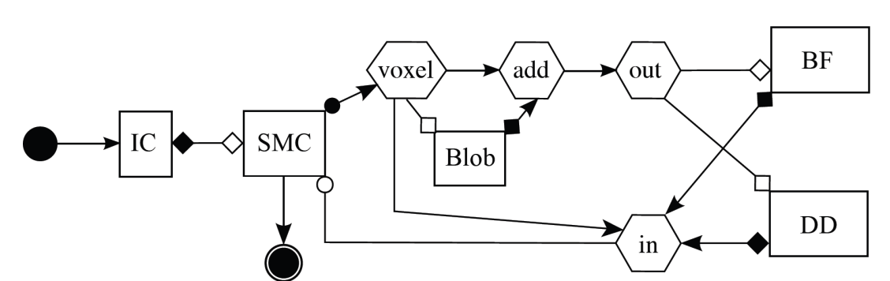
Multiscale Modeling Language
Submodel execution loop in pseudocode
f := finit /*initialization*/
t := 0
while not EC(f, t):
Oi(f, t) /*intermediate observation*/
f := S(f, t) /*solving step*/
t += theta(f)
end
Of(f, t) /*final observation*/
Uniformly describes multiscale models and their computational implementation on abstract level
Two representations: graphical (gMML), textual (xMML)
Includes description of
scale submodules
scaleless submodules (so called mappers and filters)
ports and their operators (for indicating type of connections between modules)
coupling topology
Implementation
Developed by J. Borgdorff and A.G. Hoekstra (University of Amsterdam)
Corresponding symbols in gMML
Of
finit
Oi
S
undefined
Example for Instent Restenosis Application
IC – initial conditions
DD- drug diffusion
BF – blood flow
SMC – smooth muscle cells

Slide 8
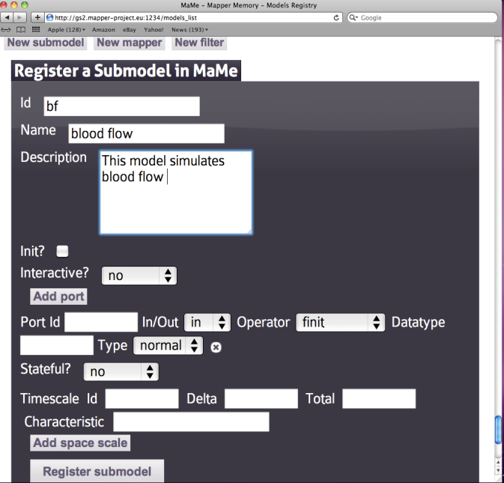
Mapper Memory (MaMe)
Semantics-aware persistence store
Records MML-based metadata about models and scales
Supports exchanging and reusing MML metadata for
other MAPPER tools via REST interface
human users within theConsortium via dedicated Web interface
Ports and their operators

Slide 9
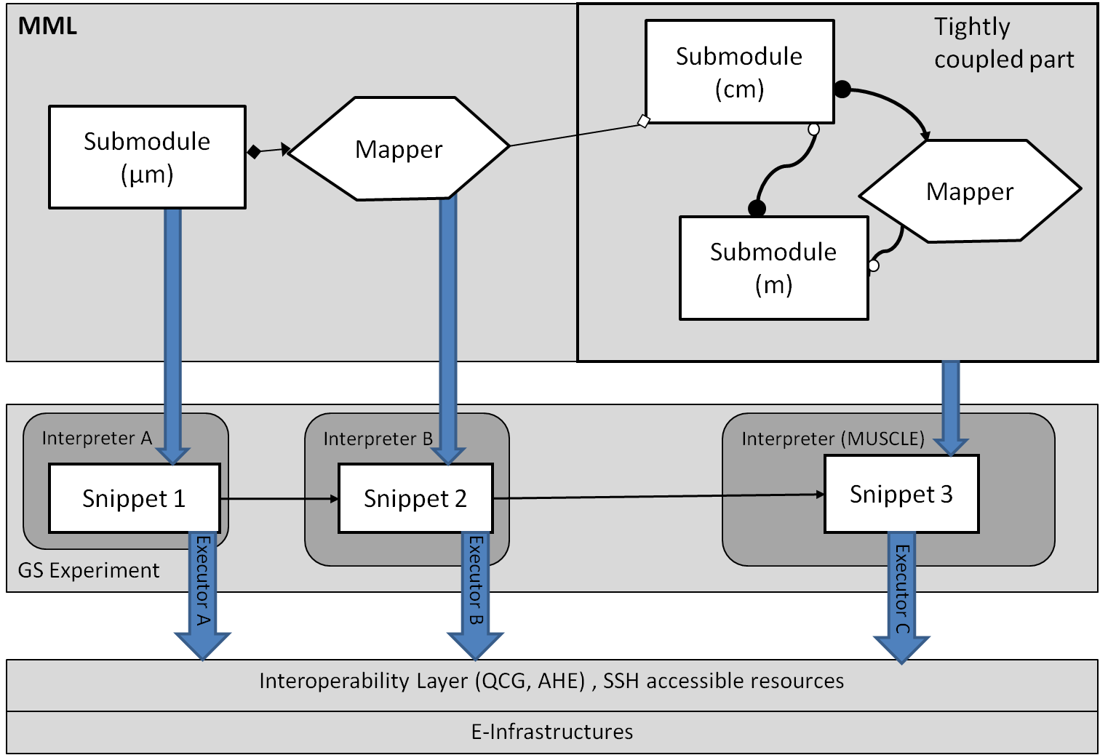
MultiscaleApplication Designer (MAD)
Supports composing multiscale applications from submodels and mappers registered in MaMe
Inport/export coupling topology represented in gMML to/from XMML file
Transforms high level MML description into executable experiment for GridSpace Experiment Workbench
MAD

Slide 10
GridSpace Experiment Workbench
Supports execution and result management of infrastructure independent experiments
Experiment - application composed of code fragments called snippets, expressed in:
general-purpose scripting programming languages(Bash, Ruby, Perl etc.)
domain-specific languages (CxA in MUSCLE, LAMMPS, Matlab etc)
Snippets are evaluated by respective programs called interpreters
Executors- responsible for snippets execution on various computational resources – servers, clusters, grid via
direct SSH on UserInterface (UI) machine
Interoperability layer (QCG, AHE)
Each snippet of the same experiment can be executed on different resource

Slide 11
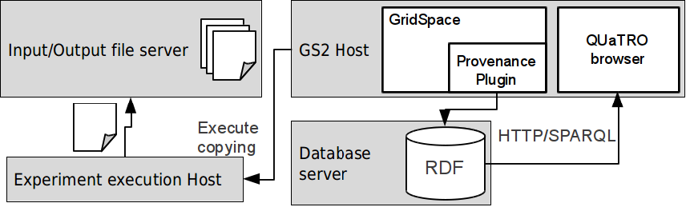
Provenance
Experiment start, stop and snippet start/stop events tracked
Provenance data stored in RDF database; OPMV-based ontology used
Input/output files of snippets are copied and snapshots are created – experiment result history
Provenance data browser – extensive querying capabilities

Slide 12
Tools usage by applications
Blood flow (Instent Restenosis 3D)
Hydrology (irrigation canals)
Nanotechnology (clay-polymer)
Fusion
Computational biology (gene-regulatory networks)

Slide 13
Efficiency Evaluation
Number of registered single-scale models:30 single-scale models, 33 mappers and two filters already registered in models registry (MaMe) coming from almost all MAPPER applications as well as test application (see http://gs2.mapper-project.eu/mame)
Successful tutorial on MAPPER seasonal school available on http://www.mapper-project.eu/web/guest/mad-mame-ew
New scientific results from applications created by the tools:
M. Ben Belgacem et al. "Coupling method for building a network of irrigation canals on distributed computing environment" to be published in Proceedings of 10th International Conference on Cellular Automata for Research and Industry, ACRI 2012, Santorini Island, Greece, September 24-27, 2012. Series: Lecture Notes in Computer Science, Vol. 7495
Joris Borgdorff et al.: A Distributed Multiscale Computation of a Tightly Coupled Model Using the Multiscale Modeling Language. Procedia CS 9: 596-605 (2012)
D. Groen et al.: A Distributed Infrastructure for Multiscale Biomedical Simulations, accepted by the Virtual Physiological Human Conference 2012.
J. Suter et al.: Distributed Multiscale Simulations of Clay-Polymer Nanocomposites, Materials Research Symposium, San Francisco, United States of America, April 2012.
Katarzyna Rycerz at al..: An Environment for Programming and Execution of Multiscale Applications submitted to TOMACS journal (in review).

Slide 14
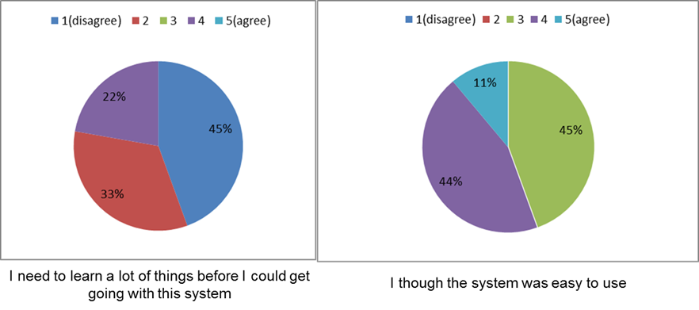
User feedback
mean time required to train a new user to use the tools measured during Seasonal School:
Most school participants learned tools tools basic in 1.5h tutorial

Slide 15
See also:
http://dice.cyfronet.pl
http://dice.cyfronet.pl/projects/details/Mapper
E. Ciepiela et al.: Exploratory Programming in the Virtual Laboratory, Proceedings of the International Multiconference on Computer Science and Information Technology p. 621–628, 2010
K. Rycerz and M. Bubak: Component Approach to Distributed Multiscale Simulations, SIMULTECH 2011, Noordwijkerhout, pp. 122-127, The Netherlands, 29-31 July, 2011
K. Rycerz et al.: An Environment for Programming and Execution of Multiscale Applications, ACM Transactions on Modeling and Computer Simulation, in review

