Slide 1
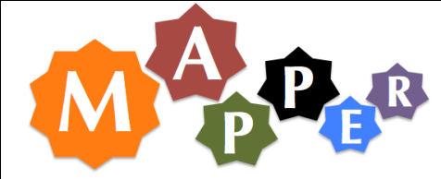
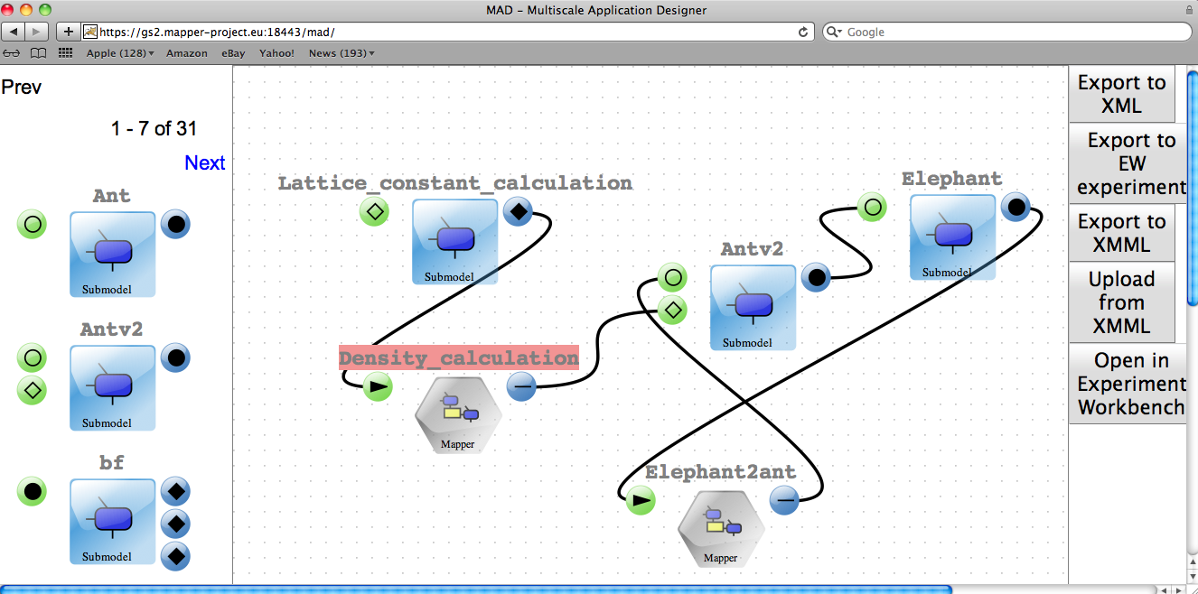
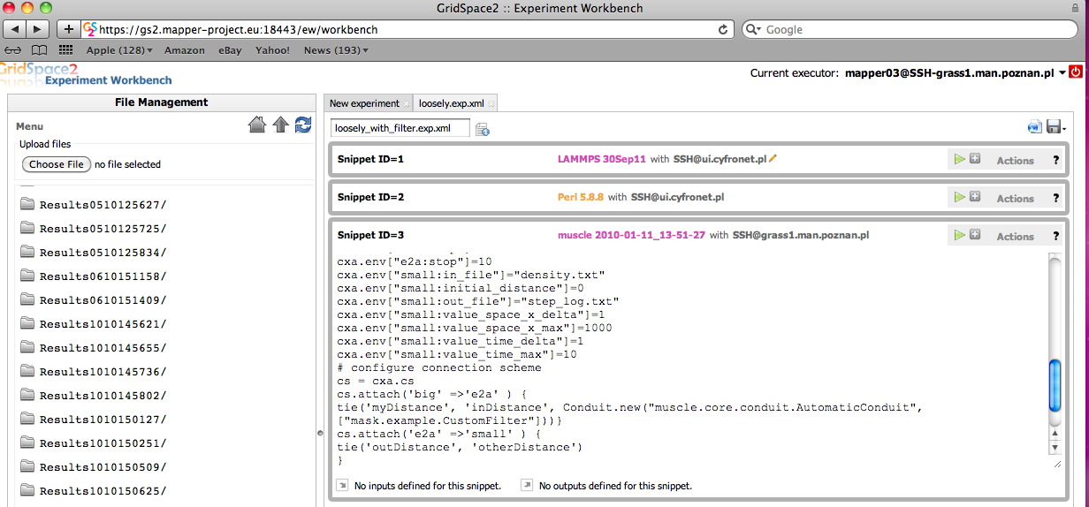
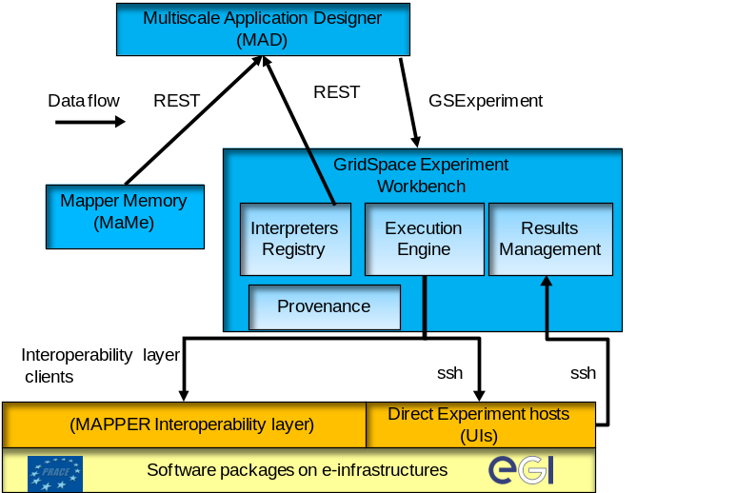
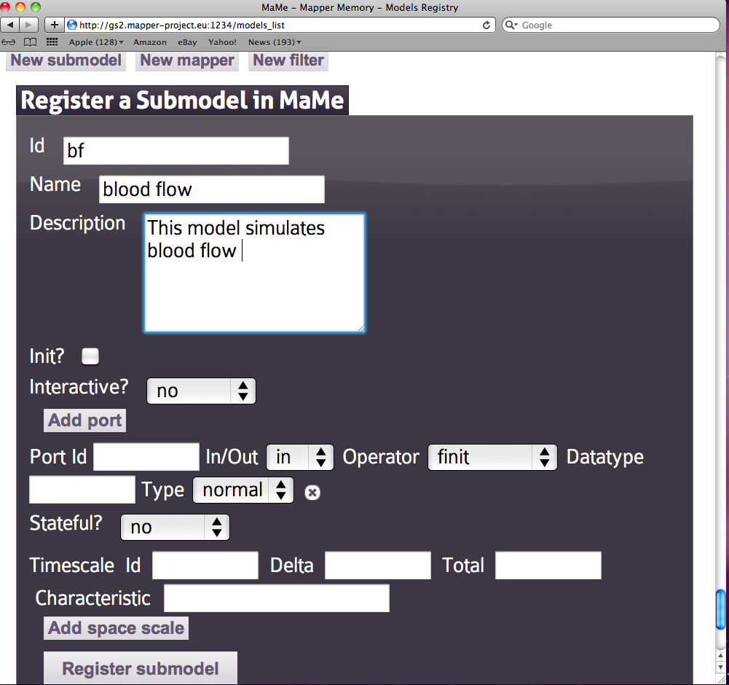

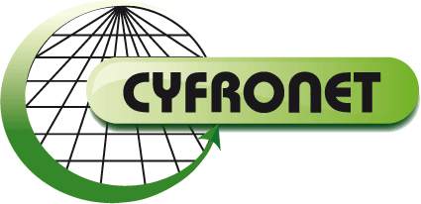



Programming and Execution of Multiscale Applications
on Distributed Infrastructures
Katarzyna Rycerz(1,2), Eryk Ciepiela(2), Tomasz Gubała(2,3), Daniel Harężlak(2), Joanna Kocot(2), Grzegorz Dyk(2),
Jan Meizner(2) and Marian Bubak (1,2,3)
(1) AGH University of Science and Technology, Department of Computer Science, Krakow, Poland
(2) AGH University of Science and Technology, ACC CYFRONET AGH, Krakow, Poland
(3) Informatics Institute, University of Amsterdam, The Netherlands
http://dice.cyfronet.pl
Goal
Tools features
MaMe is a semantic-aware persistence store to record metadata
about models and scales
MAD is a user-friendly visual composition tool transforming high
level MML description into executable GridSpace experiment
GridSpace Experiment Workbench (EW) supports execution
and result management of generated experiments on
e-infrastructures via interoperability layers using Interpreter-
Executor model of computation
the environment for composing multiscale applications
    built from single scale models implemented as scientific
    software components
    distributed in various European e-Infrastructures
applications structure described in Multiscale Modelling
Language (MML)
    single scale sub-modules
    scaleless converters
    the coupling topology describing their connections
2.
Compose Application in MAD
https://gs2.mapper-project.eu/mad
3.
Execute experiment in GridSpace EW
https://gs2.mapper-project.eu/ew
4.
View results
1.
Register modules in MaMe
http://gs2.mapper-project.eu/mame
Interpreter – Executor model
Interpreter - a software package available on the infrastructure, e.g.:
  Multiscale Coupling Library and Environment (MUSCLE)
  Large-scale Atomic/Molecular Massively Parallel Simulator (LAMMPS)
Executor - a common entity for hosts, clusters, grid brokers, etc. capable of running software which is already installed (represented as Interpreters).
Support for colaborative work
enabling sharing infrastructure-independent
experiments
supporting reusability of simulation models
implementations
References
E. Ciepiela at.al Exploratory Programming in the Virtual Laboratory, in Proceedings of the International Multiconference on Computer Science and Information Technology pp. 621–628, 2010
K. Rycerz and M. Bubak: Building and Running Collaborative Distributed Multiscale Applications, in: W. Dubitzky et al.(Eds), Chapter 6, Large Scale Computing, J. Wiley and Sons, 2012
K. Rycerz and M. Bubak: Component Approach to Distributed Multiscale Simulations, SIMULTECH 2011, 1st International Conference on Simulation, Modeling Technologies and Applications, Noordwijkerhout, pp. 122-127, The Netherlands, 29-31 July, 2011
Acknowledgements
This research was supported by the MAPPER project – grant
agreement no 261507.MAPPER

