Slide 1
MAPPER Multiscale Programming and Execution Tools
WP8 after year 1
Marian Bubak, Katarzyna Rycerz and WP8 team
{bubak,kzajac}@agh.edu.pl
ACC Cyfronet AGH Krakow PL
11/24/2011

Slide 2
Plan
Motivation and goals, tasks and the team
Objectives and results for Year 1
  Results of requirement analysis
  Programming and Execution Tools
    Architecture
    Implementation status
Summary of achievements
Plans for Year 2
WP8 Programming and Execution Tools after Year 1

Slide 3
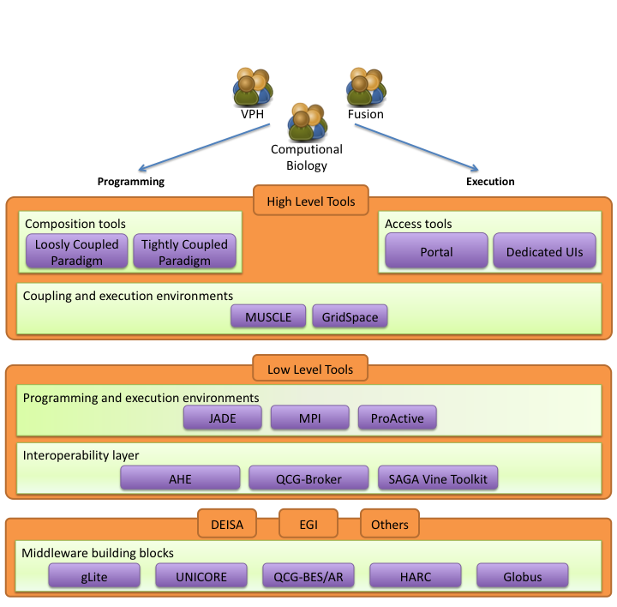
Objectives
Design and implement an environment for composing multiscale simulations from single scale models
  encapsulated as scientific software components
  distributed in various European e-Infrastructures
  supporting loosely coupled and tightly coupled paradigm
Support composition of simulation models:
  using scripting approach
  by reusable “in-silico” experiments
Allow interaction between software components from different e-Infrastructures in a hybrid way.
Measure efficiency of the tools developed in this work package.
WP8 Programming and Execution Tools after Year 1

Slide 4




1st Year Objectives
Design Multiscale Modelling Language (MML) aiming at describing structure of multiscale application
Design the architecture of the programming and execution tools supporting MML-based applications
Implement first prototype of the tools
Demonstrate the functionality of the prototype
Registration of MML metadata: submodules and scales
Application composition:
from MML to executable experiment
Execution of experiment using interoperability layer
on e-infrastructure
Result
Management
WP8 Programming and Execution Tools after Year 1

Slide 5
Tasks and the Team (1/2)
Application Manager (WP7, WP8): Marian Bubak
WP8 leader: Katarzyna Rycerz
T8.1 User Interfaces (this tasks covers visual tools)
  MML language and jMML library: Joris Borgdorff, Bastien Chopard
  Multiscale Application Designer: Daniel Harezlak
  GridSpace Experiment Workbench : Eryk Ciepiela, Joanna Kocot
T8.2 Programming Tools
  Mapper Memory and XMML Repository: Tomasz Gubala
  SBML Toolbox: Alexandru Mizeranschi
WP8 Programming and Execution Tools after Year 1

Slide 6
Tasks and the Team (2/2)
T8.3 Execution Tools:
  GridSpace Execution Engine: Eryk Ciepiela, in cooperation with Mariusz Mamonski, Tomasz Piontek (QCG, DRAMAA) and Stefan Zasada, Derek Groen (AHE)
  MUSCLE as GridSpace interpreter: Eryk Ciepiela, Katarzyna Rycerz (SSH resources), Mariusz Mamonski (QCG resources)
  GridSpace Result Management: Eryk Ciepiela, Joanna Kocot, Grzegorz Dyk
T8.4: Provenance: Grzegorz Dyk
  Tracking experiment execution process
  Storing experiment input and output file history
  Browsing provenance data
T8.5: Evaluation of efficiency of WP8 tools: whole team
WP8 Programming and Execution Tools after Year 1

Slide 7
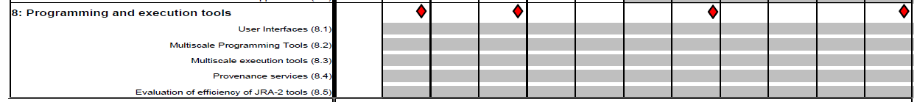
Timeline
D 8.1
D 8.2
D 8.3
D 8.4
MS 19
MS 20
MS 21
M 6 Description of the Architecture and Interfaces, results in D 8.1
M12 First prototype of multiscale computing programming and execution tools, results in D 8.2, MS19
M24 Second prototype of multiscale computing programming and execution tools, D 8.3, MS 20
M32 Final acceptance of multiscale computing programming and execution tools , D 8.4, MS 21
WP8 Programming and Execution Tools after Year 1

Slide 8
Requirements Analysis
Focus on multiscale applications that can be described as a set of connected, but independent single scale modules and mappers (converters)
Support describing such applications in uniform (standardized) way to:
  analyze application behavior
  support switching between different versions of the modules with the same scale and functionality
  support building different multiscale applications from the same modules (reusability)
Support computationally intensive simulation modules
  requiring HPC or Grid resources,
  often implemented as parallel programs
Support tight (with loop), loose (without loop) or hybrid (both) connection modes
WP8 Programming and Execution Tools after Year 1

Slide 9
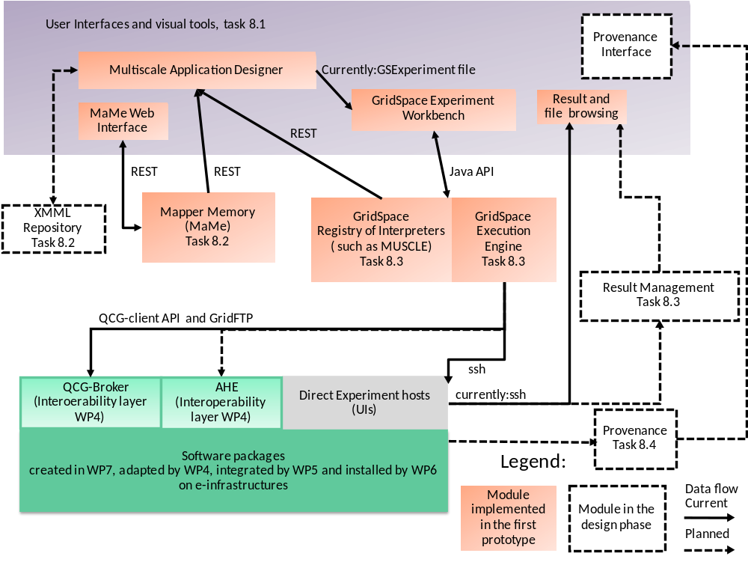
Overview of Tools Architecture
MAPPER Memory (MaMe) a semantics-aware persistence store to record metadata about models and scales
Multiscale Application Designer (MAD) visual composition tool transforming high level MML description into executable experiment
GridSpace Experiment Workbench (EW) execution and result management of experiments on e-infrastructures via interoperability layers (AHE, QCG)
WP8 Programming and Execution Tools after Year 1

Slide 10
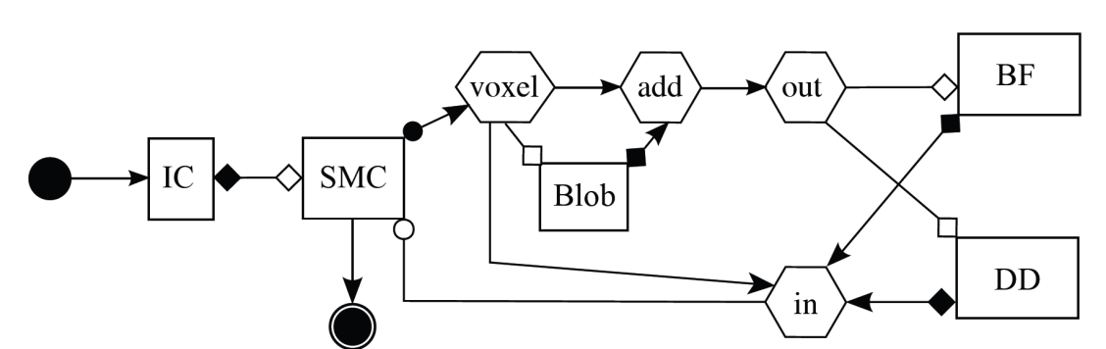
Multiscale Modeling Language
Uniformly describes multiscale models and their computational implementation on abstract level
Two representations: graphical (gMML), textual (xMML)
Includes description of
  scale submodules
  scaleless submodules (so called mappers and filters)
  ports and their operators (for indicating type of connections between modules)
  coupling topology
  implementation
Submodel execution loop in pseudocode
f := finit /*initialization*/
t := 0
while not EC(f, t):
Oi(f, t) /*intermediate observation*/
f := S(f, t) /*solving step*/
t += theta(f)
end
Of(f, t) /*final observation*/
Corresponding symbols in gMML
Of
finit
Oi
S
undefined
Example for Instent Restenosis Application
IC – initial conditions
DD- drug diffusion
BF – blood flow
SMC – smooth muscle cells
WP8 Programming and Execution Tools after Year 1

Slide 11
jMML Library
Supports XMML analysis:
Detection of initial models
Constructing coupling topology (gMML)
Generating task graph
Deadlock detection
Generating Scale Separation Map
Supports Graphviz or pdf formats
WP8 Programming and Execution Tools after Year 1

Slide 12
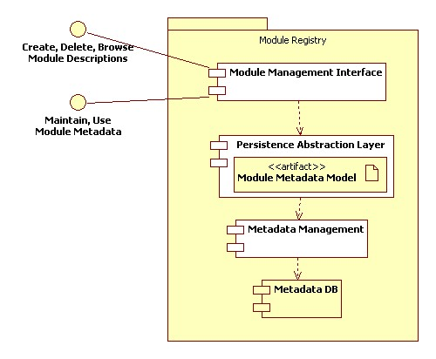
MaMe - Mapper Memory
Provides rich, semantics-aware persistence store for other components to record information
Based on a well-defined domain model containing MAPPER metadata defined in MML
Other MAPPER tools store, publish and reuse such matadata throughout the entire Project and its Consortium
Provides dedicated web interface for human users to browse and curate metadata
WP8 Programming and Execution Tools after Year 1

Slide 13
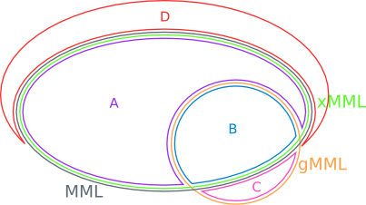
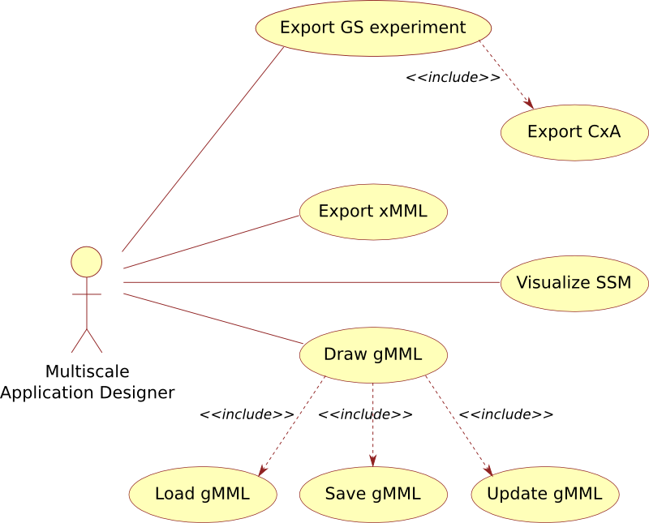
MAD – MultiScale Application Designer
User friendly visual tool for composing multiscale applications
Supports importing application structure from xMML (section A and B)
Supports composing multiscale applications in gMML (section B) with additional graphical specific information - layout, color etc. (section C)
Transforms gMML into xMML
Performs MML analysis to identify its loosely and tightly coupled parts
Using information from MaMe and GridSpace EW, transforms gMML into executable formats with information needed for actual execution (section D) :
  GridSpace Experiment
  Muscle connection file (cxa.rb)
WP8 Programming and Execution Tools after Year 1

Slide 14
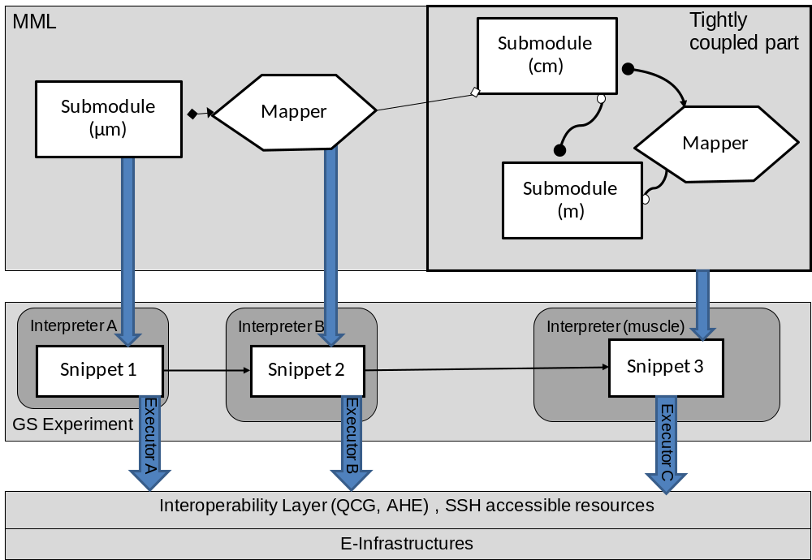
GridSpace Experiment
Workbench
Supports execution of experiments on e-infrastructures via interoperability layers
Result management support
Uses Interpreter-Executor model of computation:
  Interpreter - a software package available on the infrastructure, usually programatically accessible by DSL or script language e.g: MUSCLE, LAMMPS, CPMD
  Executor - a common entity for hosts, clusters, grid brokers etc. capable of running Interpreters
Allows easy configuration of available executors and interpreters
Transforming example MML into executable GS Experiment
WP8 Programming and Execution Tools after Year 1

Slide 15
Functionality of Tools after Year 1
MaMe
  most of the functionality of registry for modules metadata
  the initial part of the functionality of xMML description repository
MAD
  functionality of MML application composition (gMML, xMML)
  supports transforming MML to executable format (GridSpace experiment)
GridSpace EW (available in Oct 2010) was enhanced to support
  experiment format independent of execution environment (executor)
  multi-site execution in one experiment
  simultaneous management of input and output (result) files from different sites
  two executors are fully implemented already- for SSH and QCG.
WP8 Programming and Execution Tools after Year 1

Slide 16
Efficiency Evaluation
Coupling applications using tools was not required after 1st year (only manually), however certain metrics still can be used
Number of registered single-scale models:19 single-scale models, 12 mappers and two filters already registered in models registry (MaMe) coming from almost all MAPPER applications as well as test application( see http://gs2.mapper-project.eu/mame)
Number of new scientific results from applications created by the tools: The preliminary papers presenting results from applications using tools were accepted on DMC2011 - Workshop on Distributed Multiscale Computing 2011 (held in conjunction with E-science 2011 conference) for
    ISR 3D and MML
    ISR 3D with MUSCLE
    Nanotechnology application in MAPPER
    ISR 2D with GridSpace and MUSCLE
    See also: http://www.computationalscience.nl/dmc2011/.
User experience with the tools: many user requests in tracking systems for MaMe, MAD and the GS Experiment Workbench at http://chomik.cyfronet.pl/trac/
WP8 Programming and Execution Tools after Year 1

Slide 17
Efficiency Evaluation
Application | Tools Used | Description
Instent Restenosis 3D | MaMe, MAD, EW | modules registered in MaMe, application composed by MAD is executed in EW
Clay-polymer Nanocomposites | MaMe, MAD, EW | modules registered in MaMe, application composed by MAD is executed in EW
Irrigation Canals | MaMe, MAD, EW | some modules registered in MaMe, application composed by MAD is executed in EW
Gene Regulatory Networks | MaMe, MAD | some modules registered in MaMe, MML of application is composed by MAD
Transport Turbulence Equilibrium | MaMe | some modules registered in MaMe
WP8 Programming and Execution Tools after Year 1

Slide 18
Deliverables, Milestones in Y1
Deliverables:
D8.1 Specification of the architecture and interfaces M6
D8.2 First prototype with demonstration M12
Milestones:
MS19 First prototype of multiscale computing programming and execution tools M12
Collaboration with other WPs on their deliverables:
D 4.1 Review on applications, users,software and e-Infrastructures M6
D 5.1 Report on the Inventory of Deployed Services M6
D 3.2 Standardization roadmap and first sustainability plan M12
D 5.2 Vertical Integration Plan M12
D 7.1 First report on adaptation of applications M12
WP8 Programming and Execution Tools after Year 1
Notes:
Inne deliwerable

Slide 19
Meetings in Y1
Kick-off meeting, Amsterdam, 06-08.10.10
  presentation and demo of GridSpace experience with multiscale applications (simulation of dense stellar systems using HLA), gathering application requirements
All hands meeting, Monachium, 14-17.02.11
  first Demo of GridSpace experiment workbench running ISR2D application on SSH accessible Polish NGI site and QCG infrastructure, verifying application requirements
WP7-8 meeting, Krakow 04-06.07.11
  demo of MAD, MaMe and GridSpace EW, first attempts to run applications using tools
All hands meeting, Poznan 18-21.10.11
  demo of current implementation, further adaptation of applications to be run using tools
WP8 Programming and Execution Tools after Year 1

Slide 20
Scientific Results
Elaboration of a concept of an environment supporting developers and users of multiscale applications for grid and cloud infrastructures
Design of the formalism for describing connections in multiscale simulations
Validation of the formalism against real applications structure by using tools
Proof of concept for transforming high level formal description to actual execution using e-infrastructures
WP8 Programming and Execution Tools after Year 1
Notes:
MB - sugestie

Slide 21
Publications & Presentations (1/2)
K. Rycerz and M. Bubak: Building and Running Collaborative Distributed Multiscale Applications. In: W. Dubitzky, K. Kurowsky, B. Schott (Eds), Chapter 6, Large Scale Computing, J. Wiley and Sons. To be published: December 2011 (2011)
K. Rycerz, M. Nowak, P. Pierzchala, M. Bubak, E. Ciepiela and D. Harezlak: Comparision of Cloud and Local HPC approach for MUSCLE-based Multiscale Simulations. Accepted by Workshop on Distributed Multiscale Computing 2011 in conjunction with the 7th IEEE e-Science conference, 5-8 December 2011 (2011)
J.Borgdorff, J.-L. Falcone, E. Lorenz, B. Chopard and A. G. Hoekstra: A principled approach to distributed multiscale computing, from formalization to execution, accepted by Workshop on Distributed Multiscale Computing 2011 in conjunction with the 7th IEEE e–Science conference
K. Rycerz, M. Bubak: Component Approach to Distributed Multiscale Simulations. In: Proc. SIMULTECH 2011, 1st International Conference on Simulation, Modeling Technologies and Applications, July 29-31, 2011, Noordwijkerhout, The Netherlands, pp. 122 - 127 (2011)
WP8 Programming and Execution Tools after Year 1

Slide 22
Publications & Presentations (2/2)
M. Baranowski: Optimization of Application Execution in Virtual Laboratory; Master of Science Thesis supervised by Marian Bubak; AGH University of Science and Technology, Krakow, Poland, (2011)
K. Rycerz, E. Ciepiela, J. Kocot, M. Nowak, P. Pierzchała, M. Bubak: Towards an Environment for Multiscale Applications, abstract at KUKDM in Zakopane, Poland (2011)
K. Rycerz, E. Ciepiela, D. Harezlak, M. Bubak: Towards Multiscale Computing Tools based on GridSpace, Presentation at Cracow Grid Workshop 2010
K. Rycerz, E. Ciepiela, T. Gubała, D. Harężlak, J. Kocot, G. Dyk, J. Meizner and M. Bubak; Programming and Execution of Multiscale Applications on Distributed Infrastructures poster presented during Cracow Grid Workshop 2011; 7-9 November 2011, Kraków, Poland
Two Master of Science theses in preparation:
M. Nowak: Multiscale Applications Composition and Execution Tools based on Simulation Models Description Languages and Coupling Libraries
P. Pierzchala: Multiscale Applications in the GridSpace Virtual Laboratory.
WP8 Programming and Execution Tools after Year 1

Slide 23
Means to high-quality software
Adoption of mature, industry-quality, standards-based approaches and technologies
  Tools are Web applications implemented using GWT (MAD, GridSpace EW), Sinatra (MaMe) deployed in Apache Tomcat (EW, MAD) or Apache Web Server (MaMe)
  MongoDB used as MaMe database
  JAXB for XML manipulation
At the same time adoption of platform and technology-independent design in order to avoid vendor lock-in
  loose coupling between components
  communication based on well-defined protocols (REST and SOAP over HTTP(S), GridFTP, SSH)
establishing tight feedback with frequent loops between releases, tests with users, running application and bugfixing
WP8 Programming and Execution Tools after Year 1

Slide 24
Hardware Contributed by Cyfronet
Dedicated VM for deployment of Cyfronet-developed tools
  3 cores of processor Intel Xeon CPU L5420 @2.5GHz, 6 GB RAM, 45 GB storage
  Deployed services
    Multiscale Application Designer
    Mapper Memory
    GridSpace Experiment Workbench
Access to Zeus cluster (part of Polish NGI)
  Cluster Platform 3000 BL 2x220, Xeon X5650 6C 2.66 GHz, Infiniband 145 TFlops, 88-th on top500 list (Nov 2011)
resources required for performing regular backups on external disk array (SAS drives, RAID 6)
Nagios-based monitoring of gs2.mapper-project.eu host and services
WP8 Programming and Execution Tools after Year 1

Slide 25
Plan for Year 2 (1/2)
Extension of functionality of all tools in general
Support for all MAPPER applications and perform adaptation to their requirements (in cooperation with WP7)
T 8.1
  Improvement on MML and MML-based visual tools (MAD, jMML), e.g.
    optional file ports in loosely coupled simulations
    full support for MML filters
    Scale Separation Map view in MAD
    multiple implementations/multiple instances
WP8 Programming and Execution Tools after Year 1
Notes:
Dodac plany ogolne cele

Slide 26
Plan for Year 2 (2/2)
T 8.2 extend MaMe to fully support functionality of XMML repository
T8.3
  Enhance capabilities of results management
  Full integration with AHE on API level using executor mechanisms (in cooperation of WP 4 and 5)
T 8.4 Implementation of provenance services according to the design
T 8.5 Evaluation of Tools Efficiency
  Including training users on 1st MAPPER school organized in cooperation of WP2
WP8 Programming and Execution Tools after Year 1

Slide 27
MAPPER at ACC Cyfronet AGH - see
http://dice.cyfronet.pl/projects/details/Mapper
  Project publications, presentations and posters
  Demonstration videos from all meetings

Slide 28
MML
Tightly coupled part
Submodule
(cm)
Submodule
µm
Mapper
Mapper
Submodule
(m)
GS Experiment
Interpreter A
Interpreter B
Interpreter (muscle)
Snippet 1
Snippet 2
Snippet 3
Executor A
Executor B
Executor C
Interoperability Layer (QCG, AHE) , SSH accessible resources
E-Infrastructures

Slide 29
Planed Final Tools Architecture
User Interfaces and visual tools, task 8.1
Provenance
Interface
Multiscale Application Designer
Currently:GSExperiment file
GridSpace Experiment
Workbench
Result and file browsing
MaMe Web Interface
REST
REST
REST
Java API
Mapper Memory (MaMe)
Task 8.2
GridSpace
Registry of Interpreters
( such as MUSCLE)
Task 8.3
GridSpace
Execution Engine
Task 8.3
XMML
Repository
Task 8.2
Result Management
Task 8.3
QCG-client API and GridFTP
ssh
QCG-Broker
(Interoerability layer WP4)
AHE (Interoperability layer WP4)
Direct Experiment hosts (UIs)
currently:ssh
Provenance
Task 8.4
Software packages
created in WP7, adapted by WP4, integrated by WP5 and installed by WP6 on e-infrastructures
Legend:
Module implemented in the first
prototype
Module in the design phase
Data flow
Current
Planned

Slide 30
MML
Tightly coupled part
Submodule
(cm)
Submodule
(µm)
Mapper
Mapper
Submodule
(m)
GS Experiment
Interpreter A
Interpreter B
Interpreter (muscle)
Snippet 1
Snippet 2
Snippet 3
Executor A
Executor B
Executor C
Interoperability Layer (QCG, AHE) , SSH accessible resources
E-Infrastructures

Slide 31
MML
Submodule A
e.g. quantum mechanics
Mapper
Transforms
Output A to Input B
Submodule B
e.g.molecular dynamics
GS Experiment
CPMD
Perl
LAMMPS
Snippet 1
Snippet 2
Snippet 3
Executor A
Executor B
Executor C
Interoperability Layer (QCG, AHE) , SSH accessible resources
E-Infrastructures

Slide 32
choose/add/delete
Mapper A
Submodule A
Mapper B
Submodule B

