Slide 1
MAPPER Multiscale Programming and Execution Tools
WP8 after year 2
Katarzyna Rycerz, Marian Bubak and WP8 team
{bubak,kzajac}@agh.edu.pl
ACC Cyfronet AGH Krakow PL http://dice.cyfronet.pl/projects/details/Mapper
11/28/2012

Slide 2
Plan
Objectives and timeline
Tasks and the team
Overview of achievements (year 2) and plans (year3)
  MAPPER Memory
  Multiscale Application Designer
  GridSpace Experiment Workbench
  Provenence Tracking System
Evaluation of Tools Efficiency
Scientific Results
Milestones, deliverables, meetings
Summary of plans for 3rd year
WP8 Programming and Execution Tools after Year 2

Slide 3
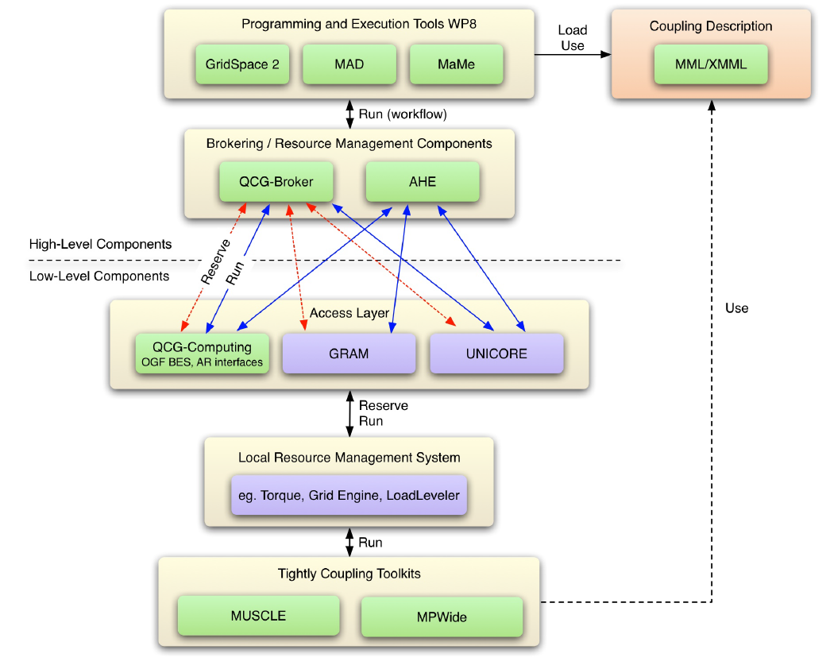
Objectives
Design and implement an environment for composing multiscale simulations from single scale models
  encapsulated as scientific software components
  distributed in various European e-Infrastructures
  supporting loosely coupled and tightly coupled paradigm
Support composition of simulation models:
  using scripting approach
  by reusable “in-silico” experiments
Allow interaction between software components from different e-Infrastructures in a hybrid way.
Measure efficiency of the tools developed in this work package.
WP8 Programming and Execution Tools after Year 2

Slide 4
Tasks and the Team
Application Manager (WP7, WP8): M. Bubak, WP8 leader: K. Rycerz
T8.1 User Interfaces (this tasks covers also visual tools)
  MML language and jMML library: J. Borgdorff, B. Chopard
  Multiscale Application Designer: D. Harezlak
  GridSpace Experiment Workbench: M. Pawlik, G. Dyk, E. Ciepiela
T8.2 Programming Tools
  Mapper Memory and XMML Repository: T. Gubala
  SBML Toolbox: A. Mizeranschi
T8.3 Execution Tools:
  GridSpace Execution Engine: G. Dyk, M. Pawlik, in cooperation with M. Mamoński, T. Piontek (QCG) and S. Zasada, D. Groen (AHE)
  MUSCLE as GridSpace interpreter: G. Dyk, M. Mamonski (using QCG)
  Result Management: G. Dyk
T8.4: Provenance: G. Dyk
T8.5: Evaluation of efficiency of WP8 tools: whole team
WP8 Programming and Execution Tools after Year 2

Slide 5
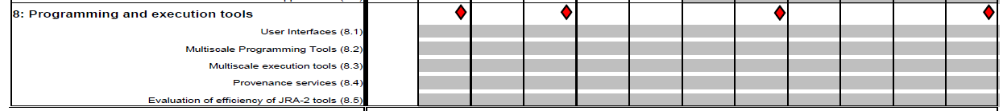
Timeline
D 8.1
D 8.2
D 8.3
D 8.4
MS 19
MS 20
MS 21
M 6 Description of the Architecture and Interfaces, results in D 8.1
M12 First prototype of multiscale computing programming and execution tools, results in D 8.2, MS19
M24 Second prototype of multiscale computing programming and execution tools, D 8.3, MS 20
M32 Final acceptance of multiscale computing programming and execution tools , D 8.4, MS 21
WP8 Programming and Execution Tools after Year 2

Slide 6
Requirements
Support description of multiscale applications in an uniform way to
  analyze application behavior
  support building different multiscale applications from the same modules („lego”-based approach, reusability)
  support switching between different versions of the modules with the same scale and functionality
Support computationally intensive simulation modules
  requiring HPC or Grid resources,
  often implemented as parallel programs
Support tight (with loop), loose (without loop) or hybrid connection modes
WP8 Programming and Execution Tools after Year 2

Slide 7
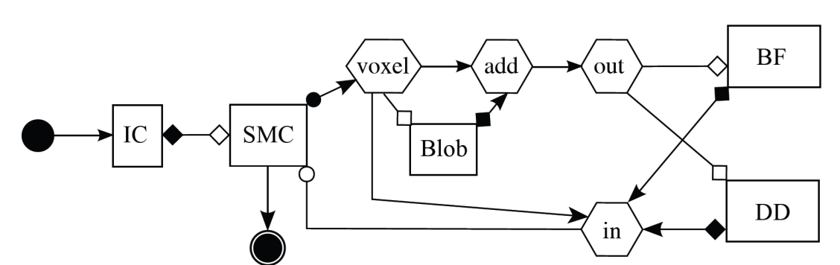
Multiscale Modeling Language and JMML library
MML uniformly describes multiscale models and their computational implementation on abstract level
  Textual form (XMML) and graphical form (gMML)
  Describes: scale submodules, scaleless mappers and filters and their connection scheme
  New MML element that terminates conduit - terminal (a source and a sink).
jMML library handles MML, new features:
  outputting MUSCLE configuration file for a given xMML file.
  generating a directory structure with preliminary code based on the xMML file.
Example for Instent Restenosis Application
IC – initial conditions
DD- drug diffusion
BF – blood flow
SMC – smooth muscle cells
WP8 Programming and Execution Tools after Year 2

Slide 8
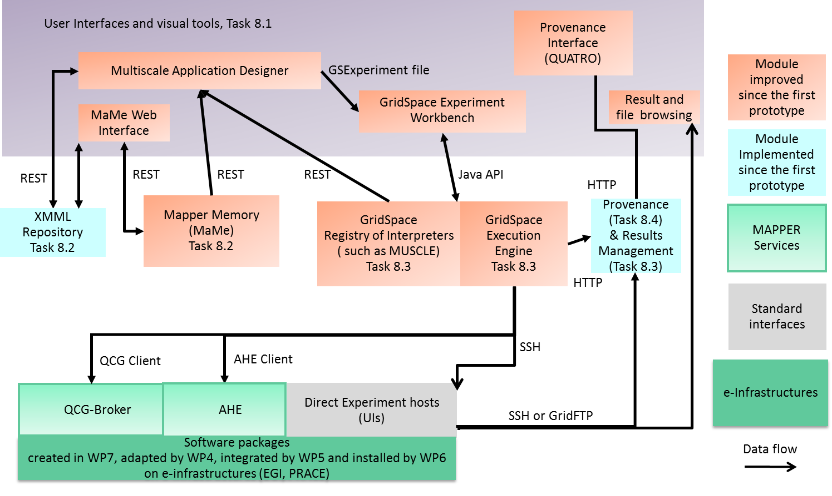
Overview of the Tools
WP8 Programming and Execution Tools after Year 2

Slide 9
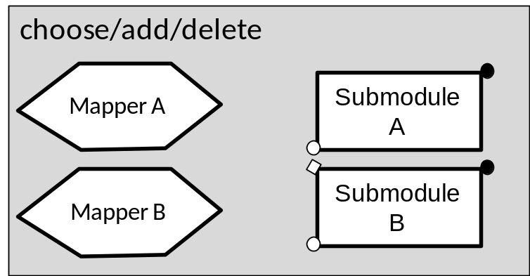
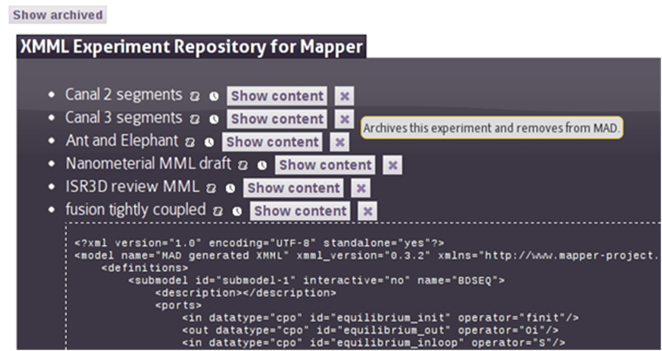
MAPPER Memory (MaMe)
Semantics-aware persistence store
Records MML-based metadata about models and scales
Supports exchanging and reusing MML metadata for
  other MAPPER tools via REST interface
  human users within theConsortium via dedicated Web interface
Available online at
http://gs2.mapper-project.eu/mame
WP8 Programming and Execution Tools after Year 2

Slide 10
MaMe – achievements and plans
Year1:
  most of the functionality of registry for modules metadata
dedicated web interface for human users and REST interface for other tools
Year 2:
extended to support XMML Repository
finer-grained (more convenient) interaction with a user
Plans for Year 3:
extend usability according to user requests (support for external users)
WP8 Programming and Execution Tools after Year 2

Slide 11

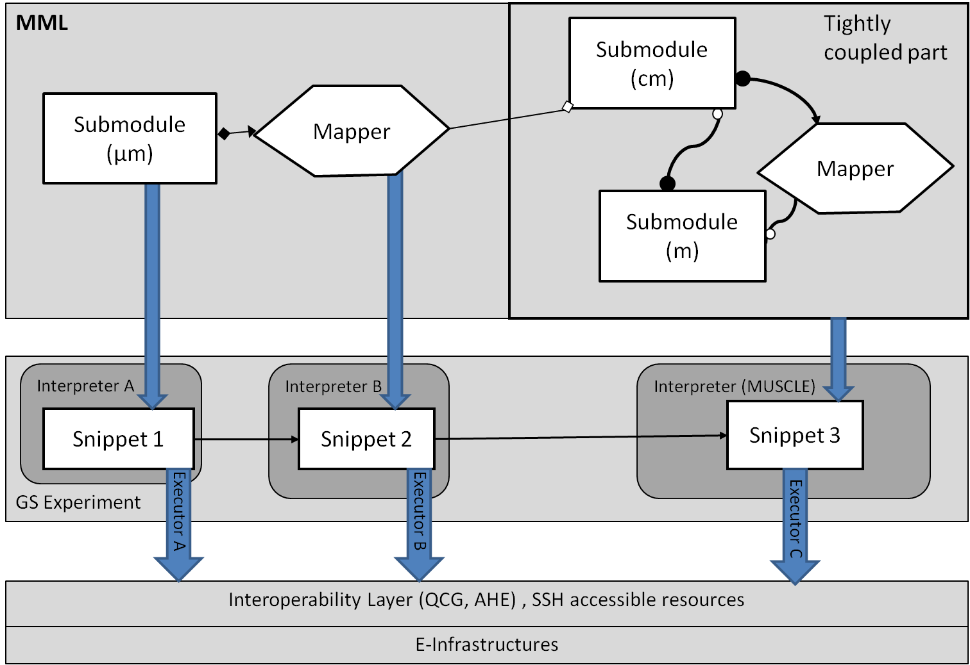
Multiscale Application Designer (MAD)
Supports composing multiscale applications from submodels and mappers registered in MaMe
Inport/export coupling topology represented in gMML to/from
XMML file
Transforms high level MML description into executable experiment for GridSpace Experiment Workbench
Available at:
https://gs2.mapper-project.eu/mad
MAD
WP8 Programming and Execution Tools after Year 2

Slide 12
MAD – achievements and plans
  Year1:
Drag-and drop functionality of MML application composition (gMML, xMML)
supports transforming MML to executable form (GridSpace experiment)
  Year 2:
editor allowing to change properties of modules (request from seasonal school)
tightly coupled sections are more visible
easy switching between different implementations
communication between XMML repository and MAD
integration with QCG reservation portal
  Plans for Year 3:
Support for terminals (sources and sinks) and MML filters
Parametrized ports
WP8 Programming and Execution Tools after Year 2

Slide 13
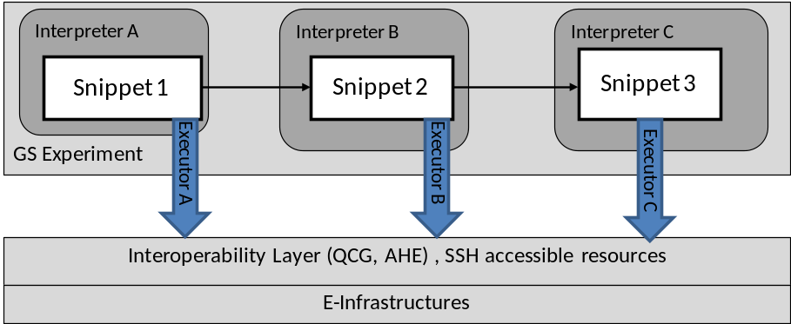
GridSpace Experiment Workbench (EW)
Supports execution and result management of infrastructure independent experiments
Experiment - application composed of code fragments called snippets, expressed in:
  general-purpose scripting programming languages(Bash, Ruby, Perl etc.)
  domain-specific languages (CxA in MUSCLE, Large-scale Atomic/Molecular Massively Parallel Simulator (LAMMPS), Car-Parrinello Molecular Dynamics (CPMD), Matlab etc.)
Snippets are evaluated by respective programs called interpreters
Executors- responsible for snippets execution on various computational resources – servers, clusters, grid via
  direct SSH on UserInterface (UI) machine
  Interoperability layer (QCG, AHE)
Each snippet of the same experiment can
be executed on different resource
Available at
https://gs2.mapper-project.eu/ew
WP8 Programming and Execution Tools after Year 2

Slide 14
GridSpace EW – achievements and plans
First version of GridSpace was available in Oct 2010 and was enhanced to support MAPPER
Year1:
Executor-interpreter model; experiment format independent of environment (executor)
multi-site execution in one experiment; management of result files from different sites
two executors implemented - for SSH and QCG.
Year 2:
Convenient support for long running simulations
New software configured in interpreters registry, parameterized interpreter arguments
AHE Executor (API-based integration), improved QCG executor
Plans for year 3
  performance tuning (e.g. several snippets as one job)
  support for GSISSH,
  more detailed error messages for a final user
WP8 Programming and Execution Tools after Year 2

Slide 15
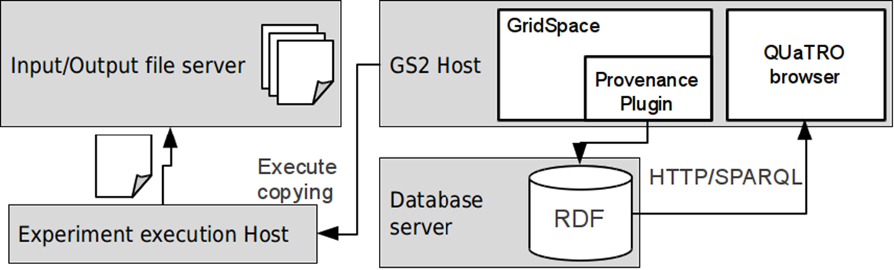
Provenance and Result Management
Experiment start, stop and snippet start/stop events tracked
Provenance data stored in RDF database; OPMV-based ontology used
Input/output files of snippets are copied and snapshots are created – experiment result history
QUATRO Provenance data browser – extensive querying capabilities

Slide 16
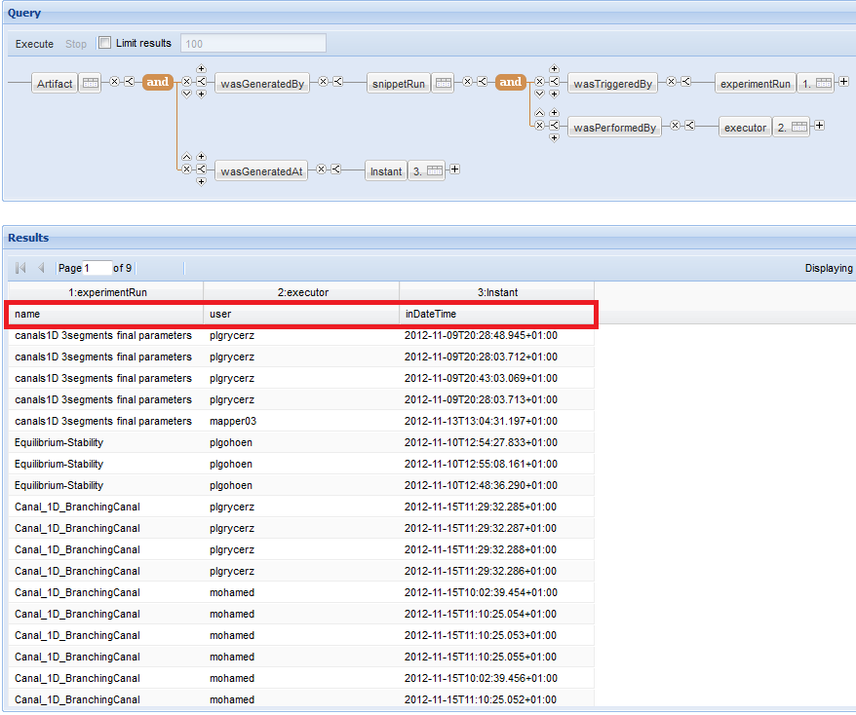
Provenence – achievements and plans
Year 1: Design of the provenance system
http://gs2.cyfronet.pl/QUATRO
Year 2:
  Tracking experiment execution process
  Storing experiment input and output file history
  Browsing provenance data
Plans for year 3:
  Define metadata gathered by provenence in order to be able to prepare statistics of tools usage

Slide 17
Means to high-quality software
Adoption of mature, industry-quality, standards-based approaches and technologies
  Tools are Web applications implemented using GWT (MAD, GridSpace EW, Provenance), Sinatra (MaMe) deployed in Apache Tomcat (EW, MAD) or Apache Web Server (MaMe)
  MongoDB used as MaMe database
  JAXB for XML manipulation
  4store used as RDF database for provenance
  Sesame for connecting to and querying provenance database
At the same time adoption of platform and technology-independent design in order to avoid vendor lock-in
  loose coupling between components
  communication based on well-defined protocols (REST and SOAP over HTTP(S), GridFTP, SSH, SPARQL)
establishing tight feedback with frequent loops between releases, tests with users, running application and bugfixing
WP8 Programming and Execution Tools after Year 2

Slide 18
Usage of tools
Application | Status
Instent Restenosis 3D | modules registered in MaMe, connected in MAD, executed in EW -using SSH and QCG executors; results already published
Clay-polymer Nanocomposites | modules registered in MaMe, connected in MAD, executed in EW by SSH executor and AHE executor
Irrigation Canals | modules registered in MaMe, connected in MAD, executed in EW -using SSH and QCG executors; results already published - used as a basis for a tutorial during first seasonal MAPPER
Gene Regulatory Networks | modules registered in MaMe, connected in MAD, executed in EW
Fusion (transport turbulence equilibrium ) | modules registered in MaMe, connected in MAD, executed in EW
Fusion (equilibrium-stability) | modules registered in MaMe, connected in MAD, executed in EW
HemeLB | Modules registered in MaMe; application is currently using high performance MPWide communication library, planned to be integrated with MUSCLE (supported by GridSpace) in the third year. As a result, usage of MAD and GridSpace is expected in the third year.
WP8 Programming and Execution Tools after Year 2

Slide 19
Evaluation of efficiency
user experience with new MAPPER tools measured by feedback forms
  SUS usability study,
  User requests are already supported in new version of MAD
number of single-scale models incorporated and used within MAPPER infrastructure
  43 submodels, 38 mappers
number of new scientific results from applications created by MAPPER tools measured by number of publications in well recognized journals/conferences
  4 accepted publications by application partners (second year of the project)
statistics of successful execution of complete multi-scale simulations
  6/7 applications are currently executed using tools. The statistics is to be measured by provenance system in the third year
WP8 Programming and Execution Tools after Year 2

Slide 20
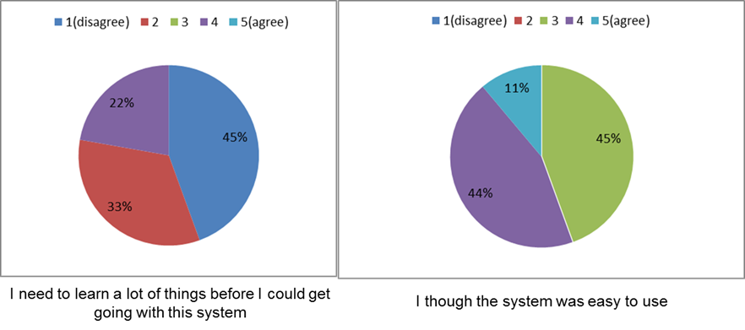
Sample answers from seasonal school
mean time required to train a new user to use MAPPER tools measured during Seasonal Schools in task 2.4.
  All school participants learned tools basic in 1.5 h tutorial

Slide 21
Deliverables, Milestones in Y2
Deliverables:
D8.3 Second prototype with demonstration M24
Milestones:
MS20 Second prototype of multiscale computing programming and execution tools M24
Collaboration with other WPs on their deliverables:
D 4.2 Software adaptation and testing reports M18
D 3.3 MAPPER profile M18
D 5.2 Vertical Integration Plan M12 – update on living document M24
D 7.2 Second report on adaptation of applications M24
D 3.4 MAPPER Test Suite M24
WP8 Programming and Execution Tools after Year 2
Notes:
Inne deliwerable

Slide 22
Meetings in Y2
All hands meeting, London, 30-31 Jan 2012
  towards second tools prototype; demo of provenence tracking system
1st MAPPER seasonal school, London,1-2 Feb 2012
  1.5h tutorial on MaMe, MAD and EW (lecture + hands on exercises)
    http://www.mapper-project.eu/web/guest/mad-mame-ew
Fusion application and WP8 tools Kraków (25-27 June 2012)
  Goal: to support Fusion partners on using tools
  Two scenarios:
    Tightly coupled transport-turbulence-equlibrium
    Loosely coupled equlibrium-stability
All hands meeting, Munchen .10-12 Oct, 2012
  demo of tools second prototype , further adaptation of applications to be run using tools
WP8 Programming and Execution Tools after Year 2

Slide 23
Scientific Results
A method and an environment for composing multiscale applications from single scale models
Validation of the the method against real applications structure by using tools
Extension of application composition techniques implemented in GridSpace to multiscale simulations
Support for multisite execution of multiscale simulations
Proof of concept for transforming high level formal description to actual execution using e-infrastructures
WP8 Programming and Execution Tools after Year 2
Notes:
MB - sugestie

Slide 24
Publications & cooperation with external users
All publications are on project web page http://gs2.mapper-project.eu/ and http://dice.cyfronet.pl/projects/details/Mapper
  4 accepted publications on application using tools
  5 publications and 5 presentations on tools
  3 MSc theses
Cooperation with external users:
  SHIWA Summer School, Budapest, Hungary, 2-6 July 2012
  MAPPER tools are intruduced to PL-Grid users
    http://www.plgrid.pl/en
  Collaboration with Dr Łukasz Rauch from Department of Applied Computer Science and Modelling AGH, Kraków
WP8 Programming and Execution Tools after Year 2

Slide 25
Accepted publications on applications using tools
M. Ben Belgacem, B. Chopard and A. Parmigiani "Coupling method for building a network of irrigation canals on distributed computing environment" to be published in Proceedings of 10th International Conference on Cellular Automata for Research and Industry, ACRI 2012, Santorini Island, Greece, September 24-27, 2012. Series: Lecture Notes in Computer Science, Vol. 7495
Joris Borgdorff, Carles Bona-Casas, Mariusz Mamonski, Krzysztof Kurowski, Tomasz Piontek, Bartosz Bosak, Katarzyna Rycerz, Eryk Ciepiela, Tomasz Gubala, Daniel Harezlak, Marian Bubak, Eric Lorenz, Alfons G. Hoekstra A Distributed Multiscale Computation of a Tightly Coupled Model Using the Multiscale Modeling Language Original Research Article Procedia Computer Science, Volume 9, 2012, Pages 596-605,
D. Groen, J. Borgdorﬀ, S. Zasada, C. Bona-Casas, J. Hetherington, R. Nash, A. Hoekstra, P. Coveney, A Distributed Infrastructure for Multiscale Biomedical Simulations, accepted by the Virtual Physiological Human Conference 2012.
J. Suter, D. Groen, L. Kabalan and P. Coveney: Distributed Multiscale Simulations of Clay-Polymer Nanocomposites, Materials Research Symposium, San Francisco, United States of America, April 2012.

Slide 26
Publications
K. Rycerz, E. Ciepiela, D. Harezlak, T. Gubała, G. Dyk, J. Meizner, M. Bubak, J. Borgdorff, A. G. Hoekstra: An Environment for Programming and Execution of Multiscale Applications, ACM Transactions on Modeling and Computer Simulation (in review)
B. Bodziechowski, E. Ciepiela, M. Bubak: Assessment of Software Quality with Static Source Code Analysis: GridSpace2 Case Study, abstract for Cracow Grid Workshop 2012, 22-24 October 2012, Kraków, Poland (2012)
K. Rycerz, D. Harężlak, G. Dyk, E. Ciepiela, T. Gubała, J. Meizner, and M. Bubak: Programming and Execution of Multiscale Applications, abstract for Cracow Grid Workshop 2012, 22-24 October 2012, Kraków, Poland (2012)
J. Borgdorff, C. Bona-Casas, M. Mamonski, K. Kurowski, T. Piontek, B. Bosak, K. Rycerz, E. Ciepiela, T. Gubala, D. Harezlak, M. Bubak, E. Lorenz, A. G. Hoekstra: A Distributed Multiscale Computation of a Tightly Coupled Model Using the Multiscale Modeling Language. In: Procedia CS 9, pp. 596-605 (2012)
K. Rycerz and M. Bubak: Building and Running Collaborative Distributed Multiscale Applications. In: W. Dubitzky, K. Kurowsky, B. Schott (Eds) Large-Scale Computing Techniques for Complex System Simulations, Chapter 6, pp. 111-130. J. Wiley and Sons ( Dec 2011)
K. Rycerz, M. Nowak, P. Pierzchala, M. Bubak, E. Ciepiela and D. Harezlak: Comparision of Cloud and Local HPC approach for MUSCLE-based Multiscale Simulations. In Proceedings of The Seventh IEEE International Conference on e-Science Workshops, Stockholm, Sweden, 5-8 December 2011. IEEE Computer Society, Washington, DC, USA, 81-88 (2011)
WP8 Programming and Execution Tools after Year 2

Slide 27
Presentations
K. Rycerz (speaker), D. Harężlak, G. Dyk, E. Ciepiela, T. Gubała, J. Meizner, M. Bubak: Programming and Execution of Multiscale Applications, Cracow Grid Workshop 2012, Kraków, Poland, 22 October 2012
B. Bodziechowski (speaker), E. Ciepiela, M. Bubak: Assessment of Software Quality with Static Source Code Analysis: GridSpace2 Case Study, Cracow Grid Workshop 2012, 22-24 October 2012, Kraków, Poland (2012)
K. Rycerz (speaker), E. Ciepiela, G. Dyk, T. Gubała, D. Harężlak, J. Meizner, M. Bubak: Multiscale Programming and Execution Tools in the MAPPER project, EGI Technical Forum 2012, Workflow community workshop, Prague, Czech Republic, 21 September 2012
M. Bubak (speaker), G. Harezlak, G. Dyk: Tools for programming and execution of multiscale applications, SCI-BUS, SHIWA, EDGI joint Summer School on Workflows and Gateways for Grids and Clouds - Introducing the latest developments in Grid and Cloud computing, Budapest, Hungary, 2-6 July 2012
M. Bubak: Multiscale Applications on European e-Infrastructures, Chalmers e-Science initiative seminar, Göteborg, Sweden, 1-2 December, 2011
WP8 Programming and Execution Tools after Year 2

Slide 28
MSC theses & cooperation with external users
MSc theses:
  Multiscale Applications Composition and Execution Tools Based on Simulation Models Description Languages and Coupling Libraries M.Nowak supervised by Katarzyna Rycerz; AGH University of Science and Technology, Krakow, Poland,(June 2012)
  Assessment of Software Quality with Static Source Code Analysis: GridSpace2 Case Study, Bartłomiej Bodziechowski; Master of Science Thesis supervised by Marian Bubak; consulted by Eryk Ciepiela; AGH University of Science and Technology, Krakow, Poland, (September 2012)
  Multiscale Applications in the Gridspace Virtual Laboratory, Paweł Pierzchała supervised by Katarzyna Rycerz; AGH University of Science and Technology, Krakow, Poland, (September 2012)
External users:
  MAPPER tools are intruduced to PL-Grid users
    http://www.plgrid.pl/en
  Collaboration with Dr Łukasz Rauch from Department of Applied Computer Science and Modelling AGH, Kraków
WP8 Programming and Execution Tools after Year 2

Slide 29
Summary of Plans for Year 3
support for all MAPPER applications and perform adaptation to their requirements (in cooperation with WP7)
support for external users
evaluation of tools efficiency
  measure statistics of the tools usage using provenence tool
  gather additional feedback from second seasonal school
ironing out software bugs and service issues
WP8 Programming and Execution Tools after Year 2
Notes:
Dodac plany ogolne cele

Slide 30
MAPPER at ACC Cyfronet AGH - see
http://www.mapper-project.eu/web/guest/mad-mame-ew
http://gs2.mapper-project.eu/
http://dice.cyfronet.pl/projects/details/Mapper
  Project publications, presentations and posters
  Administrators manuals
  Tutorials for end users
  Demonstration videos from all meetings

