Slide 1

MSc Thesis
MONITORING OF COMPONENT-BASED APPLICATIONS
Agile Monitoring Adherence Environment
author: Eryk Ciepiela
supervisor: Marian Bubak, PhD
consultation: Maciej Malawski, MSc

Slide 2
Outline
Introduction
  MSc Thesis Goals
  Technologies to Be Addressed
State of the Art
  Analysis of a Monitoring Problem
  Issues to Address
  Discussion of Available Solutions
  Available Solutions Summary
leMonAdE Monitoring System
  Concept
  Techniques and Technologies Employed
  Design and Implementation
  Performance Analysis and Discussion
Work status
  Summary of Work Done
  Future Work

Slide 3
MSc Thesis Goals
Consider general problem of a monitoring in distributed systems and provide a monitoring system
  Focus on applications complying component paradigm
  Focus on GRID environment
Address specific technologies
  Address specific platform – Java,
  Address specific component application specification – CCA
  Enhance concrete framework – Mocca, along with dedicated application manager – Moccaccino
Develop a model of monitored component-based application
  Architecture Description Language, Application Object Model dedicated to CCA
  Application Instrumentation Specification
Provide a complete framework supporting component-based application with enabled monitoring capabilities
  Instrumentation of Mocca framework
  Monitoring support in Moccaccino application manager
Provide universal extension to the existing Java-based frameworks that enables monitoring capabilities

Slide 4
Technologies to Be Addressed
H2O
  Java-based, generic distributed component framework decoupling the roles of container (called kernel) provider and application provider that employs RMIX as a transport layer, which overlays divers transport protocols
Common Component Architecture (CCA)
  Specification of component-based application model dedicated to HPC and supercomputer environments that defines entities like components, ports connections etc.
Mocca
  Implements CCA model over H2O framework enabling deploying CCA components within H2O kernels
Moccaccino Manager
  Developed in a scope of project workshop, supports deployment, launching and destroying of Mocca applications by taking advantage of its own Architecture Description Language for Moccaccino (ADLM)
Virolab
  Exploits Mocca as one of a service implementation technology of employs emerging solutions in its Monitoring System

Slide 5
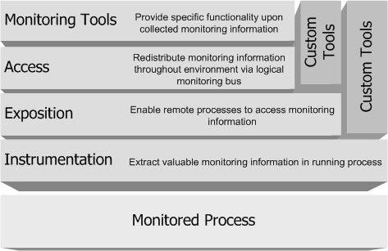
Analysis of a Monitoring Problem
Proposed monitoring system reference architecture
  instrumentation layer extracts, pulls out or drags valuable information from running application processes
  exposition layer provide means in order to make this information remotely accessible, from outside the target application process
  access layer aims at on how to efficiently access monitoring information in usually distributed environment
  tool layer processes collected monitoring information and serve the end user with it

Slide 6
Issues to Address
Instrumentation layer
  Hot-plugging into running applications, dynamic enabling and disabling
  Minimize intrusion into the application code, container and frameworks
  Preserving a proper run of the application, security constraints and policies
  Access to application runtime state, awareness of a context: application, place and time
  Monitoring of high-level business logic
Exposition layer
  Interoperability, standardized data model, protocols
  Unauthorized access, information confidentiality
Access layer
  Support for diverse conversation modes (query-response mode, notification mode)
  Effective data redistribution in usually distributed environment (especially GRID)
  Scalability, network throughput, communication latency, jitter and reliability
Overall
  Good fitting in the software platform, easiness of installation and employment
  No intrusion in the application development process
  No derangement of the execution environment
  No memory-consuming overgrown library prerequisites
  Transparency of monitoring system for component’s business logic

Slide 7
Discussion of Available Solutions
Instrumentation techniques
  Source code instrumentation:
    logging libraries
    Java Management Extension (JMX) instrumentation layer,
    Message-Oriented Middleware (MOM) API (e.g. Java Message Service, Message Passing Interface)
  Bytecode instrumentation (javax.instrumentation API, BCEL, ASM)
    Compile-time instrumentation
    Load-time instrumentation
    Dynamic instrumentation
  Abstract Syntax Tree (AST) approach (e.g. Eclipse JDT, SIR)
  Aspect-Oriented Programming approach (e.g. Spring AOP, AspectJ, JBoss AOP, AspectWerkz)
Exposition techniques
  MOMs providers
  JMX Agent Layer (MBean features: attributes, operations, notifications)
  Java Platform Debugging Architecture (JPDA)
  Plain low level sockets (TCP, UDP)
  Higher layer protocols (SOAP), WS-Notification
Access techniques
  MOMs providers
  JMX Distributed Services Layer (Connectors, Adapters)
  Reliable multicast (e.g. JGroups)
  Peer-to-peer networks (e.g. JXTA)

Slide 8
Available Solutions Summary
No solution fully suitable
Some issues remain still unaddressed
  Poor support for instrumentation hot-plugging into running applications, dynamic enabling and disabling
  Intrusion into an application code, application development process
  Too cumbersome instrumentation
  No support for monitoring of high-level business logic
Solutions discussed are easy to combine and complement each other
Agile Monitoring Adherence Environment
(leMonAdE) is needed and is possible to achieve
  Agile adherence to existing solutions and standards
  Agile adherence to applications

Slide 9
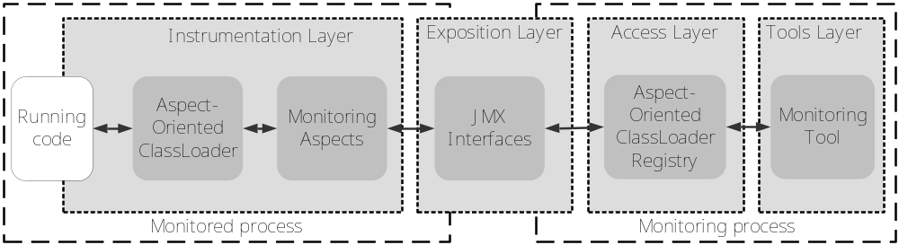
Concept
Aspect-Oriented Class Loader
(AOCL)
  Base classes, aspect classes
  bytecode provider
  AOP-like instrumentation engine
Monitoring Aspects
  POJOs (stateful, rich with logic)
  Advise in pointcut specified
Remote Interfaces for AOCL and aspects
AOCL Registry
  Stores addresses to AOCL and aspect MBeans
Adaptation of Mocca Framework class loaders hierarchy
  Incorporation of AOCL
Extensions to Moccaccino Manager
  Application Instrumentation Specification for Moccaccino (AISM) support
  Associates component instance with corresponding AOCL
  AOCL Registry maintenance
Monitoring Tools basing on AOCL Registry or Moccaccino Manager
  AOCL Registry stores all information needed to access AOCL and aspect MBeans
  Moccaccino Manager maintains AOCL Registry

Slide 10
Techniques and Technologies Employed
JMX
  Built in the Java Platform
  Standardized, plenty of supporting tools
  Supports custom connectors
Java custom class loading policy
  Well-defined extension point of a Java platform
  Enables loading classes from arbitrary bytecode provider
  Class loaders as the isolated spaces of classes
AspectWerkz AOP framework
  Uses ASM bytecode manipulation library
  Uses javax.instrumentation API
  Powerful pointcut expression language
  Supports annotation-driven development

Slide 11
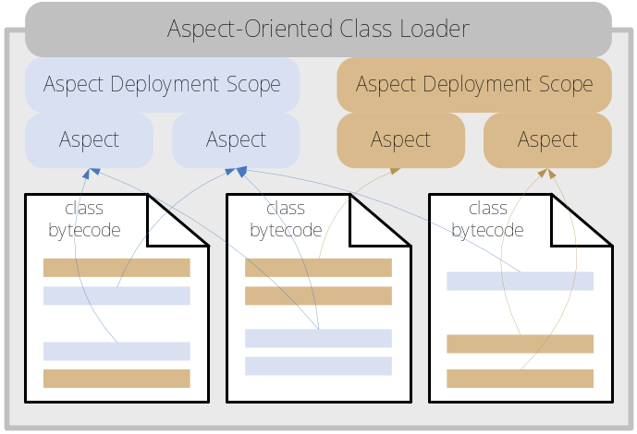
Design. Instrumentation Layer
Aspect-Oriented Class Loader (AOCL)
  Provides base classes and aspect bytecode from
  arbitrary remote location specified at runtime
  Manages zero ore more
  Aspect Deployment Scopes and
  Stores application and place context information
Aspect Deployment Scope (ADS)
  Specifies pre-instrumentation pointcut
  Manages zero or more aspects that may be
  woven only in join-points of pre-instrumentation
  pointcut
  May be static, having a fixed pointcut expression explicitly specified
  May be parameterized, having a parameterized pointcut expression specified, whereas the actual pointcut expression is resolved according to the parameter values provided
Monitoring Aspect
  POJO
  May be static, with pointcut specified explicitly coded in aspect class annotations
  May be static, with pointcut specified explicitly as parameters passed to the aspect deployment request
  May be parameterized, with pointcut specified implicitly with parameters passed to the aspect deployment request while actual pointcut is resolved by parameterized ADS

Slide 12
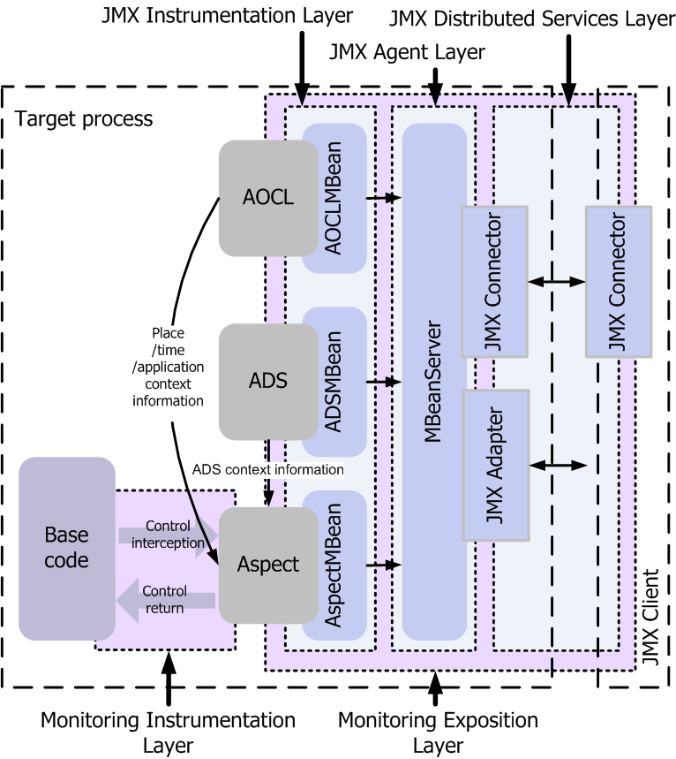
Design. Exposition/Access/Tool Layers
AOCL, ADSs and aspects as standard MBeans with remote interface exposing:
  attributes, operations and notifications
AOCL instantiated with configuration specified either via API or with XML-based document:
  ADSs specification
  Aspect specification
ADS remote interface allowing deployment/undeployment of aspects at runtime
AOCL registry as storage of MBean names and addresses on a monitoring tool side
  Maintains connections to every MBean involved using RMI JMX Connector
Monitoring tools based on JMX console

Slide 13
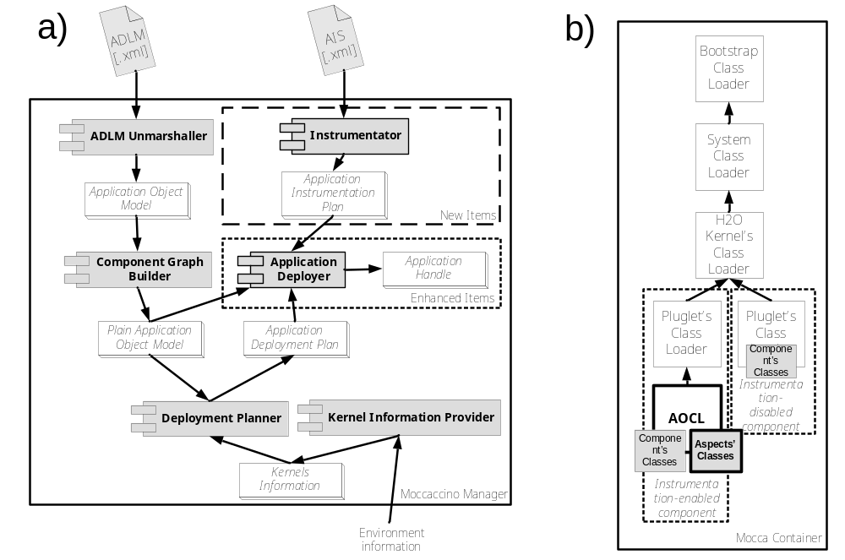
Design. Extensions to Mocca and Moccaccino
Moccaccino Manager: Instrumentator module that generates one AOCL configuration per each component instance according do Application Instrumentation Specification (AIS). Deployer module that sends AOCL configuration along with component instance deployment request to H2O/Mocca container. Application Handle implements AOCL Registry.
Mocca: Component’s class loader is replaced with AOCL that extends H2O/Mocca container class loader hierarchy.
Moccaccino Eclipse IDE Plug-in: UI built over Moccaccino Manager.

Slide 14
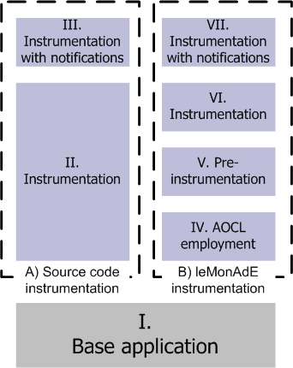
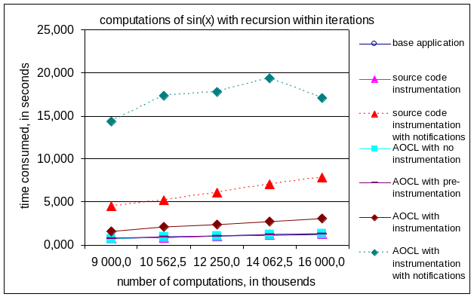
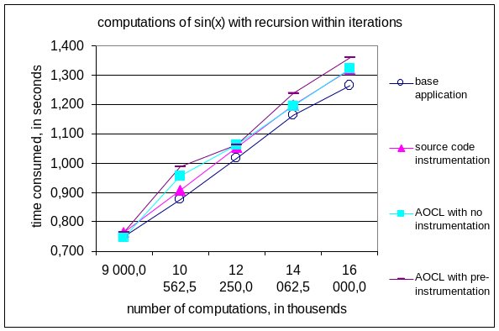
Performance Analysis and Discussion
Methodology
  Equivalent instrumentation using either source code instrumentation or leMonAdE techniques
  Instrumentation with JMX notification either enabled or disabled
  Test applications with different stack characteristics (recursion vs. iterations)
  The worst, non real-world case investigated - intensively instrumented application
Results
  pre-instrumentation overhead is optimized by JVM and is negligible
  leMonAdE instrumentation without notifications overhead is 2 orders of magnitude greater than in the case of source code instrumentation
  notification sent by leMonAdE instrumentation causes overhead 1,5-2,5 times greater than in the case of source code instrumentation

Slide 15
Summary of Work Done
Achievements
  Separation of business logic and monitoring concern
  Adherence to existing standards and specifications
  Introspective monitoring
  Monitoring of high-level business logic
  Dynamic instrumentation
  Agile adaptation
  Monitored application model
  Minimizing overhead
Work status
  leMonAdE AOCL ready to use in every Java-based container
  Ready to use leMonAdE-enabled Mocca
  Ready to use leMonAdE-enabled Moccaccino Manager
  Prototype of Eclipse plug-in dedicated to leMonAdE-enabled Moccaccino Manager

Slide 16
Future Work
Security - not covered by this thesis however taken into consideration on the design stage – taking advantage of Shibboleth
Efficient and scalable monitoring infrastructure data bus – integration with Gemini, dedicated JMX connector
Systematic development of monitoring aspects set
Providing leMonAdE-enabled Java-based containers
  Axis, XFire Web Services frameworks
  Web Services Resource Framework
  Java Enterprise Edition containers

Slide 17
Agile Monitoring Adherence Environment
Please, visit leMonAdE site
http://gforge.cyfronet.pl/projects/lemonade/

