Slide 1
Assessment of Software Quality with Static Source Code Analysis: GridSpace2 Case Study
Bartłomiej Bodziechowski¹, Eryk Ciepiela², Marian Bubak^{1,2}
¹AGH University of Science and Technology, Department of Computer Science AGH,
²AGH University of Science and Technology, ACC Cyfronet AGH,

Slide 2
Introduction – few words about quality of software under development
Problems connected with software under development:
Rigidity – The system is hard to change because every change forces many other changes.
Fragility – Changes cause the system to break in conceptually unrelated places.
Immobility – It's hard to disentangle the system into reusable components.
Viscosity – Doing things right is harder than doing things wrong.
Quality of software under development assured by
Dynamic analysis
- testing
Static analysis
- metrics
Metric definition: A rule for quantifying some characteristics or attribute of a computer software entity.
Key point: to find relation between metric results and external quality features: functionality, reliability, portability, efficiency, maintainability (ISO 9126).

Slide 3
Goals
Assessment of usefulness of software static metrics in software engineering,
Application of software static metrics for GridSpace2 and indication of areas that need to be reviewed and potentially need refactoring,
Identifying areas for which static software metrics could be applied for object oriented software,
Research and grouping of static software metrics based on available literature and studies
Review of open source tools implementing static software metrics for Java programming language.

Slide 4
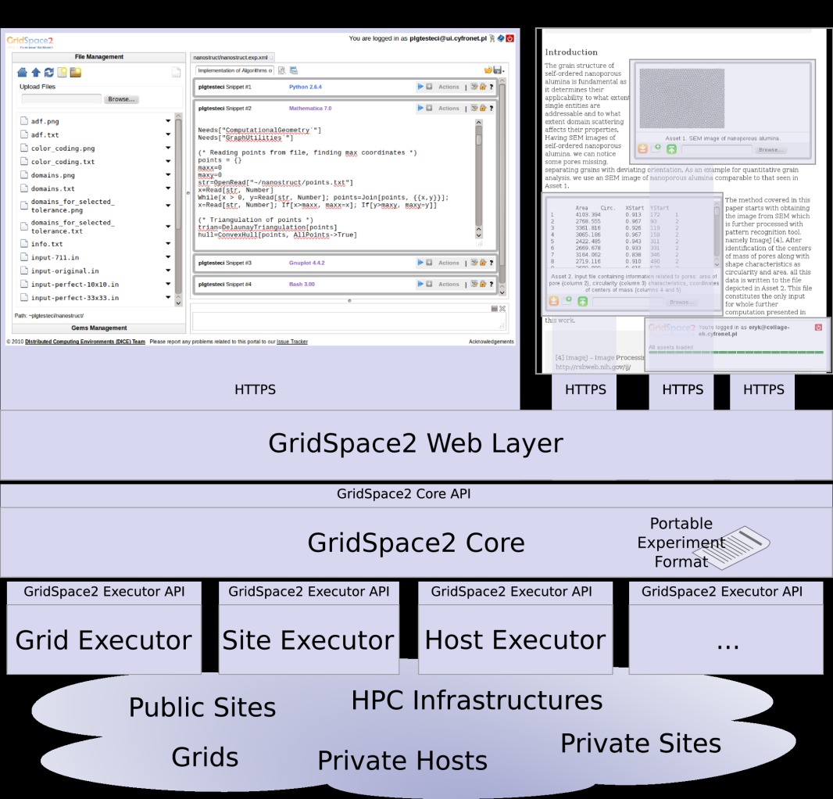
GridSpace2
GS2 is a platform for creating scientific computing application (in silico experiments) with Polish and European data center resources,
Developed by Distributed Computing Environments Team working at CYFRONET AGH.
Important features of GS2 from metrics point of view :
Relatively big projects consist of 400 classes divided into 70 packages,
Multilayered application,
Developed by the team of programmers,
Under constant changes due to the need of adaptation to still changing context and environment of working,
Written in Java.

Slide 5
Areas measured by software static metrics
Areas
Counts
Object-oriented pardigms
Laws and principles
Artifacts
SOLID
Packages
Law of Demeter
Inheritance
Single responsibility principle
Dependencies
Cohesion
Couplings
Encapsulation
Open close principle
Reuse/release equivalency principle
Acyclic dependency principle
Others
Liskov substitution principle
Polymorphism
Common reuse principle
Stable dependenciy principle
Duplicated code
Interface segragation principle
Cohesion
Common close principle
Stable abstractions principle
Dependency inversion principle
Unit testing covarage
Red – not covered by metrics

Slide 6
Metrics - division
Metrics
Size and complexity
Object oriented metrics
Duplicates and unit testing covarage
Readability, good practice and potential bugs for Java
Counts of artifacts
MOOD (metrics of object-oriented design) by F.Abreu
Counts of couplings
Chidamber-Kemerer set of metrics
R. Martina set of metrics for packages and modules
Other laws and principles

Slide 7
Metrics
Metric definition: A rule for quantifying some characteristics or attribute of a computer software entity.
Proposals of metrics in scientific publications and in tools (mainly size and complexity),
Verification of metrics:
Theoretical – understanding the theoretical basis,
Practical – relationships with external features of software quality,
Expected values for the metrics:
Resulting from definition,
Proposed based on evaluation of software identified as high quality.

Slide 8
Examples of metrics – Chidamber Kemerer set of object-oriented metrics
Response For a Class
Number of methods that can be invoked in response on massage received by object of considered class
Typical values: 20-100, review recommended for >200 (L. Rosenberg NASA)
To high value means:
High internal complexity,
To big responsibility set for the class,
High cost of testing and maintainability.
Coupling Between Objects
Number of classes that are connected with considered class in relationships other then inheritance (efferent couplings),
The lower the better values,
High values means that class is more sensitive for changes in other place of system – difficulties with maintainability.
Weighted Method per Class
Weight of methods is cyclomatic complexity of McCabe’a.
60% of classes has WMC [0;20], 36% WMC [20;100], review recommended for >100 (L.R. NASA)

Slide 9
Examples of metrics – Chidamber Kemerer set of object-oriented metrics
Depth of Inheritance Tree
The maximum number of levels of parent classes,
High DIT – high specialization of class, reducing duplicates,
Low DIT – weak usage of inheritances and usage of existing packages.
Number of Children
Is the number of direct descendents of class,
Low value again means weak usage of inheritance
High value – to big responsibility, difficulties in testing
Lack of Cohesion Of Methods
Indicates lack of cohesion of methods inside the class,
It is differences between number of pairs of methods invoking different attributes P and number of pairs of methods invoking at least one common attribute Q :
LCOM1 = P - Q , if P > Q LCOM1 = 0 otherwise

Slide 10
Tools for static software analysis for Java language
7 tools implementing metrics:
Stan: results in the form of histograms, visualization of dependencies on all level of abstractions,
RefactorIT: a lot of different metrics, creation of report with precise results for all artifacts useful to carry out self-analysis
Sonar: the highest numbers or releases, support for refactoring
JDepend, Ckjm, Simian, Cobertura,
3 tools based on rule-set which are checking code for good practice, readability and potential bugs
PMD, Checkstyle, Findbugs

Slide 11
Using metrics in practise
Integrate metrics tools in software development process (Eclipse, Maven plugins)
Assess the quality of measuring feature for whole system. Histograms are the best to do it.
Review of these artifacts
Indicate artifacts with metrics values outside of the recomendations
Decision about refactoring

Slide 12
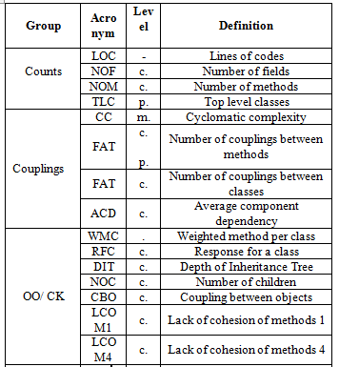
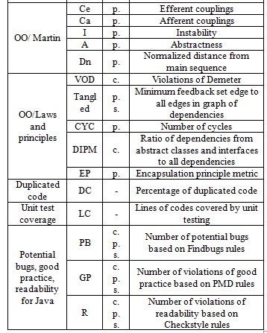
Metrics checked for GS2
Level: m – methods, c – classes, p – packages , s - system

Slide 13
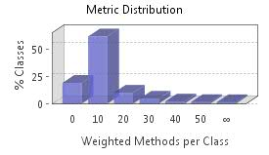
Measurments of GS2
7 different tools were used: Stan, RefactorIT, Sonar, Simian, PMD, Checkstyle, Findbugs.
Most important results:
Good results obtained for counts metrics of artifacts and couplings (for different metrics only from a few to max 14 classes out of recommended values,
Metrics CBO, RFC i WMC results similar like for counts metrics (violations offen for the same classes),
Inheritance used mainly by using external packages (high values of DIT and low values for NOC),
Classes | WMC
ew.workbench.client.ui.SnippetPanel | 136
sshexecutor.SSHFileManager | 120
sshexecutor.ModifiedSCPClient | 118
core.execution.ExperimentSessionBase | 109
ew.workbench.client.ui.ExperimentPan | 78

Slide 14
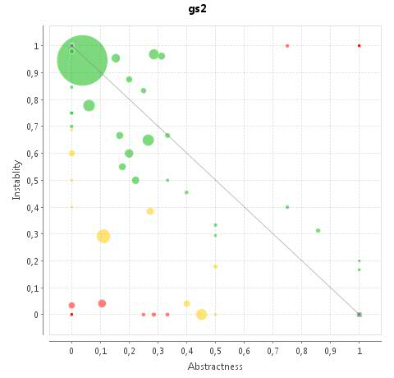
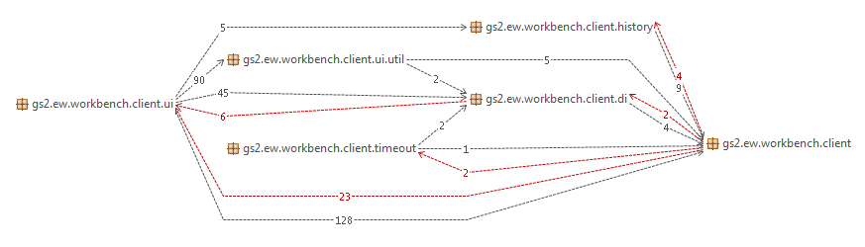
Measurments of GS2
Ca. 7% classes needed to be divided to smaller (lack of cohesion) LCOM4>1,
Breaking of Stable Abstractions principle ,
42% of classes break Law of Demeter,
40% packages involved in cycles braking – breaking Acyclic Dependency Principle
Law level of duplicates ~5% - good result
Unit tests - line covarage 17%

Slide 15
Conclusions
Using software static metrics is useful in keeping high quality of software under development,
There are many areas that can be checked by metrics (object-oriented paradigms, laws, principles) but lack of studies for using metrics in the context of design patterns,
Values of metrics stay in correlation with external quality features: functionality, reliability, portability, efficiency, maintainability (studies for MOOD and CK set of metrics),
Threshold values of metrics set up based on software identified as high quality software or proposal inside tools which roots are not known – cautious recommended.
Violation of threshold doesn’t mean need of refactoring – it is only yellow light informing about higher risk of potential failure.
Tools based on rules sets (PMD, Checkstyle, Findbugs) needed to be used during code writing, can not be used for audits,
Open source tools contains bugs e.g. DIT in Stan, or EP in RefactorIT,
Using metrics can help to better understand the software especially its complexity.

Slide 16
Future works
Improvement of definitions of existing metrics based on better understanding of theoretical basis,
Further studies between metrics violations and problems with external quality features: functionality, reliability, portability, efficiency, maintainability are needed.
Studies on using static metrics in context of design pattern.
New metrics definitions.

