Slide 1



Bioinformatics Applications in the Virtual Laboratory
Tomasz Jadczyk
AGH University of Science and Technology, Krakow
Msc Thesis
Supervisor: dr. Marian Bubak
Advice: dr. Maciej Malawski

Slide 2
Outline
  Thesis objectives
  Short introduction to bioinformatics and virtual laboratory
  Classification of applications and gems - layers
  Bioinformatics databases
  Basic analysis gems
  Protein sequence and structure comparison
  Comparison of services for predicting ligand binding site
  Microarray data analysis
  Summary

Slide 3
Thesis Objectives
Analysis of bioinformatics applications
Classification of the applications
Design of applications integration
Creating a set of ViroLab gems and preparing experiments
Preparing general methods and tools to make using bioinformatics applications easier in the virtual laboratory experiments

Slide 4
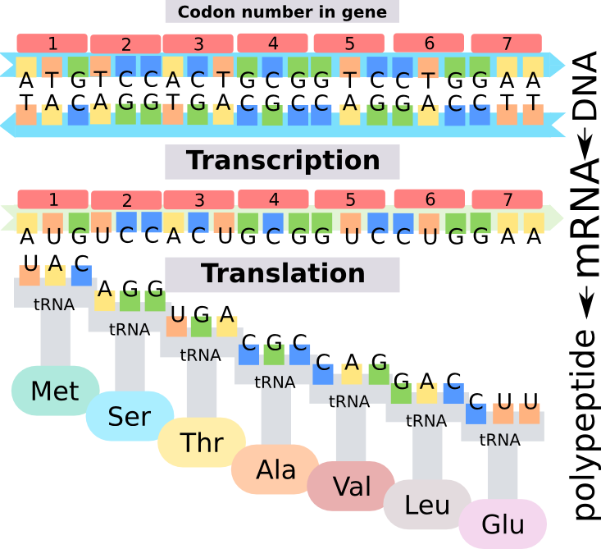
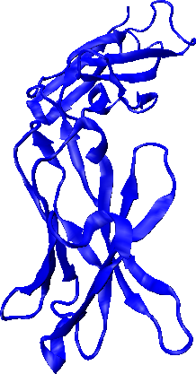
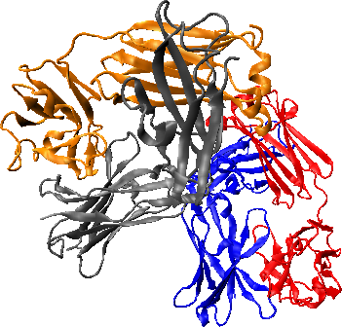
Short Introduction to Bioinformatics
Bioinformatics – interdisciplinary science
  Development of computing methods
  Management and analysis of biological information
Main research areas
Information management in living cells
The Central Dogma of Molecular Biology
Protein structure
Evolution

Slide 5
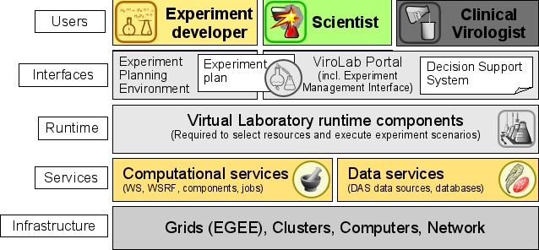
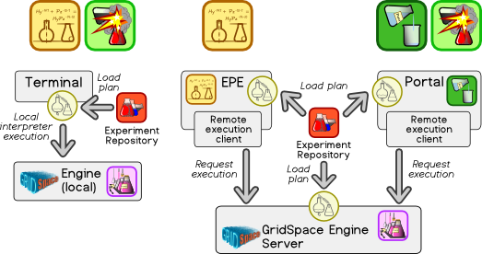
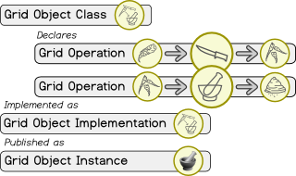
Short Introduction to VLvl
ViroLab virtual laboratory is a set of integrated components that, used together, form a distributed and collaborative space for science
Experiment is a process that combines together data with a set of activities (available as gems) that act on that data in order to yield experiment results
Gem (Grid Object) realizes interface and may be implemented in one of the available technologies: Web service, MOCCA, WSRF, WTS, gLite, AHE
Two main groups of ViroLab users: experiment developers and experiment users employ EPE and EMI environments to create and run the experiment

Slide 6
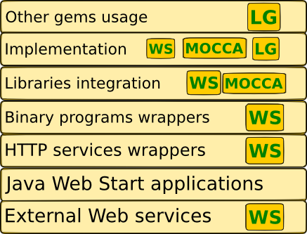
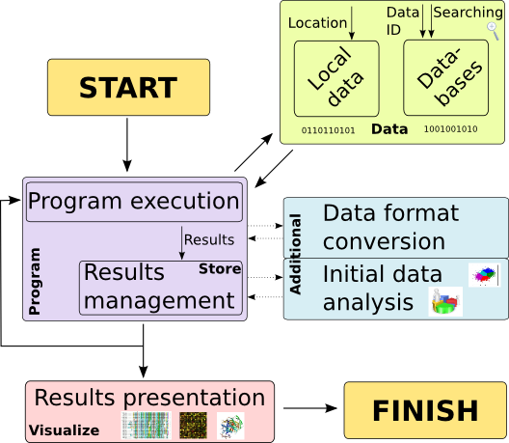
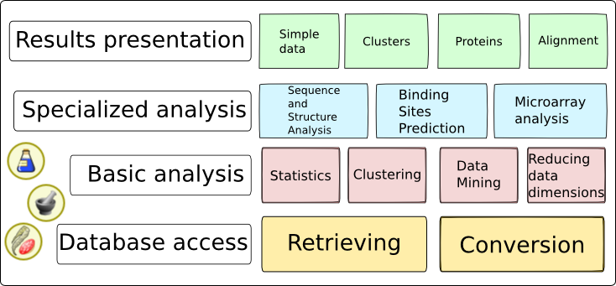
Classification of Applications and Gems
General model of bioinformatics experiment
Bioinformatics gem technologies
Web service (WS)
MOCCA component
Local gem (LG)
Gem scope of usage
  Database access
  Basic analysis
  Specialized analysis
  Presentation

Slide 7
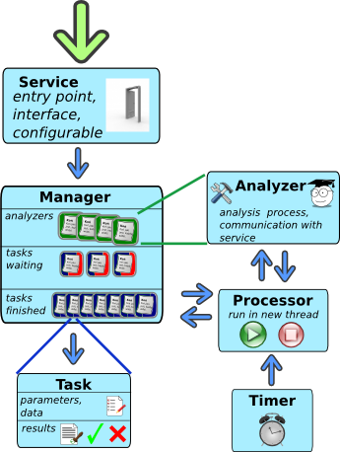
Additional Integration Mechanisms
Available technologies of Grid Object Implementation do not enable correct integration of all types of bioinformatics applications. Two enhancements were developed.
Task queuing system
  Using Web services
  Simultaneous running many tasks
  SOAP protocol limitations (timeouts)
  Tasks management
  Configurable
Binary program wrapper
  Running local command-line programs as Web service

Slide 8
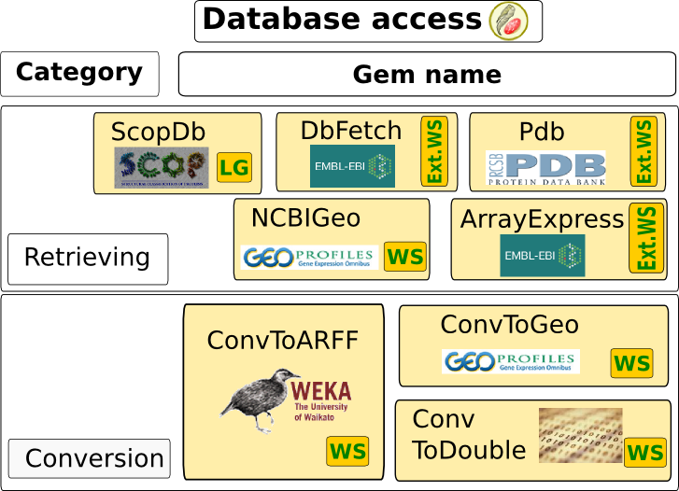
Database Access Layer
Accessing to data from various external bioinformatics databases:
  DbFetch
  PDB
  Microarray data: GEO, ArrayExpress
  Scop
Data formats:
  PDB File
  FASTA
Format conversion

Slide 9
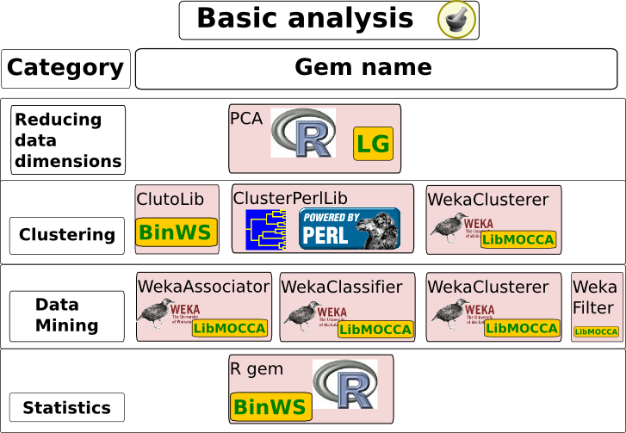
Basic Analysis Layer
Statistical computation – R
Data mining
  Weka library
Data clustering
  Cluto
  Cluster 3.0
  WekaClusterer
Data dimensionality reduction
  PCA and MDS

Slide 10
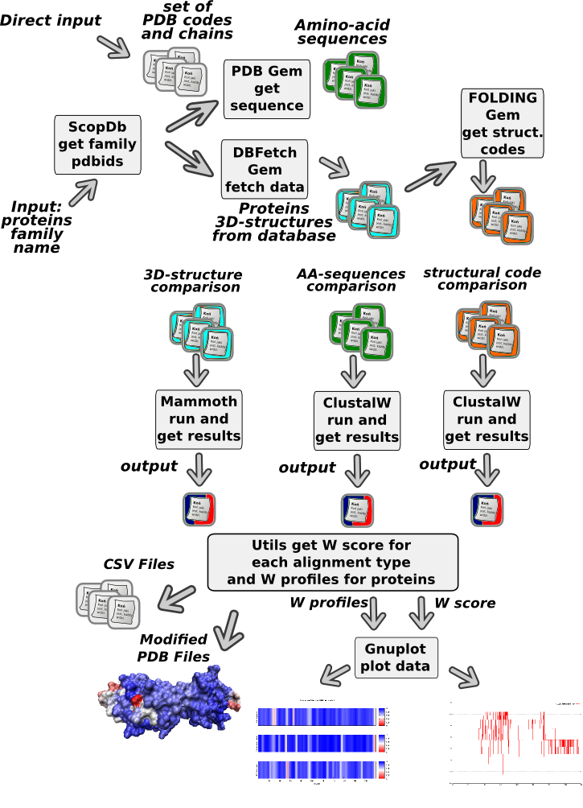
Protein Sequence and Structure Comparison (1/2)
Compare family of proteins on three levels of protein description
  Amino acid sequence
  Structural sequence
  3D structure
Search for conservative regions on each level
„Early Stage” model developed by prof. Irena Roterman and her team
Possibility of using different gems to solve the same part of problem

Slide 11
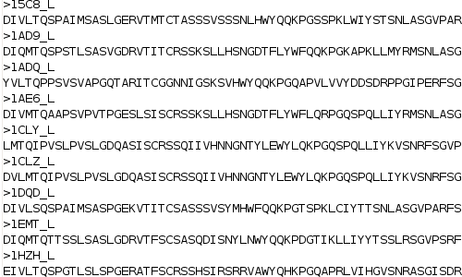
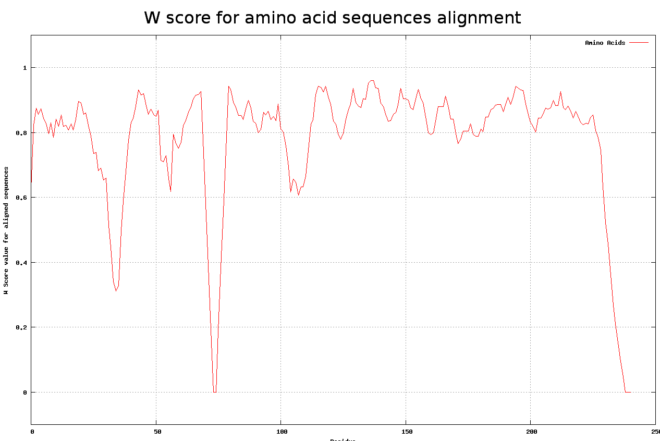
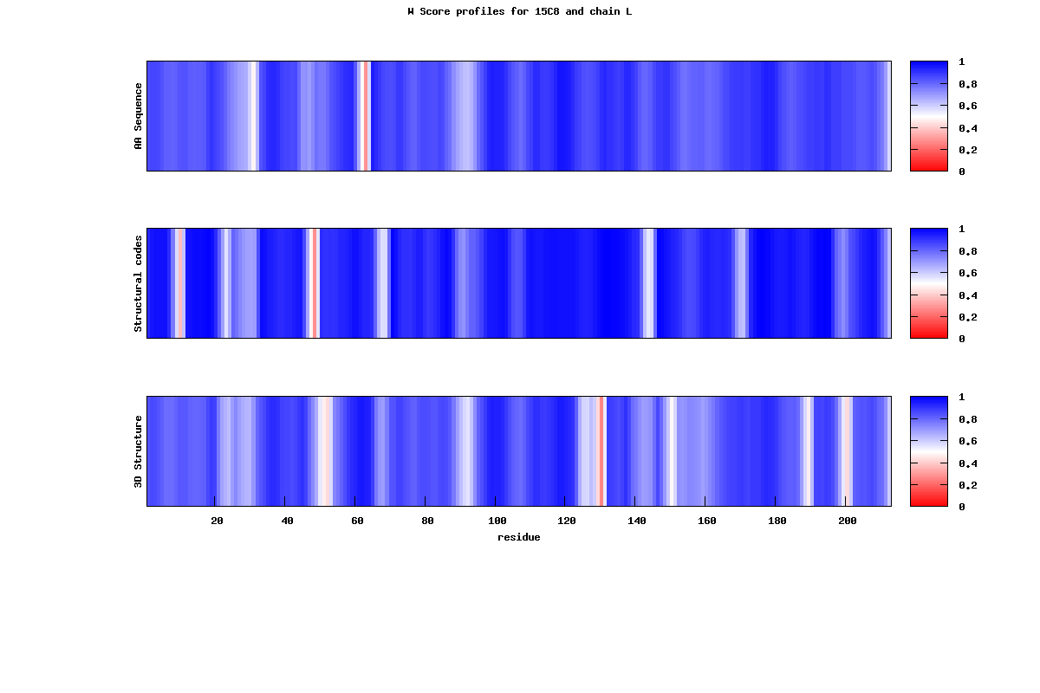
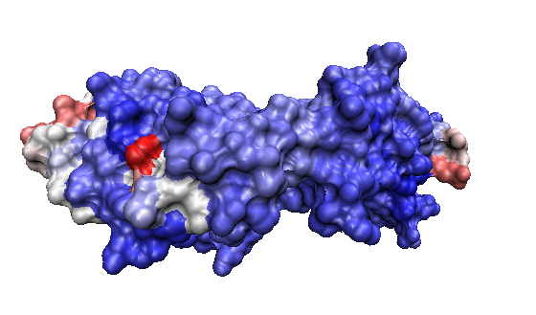
Protein Sequence and Structure Comparison (2/2)
Data gathering:
  Pdb codes (ScopDb, direct data)
  AA sequence (Pdb)
  Structural codes (EarlyFolding)
  3D structures (DbFetch)
  Additional data manipulation
Aligning sequences and structural codes
  FASTA format
  ClustalW
Aligning structures
  PDB files
  Mammoth
Analyzing alignments
  Computing W score
Creating results
  W score and W profiles plots
  Modified PDB files
  CSV files
Additional visualization
Part of experiment | Gems
Data gathering | ScopDb, Pdb, DbFetch, EarlyFolding,
Sequences alignment | ClustalW, ClustalW2, Muscle, T-Coffee
Structures alignment | Mammoth, MultiProt, SSM
Results | ClustalWUtils, GnuPlot

Slide 12
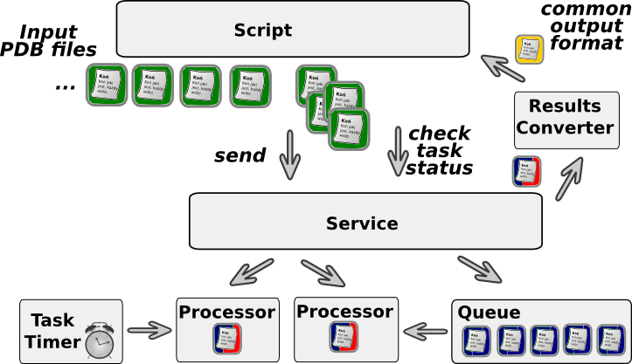
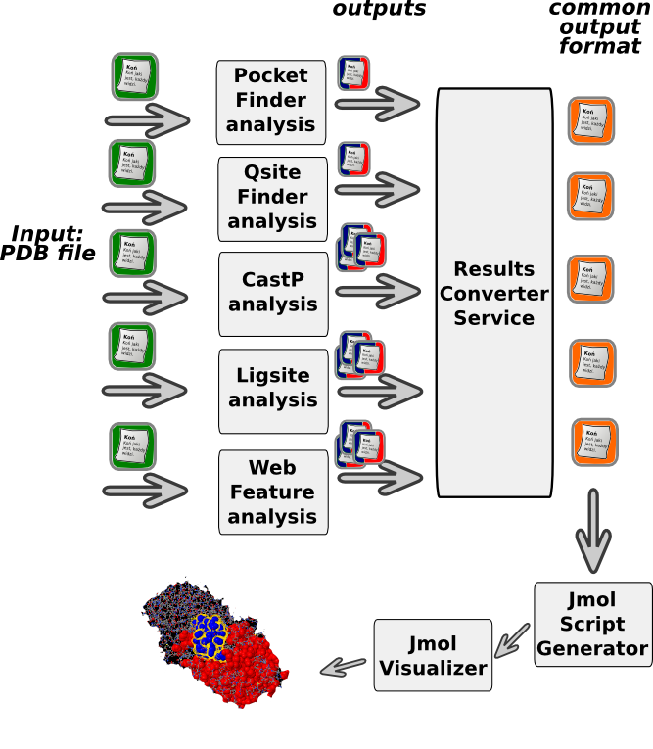
Comparison of Services for Predicting Ligand Binding Site (1/2)
Searching for binding sites in protein allows defining protein function or searching for substances which will have an effect on this protein
Most of services are available only via WWW or email – HTTP communication wrapping and Task queuing system used
  Specialization of the general architecture:
    ProteinService
    ProteinTask
    analyzers
Converting results from service specific format to the common one.

Slide 13
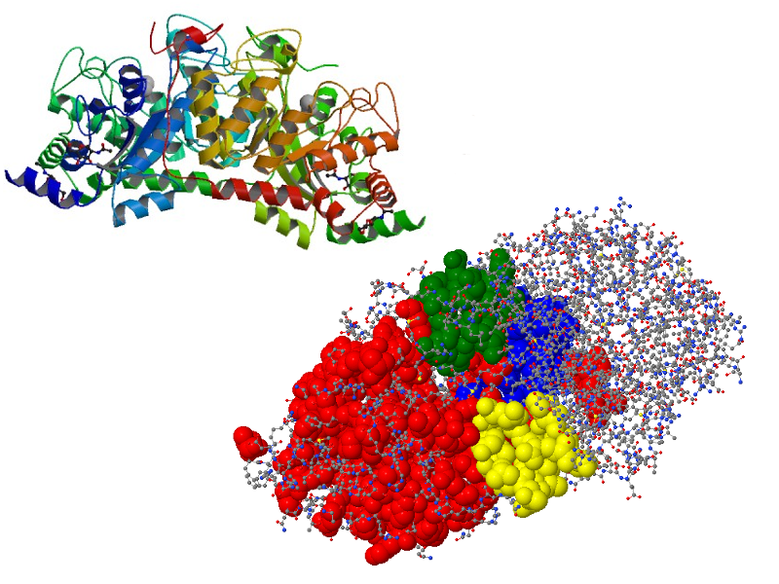
Comparison of Services for Predicting Ligand Binding Site (2/2)
Part of experiment | Gems
Analysis | CastP, ConSurf, Fod, Ligsite_csc, Pass, PocketFinder, QsiteFinder, SuMo, WebFeature
Conversion | ResultsConverter
Results | Jmol
PDB Files in single directory
Any number of available services used
Creating all tasks for each service, but sending only a part of them. Remaining tasks are sent subsequently, when results are obtained
Converting results to common format
Generating Jmol visualization scripts

Slide 14
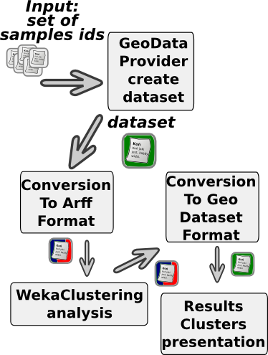
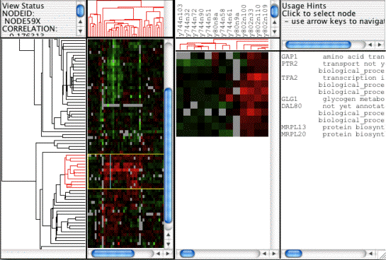
Microarray Data Analysis
Microarray technology allows to measure gene expression in samples and to compare results with some reference values – samples can be joined into datasets
Clustering gene and samples data required
Using data sets from Geo and ArrayExpress databases or creating new ones, based on Samples identifiers
New data model and clustering library has been developed
Results presentation

Slide 15

Summary
The main goal of the thesis was successfully achieved. Selected bioinformatics applications are available in the virtual laboratory
All sub-goals were also completed:
 | Analysis of bioinformatics applications | Main bioinformatics research areas to be supported were selected and required databases were identified
 | Classification of the applications | Two classifications of applications have been developed: by scope of usage and by technology
 | Design of applications integration | An appropriate integration technology was assigned to each application
 | ViroLab gems and experiments | 42 gems (5 Database access, 11 Basic analysis, 21 Specialized analysis and 5 Results presentation), 3 main experiments (Comparing proteins, Comparing services for prediction of ligand binding site and Microarray data analysis)
 | Preparing general methods and tools | Integration mechanisms, additional gems, like data format converters
Thanks to prof. Irena Roterman-Konieczna, dr. Monika Piwowar and Katarzyna Prymula, Department of Bioinformatics and Telemedicine, Jagiellonian University – Medical College

