Slide 1

Environment for Management of Experiments on the Grid
Master of Science Thesis
Paweł Charkowski
Supervisor: dr inż. Marian Bubak
Consultancy: dr inż. Maciej Malawski
AGH University of Science and Technology, Krakow, Poland
Faculty of Electrical Engineering, Automatics, Computer Science and Electronics
Institute of Computer Science

Slide 2
Outline
Goals of the thesis
Introduction to the ViroLab
Overview of related works (DIANE, Nimrod, Askalon, Zenturio)
Experiment management system requirements
EMGE system architecture
Testing and integration of EMGE
Summary

Slide 3
Goals of the thesis
Analysis of the problem of grid experiments management environment
Identification of available experiment management solutions
  Research and discussion of related works to gain better problem view
Design and development of the Environment for Management of Grid Experiments adapted to the ViroLab Virtual Laboratory
  Design of appriopriate database model
  Implementation of system modules
Proving correctness and usefulness of the developed system
  Unit tests, integration tests, execution of sample test experiment

Slide 4
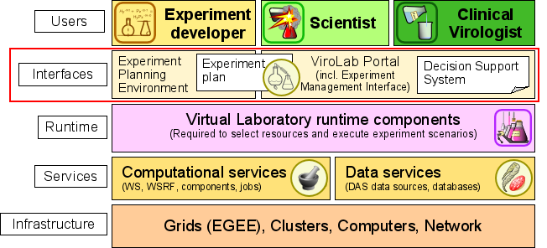
ViroLab Virtual Laboratory
The ViroLab Virtual Laboratory is an infrastructure for transparent data access, experiment execution, and collaboration support for distributed analysis
Works on grid infrastructure
The system designed in this thesis is located in the „interfaces” layer
Research project of the 6th EU Framework Program
  Virtual laboratory for infectious disease treatment support (mainly HIV)
  Experiment developement is located at ACK Cyfronet AGH

Slide 5
Motivation for the Environment for Management of Experiments on the Grid
ViroLab lacks a management environment for complex experiments
  Each single task has to be executed separately by the user (EPE, EMI)
  Problem when the same operation has to be performed for several parameters: long execution time (when using loop) or the experiment user has to schedule several task instances manually
  Issues with tasks having long execution time:
  When something fails the whole task has to be rescheduled
  Dividing such task to several part requires user to manually manage execution sequence and data passing
Creating a experiment management environment would:
  solve issues described above
  be a more user-friendly solution
  allow system administrator to gain better knowledge about executed tasks (logs)

Slide 6
Overwiev of related works 1/2
DIANE
  Master/worker architecture
  Each worker agent must be started manually
  Execution of parameter-study experiments
  Application adapter package required to launch non-paramter-study experiments
  Python
    experiment scripts for DIANE must be written in python
Nimrod
  Manages execution of parameter-study experiments
  Experiment description in a plan file
    parameter section and tasks section
  Experimentator must provide console command, used to launch task, during experiment scheduling
    problem with ViroLab security credentials validation timeout
  Tasks are executed as console commands
    using GSEngine client would require it to be installed at every host that nimrod/g launches
    tasks on

Slide 7
Overwiev of related works 2/2
Askalon
  Service-oriented architecture
  UML-based graphical tool for workflow modeling
    used also to monitor task status
    launched on user host
  Requires programatic skills form users - virolab user do not always has:
    learn AGWL language
    know how to model in UML
Zenturio
  Interacts with user through a web portal
    interface for submitting, monitoring, controlling the experiement and analyzing experiments results
  ZEN - directive based language used to specify application parameters
    directives hidden in „comment” lines – independent from programming language
    Script modification needed before each execution
    Requires user to learn ZEN language
  Consists of several Grid services

Slide 8
Requirements
Functional requirements
  Management of experiments execution in ViroLab
  taking care of all aspects connected with scheduling, like: security credentials management, experiment failure recovery, proper task sequence
  Workflow composition support
  Enable end-users to specify experiment workflows, defining task dependencies, passing task outputs as input to another tasks
  Provide UI for ViroLab users
  interface for monitoring experiment status and submiting new experiments
Non-functional requirements
  Use the GSEngine for job execution
  Provided user interface needs to be intuitive and easy to use
  Resource usage minimalization
  minimize grid resources usage and database size
  Easily configurable
  Limited number of simultaneosuly scheduled user tasks
  to prevent one user from overloading the system,and blocking other users’ task execution

Slide 9
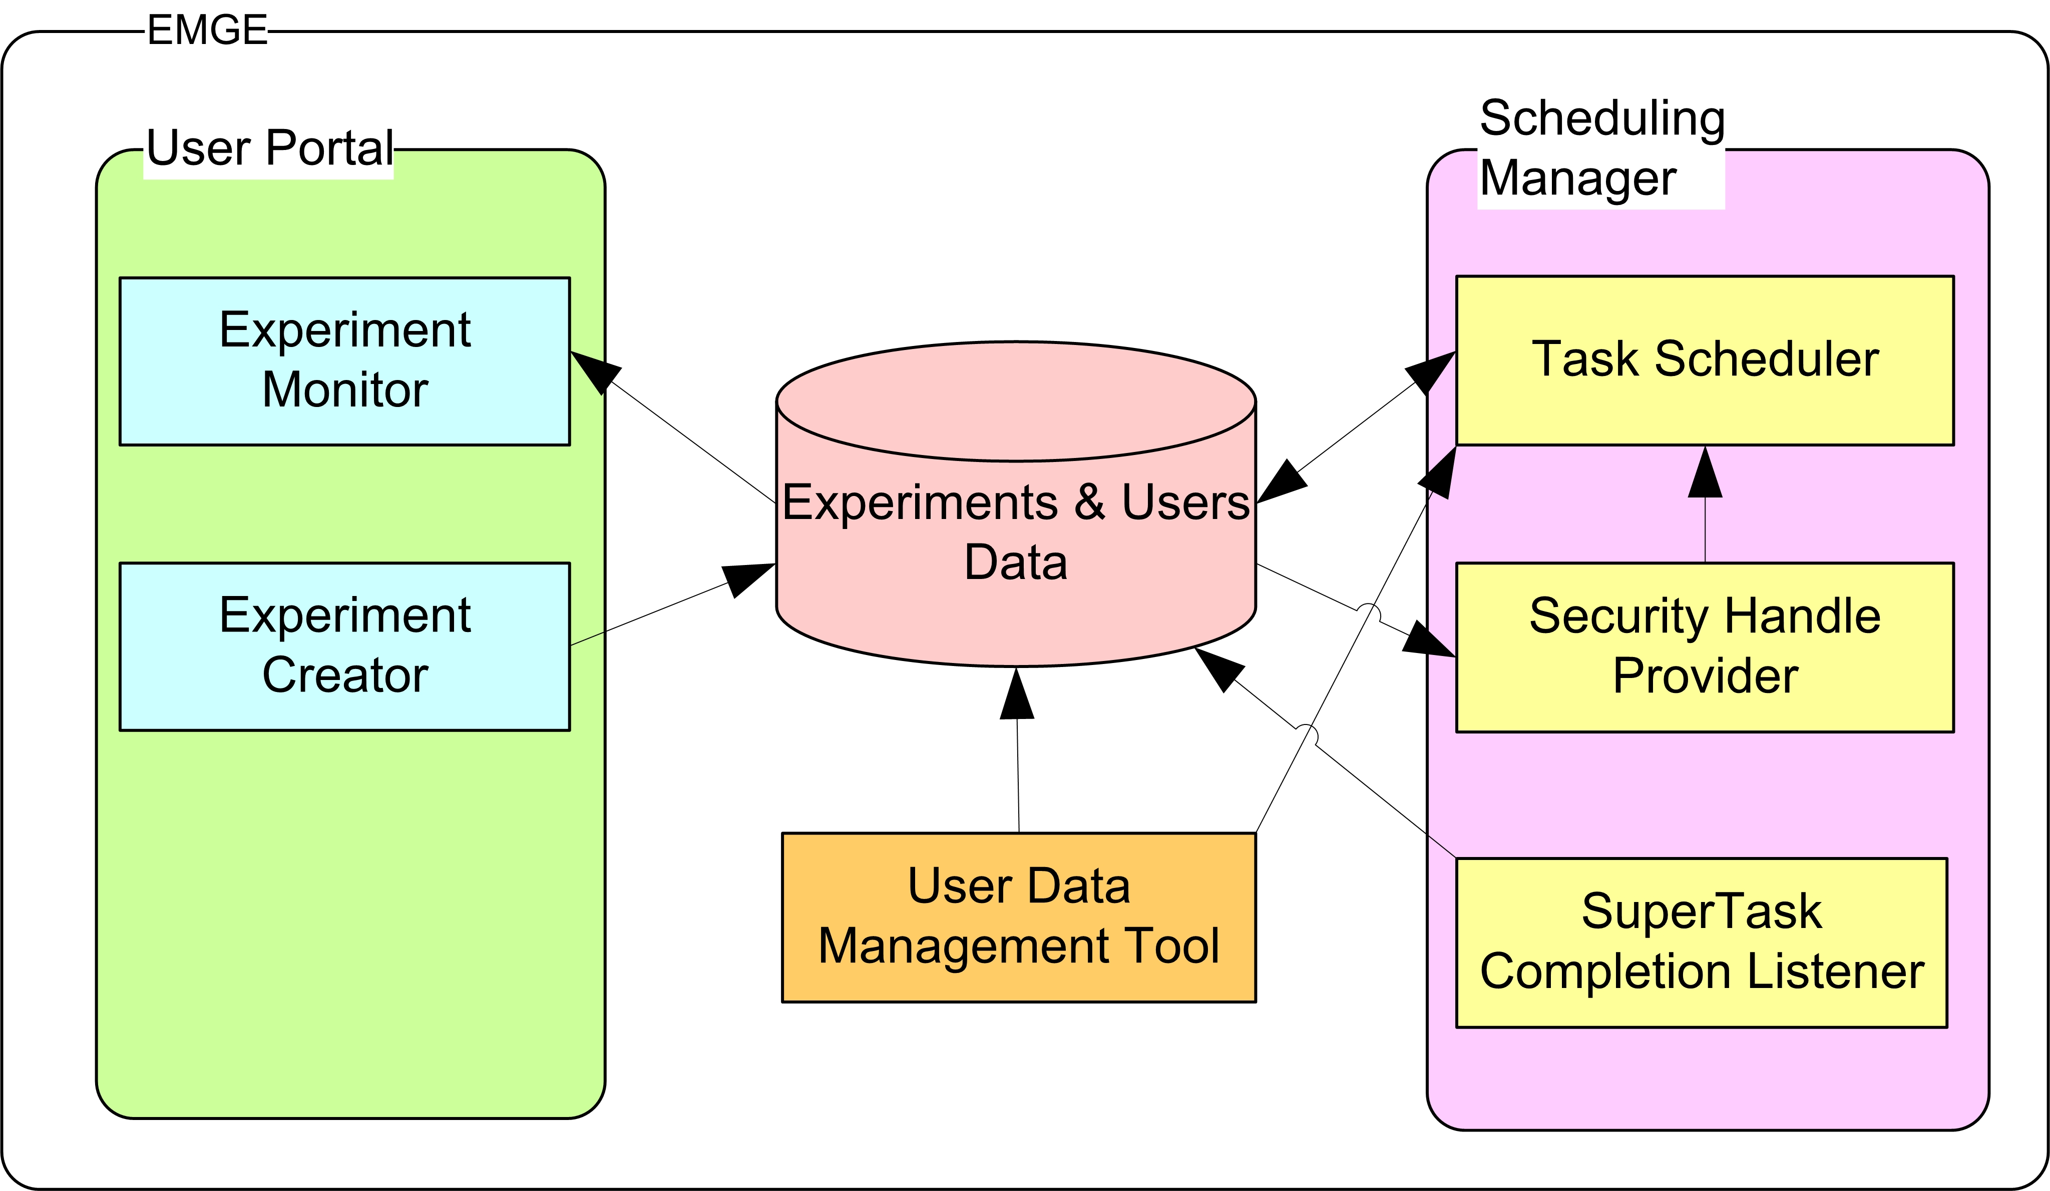
System concepts
Communication with users through a web portal
Independent modules
  Experiment Scheduler and User Portal independent from each other
Database oriented architecture
  experiment information stored in database

Slide 10
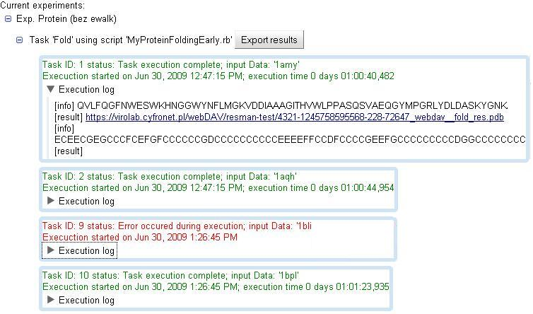
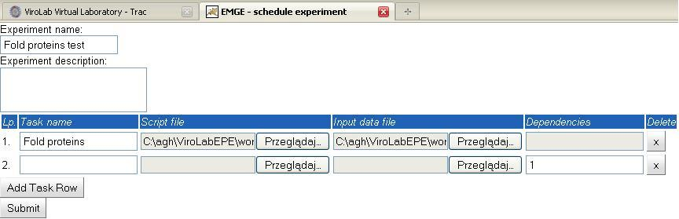
Architecture – User Portal
Experiment Monitor
- displays user’s experiments structure
- shows current task status
- displays task execution information
Experiment Creator
- enables submiting new experiments

Slide 11
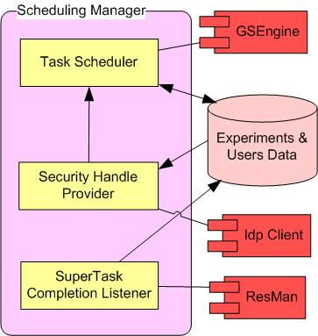
Architecture – Scheduling Manager
Task Scheduler
  manages & schedules task execuiton
  uses GSEngine for task execution
  callbacks update task current state in database
Security Handle Provider
  manages shibboleth handles
  requests new handles if necessary using IdpClient
SuperTask Completion Listener
  listens for task execution completion
  super task results stored using ResMan
  spawns new tasks
  input for new tasks passed as rID’s (ResMan id’s)

Slide 12
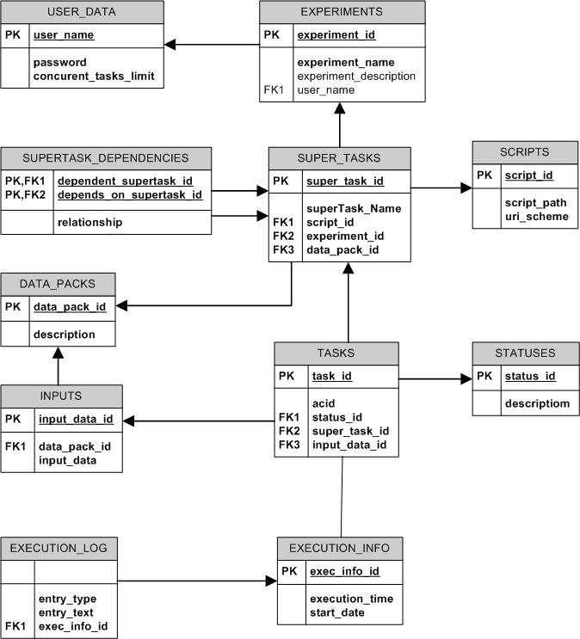
Database model
Database model reflects structure of experiments
Storers all information required for execution of a task
Each table has corresponding bean class
Tables accessed through dedicated Data Access Objects
Object-relational mapping using Hibernate

Slide 13
EMGE Implementation
Implementation details
  task input data read from file – each line used as execution arguments, number of tasks equals number of lines in file
  scripts code uploaded from user host
  super task results shown as ResMan links
  task execution log available to experiment owner
  new tasks periodically scheduled for execution, and on task completion notification
  results between dependant tasks passed as ResMan links
Technologies used :
  Core of EMGE: Java SE 6.0
  User Portal implemented using Google Web Toolkit (GWT)
  Databse access using Hibernate 3.0
  Apache Tomcat Web Server 6.0
  Spring Framework IoC container used in Scheduling Manger
  EMGE tests: Junit testing framework

Slide 14
Testing and Integration
Unit tests
  All implemented classes are covered with unit tests
  All unit tests passed
Integration
  Intergration with GSEngine, ResMan and IdpClient tested and works correctly
  Internal components communication works correctly
Deployment
  Application deployed and launched
  Example experiment of protein folding composed of ower 1000 jobs successfully executed

Slide 15
Summary
The main goal of the this: providing an experiment management environment for ViroLab, has been successfully achieved.
Performed research of related works gave knowledge about strong and weak points of solutions used in those works.
Executed unit and integration tests proved correctness of the developed system.
EMGE has been successfully deployed on a web server and operates correctly for real experiments

Slide 16
Future work
Drag&drop interface for workflow composition
  Drag&drop mechanism is more user friendly. It is also less error prone that current interface, as it will be easier for users to notice workflow composition error on a block diagram.
Adaptation to use experiments requiring input at runtime
  Many existing experiment scripts available in ViroLab require user input at runtime. Such experiments are not supported by current version of EMGE.

Slide 17
Web sites
visit following web sites:
http://www.virolab.org
http://virolab.cyfronet.pl
https://gforge.cyfronet.pl/projects/emge/

