Slide 1



Universal Grid Client: Grid Operation Invoker
Tomasz Bartyński¹, Marian Bubak^{1,2}
Tomasz Gubała^{1,3}, Maciej Malawski^{1,2}
1 Academic Computer Centre – CYFRONET
2 Institute ofComputer Science, AGH
3 Section Computational Science, UvA

Slide 2
Outline
Motivation: high-level programming of scientific experiments on the Grid
Concept of Grid Operation Invoker
Levels of abstraction
Implementation and technology adapters
GridSpace environment
Real applications
Summary and future work

Slide 3
Motivation
A Grid environment offers:
  Computational resources
  Rich functionality of deployed software
But:
  It is heterogeneous and not interoperable
    WS, WSRF
    Components: CCA, CCM, GCM,
    Jobs: EGEE (gLite, LCG), DEISA (UNICORE), NGS, etc.
A mechanism for accessing Grid in a uniform manner would enable development of high-level applications

Slide 4

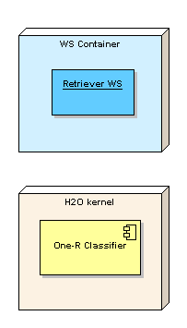

Example Problem
A scientist needs to perform the following data mining experiment:
  Retrieve data set
  Classify data
  Evaluate classification quality
She/he knows that there are:
  A Web Service that can retrieve the data, split it and evaluate classification quality
  A stateful MOCCA component that can classify data using one rule algorithm
DB
DB

Slide 5
Alternative to Workflows
The application logic can be expressed in a modern object-oriented scripting language
  Full set of control structures
  Rapid prototyping
  Clear syntax, readable and easy to understand code
Various middlewares and programming models can cooperate
User can easily include new functionality by:
  Using external services or libraries
  Implementing experiment logic in the script

Slide 6
Solution – User Perspective
Write a script in a modern scripting language that allows invocations of remote operations in various communication protocols
require 'cyfronet/gridspace/goi/core/g_obj‘ retriever = GObj.create('WekaGem') A = retriever.loadDataFromDatabase(DB, QUERY, USER, PASSWD) B = retriever.splitData(A, 20) trainA = B.trainingData testA = B.testingData classifier = GObj.create(‘OneRuleClassifier') attributeName = 'play' classifier.train(trainA, attributeName) prediction = classifier.classify(testA) puts retriever.compare(testA, prediction, attributeName)

Slide 7
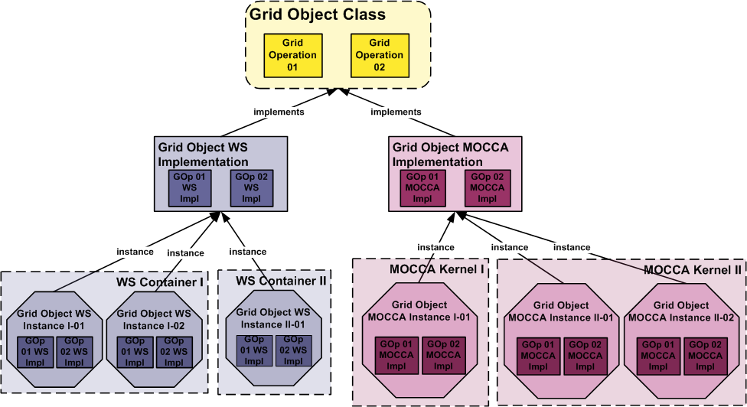
Abstraction over Grid
Multiple levels of abstraction supported
  Hiding complexity
  Full control if needed
Grid Operation
Grid Object
  Class
  Implementation
  Instance

Slide 8
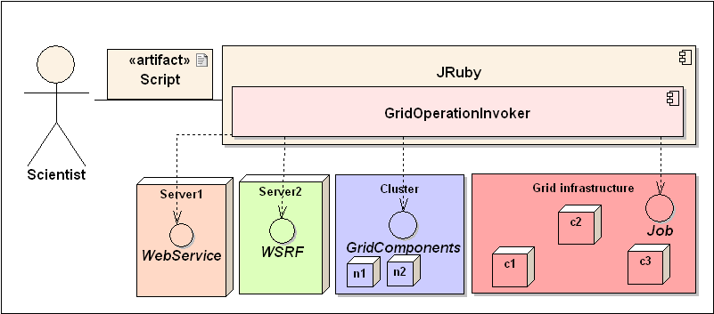
Grid Operation Invoker (GOI)
Uniform API for creating Grid Object representatives on client side
Grid Object representative
  used like ordinary object in the script
  can interface Grid Object Instance in its specific protocol
Each technology is supported by a dedicated adapter

Slide 9
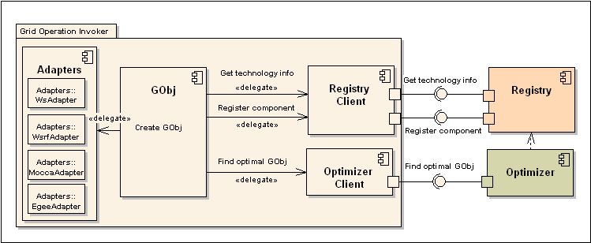
GOI Algorithm
Grid Operation Invoker:
Queries an Optimizer for the optimal instance id
Queries a Registry for the technology information about selected instance
Instantiates representative using specific adapter
User can bypass steps 1 and 2 (lower abstraction level).

Slide 10
JRuby Implementation
Advantages of Ruby
  Object-oriented language with simple and clear syntax
  Good built-in support for distributed computing
  Metaprogramming
  Growing popularity and good support
JRuby is a Java implementation of the Ruby interpreter and enables utilization of Java libraries in the scripts

Slide 11
Technology Adapters
Web Service – based on a Ruby build-in support for this technology
MOCCA – based on a Java library providing client side API
LCG – based on the EDG UI and X509 Grid certificates
GOI can be easily extended by adding new adapters

Slide 12
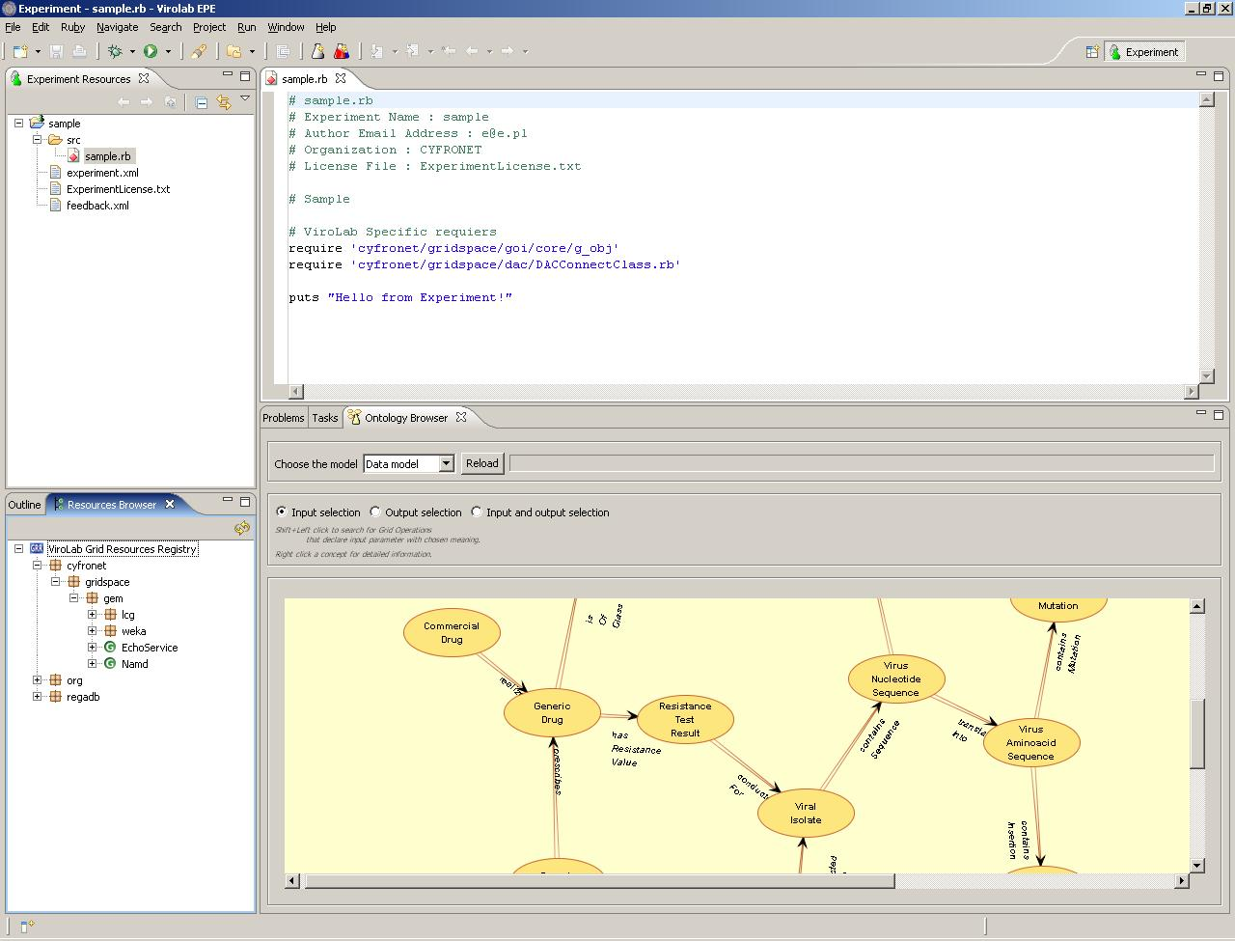
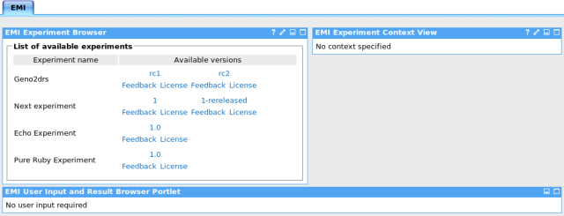
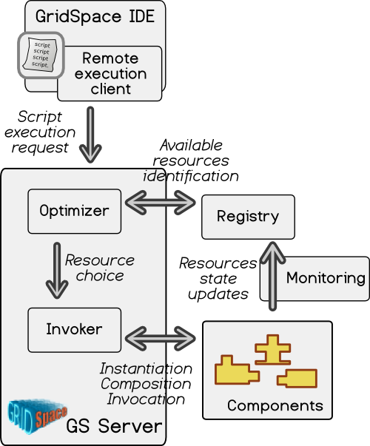
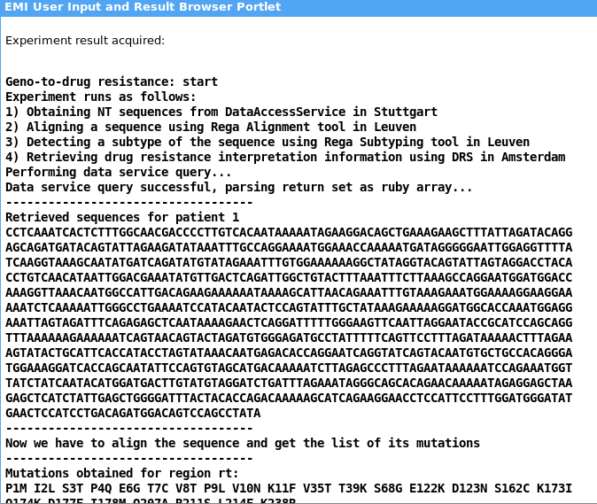
GOI in GridSpace
A platform dedicated to support problem solving environments and virtual laboratories
Based on a high-level scripting approach to the Grid programming
Features:
  A command line tool and a portal for experiment execution
  A dedicated IDE
Middleware

Slide 13
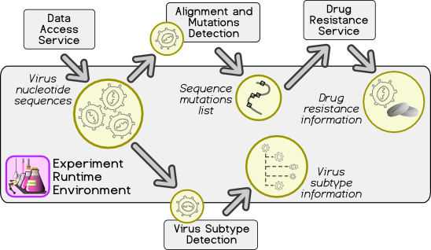
Employing GOI in ViroLab
ViroLab is an EU research project which main objective is to provide a Virtual Laboratory for Infectious Diseases
The GOI is used as a core for the runtime system in the ViroLab Virtual Laboratory
Real life problems solved
in ViroLab
  From genotype information
  to drug ranking system
  Biostatistics experiments
  using Weka data mining tools

Slide 14
Summary and Future Work
GOI proved its usability in:
  Providing uniform access to Grid resources
  Enabling development of high-level experiments solving real-life problems
Next efforts are targeted at
  Implementing adapters for more technologies
  Integration with monitoring and security infrastructures

Slide 15
References
On the Web
  http://virolab.cyfronet.pl
  http://virolab.org
  http://www.icsr.agh.edu.pl/mambo/mocca
Related publications
  Marian Bubak, Tomasz Gubala, Maciej Malawski, Marek Kasztelnik, Tomasz Bartyński, Piotr Nowakowski; Virtual Laboratory in ViroLab, Cracow Grid Workshop CGW'06
  Peter M.A. Sloot, Ilkay Altintas, Marian Bubak, Charles A. Boucher; From Molecule to Man: Decision Support in Individualized E-Health, IEEE Computer Society,vol 39, no.11, pp. 40-46, Nov., 2006
  M. Bubak, T. Gubała, P. Nowakowski; The ViroLab Virtual Laboratory for Viral Disease Treatment, iSTGW bulletin (submitted)
  Joanna Kocot, Iwona Ryszka; Optimization of Grid Application Execution, Master of Science Thesis supervised by Marian Bubak; AGH University of Science and Technology, June 2007, Krakow, Poland;

