Slide 1
Optimization of application in virtual laboratory constructing workflows based on application sources and providing data for workflow scheduling algorithms
Mikołaj Baranowski
Supervisor: Marian Bubak, PhD
Advice: Maciej Malawski, PhD
AGH University of Science and Technology

Slide 2

GridSpace environment
GridSpace platform provides environment for planning and executing distributed applications
Applications can be developed in a Ruby programming language
Complex services are available as Grid Objects and their methods – synchronous and asynchronous
Existing solutions do not provide any optimization based on Ruby source code structure and control flow
AGH University of Science and Technology

Slide 3
Research objectives
Find dependencies between grid object operations invoked from Ruby scripts
Build workflow basing on application source code
Validate approach by building workflows for control-flow patterns and well known applications (Montage, CyberShake, Epigenomics)
Provide data needed to enable optimizations based on Ruby source code structure
Provide models for scheduling algorithms
AGH University of Science and Technology

Slide 4
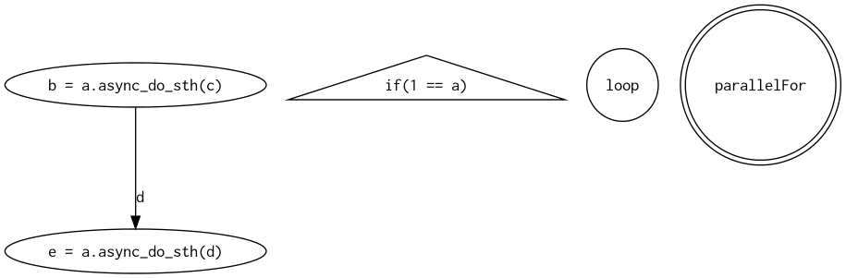
Workflow model
Tasks are represented as graph nodes – ellipses (in Ruby source code, they are operations on grid objects)
Control preconditions are represented as graph nodes – circles for loops, triangles for if statements (in Ruby: if, loop, for, while statements)
Data transfers are represented as edges with labels (operation dependencies are extracted from source code)
AGH University of Science and Technology

Slide 5
S-expressions
All information has to be extracted from source code
Ruby source is parsed and transformed into s-expressions – list based structures which contain all information from source code
a = Gobj.create
b = a.async_do_sth
c = b.get_result
s(:block,
s(:lasgn, :a,
s(:call, s(: const , :GObj), :create, s(:arglist))),
s(:lasgn, :b,
s(:call, s(:lvar , :a), :async_do_sth, s(:arglist))),
s(:lasgn, :c,
s(:call, s(:lvar , :b), :get_result, s(:arglist))))
AGH University of Science and Technology

Slide 6
Analyzing internal representation
Internal representation is created from s-expressions
It is traversed to find patterns of assignments, operations, loops, if statements etc.
Locate grid objects (they are results of a special kind of operations: Gobj.create())
Determine grid objects scopes
Locate grid operations (as operations on grid objects)
Locate grid operations handlers
Find direct dependencies (analyzing operations arguments and results)
Resolve transitive dependencies
Locate pairs – asynchronous operation – dependent result request on operation handler
AGH University of Science and Technology

Slide 7
Issues
Typical issues met during analyzing process
Block statement
Reassignment
Dependencies between blocks (variable scopes), plus:
If statements – read conditions, each branch works on different variables
if a == 2
b = 1
end
Loop – looped dependencies
a = 1
for i in 2..10
a = a * i
end
puts a
a = "foo"
a = 0
b = a + 2
There are two values and one label, dependencies should be between values, solution – change labels keeping variable scopes
a = "foo"
a_1 = 0
b = a_1 + 2
AGH University of Science and Technology

Slide 8
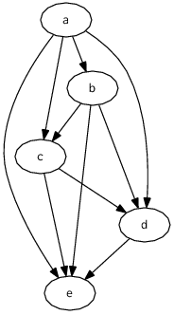
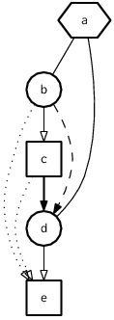
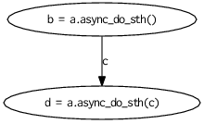
Building workflow for sequence pattern
a = Gobj.create
b = a.async_do_sth(””)
c = b.get_result
d = a.async_do_sth(c)
e = d.get_result
dependencies between operations
(hexagon – grid object, circle – grid operation, square – result request)
Building workflow from Ruby script
Two intermediate graphs are presented
Workflow presents sequence workflow pattern
final result, workflow
dependencies between assignments
AGH University of Science and Technology

Slide 9
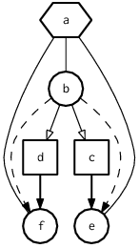
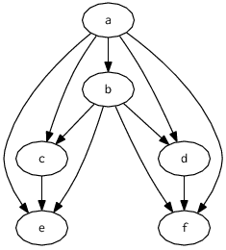
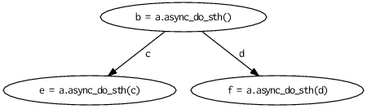
Parallel split pattern
a = GObj.create
b = a.async_do_sth
c = b.get_result
d = b.get_result
e = a.async_do_sth(c)
f = a.async_do_sth(d)
Parallel split workflow pattern is presented
Intermediate graphs show analyzing steps
AGH University of Science and Technology

Slide 10
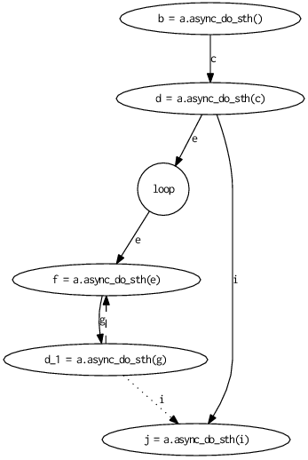
Expanding iterations – loop statement
In workflow, loop is presented as a circle with label loop
Dashed arrow stands for looped dependencies
First iteration uses variable d=a.async_do_sth(c), following iterations work with variable d=a.async_do_sth(g) produced by previous one
Reassignment issue also occurs
Dotted arrow stands for exit from loop statement
a = GObj.create
b = a.async_do_sth
c = b.get_result
d = a.async_do_sth(c)
5.times do
e = d.get_result
f = a.async_do_sth(e)
g = f.get_result
d = a.async_do_sth(g)
end
i = d.get_result
j = a.async_do_sth(i)
k = j.get_result
AGH University of Science and Technology

Slide 11
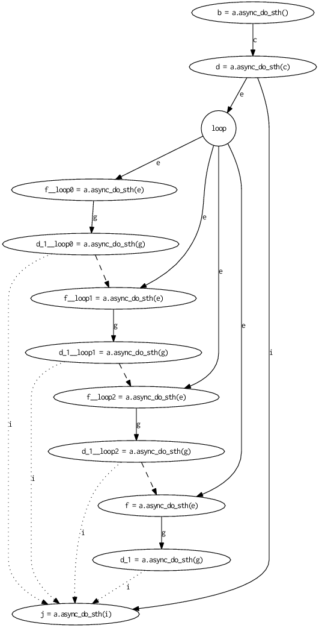
As it was mentioned in previous slide, operations in loop body depend from values calculated during last iteration
Unrolled loop simulates many iterations by creating sequence of operations
Additional nodes have modified name (_loop*)
Dashed arrow stands for looped dependencies
Dotted arrow stands for loop end
Long arrow from node d=a.async_do_sth(c) to node j=a.async_do_sth(i) indicates that loop condition were not fulfilled
AGH University of Science and Technology

Slide 12
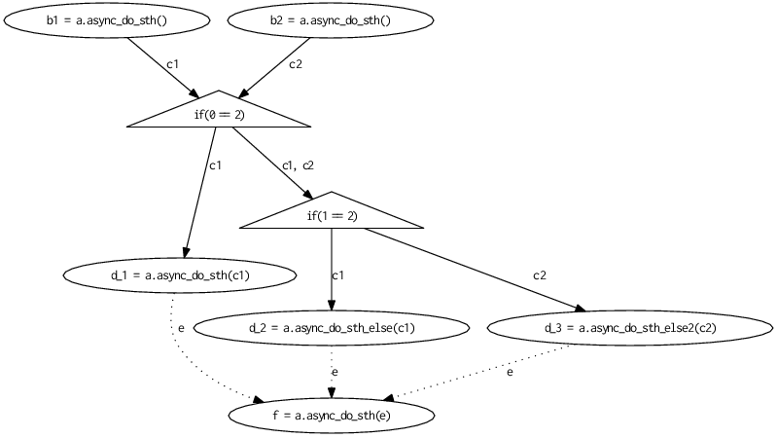
If statement
a = GObj.create
b1 = a.async_do_sth
c1 = b1.get_result
b2 = a.async_do_sth
c2 = b2.get_result
d = 0
if 0 == 2
d = a. async_do_sth(c1)
elsif 1 == 2
d = a. async_do_sth_else(c1)
else
d = a. async_do_sth_else2(c2)
end
e = d. get_result
f = a. async_do_sth(e)
g = f. get_result
Triangle stands for if statement
Exit from if statement is represented by dotted arrows
Arrows that come out from if node are alternative branches
Variable d which appears in every branch stands for different value – reassignment issue – label is changed to d_1, d_2 and d_3 for each branch
AGH University of Science and Technology

Slide 13
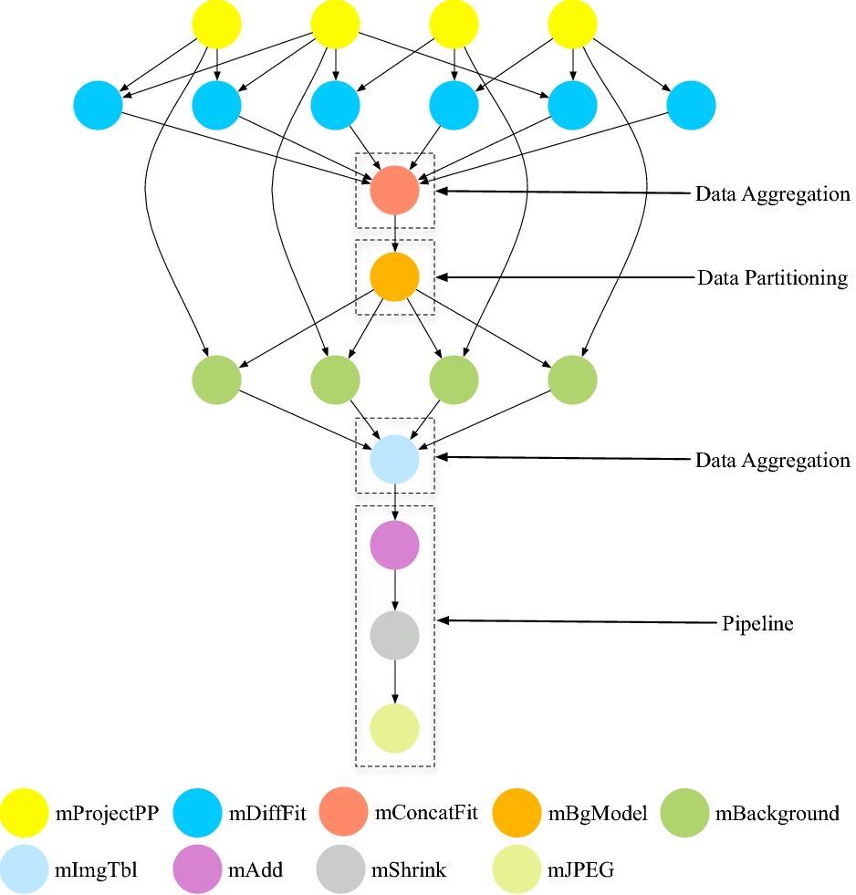
Montage application
Montage application (An Astronomical Image Mosaic Engine) produces sky mosaics from many images bade on different angles, proportions, magnifications
Graph presents original workflow created for montage application
Montage application is built from separated ANSI C modules – its processes are represented as nodes
AGH University of Science and Technology

Slide 14
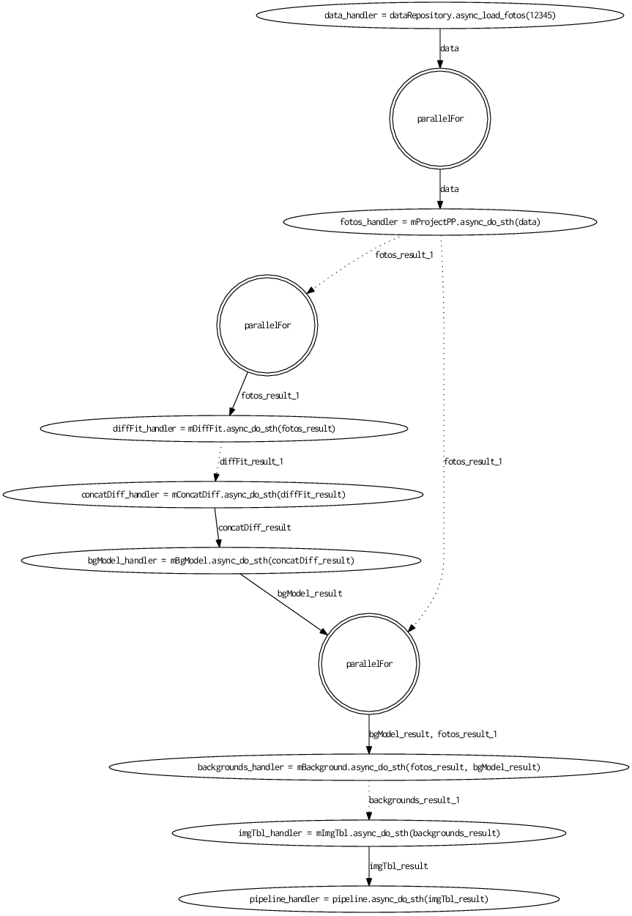
Hypothetical GridSpace application which manages montage application modules execution and coordinates its data flow was prepared
Graph presents workflow generated for this application
parallelFor node stands for loop which iterations are executed in parallel
AGH University of Science and Technology

Slide 15
Future work
Improve resolving dependencies for more complex Ruby scripts
Introduce Ruby language limitations to improve analyzing process (immutable variables, deny passing blocks, remove yield statement)
Ruby language has to complex syntax – basing on the experience with analyzing Ruby scripts, define requirements for workflow oriented language
AGH University of Science and Technology

Slide 16
Conclusions
Resolving dependencies – dependencies were resolved for many complex scripts – further progress might be possible only if special conventions or language modifications ware introduced
Building workflows – correctness of workflows fully depends on resolving dependencies
Workflows for Montage, CyberShake and Epigenomics applications ware created
Workflow model for scheduling algorithms ware developed
AGH University of Science and Technology

