Slide 1

Recording application executions enriched with domain semantics of computations and data
Master of Science Thesis
Michał Pelczar
Krakow, 30.9.2008

Slide 2

Outline
Background
Objectives
Provenance model
Information building
Feasibility study
QUaTRO
State of the art
Research outline
Publications

Slide 3
Background
E-Science
  Advanced computing technologies supporting scientists
  Global collaboration in key areas of science
Semantic Web provides data scalability
  XML, RDF, RDFS, OWL
  Ontology serves as taxonomy
Grid computing provides computation scalability
Virtual experiments influence scientiﬁc discoveries pace

Slide 4
Provenance
metadata that pertains to the derivation history of a data product starting from its original sources
the seven W’s: Who, What, Where, Why, When, Which, hoW
Scientific results reproducibility
Guarantee of data reliability and quality
Regulatory mechanism of sensitive data protection
Mean of eﬃciency optimization

Slide 5
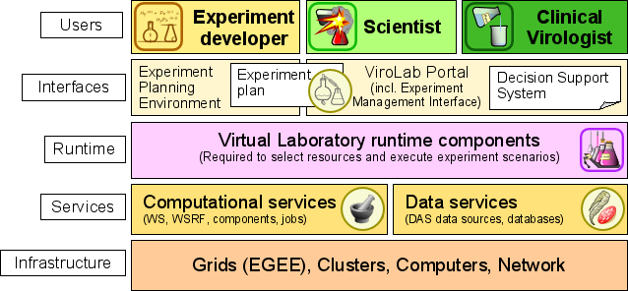
ViroLab
Virtual laboratory for infectious diseases
Prevention, diagnosis and treatment
Medical science, computer science, healthcare

Slide 6
Objectives
Design information model for provenance
Design data model for monitoring system
Adapt existing monitoring infrastructure to the provenance requirements
Deﬁne ontology creation process
  Ontology and data model independent
  Manageable
  Augmentable
  Described semantically
Design and implement component realizing the process
Incorporate the component into system grid infrastructure
Design and implement provenance querying component

Slide 7
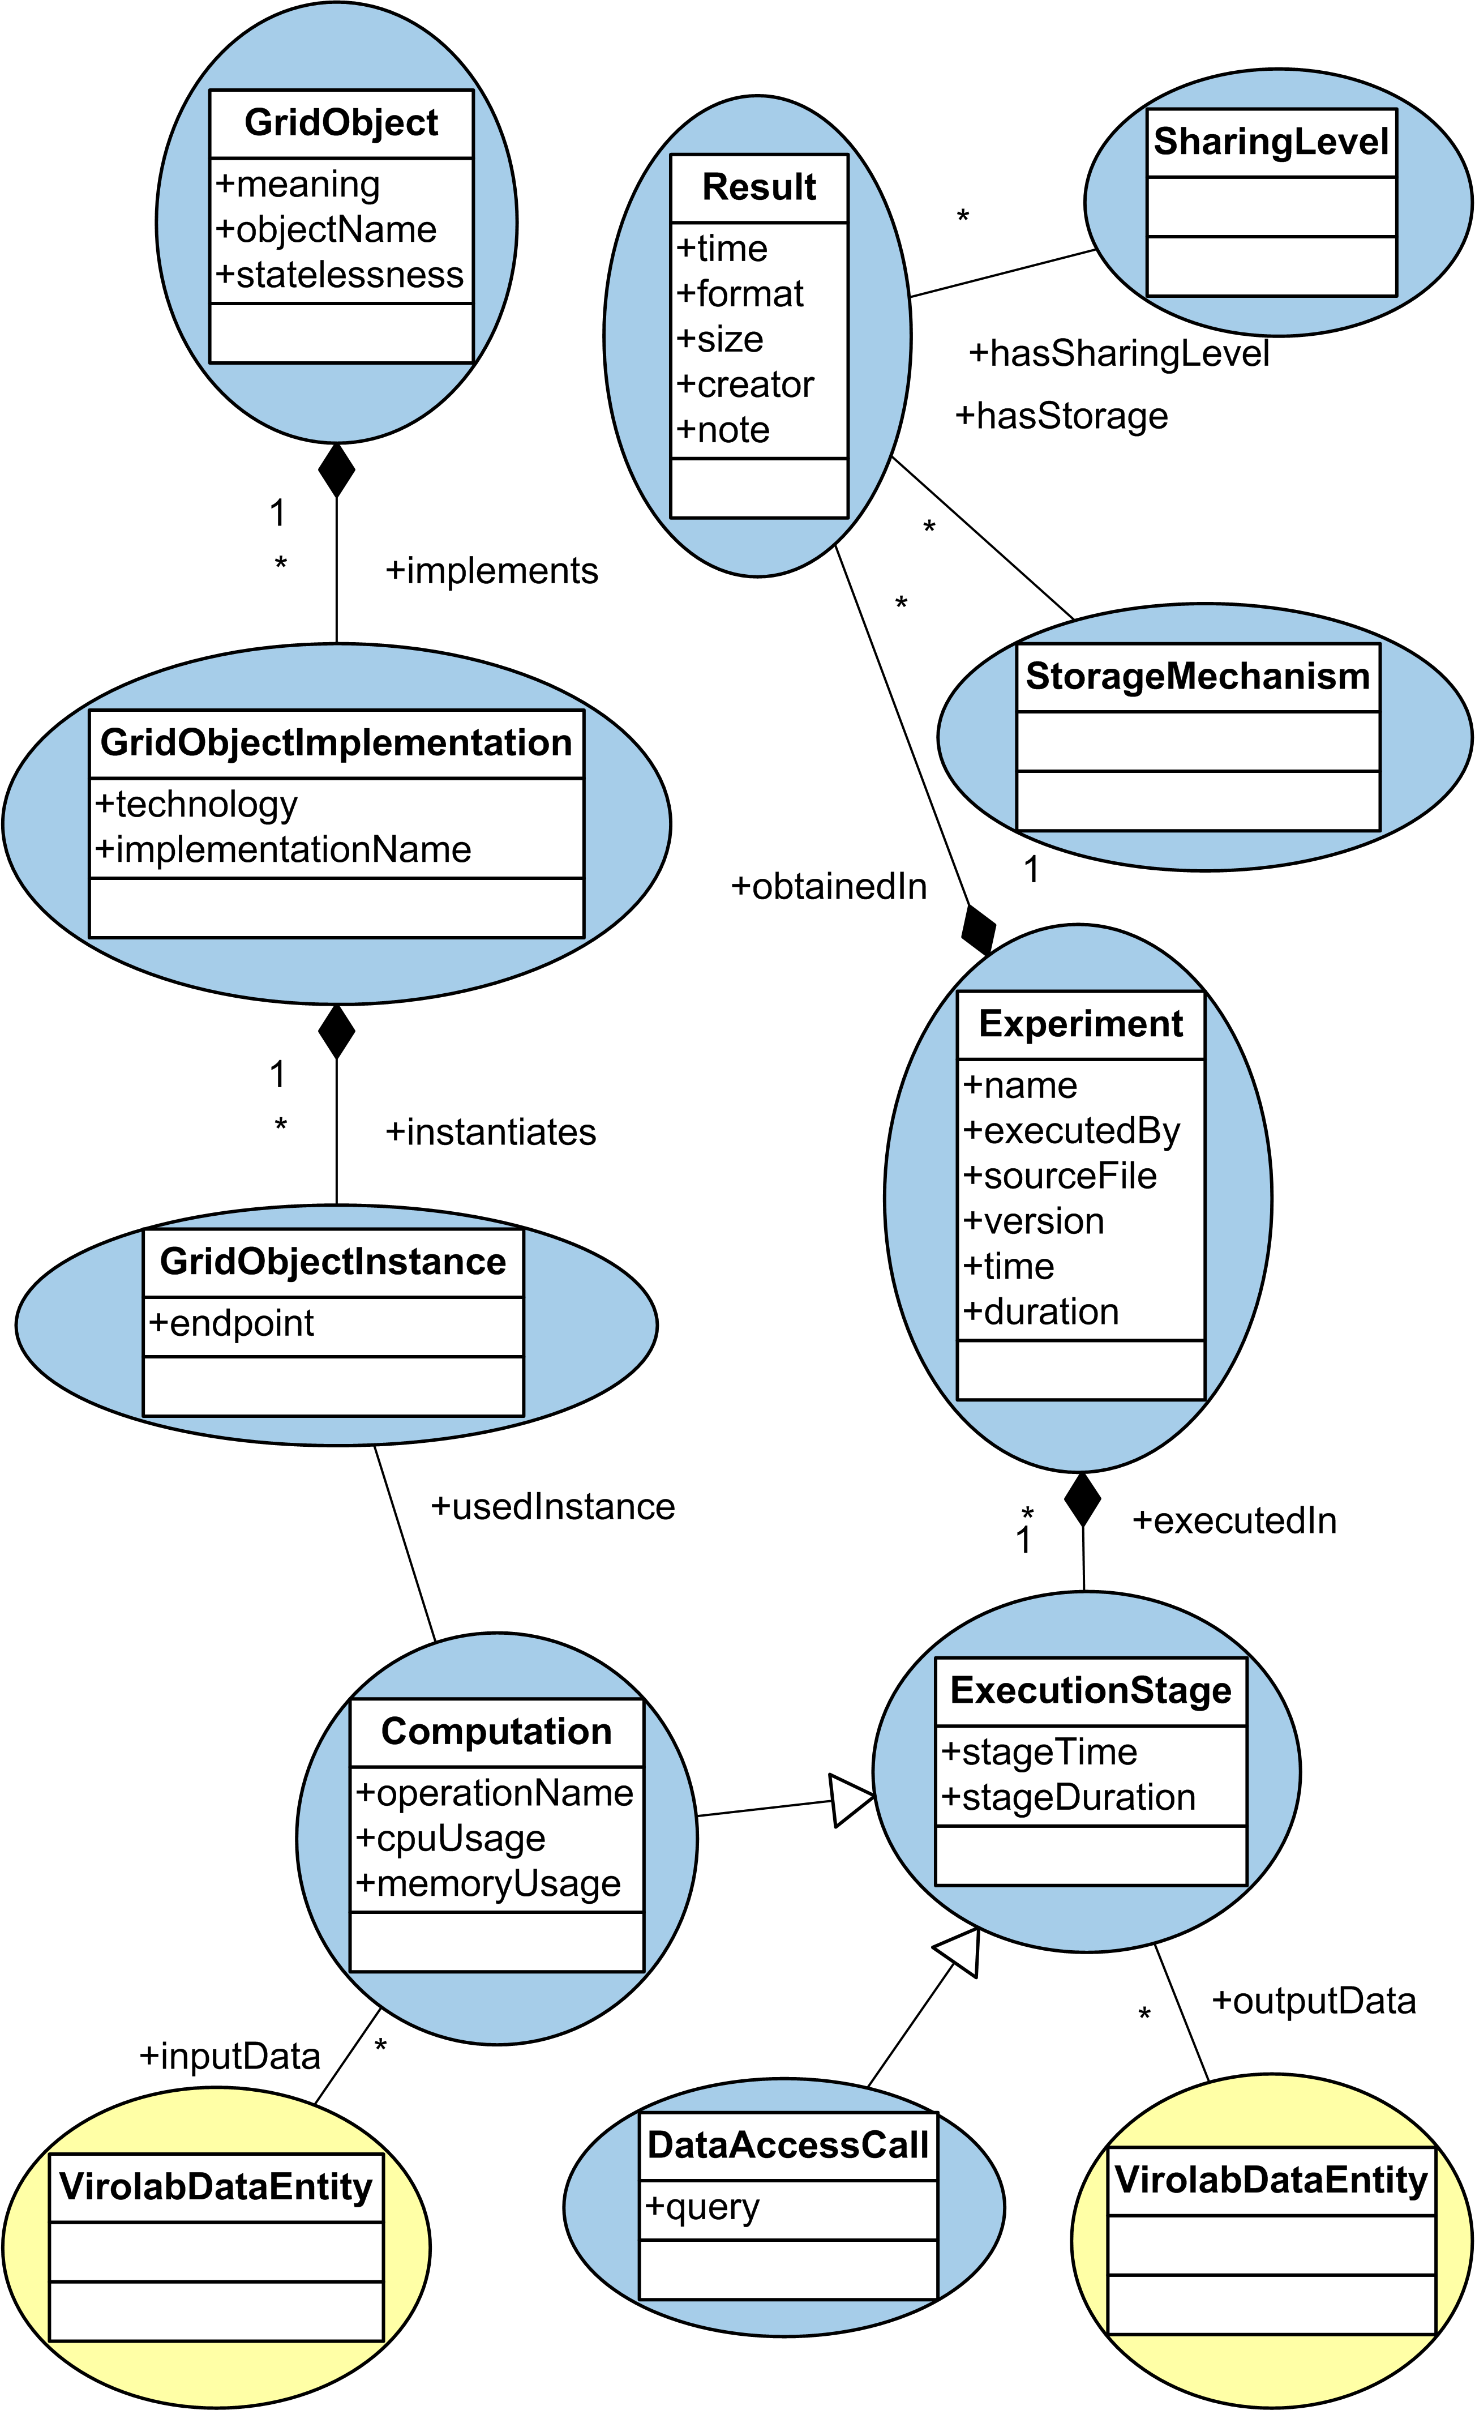
Provenance model
Experiment re-execution
Data dependencies
Results management
Performance
Resources availability
Related with ontologies:
  Data
  Domain

Slide 8
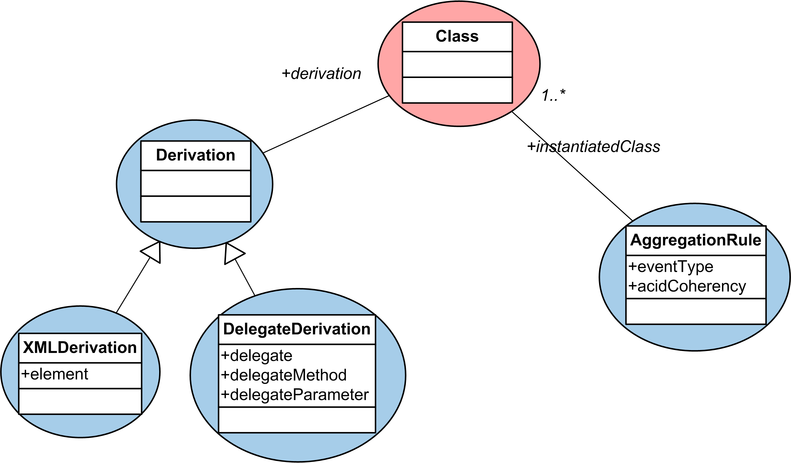
Ontology extension
Derivation concepts
  XML
  Delegates
Aggregation rules
Annotations
  Classes
  Properties

Slide 9
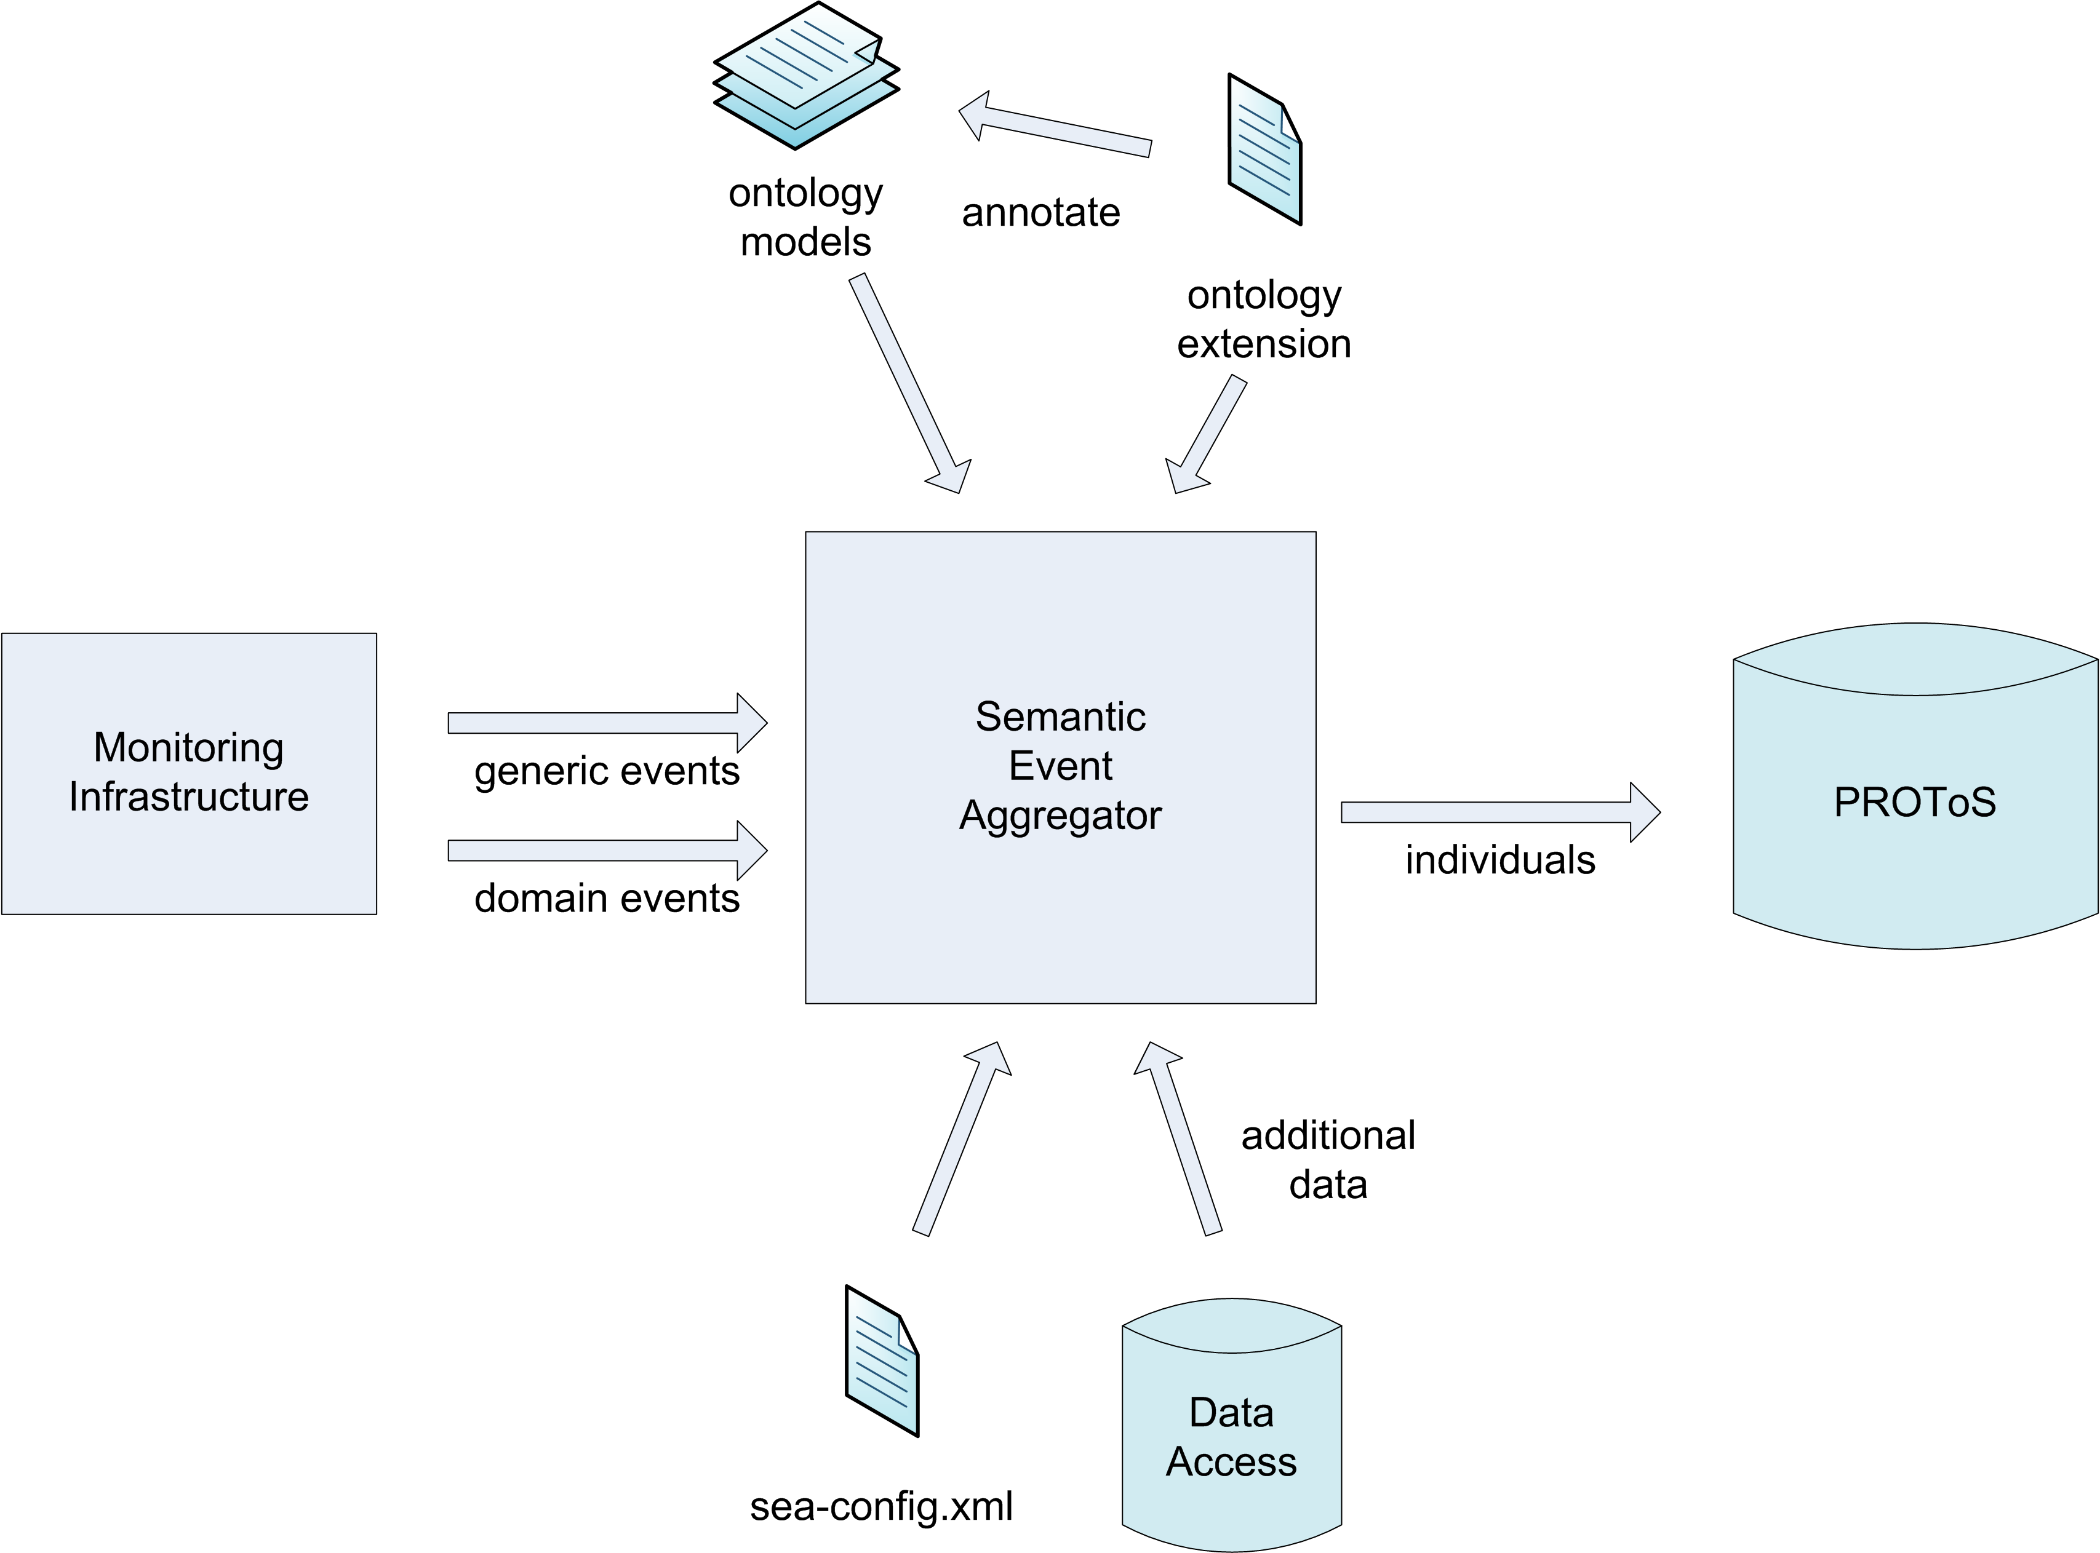
Information building
OWL and XSD independent
Manageable
Events correlation
Events aggregation
Experiment
transaction
support
Knowledge
history
tracking
Association strategy

Slide 10
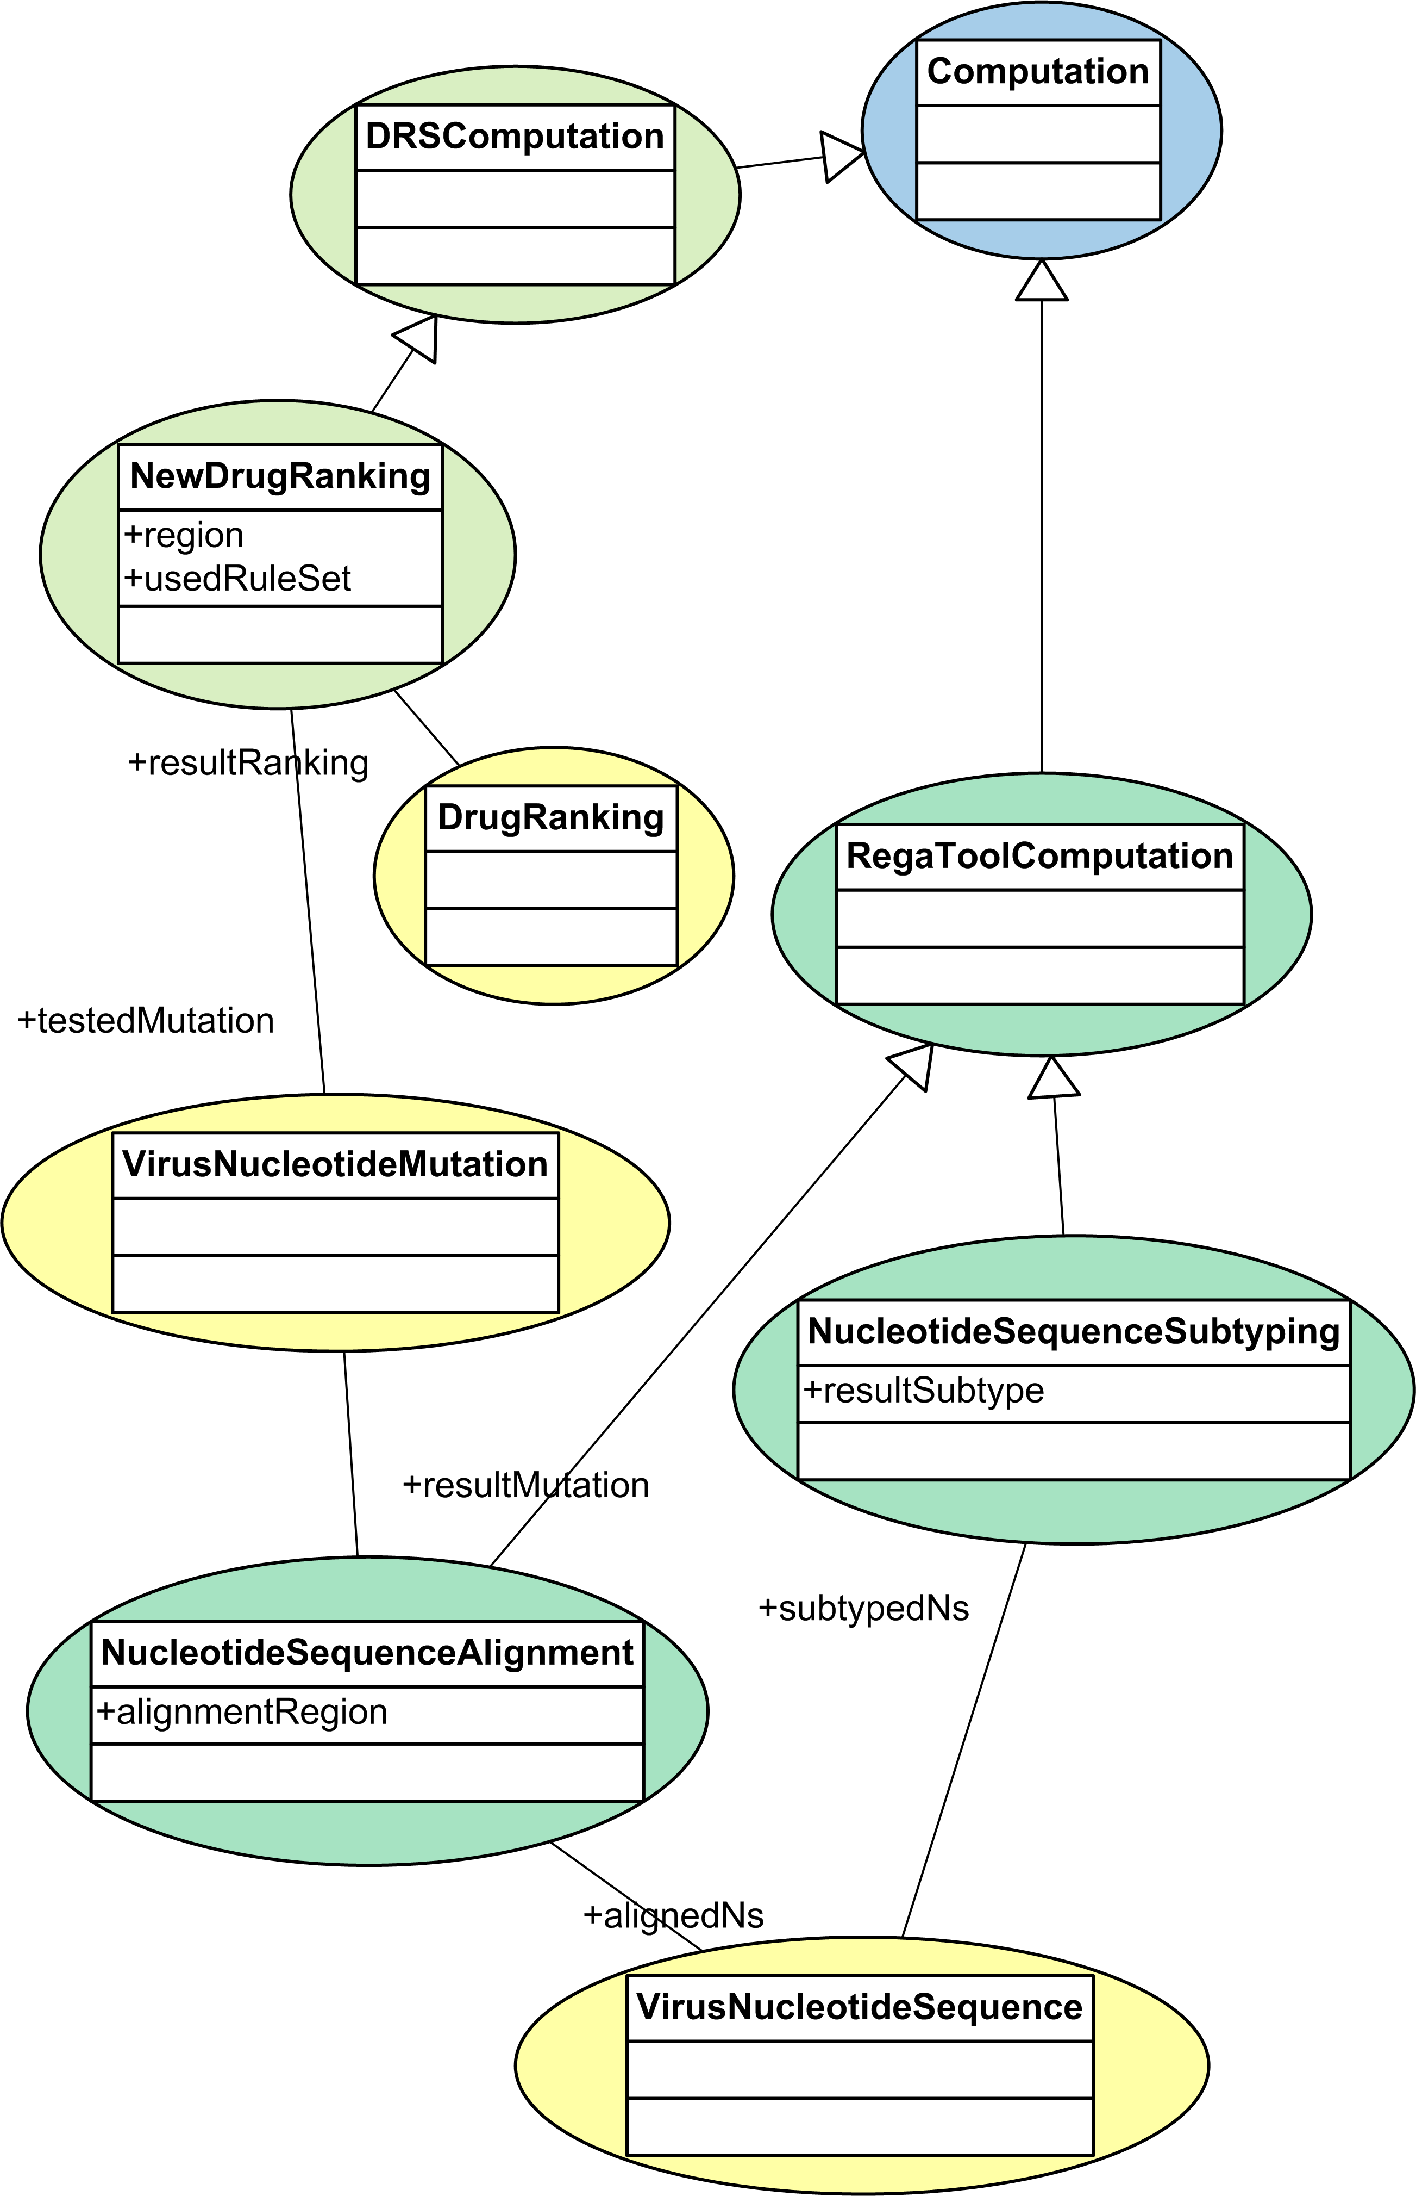
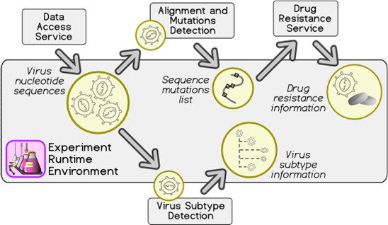
Proof of concept:
Drug resistance case study
Alignment
Subtyping
Drug ranking
Different levels of semantics
  Data
  Computation

Slide 11
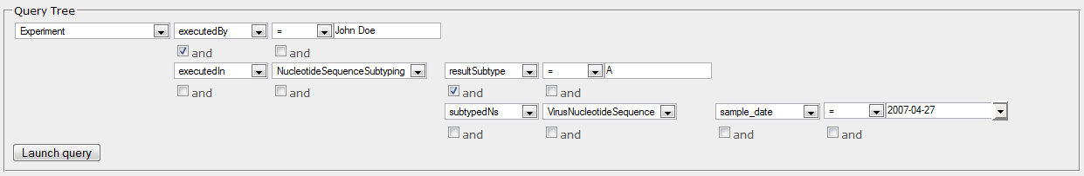
QUaTRO
Abstract query language
  Data representation and storage transparent
  Understandable by non-IT specialist
  Conﬁgurable by ontologies
  Easy to integrate with GUI
  Extendible

Slide 12
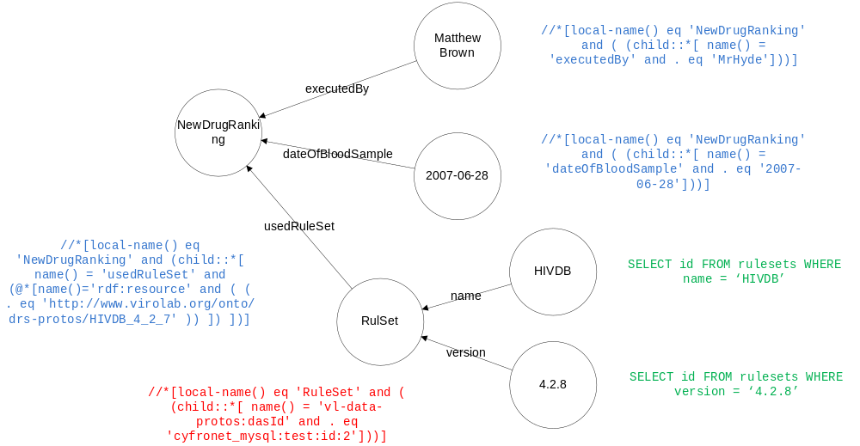
Query processing
Provenance ontologies
Mapping ontologies
File systems
Databases
Operators

Slide 13
Summary
Data model for operations and resources
Ontologies for data, experiments and geno2drs scenario
Monitoring infrastructure: remote logging, automatic generation of helpers
Semantic Event Aggregator implemented and deployed as OneJAR application
QUaTRO integrated into GridSphere portal

Slide 14
Future work
QUaTRO extensions
  Join operation
  Provenance graph rendering
  File system querying
Model extensions
  Performance recording
  Data origin recording
Explicit provenance recording
  Domain ontologies generation
  Partial results storage
  Domain events publication

Slide 15
Publications
B. Balis, M. Bubak, M. Pelczar, From Monitoring Data to Experiment Information – Monitoring of Grid Scientiﬁc Workﬂows. In G. Fox, K. Chiu, and R. Buyya, editors, Third IEEE International Conference on e-Science and Grid Computing, e-Science 2007, Bangalore, India, 10-13 December 2007, pages 187-194. IEEE Computer Society, 2007.
B. Balis, M. Bubak, M. Pelczar, J. Wach, Provenance Tracking and Querying in ViroLab. In Cracow GridWorkshop 2007Workshop Proceedings, pp.71-76, ACC CYFRONET AGH 2008.
B. Balis, M. Bubak, M. Pelczar, J. Wach, Provenance Querying for End-Users: A Drug Resistance Case Study. In: Bubak, M., Albada, G.D.v., Dongarra, J., Sloot, P.M.A. (Eds.), Proceedings ICCS 2008, Krakoland, June 23-25, 2008, LNCS 5103, pp. 80-89, Springer 2008.

Slide 16
Detailed information
ViroLab: http://www.virolab.org
VLvl: http://www.virolab.cyfronet.pl
http://grid.cyfronet.pl/virolab/wiki
QUaTRO: http://virolab.cyfronet.pl/trac/quatro
Ontologies: http://virolab.cyfronet.pl/onto

