Slide 1

Master of Science Thesis
Tomasz Bartyński
Remote execution of delegated operations with support for automatic selection among multiple communication protocols
Supervisor:
dr inż.Marian Bubak
Consultancy:
Maciej Malawski
Tomasz Gubała
Institute of Computer Science
AGH

Slide 2
Outline
Motivation
State of the art
Vision
Analysis
Design
Implementation
Tests and apps
Summary and future work

Slide 3
Description of the problem
Difficulties in accessing grid resources
  Diverse middleware
    Multitude of communication protocols
    Different data formats
    Different security mechanisms
  Dynamic nature of the environment
  Various computation models
  No interoperability among middleware
  Low-level programming specific for a middleware technology or usage of dedicated tools (like EDG UI) are required

Slide 4
Objectives
Provide uniform access to application elements, which are distributed as services, components or jobs, from a scripting language
Support leading middleware technologies
Support automatic resource selection

Slide 5
Middleware technologies
Web Service
WSRF
Component technologies (MOCCA, ProActive, EJB)
Job-oriented (LCG, gLite, UNICORE, WTS)

Slide 6
Available solutions
Workflow-based systems
  Kepler
  Triana
  KWf-Grid
Libraries and frameworks
  GAT/SAGA
  Net/Grid Solve
  WSIF
  GEODISE

Slide 7
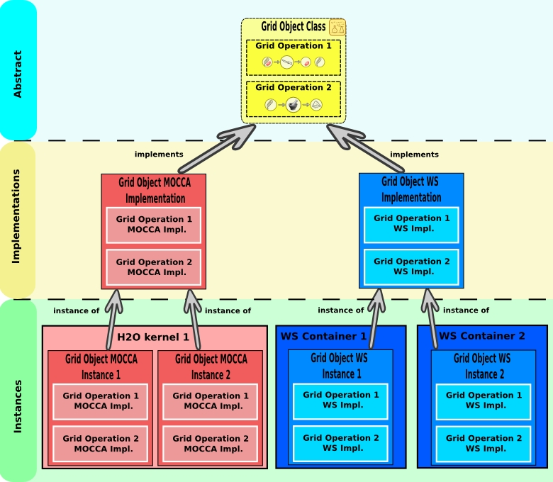
Abstraction over grid environment
Grid Operation
Grid Object Class
Grid Object Implementation
Grid Object Instance
Grid Object

Slide 8
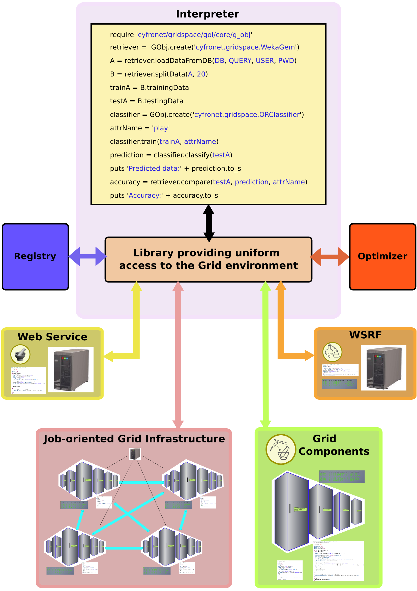
Accessing grid resources within a script
Enables fast prototyping of high-level adaptable applications
Easy to grasp syntax and concise code
Full expressivness in terms of application logic
Enables to combine local and remote computations
Is a generic solution based on a proven and broadly accepted technology

Slide 9
Development of a grid application
require ‘cyfronet/gridspace/goi/core/g_obj’
require ‘cyfronet/gridspace/goi/adapters/resource’
cl1 = GObj.create(’weka.OneRuleClassifier’)
cl2 = GObj.create_instance(7)
cl3 = Resource.new(techInfo)
….
localCl = LocalClassifier.new
….
classification1 = cl1.classify(data1)
classification2 = cl2.classify(data2)
classification3 = cl3.classify(data3)
classification4 = localCl.classify(data4)
Create Grid Object representatives in a uniform and easy way by providing:
  Grid Object Class name
  Grid Object Instance id
  Grid Object Instance technology information
Use Grid Object representatives like standard local objects

Slide 10
Requirements
Enable coherent and transparent usage of grid resources
Extendable and light-weight client-side library for a modern and accepted scripting language
Seamlessly handle required data conversions

Slide 11
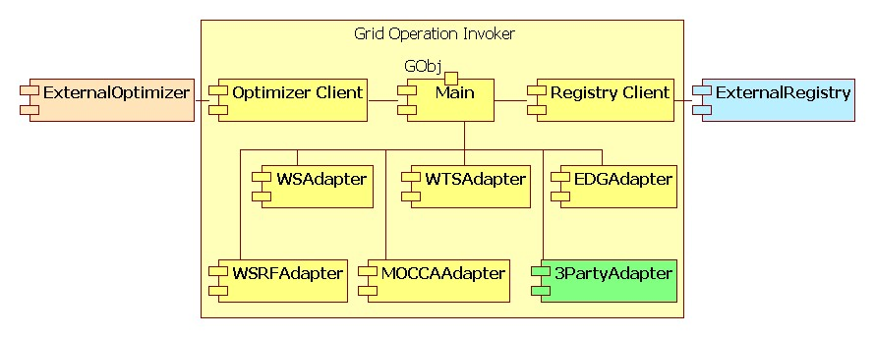
Architecture of GOI
Modular, adapters loaded at runtime..

Slide 12
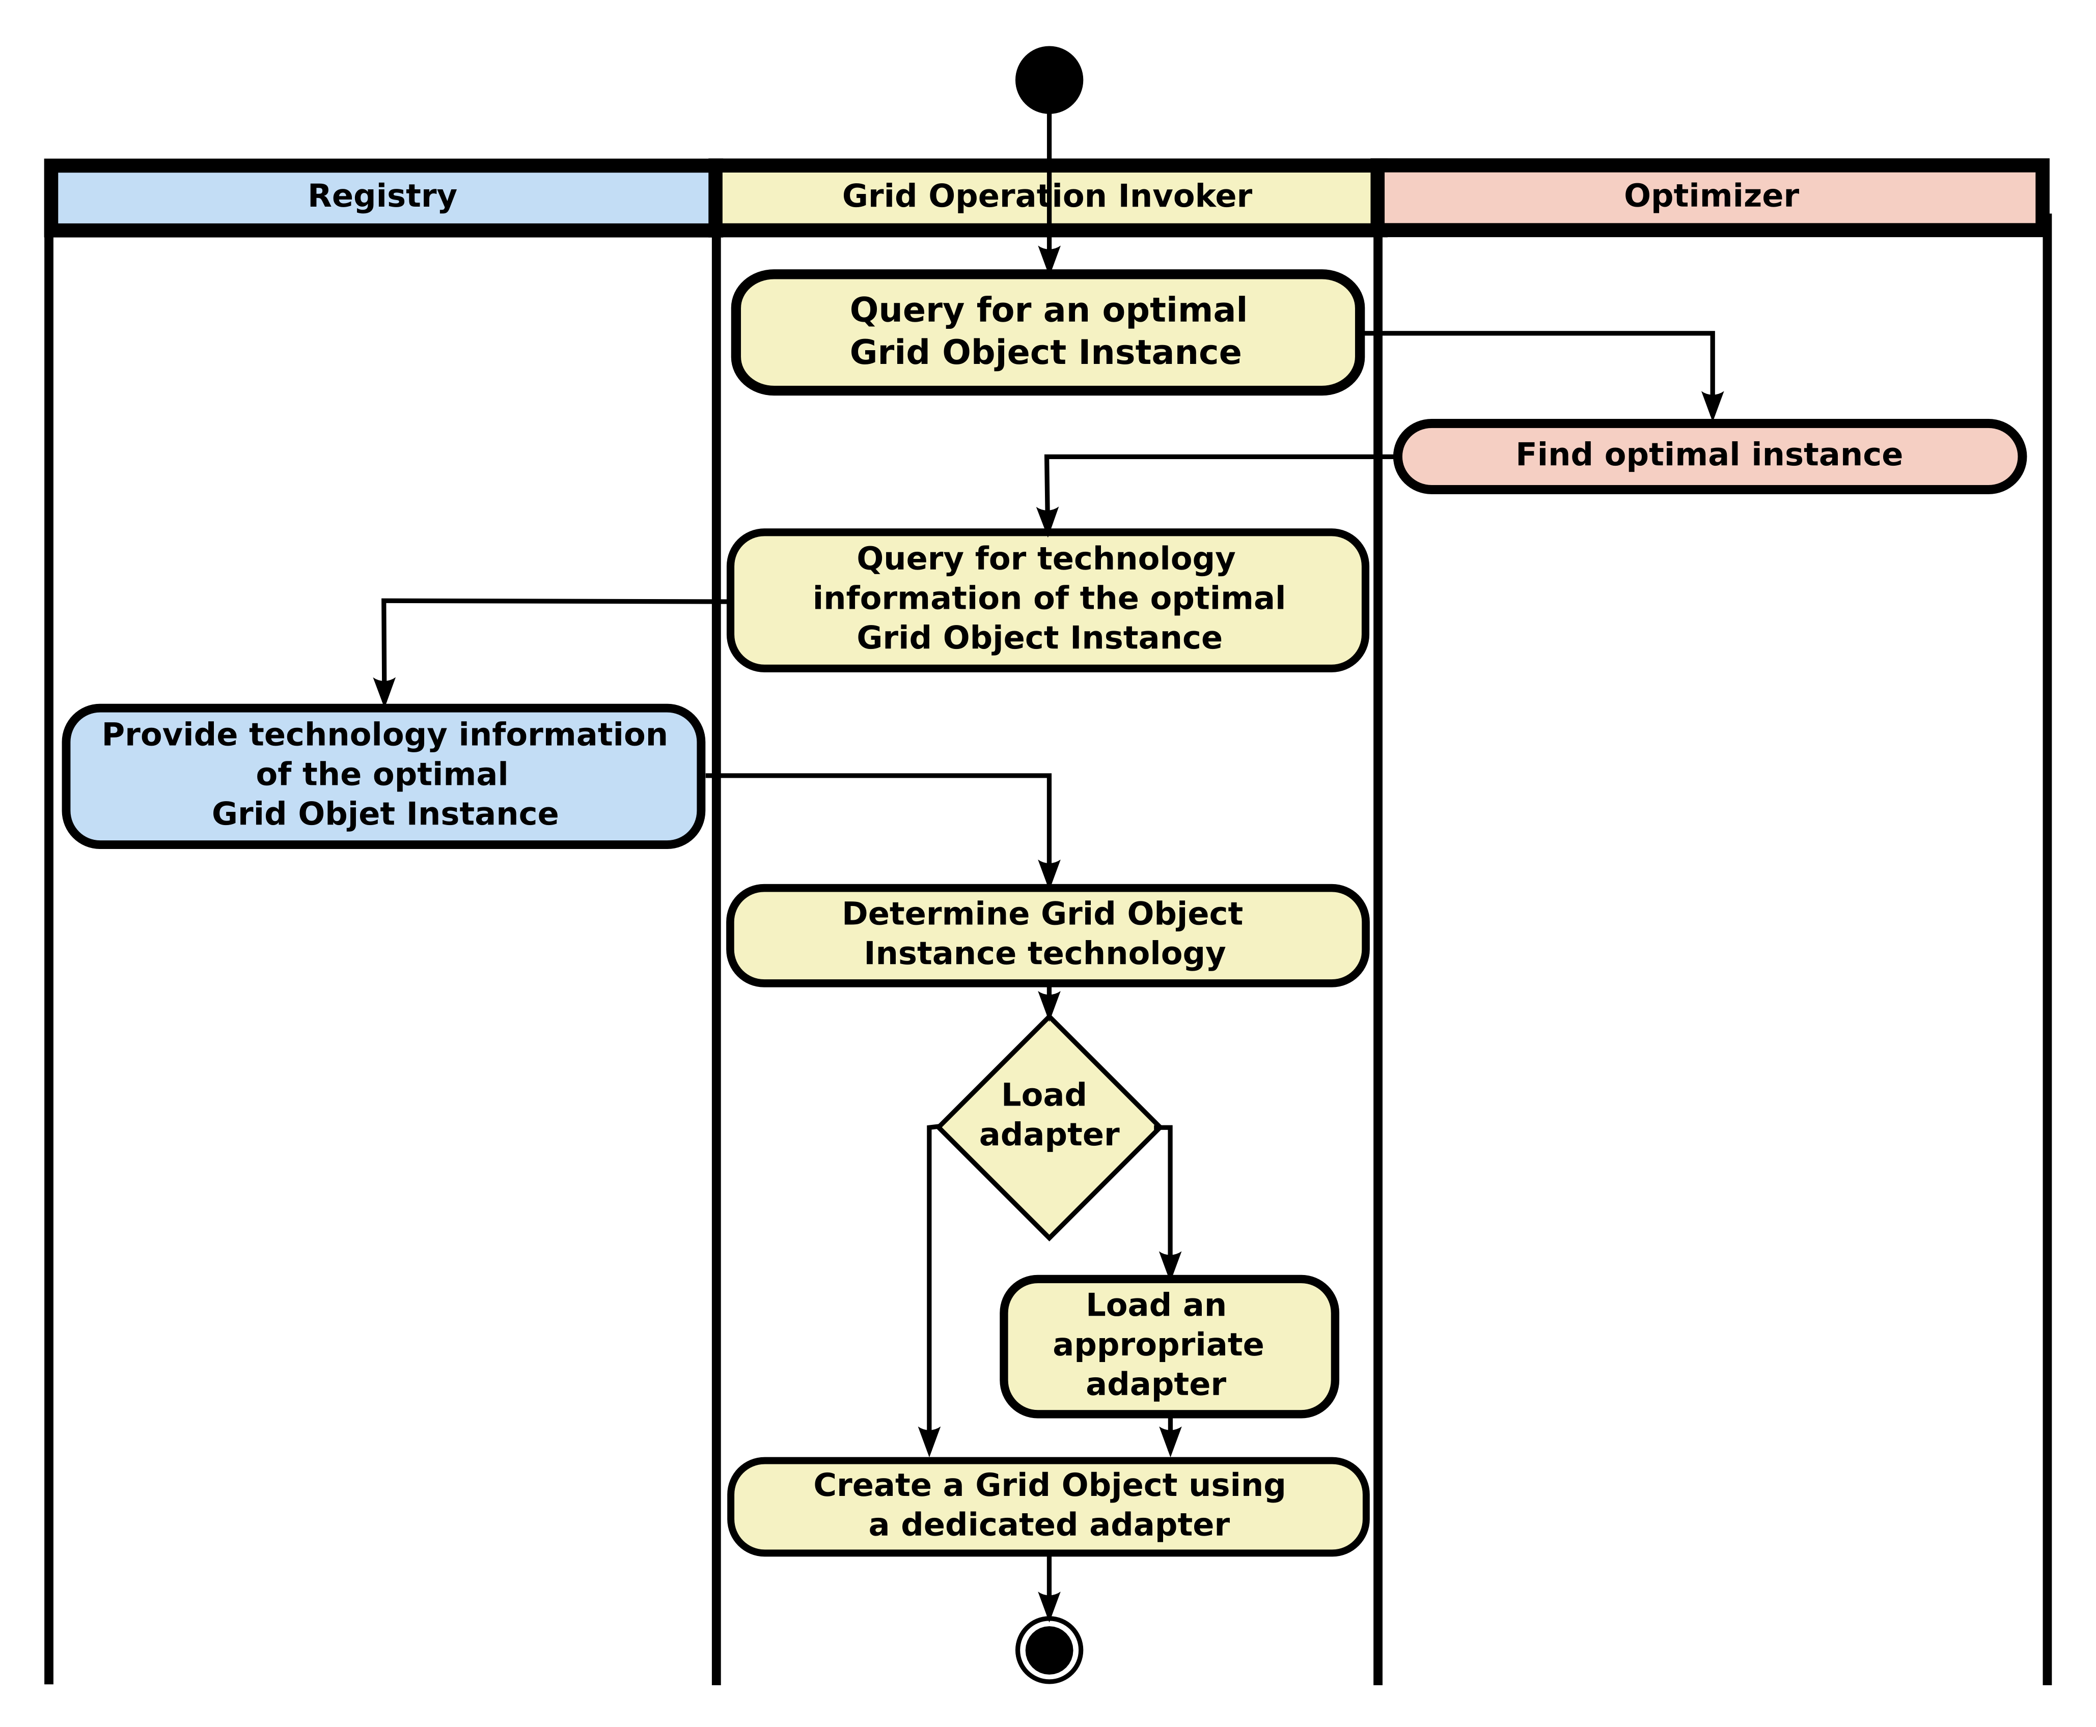
Creating a Grid Object
Query for an optimal instance
Query for technology information of the selected instance
Produce a Grid Object

Slide 13
Techniques and technologies employed
Object-oriented paradigm
Metaprogramming (generating script at run time)
Design patterns:
  Abstract factory – GObj class
  Adaptor – technology adapters
  Proxy – resource classes
JRuby
Libraries for:
  MOCCA (client-side)
  WTS (client-side)
  Globus Toolkit 4 (WS-Java Core)
EDG User Interface

Slide 14
Work status
JRuby implementation of GOI provides uniform interface for the following technologies:
  Web Service
  WSRF
  MOCCA
  WTS
  EGEE (EDG UI)
Integrated with Grid Resource Registry and Grid Application Optimizer

Slide 15
Grid application using GOI
Weka Data Mining application
HIV genotype to drug ranking system

Slide 16
Summary and future work
Objectives have been achieved
  WS, WSRF, MOCCA, WTS and LCG can be used in a uniform manner from Ruby
  The system is integrated with GrAppO and GRR
  Real-life applications are employing the GOI library
Future work
  Develop adapters for AHE and UNICORE
  Provide mechanism for Grid Object introspection
  Integration with security mechanism – Shibboleth
  Integration with monitoring

Slide 17
References
Publications:
  PPAM
  CGW
  ICCS
Web
  ViroLab Virtual Laboratory
http://virolab.cyfronet.pl
  ViroLab project homepage
http://virolab.org
  Grid Operation Invoker homepage
https://gforge.cyfronet.pl/projects/goi

