Slide 1

Collection and storage of provenance data
Jakub Wach
Master of Science Thesis
Faculty of Electrical Engineering, Automatics, Computer Science and Electronics
Institute of Computer Science
Kraków, 09.09.2008

Slide 2

Outline
This thesis goals
Motivation
Provenance introduction
Requirements
  How to, Brief analysis
System’s architecture
  Assumptions, Environment, Details
Reference implementation
Feasibility study
Work status

Slide 3
Thesis goals
Requirement’s analysis for provenance tracking in modern e-science virtual laboratories
Provenance data model design for the ViroLab virtual laboratory
Design of the provenance tracking system adapted for ViroLab’s requirements
Reference implementation of the system
ViroLab environment integration and real-world usage
Usefulness study of the presented solution

Slide 4




Motivation
Rapid development of the e-science infrastructure
Semantic Grid – new direction and new challenges
Limitations of current, narrow-minded provenance solutions
Lack of user-oriented tools and models
Full potential of e-science systems is yet to be discovered

Slide 5
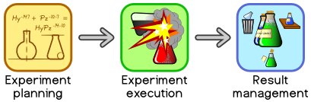
Introduction
Virtual laboratories – new tools for e-science
Limitations of current solutions
  Fixed models ☹
  „Too user-friendly” ☹
ViroLab EU project – overview
ViroLab’s virtual laboratory and it’s approach
Virusology applications in the ViroLab

Slide 6
Requirements – how to... ?
The Challenging Task – requirements gathering and analysis
  Lack of example systems, users, real-world usage models...
Sources
  Applications and users
  Complex, artificial scenarios
  State of the art – weak spots
  Research – Provenance Challenge

Slide 7
Requirements – brief list
Most important - functional
  Actor provenance and annotations
  Immutable data - infinite storage
  Query capabilities
Not to be underestimated – non-functional
  Scalable data storage
  Distributed processing – performance!
  Easiness of management and configuration

Slide 8
Architecture – assumptions
Employ semantic – in data and processing
Query capabilities driven by languages – XQuery
XML data form = XML native storage
Communication
  Interoperability...
  ...and performance
Data store architecture impacted by the data model characteristics

Slide 9
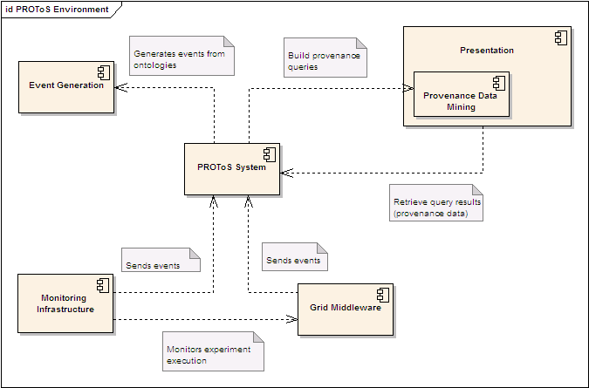
Architecture - environment
All components, required to achieve fully-functional provenance tracking
  Monitoring
  Middleware
  Event generator
  Querying

Slide 10
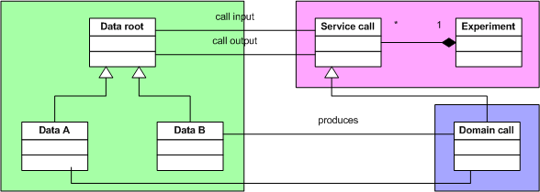
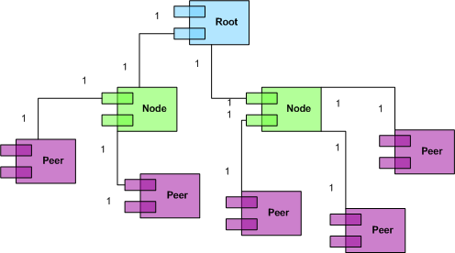
Architecture - details
PROToS data model concepts
PROToS core components
  Retrieval
  Gathering
  Supervising
Distributed storage

Slide 11



Reference implementation
Maven2 and components
  Components groups
Management and configuration
  Run-time
  Compile-time
Core technologies
  Dependency Injection container
  Communication
  XML and semantic processing

Slide 12

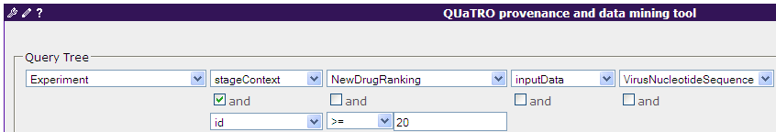
Feasibility study
Provenance usage
  Application optimization
  Result management
  Experiment replay
Querying capabilities
  QUaTRO
Sample scenarios
  Drug Resistance Workflow

Slide 13
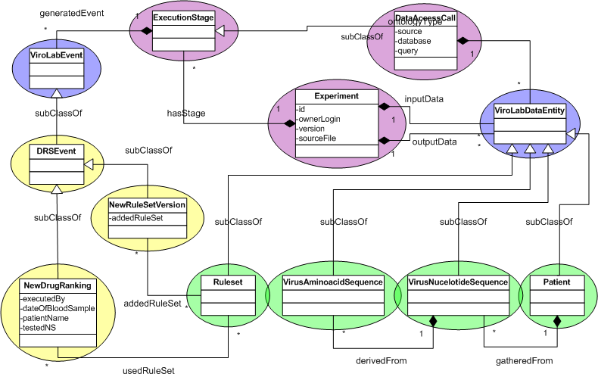
Feasibility study – cont.
Ontologies for the Vlvl
Experiment, data and domain models

Slide 14
Work status
Goals achieved
  Successful VLvl integration ☺
  Full architectural ground ☺
  Real-world usage and feedback ☺
To be done
  Distributed query support ☹
  Data and node migration 😐
  Reliability – testing, testing, testing ! ☺

Slide 15
Collection and storage of provenance data
Please visit following websites:
ViroLab : http://www.virolab.org
VLvl : http://virolab.cyfronet.pl
PROToS : http://virolab.cyfronet.pl/trac/protos
QUaTRO : http://virolab.cyfronet.pl/trac/quatro

