Slide 1
Neo4j
CYGNI-7-databases
Johannes Dolk

Slide 2
Itinerary
Graph databases, cypher and neo4j
Mutual code exercises
Individual work
Mutual code exercises
Individual work
Node + NEO4j

Slide 3
What is a Graph?

Slide 4
What is a Graph?
NODE

Slide 5
What is a GRAPH?
RELATIONSHIP

Slide 6
What is a Node?
Represents some sort of entity
bank
Pony
Jon
car

Slide 7
What is a NODE?
Can be named
PONY
BANK
JON
CAR

Slide 8
What is a NODE?
Can have properties
{adorable: true}
{interest: 12%}
{age: 43}
{model:
Tesla}

Slide 9
What is a RELATIONSHIP?
Has a Direction

Slide 10
What is a RELATIONSHIP?
Can have properties
wants
debt
owns
lease

Slide 11
A complete GRaph
PONY
BANK
wants
debt
JON
owns
leases
CAR

Slide 12
What is a graph DAtabase?
A graph database is an online database management system with Create, Read, Update and Delete (CRUD) operations working on a graph data model.
Native Graph storage and graph processing
stores interconnected data and Makes sense of that data
Treats relationships as first class citizens

Slide 13
Why use a graph database?
Whiteboard friendly
Best matches relationshipdb use cases

Slide 14
Other Graph DAtabases
ArangoDb
Datastax Enterprise graph
OrientDB
Titandb

Slide 15
Graph databases use cases
Social Networking

Slide 16
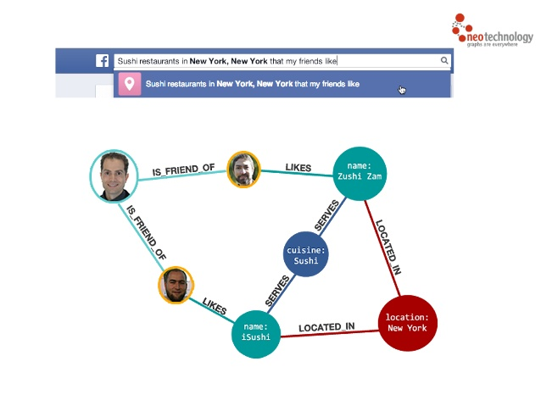
Graph databases use cases
Social Networking

Slide 17
Graph databases use cases
Social Networking
Fraud detection

Slide 18
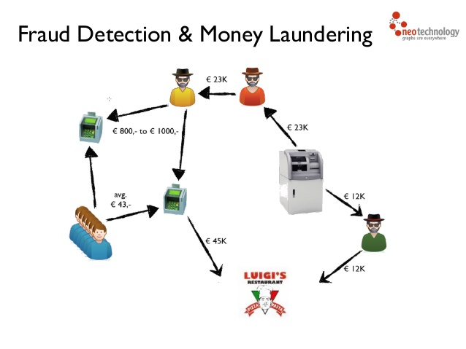
Graph databases use cases
Fraud detection

Slide 19
Graph databases use cases
Fraud detection:
Panama papers used neo4j
https://panamapapers.icij.org/

Slide 20
Graph databases use cases
Social Networking
Fraud detection
Real time recommendations
Manage and monitor networks
Identity and access management

Slide 21
Why neo4j? (According to neo foundation)
Worlds leading graph database
Biggest and Most Active Graph Community on the Planet
Highly Performant Read and Write Scalability, Without Compromise
Rock-Solid Reliability for Mission-Critical Production Applications

Slide 22
Why neo4j?
Google friendly
Made in sweden
Great documentation
Active community
Free community version

Slide 23
Facts neo4j
Current version 3.0x
Neo4j removed the 34billion node roof, unlimited number of nodes
Runs as both embedded and server
ACID (Atomicity, Consistency, Isolation, Durability)
Traversals > 1million/s
Built in java
Opencypher
REST based communication between client and server
Spring data supported
Official Drivers for all major languages

Slide 24
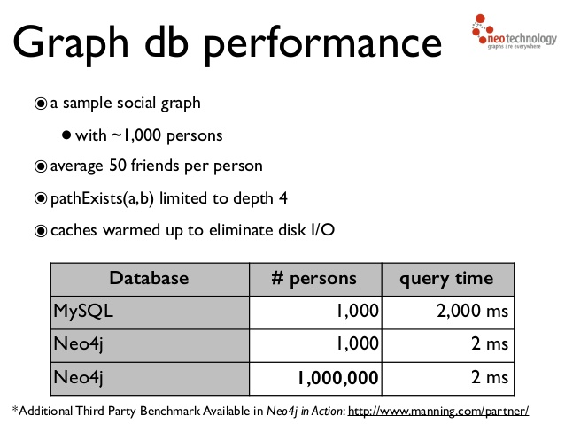
Why neo4j?

Slide 25
Cypher?
Sql for graphs -sql cannot express paths
Created specifically for graph by neo foundation
Focuses on what to fetch from graph, not how to fetch it
Simple –gremlin too complex

Slide 26
Cypher?
Human readable

Slide 27
Cypher?
Human readable
Expressive

Slide 28
Cypher?
Human readable
Expressive
Borrows from sql (where, filter, collection, sum, Aggregate, order by, limit)
CRUD

Slide 29
Cypher
Based on ascii-ART

Slide 30
Cypher
Based on ascii-ART

Slide 31
Cypher
Based on ascii-ART
( ) --> ( )

Slide 32
Cypher
Named Nodes
A
B

Slide 33
Cypher
Named Nodes
(A) --> (b)
A
B

Slide 34
Cypher
Relationships
likes
A
B

Slide 35
Cypher
Named RELAtionships
likes
(A) –[:LIKES]-> (b)
A
B

Slide 36
Cypher
PATHS
(A)-->(B)-->(c)
A
B
B

Slide 37
Cypher Syntax Node
(:Wine)
Label

Slide 38
Cypher Syntax Node
(w:Wine)
Variable name

Slide 39
Cypher Syntax Node
(w:Wine {name: ‘Prancing Ice Wine 2007’})
Properties

Slide 40
Cypher Syntax Relationship
[:Likes]
Label

Slide 41
Cypher Syntax Relationship
[likes:Likes]
Variable name

Slide 42
Cypher Syntax Relationship
[likes:Likes {type: ‘sumtype’}]
properties

Slide 43
Cypher Syntax
Create
Match
WHERE
Optional match
Return
set

Slide 44
Modelling example

Slide 45
DEMO TIME

Slide 46
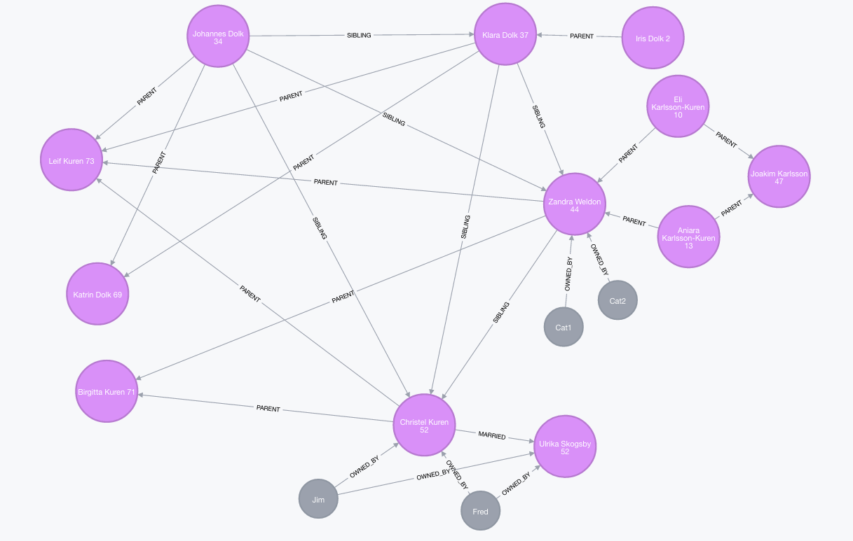
EXERCISE 1
1. Create Family:

Slide 47
EXERCISE 1
1. Create Family: 2. Find Elis grandparents 3. List all pets and their owners 4. list all members from Oldest to Youngest

Slide 48
Exercise 2
1. Find all actors, sort them by how many movies they have acted in, return number of movies and actors names 2. Find all directors that have worked with Tom Hanks, Sort them by age 3. Find all Actors that have worked together, sort them by number of times they have worked together. Return the actors names and how many times.

