Slide 1
Otter — Governed Change Control for LLM Runtimes
UiPath AgentHack. Build the AI agents of tomorrow.

Slide 2

Individual Otter
Yu-Hao Chen
Software Engineer fongse@gmail.com

Slide 3
Problem statement and proposed solution
Problem
Solution
When a production LLM provider degrades, teams switch models manually — no evidence trail, no approval gate, no rollback plan.
Ad-hoc failover is a governance gap that grows with every model dependency.
10-node BPMN workflow on UiPath Maestro: parallel evidence gathering, AI diagnosis, policy-gated approval, canary kill-switch.
Every node exchanges typed Pydantic contracts — the graph rejects malformed data at runtime.

Slide 4
Benefits and technologies used
Details
Benefits, impact and outcomes
End-user | SRE / ML platform teams
User department | Platform Engineering / MLOps
Industries | Any org running LLMs in production
UiPath products | Maestro, Orchestrator, Coded Agents
Other tech | LangGraph, Gemini Flash, Pydantic v2
• Model switch decisions backed by evidence, not intuition
• Policy gate prevents unauthorized routing changes

Slide 5
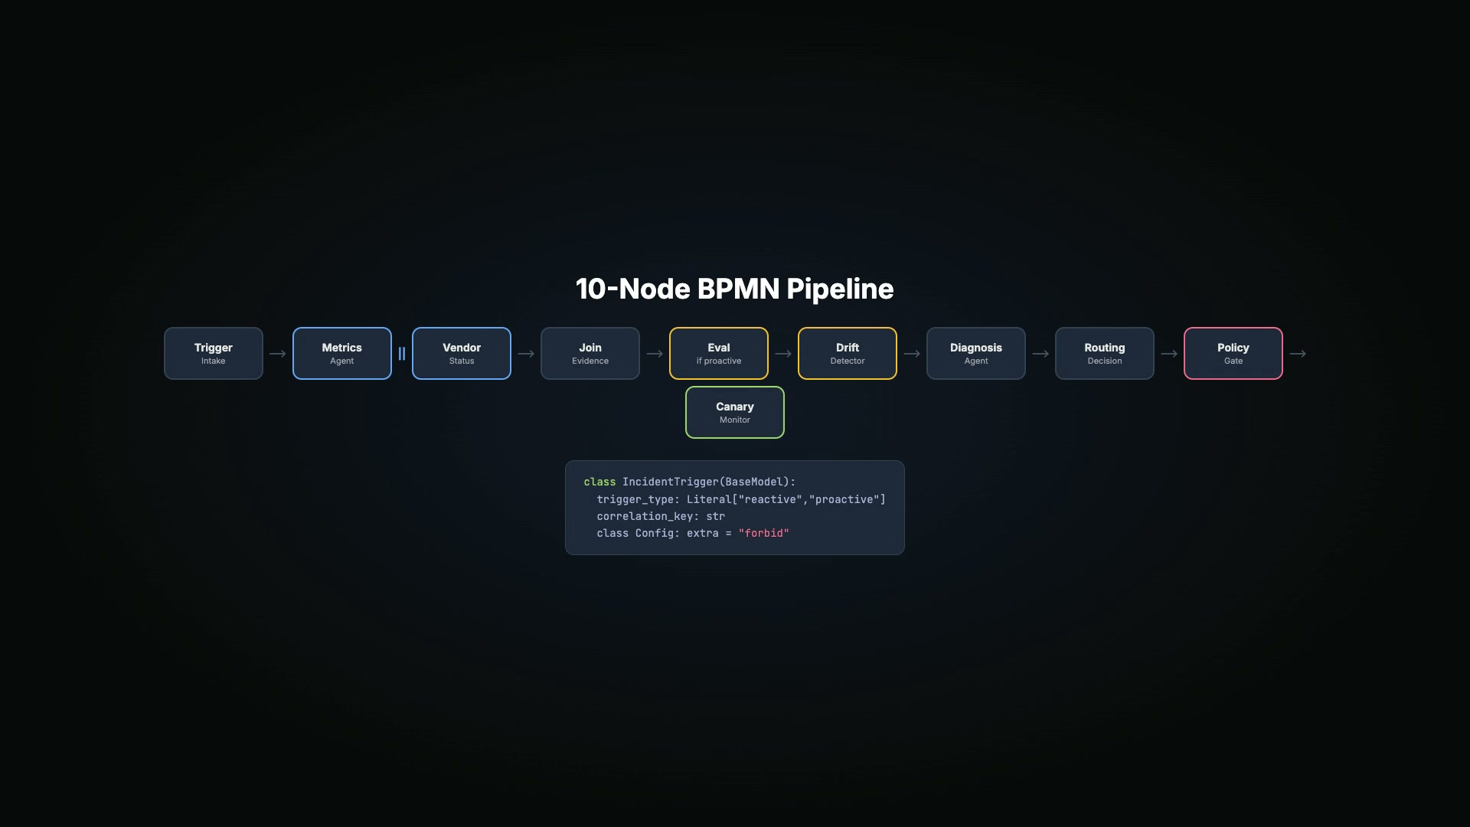
Solution architecture

Slide 6
Demo Highlights
• 10 BPMN nodes, 11 Pydantic schemas, extra='forbid'
However, make sure you keep it under 10 slides.
• Parallel gateway: metrics + vendor status agents
• Conditional branch: eval/drift only on proactive triggers
• Diagnosis agent: live Gemini function-calling
• Canary regression → automatic rollback
• Deployed on UiPath Maestro (Process ID 1905463)

Slide 7
Governed model routing — not ad-hoc failover. github.com/cyh7789/otter

