Slide 1
Computer and Robot Vision I
Chapter 2
Binary Machine Vision:
Thresholding and Segmentation
Presented by: 傅楸善 & 陳智偉
0931 370 865
d95922013@ntu.edu.tw
指導教授: 傅楸善 博士

Slide 2
2.1 Introduction
binary value 1: considered part of object
binary value 0: background pixel
binary machine vision: generation and analysis of binary image

Slide 3
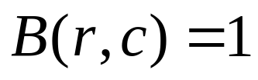
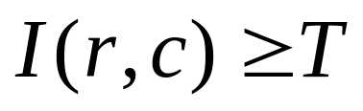
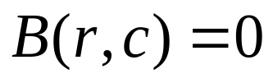
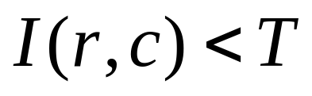
2.2 Thresholding
if
if
r: row, c: column
I: grayscale intensity, B: binary intensity
T: intensity threshold

Slide 4
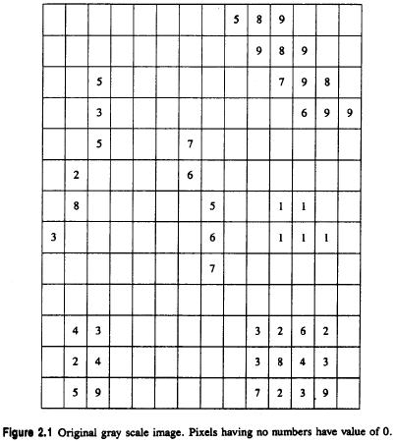
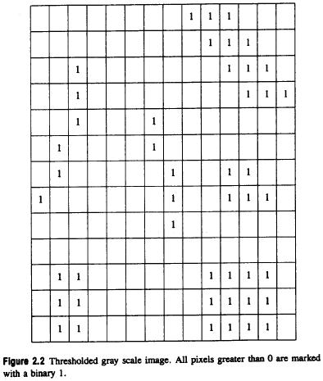
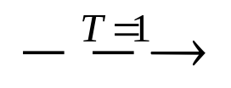
2.2 Thresholding

Slide 5



2.2 Thresholding

Slide 6
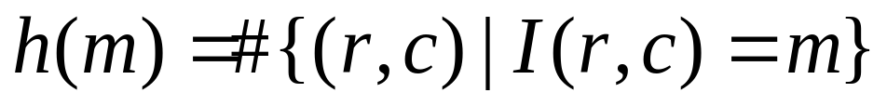
2.2 Thresholding
histogram
m spans each gray level value e.g. 0 - 255 􀀀
#: operator counts the number of elements in a set

Slide 7

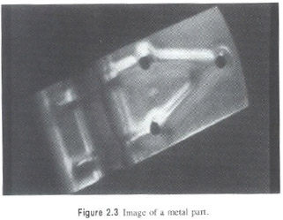
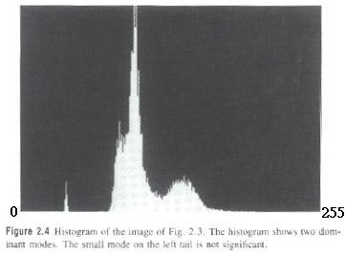
2.2 Thresholding

Slide 8
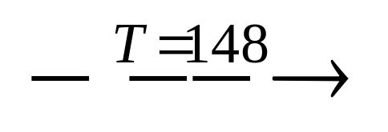
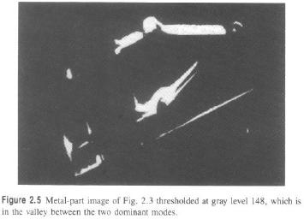
2.2 Thresholding

Slide 9

2.2 Thresholding

Slide 10
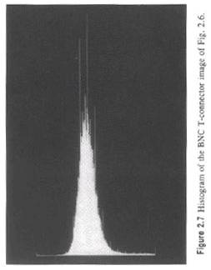
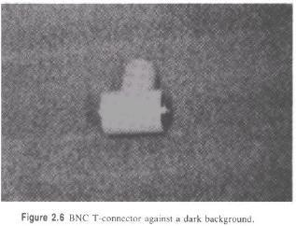
2.2 Thresholding
Notes:
Bayonet Neill Concelman Connector (BNC)
The standard connector used to connect IEEE 802.3 10Base2 coaxial cable to an MAU(媒體附著單元 (Media attachment unit))

Slide 11
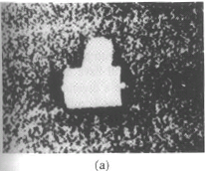
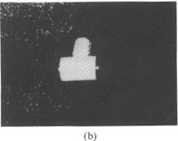
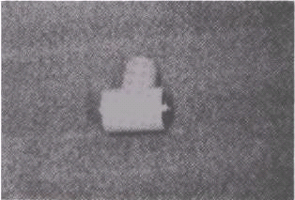
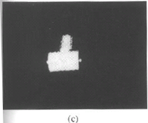
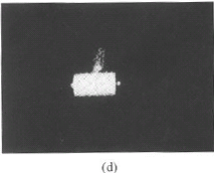
2.2 Thresholding

Slide 12

Take a Break

Slide 13
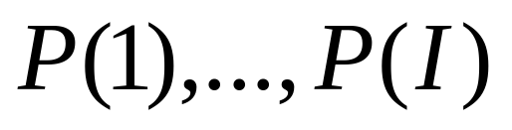


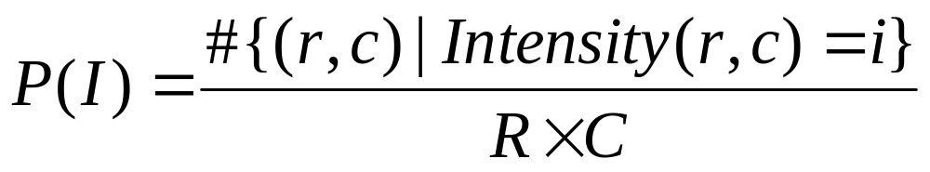

2.2.1
Minimizing Within-Group Variance
: histogram probabilities of
gray values
: the spatial domain of the image
Notes:
otsu

Slide 14
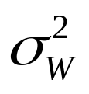
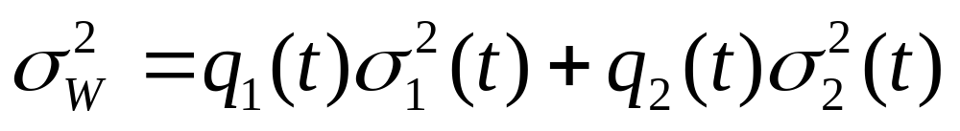
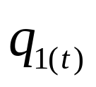

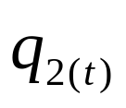



2.2.1
Minimizing Within-Group Variance
Within-group variance : weighted sum of group
variances
: probability for the group with values
: probability for the group with values
: variance for the group with values
: variance for the group with values

Slide 15
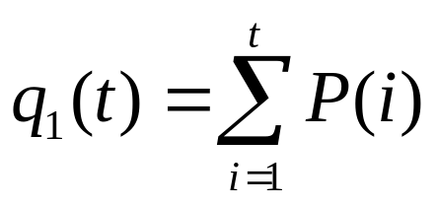
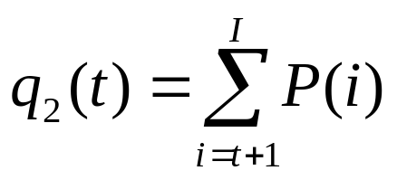
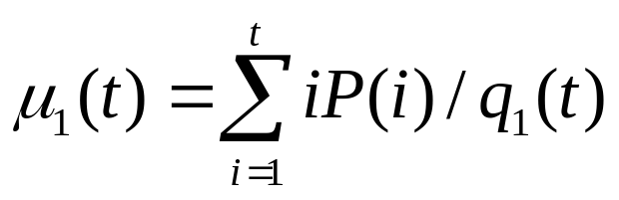
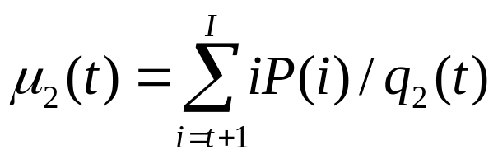
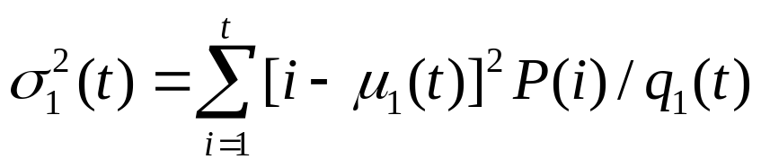
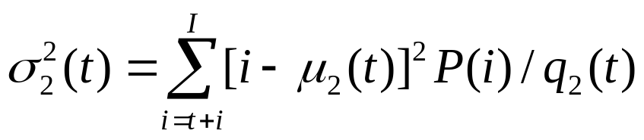

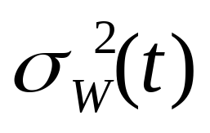
2.2.1
Minimizing Within-Group Variance
find which minimizes

Slide 16
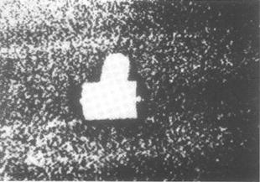
2.2.1
Minimizing Within-Group Variance

Slide 17

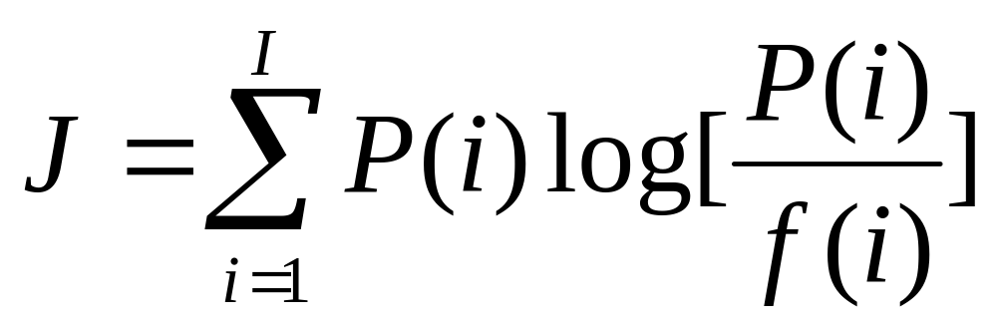
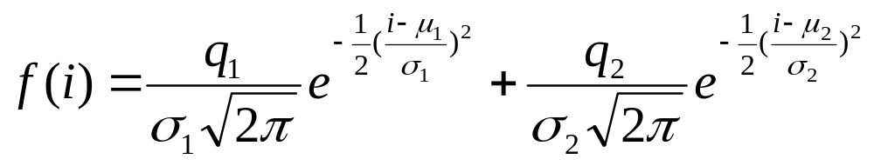
2.2.2
Minimizing Kullback Information Distance
minimize the Kullback directed divergence
mixture distribution of the two Gaussians in histogram:
Notes:
q1 q2: weight?

Slide 18
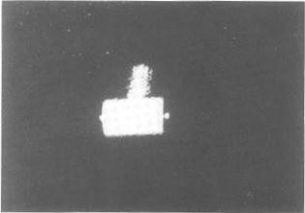
2.2.2
Minimizing Kullback Information Distance

Slide 19
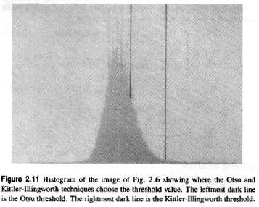
2.2.2
Minimizing Kullback Information Distance
Left dark line:
Otsu
Right dark line:
Kittler-Illingworth

Slide 20
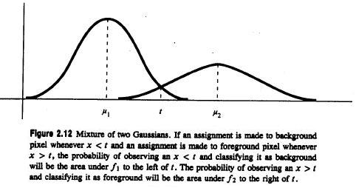
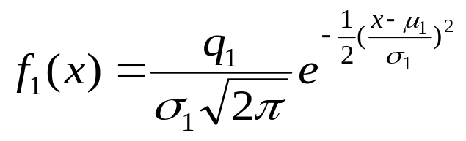
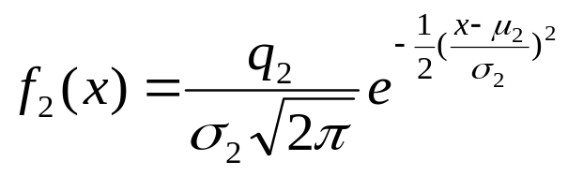

2.2.2
Minimizing Kullback Information Distance
: mean of distribution

Slide 21

Take a Break

Slide 22
2.3 Connected Components Labeling
Connected components analysis of a binary image consists of the connected components labeling of the binary-1 pixels followed by property measurement of the component regions and decision making.
All pixels that have value binary-1 and are connected to each other by a path of pixels all with value binary-1 are given the same identifying label.
Notes:
definition

Slide 23
2.3 Connected Components Labeling
label: unique name or index of the region
label: identifier for a potential object region
connected components labeling: a grouping operation
pixel property: position, gray level or brightness level
region property: shape, bounding box, position, intensity statistics
Notes:
Term explanation
Bounding box?

Slide 24



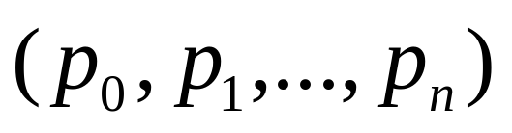
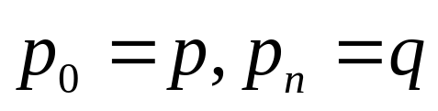

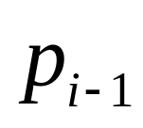
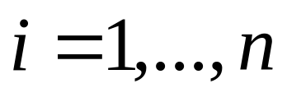
􀀀
2.3.1 Connected Components Operators
Two 1-pixels and belong to the same
connected component if there is a sequence of
1-pixels of where
and is a neighbor of 􀀀 for
Notes:
definition

Slide 25
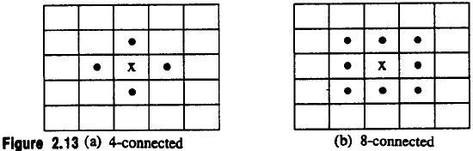
􀀀
2.3.1 Connected Components Operators
4-connected: north, south, east, west
8-connected: north, south, east, west,
northeast, northwest, southeast, southwest
Border: subset of 1-pixels also adjacent to 0-pixels
Notes:
To explain what neighborhood is

Slide 26
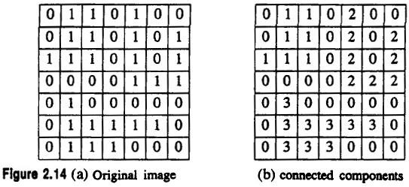
􀀀
2.3.1 Connected Components Operators
Notes:
example

Slide 27
􀀀
2.3.1 Connected Components Operators
Rosenfeld has shown that
if C is a component of 1s and
D is an adjacent component of 0s
and
if 4-connectedness is used for 1 (/0) -pixels and
8-connectedness is used for 0 (/1) -pixels
then either C surrounds D (D is a hole in C) or
D surrounds C (C is a hole in D)
Notes:
theory

Slide 28
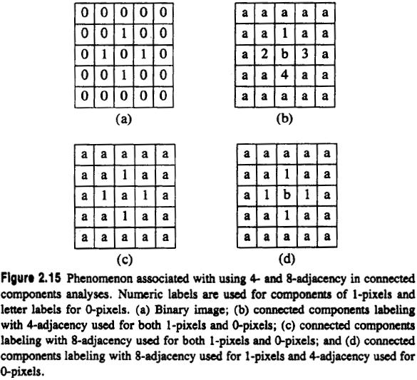
􀀀
2.2.3 Connected Components Operators
Notes:
Phenomenon:現象
example
:

Slide 29
2.3.2 Connected Components Algorithms
All the algorithms process a row of the image at a time
All the algorithms assign new labels to the first pixel of each component and attempt to propagate the label of a pixel to right or below neighbors
This process continues until the pixel marked A in row 4 encountered
Notes:
Principle & stop condition

Slide 30
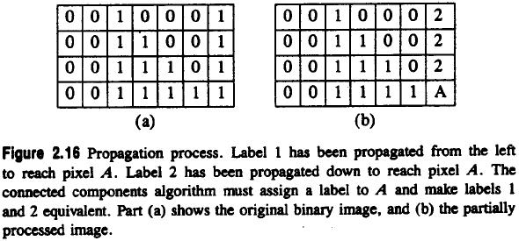
2.3.2 Connected Components Algorithms
Notes:
example

Slide 31
2.3.2 Connected Components Algorithms
The differences among the algorithms of three types:
What label should be assigned to pixel A?
How to keep track of the equivalence of two or more labels?
How to use the equivalence information to complete processing?
Notes:
issue

Slide 32
2.3.3 An Iterative Algorithm
initialization of each pixel to a unique label
iteration of top-down followed by bottom-up passes until no change
Notes:
Algorithm’s flow
Top-down left-right followed by bottom-up right-left

Slide 33
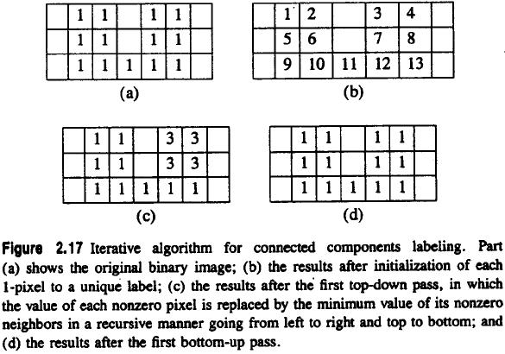
2.3.3 An Iterative Algorithm
Notes:
Why can’t just one iterative
Jump to 35(ori) 36(after top-down)=>12與7的交界處

Slide 34

Take a Break

Slide 35
2.3.4 The Classical Algorithm
makes two passes but requires a large global table for
equivalences
performs label propagation as above
when two different labels propagate to the same pixel, the
smaller label propagates and equivalence entered into
table
equivalence classes are found by transitive closure
second pass performs a translation
Notes:
Two top-down phase
First phase: assign label and establish equ_table
mid-phase: find equivalence classes
Second phase: chx label according to equ_label

Slide 36
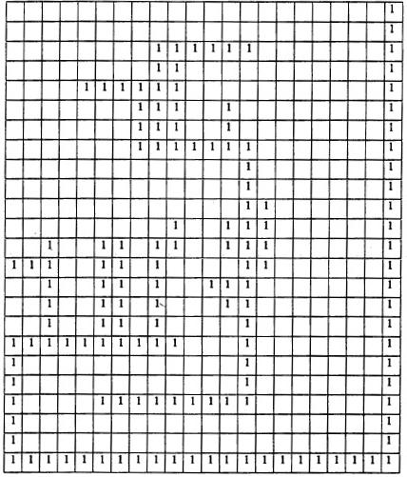

2.3.4 The Classical Algorithm

Slide 37



Slide 38
2.3.4 The Classical Algorithm
main problem: global equivalence table may be
too large for memory
Notes:
problem

Slide 39
2.3.5 A Space-Efficient Two-Pass Algorithm That Uses a Local Equivalence Table
Small table stores only equivalences from current and preceding lines
Maximum number of equivalences = image width
Relabel each line with equivalence labels when equivalence detected
Notes:
Point2. alternation

Slide 40

2.3.5 A Space-Efficient Two-Pass Algorithm That Uses a Local Equivalence Table

Slide 41

2.3.6 An Efficient Run-Length Implementation of the Local Table Method
run-length encoding: transmits lengths of runs
of zeros and ones
Example:

Slide 42

run 1
run 2
run 7
run number
Notes:
Original picture
Label number start and end

Slide 43

Notes:
Mid-table: label/next array
Left-table: EQ_CLASS array

Slide 44

2.3.6 An Efficient Run-Length Implementation of the Local Table Method

Slide 45


Slide 46


Slide 47

2.3.6 An Efficient Run-Length Implementation of the Local Table Method

Slide 48


Slide 49

2.3.6 An Efficient Run-Length Implementation of the Local Table Method

Slide 50


Slide 51

Take a Break

Slide 52
2.4 Signature Segmentation and Analysis
signature: histogram of the nonzero pixels of the resulting masked image
signature: a projection
projections can be vertical, horizontal, diagonal, circular, radial…

Slide 53


Slide 54






2.4 Signature Segmentation and Analysis
vertical projection of a segment:
column between
horizontal projection: row between
vertical and horizontal projection define a rectangle
and

Slide 55

2.4 Signature Segmentation and Analysis

Slide 56


Slide 57


Slide 58
2.4 Signature Segmentation and Analysis
segment the vertical and horizontal projections
treat each rectangular subimage as the image

Slide 59


2.4 Signature Segmentation and Analysis
OCR: Optical Character Recognition
MICR: Magnetic Ink Character Recognition
Notes:
Magnetic ink character recognition

Slide 60


2.4 Signature Segmentation and Analysis
Diagonal projections:
: from upper left to lower right
: from upper right to lower left
object area: sum of all the projections values in the segment

Slide 61


Slide 62
2.5 Summary
when components spaced away and relatively
few, use signature segmentation

Slide 63

Take a Break

Slide 64
Project due Oct. 19
Write a program to generate:
a binary image (threshold at 128)
a histogram
connected components (regions with +
at centroid, bounding box)

