Slide 1
Toolkits for Ubiquitous Computing, Context Awareness, and CSCW

Slide 2
Outline
Groupware (CSCW)
    GROUPKIT ( Greenberg, Roseman 1992/9 )
Context-Aware Computing
    Context-Aware Toolkit ( Anind Dey, 2001 )
Ubiquitous Computing
    iStuff (Ballagas, CHI2003 )
Others ( Aura, Gaia, Oxygen, EasyLiving )

Slide 3
Common Issues
Multi-device, multi-user interactions
Beyond the desktop, beyond well-known GUI
Central vs. distributed architectural approaches
Early in development of toolkits
Significant benefits for abstracting complexities from application developers

Slide 4
Groupware (CSCW)

Slide 5
Groupware Toolkits
Build applications for synchronous and distributed computer-based conferencing
More mature than Ubicomp and Context-Aware toolkits
Similarities (concerns of distributed systems and communication, value of widget approach)
Will only lightly address

Slide 6
Groupware Toolkits : Requirements
Run-time architectures
Groupware programming abstractions
Groupware widgets
Session managers
[Greenberg, Roseman 1992, 9]

Slide 7
Groupware Toolkits : Requirements
Run-time architectures
    automatically manage processes, interconnections, and communications
Groupware programming abstractions
Groupware widgets
Session managers

Slide 8
Groupware Toolkits : Requirements
Run-time architectures
Groupware programming abstractions
    Used by a programmer to synchronize interaction events and the data model between processes as well as views across displays
Groupware widgets
Session managers

Slide 9
Groupware Toolkits : Requirements
Run-time architectures
Groupware programming abstractions
Groupware widgets
    Let programmers add generic groupware constructs (single-user-like or unique to groupware)
Session managers

Slide 10
Groupware Toolkits : Requirements
Run-time architectures
Groupware programming abstractions
Groupware widgets
Session managers
    Let end users create, join, leave, and manage meetings

Slide 11
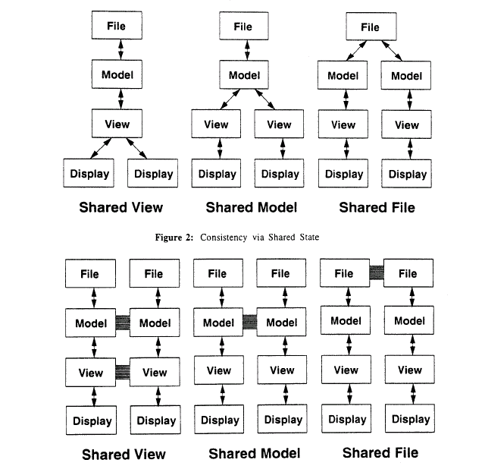
Run-time Architectures : Options
How synchronization occurs across multiple layers of state [Patterson 1995]

Slide 12
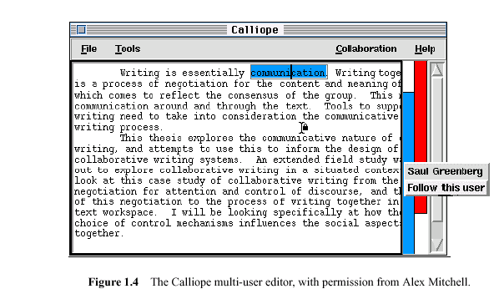
Groupware Widgets
(redesign of single-user versions)

Slide 13
References
Greenberg, S. and Roseman, M., 1999. Groupware Toolkits for Synchronous Work. In: Beaudouin-Lafon, M. (Ed.), Trends In CSCW'99, No. 7 in Trends in Software, John Wiley & Sons, New York, NY, USA, ch. 6, pp. 135–168.
Patterson, J. F., 1995. A taxonomy of architectures for synchronous groupware applications. SIGOIS Bulletin, ACM Press, April 1995, Vol. 15 #3, pp. 27-29.

Slide 14
Context-Aware Computing

Slide 15
Context-Aware Computing
Introduction / Background
Survey Highlights (Moran & Dourish, Chen & Kotz)
Anind Dey’s Context-Aware Toolkit (Thesis)

Slide 16
Context-Awareness : Goal
“Acquire and utilize information about the context of a device to provide services that are appropriate to the particular people, place, time, event, etc.”
(Moran & Dourish, 2001)
“Enhance the behavior of any application by informing it of the context of use.”
(Dey, 2001)

Slide 17
Background
Researchers at Olivetti Research and PARC pioneered Context-Aware Computing (’92, ’93)
…under the vision of “Ubiquitous Computing” (a.k.a. pervasive, invisible computing)
Many definitions of the term “context”

Slide 18
Definition : Context
Shilit [94]*
Schmidt [99]
Dey [99]
Chen, Kotz (survey) [00]
3 Categories of context:
Computing context (connectivity, bandwidth, resources)
User context (profile, location, nearby people)
Physical context (lighting, noise, traffic, temperature)
* First to define the term “context-aware”

Slide 19
Definition : Context
Shilit [94]
Schmidt [99]
Dey [99]
Chen, Kotz (survey) [00]
“…knowledge about the user’s and IT device’s state, including surroundings, situation, and to a less extend, location”
Enumerations vs. definitions. User’s or applications environment?

Slide 20
Definition : Context
Shilit [94]
Schmidt [99]
Dey [99, 01]
Chen, Kotz (survey) [00]
“…any information that can be used to characterize the situation of entities (person, place, object) that are considered relevant to the interaction between a user and an application, including the user and the application themselves.”

Slide 21
Definition : Context
Shilit [94]
Schmidt [99]
Dey [99]
Chen, Kotz (survey) [00]
“…the set of environmental states and settings that either determines an application’s behavior or in which an application event occurs and is interesting to the user”

Slide 22
Types of Context
Primary (low-level)
    Location, time, nearby objects, network bandwidth, orientation, light, tilt, vibration, sound, temperature…
Complex (high-level)
    “current activity”, complex social situations (e.g., in a meeting, giving a presentation)
Context History
Context Properties
    E.g., Rate of change (user location vs. printer location)

Slide 23
Collection of Context
Explicit : manual acquisition of context data from user(s)
Implicit : automatic collection of context data from sensors (ideal)

Slide 24
Use of Context
( Chen & Kotz )
Active : application automatically adapts to discovered context by changing the application’s behavior (phone ring)
Passive : application presents the new/updated context to a user or makes the context persistent for the user to retrieve later (in/out)

Slide 25
Use of Context
( Dey ) : Context-Aware Applications Support
Presentation of information and services to a user
    E.g., nearby printers, car on map
Automatic execution of a service
    E.g., car navigation that reroutes on missed turn, ring-changing cell phone
Tagging of context to information for later retrieval
    E.g., informal meeting notes collected during a meeting

Slide 26
Other Issues
Modeling context information (everyone uses different approached = no interoperability)
    Location model ( symbolic, geometric, hybrid)
    Data structures ( key-value pairs, tagged encoding, object-oriented model, logic-based facts/rules)
System infrastructure
    Centralized vs. distributed architecture
Security & Privacy
    Accuracy, secrecy

Slide 27
Comments
Few contexts other than location have been used in actual applications
Context history is believed to be useful, but is rarely used
Reliance on user(s) explicitly providing context information proves obtrusive / inconvenient
(Chen & Kotz)

Slide 28
Dey’s Context-Aware Toolkit
Definition and classification of context
Introduce a conceptual framework for context-aware application development
Present a toolkit for context-aware research

Slide 29
Context : Entities & Categories
Places : regions of geographical space (rooms, offices, buildings, streets)
People : individuals or groups (co-located or distributed)
Things : physical objects, software artifacts

Slide 30
Context : Entities & Categories
Identity : ability to assign a unique identifier to an entity
Location : position, orientation, elevation, spatial relationships (co-location, proximity, containment)
Status (or activity) : intrinsic characteristics of an entity that can be sensed (temp, tiredness, attending a meeting)
Time : timestamp, time span, order of events

Slide 31
Framework Requirements
Separation of concerns,
Context interpretation,
Transparent, distributed, communications,
Constant availability of context acquisition,
Cotext storage, and
Resource discovery

Slide 32
Framework Requirements
Separation of concerns,
    Abstract context acquisition from application development
    As UI toolkit widgets / interactors handle input
Context interpretation,
Transparent, distributed, communications,
Constant availability of context acquisition,
Cotext storage, and
Resource discovery

Slide 33
Framework Requirements
Separation of concerns,
Context interpretation,
    E.g., App only interested in high-level context (meeting start)
    May require multiple layers of interpretation first
Transparent, distributed, communications,
Constant availability of context acquisition,
Cotext storage, and
Resource discovery

Slide 34
Framework Requirements
Separation of concerns,
Context interpretation,
Transparent, distributed, communications,
    Context from multiple, distributed, networked sources
    Distributed communication transparent to sensors & apps
Constant availability of context acquisition,
Cotext storage, and
Resource discovery

Slide 35
Framework Requirements
Separation of concerns,
Context interpretation,
Transparent, distributed, communications,
Constant availability of context acquisition,
    Components that acquire context must execute independently (from apps that use them) – unlike GUI components
Cotext storage, and
Resource discovery

Slide 36
Framework Requirements
Separation of concerns,
Context interpretation,
Transparent, distributed, communications,
Constant availability of context acquisition,
Context storage,
    Context history can be used to establish trends and predict use
    Collect context data even without currently interested apps
Resource discovery

Slide 37
Framework Requirements
Separation of concerns,
Context interpretation,
Transparent, distributed, communications,
Constant availability of context acquisition,
Cotext storage, and
Resource discovery
    A mechanism is required to help applications find and communicate with a sensor (sensor’s interface)

Slide 38
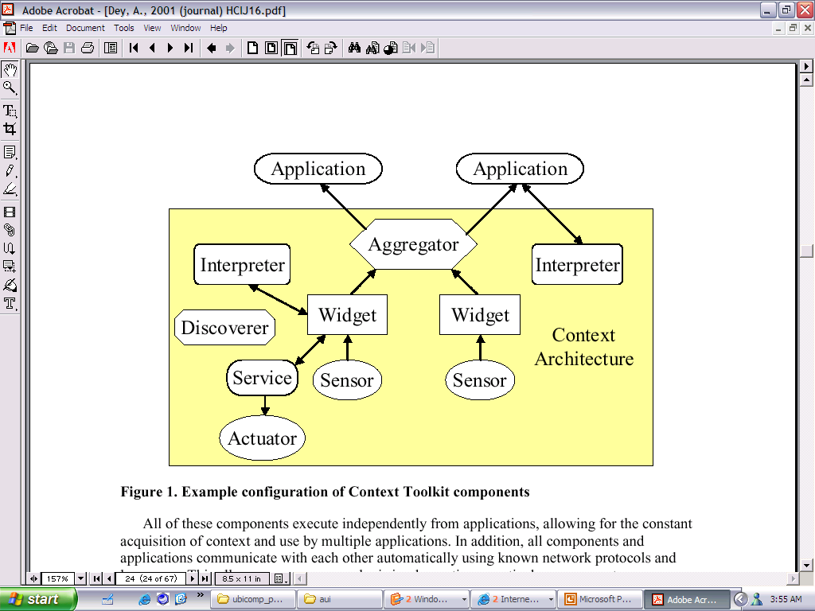
Framework Components (Toolkit)
Meet the requirements :
Context widgets
Interpreters
Aggregators
Services
Discoverers

Slide 39
Components : Context widgets
Hide the complexity of the actual sensors from the application(s)
Abstract context information to suit the expected needs of applications (e.g., filters detail)
Provide customizable and reusable building blocks of context sensing (like GUI widgets)
More detail on request : type of sensor, resolution and accuracy, how data is acquired
Query/poll & notify/callback mechanisms

Slide 40
Components : Interpreters
Transform context information by raising its level of abstraction
Take information from one or more context sources and produce a new piece of context information
All interpreters have a common interface
E.g., people in room + calendar data = meeting

Slide 41
Components : Aggregators
Gather logically related information and make it available within a single “repository” (software component)
Related information : about entities (people, places, objects)
Applications only need to communicate with a single source for related information
Similar capabilities as a widget (query/notify)

Slide 42
Components : Services
The analog to the context widget
    widget = input, service = output
Responsible for controlling/changing state information in the environment (actuators)
Execute actions on behalf of applications
E.g., turn on light

Slide 43
Components : Discoverers
Maintain registry of capabilities (components) in the framework
Applications use discoverers to find particular components
    White pages lookup (by name, identity)
    Yellow pages lookup (by attributes, service type)

Slide 44
Component Relationships

Slide 45
Toolkit Details
Developed in Java (instances of widgets and apps in C++, Frontier, VB, Python)
Simple distributed infrastructure uses peer-to-peer communications
Communication mechanism based on HTTP and XML encoded messages (support wide range of devices)
Each component (widget, aggregator, interpreter, discoverer) implemented as a single process

Slide 46
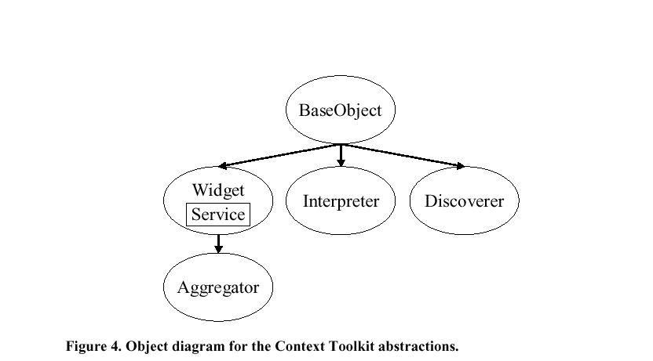
Class Heirarchy
Distributed communications ability encapsulated in BaseObject

Slide 47
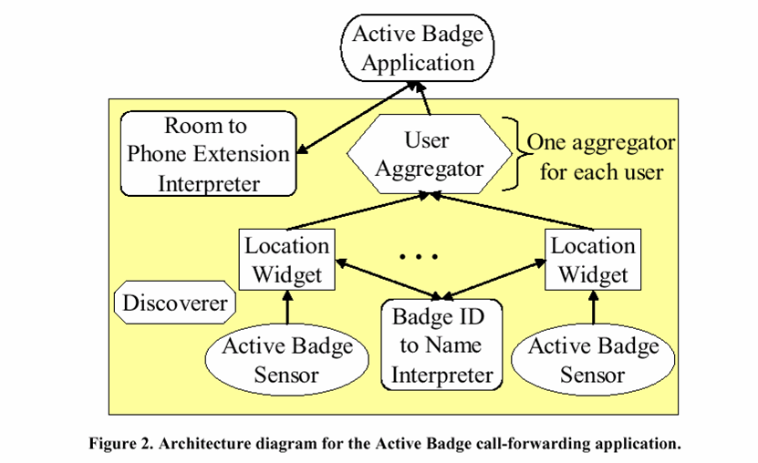
Application : Active Badge

Slide 48
References
Moran, T.P. and Dourish, P., editors, 2001. Special Issue on Context-Aware Computing, Human-Computer Interaction. 16 (2-4), pp. 87-419. (Introduction)
Dey, A.K., Abowd, G.D., and Salber, D., 2001. A Conceptual Framework and a Toolkit for Supporting the Rapid Prototyping of Context-Aware Applications, Human-Computer Interaction. 16 (2-4), 97-166.
Guanling Chen and David Kotz, "A Survey of Context-Aware Mobile Computing Research". Dartmouth Computer Science Technical Report TR2000-381.

Slide 49
Ubiquitous Computing

Slide 50
Stanford’s iStuff Toolkit
Introduction and goals
Architecture (pieces, events, mapping)
Existing device components (I/O)

Slide 51
iStuff : Introduction
Part of Stanford’s iRoom Project, presented at CHI2003
Toolkit designed to support user interface prototyping in ubicomp environments
Domain : explicit interaction with room-sized environment (various displays, inputs, outputs)
Goal : allow multiple, co-located users to fluidly interact with any of the displays and applications

Slide 52
Desktop and “Post-desktop”
Desktop
    One user,
    One set of hardware,
    Single point of focus
Post-desktop
    Multiple displays
    Multiple input devices
    Multiple systems
    Multiple applications
    Multiple concurrent users
Contribution : flexible event and event-mapping model for this context

Slide 53
Applied Concepts
Abstracting device input away from application-level code, (Meyers, 1990 : Garnet)
Hierarchical event structures can provide higher-grain code reuse, and
Abstracting low-level events to application-level events (Meyers and Kosbie, CHI’96)
Addition of run-time retargetable event flow

Slide 54
iStuff Architecture Summary
Toolkit designed on top of iROS (a TCP- and Java-based middleware that allows multiple machines and applications to exchange information)
iROS supports communication through the “Event Heap” (central server)
Standard machines and operating systems
Dynamically configurable intermediary simplifies mapping of devices/interactions to applications

Slide 55
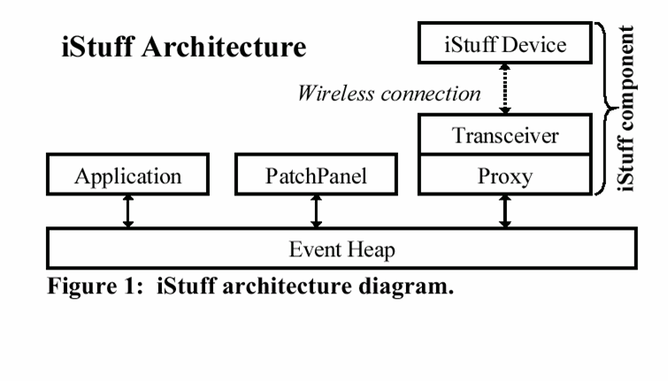
iStuff Architecture Diagram
Lightweight wireless input/output devices (buttons, sliders, wands, speakers, mics)
+ Software proxies for each device
Components (device + proxy) can be dynamically mapped to different applications with the “Patch-Panel”
Synchronous communication based on iROS events
Patch Panel does not sit between proxies and apps (non-destructive mapping)

Slide 56
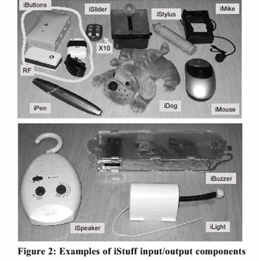
iStuff : Components
Wireless Device
+ host machine
+ transciever
+ software proxy
Generates events to (or extracts from) the Event Heap

Slide 57
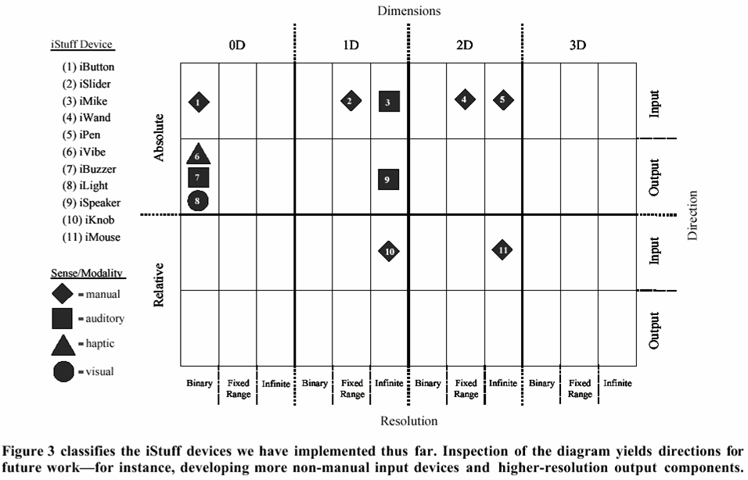
Component Classification Matrix
Suggests research opportunities for new device types

Slide 58
iStuff : Event Communication
Event is a message that contains a type and an optional number of fields (key-value pairs)
Extends the notion of an event queue to an entire interactive room (multiple machines, users)
iROS implementation (mostly Java) is available Open Source
    http://iros.sourceforge.net/

Slide 59
iStuff : Patch Panel
Non-destructively translates events from one type to another (supports arithmetic expressions)
Developers encouraged to use their own abstract event types and use the Patch Panel to map to specific component events
Run-time retargetability (by events) allows dynamic change of “focus” (I/O) and mappings (e.g., iButton : light on > light off)
Also have web-based GUI access to Patch Panel

Slide 60
References
Ballagas, R., Ringel, M., Stone, M., Borchers, J.. iStuff: A Physical User Interface Toolkit for Ubiquitous Computing Environments. CHI2003. 537-544.
http://iwork.stanford.edu/

Slide 61
Other Systems

Slide 62
Other Systems
Aura (CMU)
Gaia (UIUC)
Oxygen (MIT)
EasyLiving (MSFT)

Slide 63
Aura (CMU)
Target : pervasive computing environments (wireless, wearables, smart spaces, reduced human attention)
Not a toolkit, but a research effort around themes (umbrella project with research thrusts)
Proactivity (layers anticipate requests) and self-tuning (layers adjust their performance)
http://www.cs.cmu.edu/~aura/

Slide 64
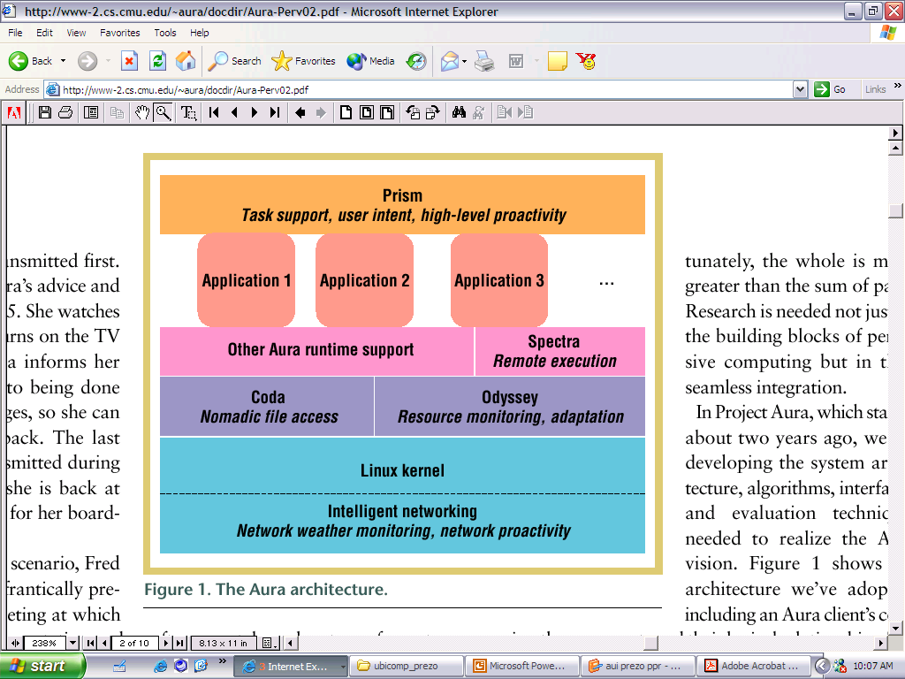
Aura…
Broadly rethink system design (hardware, networking, middleware applications, user tasks)
Task-driven computing, energy-aware adaptation, intelligent networking, speech, nomadic data access, UI adaptability…

Slide 65
Gaia (UIUC)
Goal : design and implement a middleware operating system that manages the resources contained in an Active Space
Gaia brings the functionality of an operating system to physical spaces (e.g., events, signals, file system, security, processes, process groups…)
Research exploration, not a toolkit
http://choices.cs.uiuc.edu/gaia/

Slide 66
Oxygen (MIT)
Pervasive human-centered computing (as available as oxygen)
Collection of projects (technologies : device, network, system, perceptual, user)
E.g., H21 Handheld, Cricket location system (indoor GPS), Intentional Naming System (resource discovery based on function), adaptive software architecture, speech/multi-modal technologies, Haystack, Semantic Web…
http://oxygen.lcs.mit.edu/

Slide 67
EasyLiving (MSFT Vision Group)
Developing a prototype architecture and technologies for building intelligent environments
    Computer vision for person-tracking and visual user interaction.
    Multiple sensor modalities combined.
    Use of a geometric model of the world to provide context.
    Automatic or semi-automatic sensor calibration and model building.
    Fine-grained events and adaptation of the user interface.
    Device-independent communication and data protocols.
    Ability to extend the system in many ways.
http://research.microsoft.com/easyliving/

Slide 68
Conclusions
Input as common challenge (context as input, distributed, multiple inputs)
Implicit (context) and explicit (iStuff) input
Many lessons from GUI toolkits (esp. abstraction) apply
New challenges (complex, distributed, flexible architectures, less control, ambiguity)

