Slide 1


Hackathon Proof of Concept
Analysing gender differences in financing within the Ivory Coast's cassava value chain
Alex Akorli, Nadine Cyizere, Rose Adeyinka
Supervisors: Chris Toumping, Lorenzo Verstraeten, Chih-Chun Chen
October 2023
Notes:
Evaluate links between gender, access to loans, trust in financial institutions and mobile money services, type of organisations, gender and environmental impact of companies.
Check out page 16 of this report: https://uploads-ssl.webflow.com/5e6519c2af4002071aa3e753/62bb013de08029250a1eada7_EN_Annual%20Report%202022_compressed.pdf

Slide 2
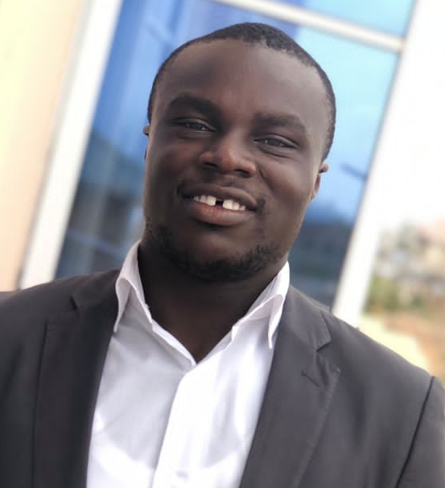
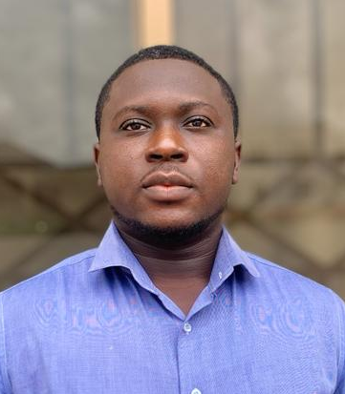

Team
Alex Akorli
An experienced research assistant with certification in data analysis. Passionate about data science with python, Machine learning and deep learning. Alex has background in production and Mechanical Engineering.
Shadrack Darku
An experienced Data Scientist skilled in building Machine Learning models, statistical analysis, and front-end web development. Passionate about designing, deploying, and optimizing AI solutions.

Slide 3
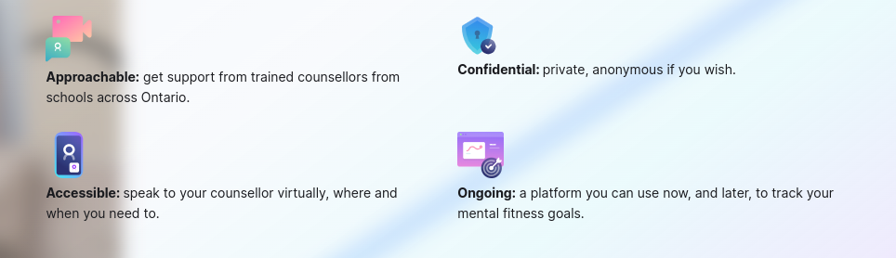
Introduction
Get A-Head is a digital platform that provides mental health support to students at colleges and universities across Ontario at no cost. Delivered through secure text, audio, and video sessions, all appointments are confidential, easily accessible and offered online.
https://geta-head.com/

Slide 4
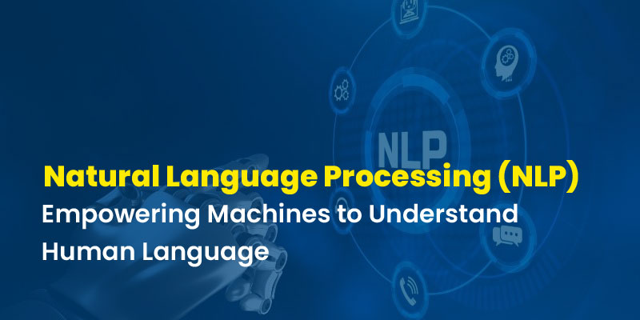
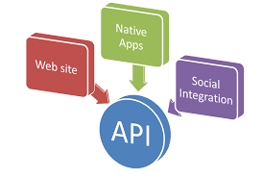
Problem Overview
Develop an advanced Natural Language Processing (NLP) solution to automate:
Transcript summarization
Subjective and Objective summaries that can be used for auto-populating clinical SOAP notes.
Provide an API, allowing seamless data communication. This means that the data, including the transcripts and generated summaries, can be accessed and processed through API calls.

Slide 5
Data Description
The available data for this project consists of session transcripts, which will be shared as a JSON object via an API call. The transcript data is segmented into different slices, but through the API, you can request any specific slice.
You have the option to request the following:
Raw data from one participant: This allows you to retrieve the unprocessed transcript data from a single participant.
Aggregate data: In the case where someone drops from the session, you can request aggregated chunks where multiple segments are joined together.
Note: the API provides flexibility in accessing and retrieving the desired transcript slices based on your specific requirements.

Slide 6
Methodology
Data Collection and Preprocessing: Clean and preprocess the collected data to remove irrelevant information, and ensure patient privacy.
Summarization Approach: Analyze the requirements and characteristics of the transcript data to determine the most suitable summarization approach:
Aggregate Transcript Summarization: Develop a summarization model that generates a concise summary of the entire transcript.
Single Voice Transcript Summarization: Create individual summaries for each participant in the conversation.
Model Development: Use pre-trained deep learning-based summarization models using the preprocessed transcript dataset. Experiment with state-of-the-art architectures, such as Transformer models or encoder-decoder frameworks
Subjective and Objective Data Extraction: Use separate pre-trained models for extracting subjective and objective data from the transcripts. Leverage natural language processing techniques to identify subjective information shared by patients and objective information collected by healthcare professionals.

Slide 7
Exploratory Data Analysis

Slide 8
Exploratory Data Analysis

Slide 9
Retrospective: Learnings and Challenges

Slide 10
Suggestions for next phase of project

Slide 11
Thank you!

