Slide 1
Live Demo: BCH Decoding Using PLUTO & LTE Toolbox

Slide 2
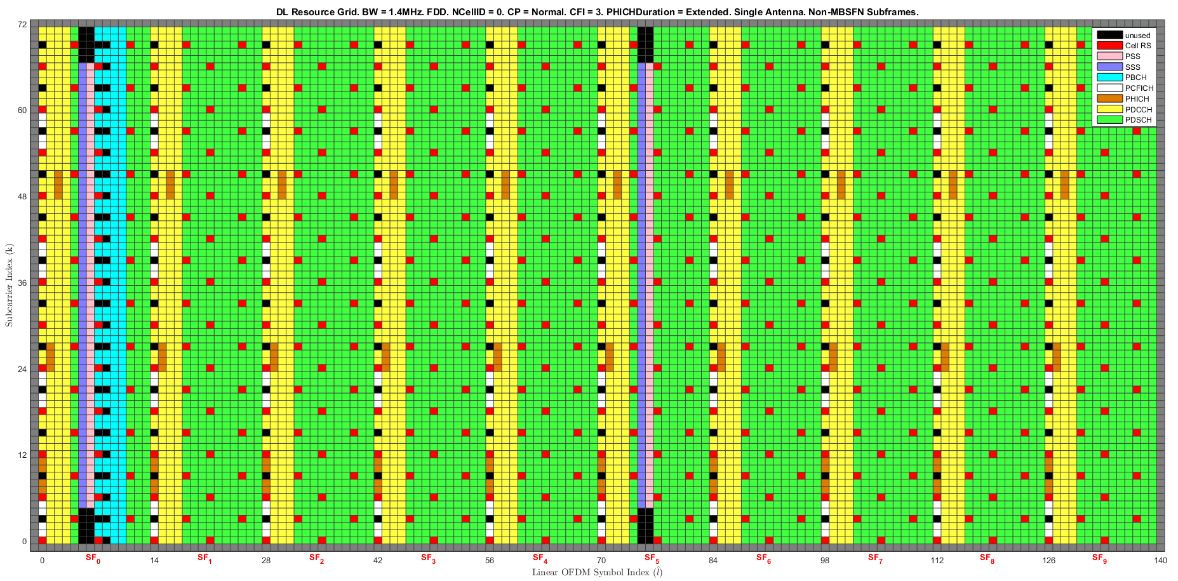
Goal: Decode BCH from Live LTE Signal
Notes:
Try
Generate the same signals as shown in this page, but use a sampling rate and signal duration specification instead of the linspace command to generate the time base.
>> edit synthSig

Slide 3
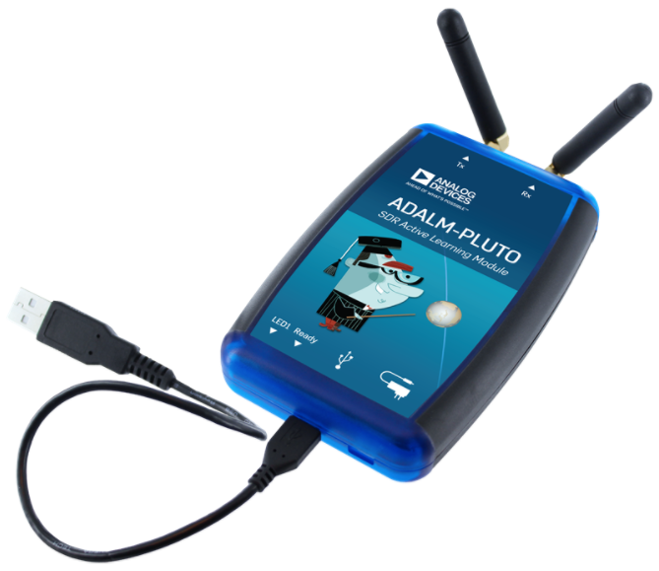
Analog Devices ADALM-PLUTO
  SDR Active Learning Module
  Available from neutronusa.com ($111) and NextWarehouse.com ($106)
Notes:
Try
>> t1 = [0 .1 .2 .3];
>> t2 = 0:0.1:0.3;
>> t3 = linspace(0,0.3,4);
>> T = [t1' t2' t3'];
>> X = sin(T);

Slide 4


ADALM-PLUTO Hardware Specifications
  Single TX. Single RX.
  Out-Of-The-Box AD9363 Configuration
    RF Frequency: 325 MHz to 3.8 GHz
    Bandwidth: Up to 20 MHz
  MathWorks Hardware Support Package AD9364 Configuration
    RF Frequency: 70 MHz to 6.0 GHz
    Bandwidth: Up to 56 MHz
  ADC and DAC Sample Rate (Complex): 65.2 kSPS to 61.44 MSPS (Note: Achievable with USB 2.0 is about 16 MHz)
  ADC and DAC Resolution: 12 bits
  Frequency Accuracy: +/- 25 ppm
Notes:
Try
>> t1 = [0 .1 .2 .3];
>> t2 = 0:0.1:0.3;
>> t3 = linspace(0,0.3,4);
>> T = [t1' t2' t3'];
>> X = sin(T);

Slide 5
MathWorks Software
  MATLAB
  LTE Toolbox
  Communications Toolbox
    RTL-SDR Hardware Support Package (Free)
    Analog Devices ADALM-Pluto Radio (Free)
Notes:
Try
>> t1 = [0 .1 .2 .3];
>> t2 = 0:0.1:0.3;
>> t3 = linspace(0,0.3,4);
>> T = [t1' t2' t3'];
>> X = sin(T);

Slide 6
Cell Phone Service Screen Mode
  iPhone
    Call: *3001#12345#*
    Select: “Serving Cell Info”
  Samsung (Non-Verizon Android)
    Call: *#0011# or *#*#197328640#*#*
  HTC (Android)
    Call: *#*#7262626#*#*
Notes:
Try
>> t1 = [0 .1 .2 .3];
>> t2 = 0:0.1:0.3;
>> t3 = linspace(0,0.3,4);
>> T = [t1' t2' t3'];
>> X = sin(T);

Slide 7
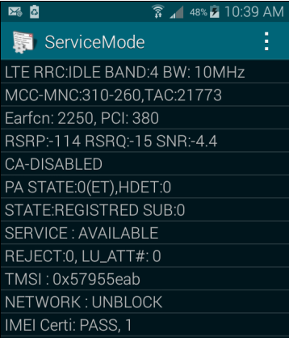
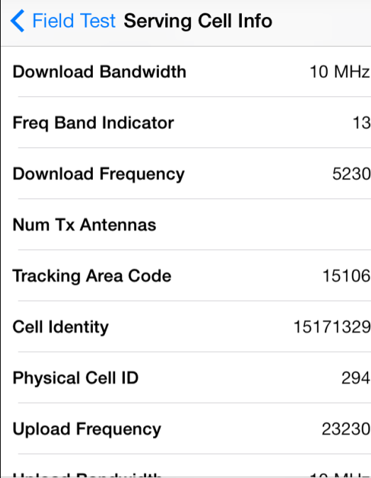
Cell Phone Service Screen Mode (Cont’d)
T-Mobile Android
Verizon iPhone
Notes:
Try
Generate the same signals as shown in this page, but use a sampling rate and signal duration specification instead of the linspace command to generate the time base.
>> edit synthSig

Slide 8
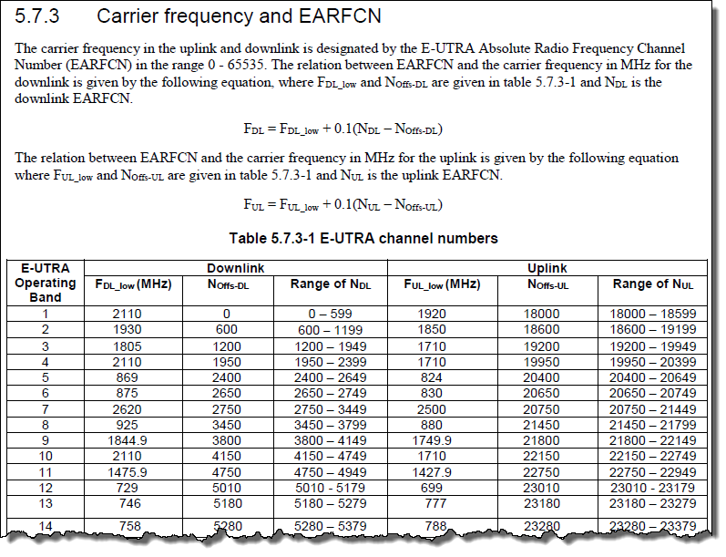
Calculate LTE Carrier Frequency
Source: Table 5.7.3-1 in pp. 18 of 36.101 V8.24.0 (2014-06)
Notes:
Try
Generate the same signals as shown in this page, but use a sampling rate and signal duration specification instead of the linspace command to generate the time base.
>> edit synthSig

Slide 9
Let’s Do It
Notes:
Try
Generate the same signals as shown in this page, but use a sampling rate and signal duration specification instead of the linspace command to generate the time base.
>> edit synthSig

Slide 10
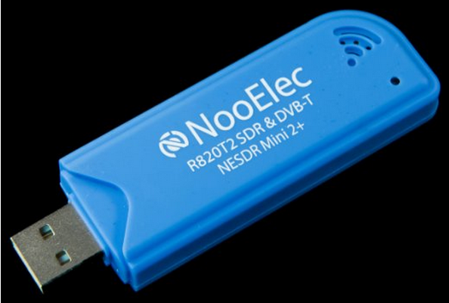
RTL-SDR (Hardware)
  Available from NooElec.com
  Originally designed as DVB TV Tuner
Notes:
Try
>> t1 = [0 .1 .2 .3];
>> t2 = 0:0.1:0.3;
>> t3 = linspace(0,0.3,4);
>> T = [t1' t2' t3'];
>> X = sin(T);

Slide 11
RTL-SDR Hardware Specifications
  0.5PPM TCXO installed as standard--rock solid tuning under nearly any conditions!
  Frequency capability 24 MHz – 1700 MHz (approximate).
  8-bit ADC.
  Maximum sample rate that does not drop samples is 2.4 MS/s (complex).
$45 USB RF Receiver
Notes:
Try
>> t1 = [0 .1 .2 .3];
>> t2 = 0:0.1:0.3;
>> t3 = linspace(0,0.3,4);
>> T = [t1' t2' t3'];
>> X = sin(T);

