Slide 1
01. data types
Data Science Institute | Python
Notes:
Hi everyone, I’m Julia — a PhD candidate at the Institute of Medical Science here at the University of Toronto.

Slide 2
Learning objectives
Introduction to Jupyter notebooks
Understand core python data types
Differentiate between statements and expressions
Use logical operators
Create and use variables
Notes:
Just to orient everyone, here are our learning objectives for today’s session.
By the end of this session
Navigate Jupyter Notebooks
Open, run, and edit code and markdown cells
Understand the difference between code cells and markdown cells
Execute cells individually and in sequence
Understand Core Python Data Types
Identify and work with common data types including integers, floats, strings, and booleans
Recognize how data types affect program behavior and outputs
Differentiate Between Statements and Expressions
Explain the difference between a statement and an expression in Python
Evaluate expressions and interpret their results
Apply Arithmetic Operators
Use basic arithmetic operators (+, -, *, /)
Apply additional operators such as exponentiation (**), integer division (//), and modulo (%)
Use Logical Operators
Apply comparison operators (==, !=, <, >, <=, >=)
Use logical operators (and, or, not) to evaluate conditions
Create and Use Variables
Assign values to variables using meaningful names
Update and reuse variables in calculations and expressions
Practice Coding in Python
Write and execute simple Python code to reinforce core concepts
Interpret error messages and troubleshoot basic issues

Slide 3

Jupyter notebook
We will be using Jupyter Notebooks, which are files that end in .ipynb.
What is a Jupyter Notebook?
A notebook lets you write code and notes in the same place
You can explain what you’re doing while writing Python code
Everything stays together in one document!
Jupyter Notebooks are made up of cells. Each cell can contain either code or text.
Code cells do the work
Text cells explain what the code is doing
Using both helps keep your notebook organized and easy to understand

Slide 4
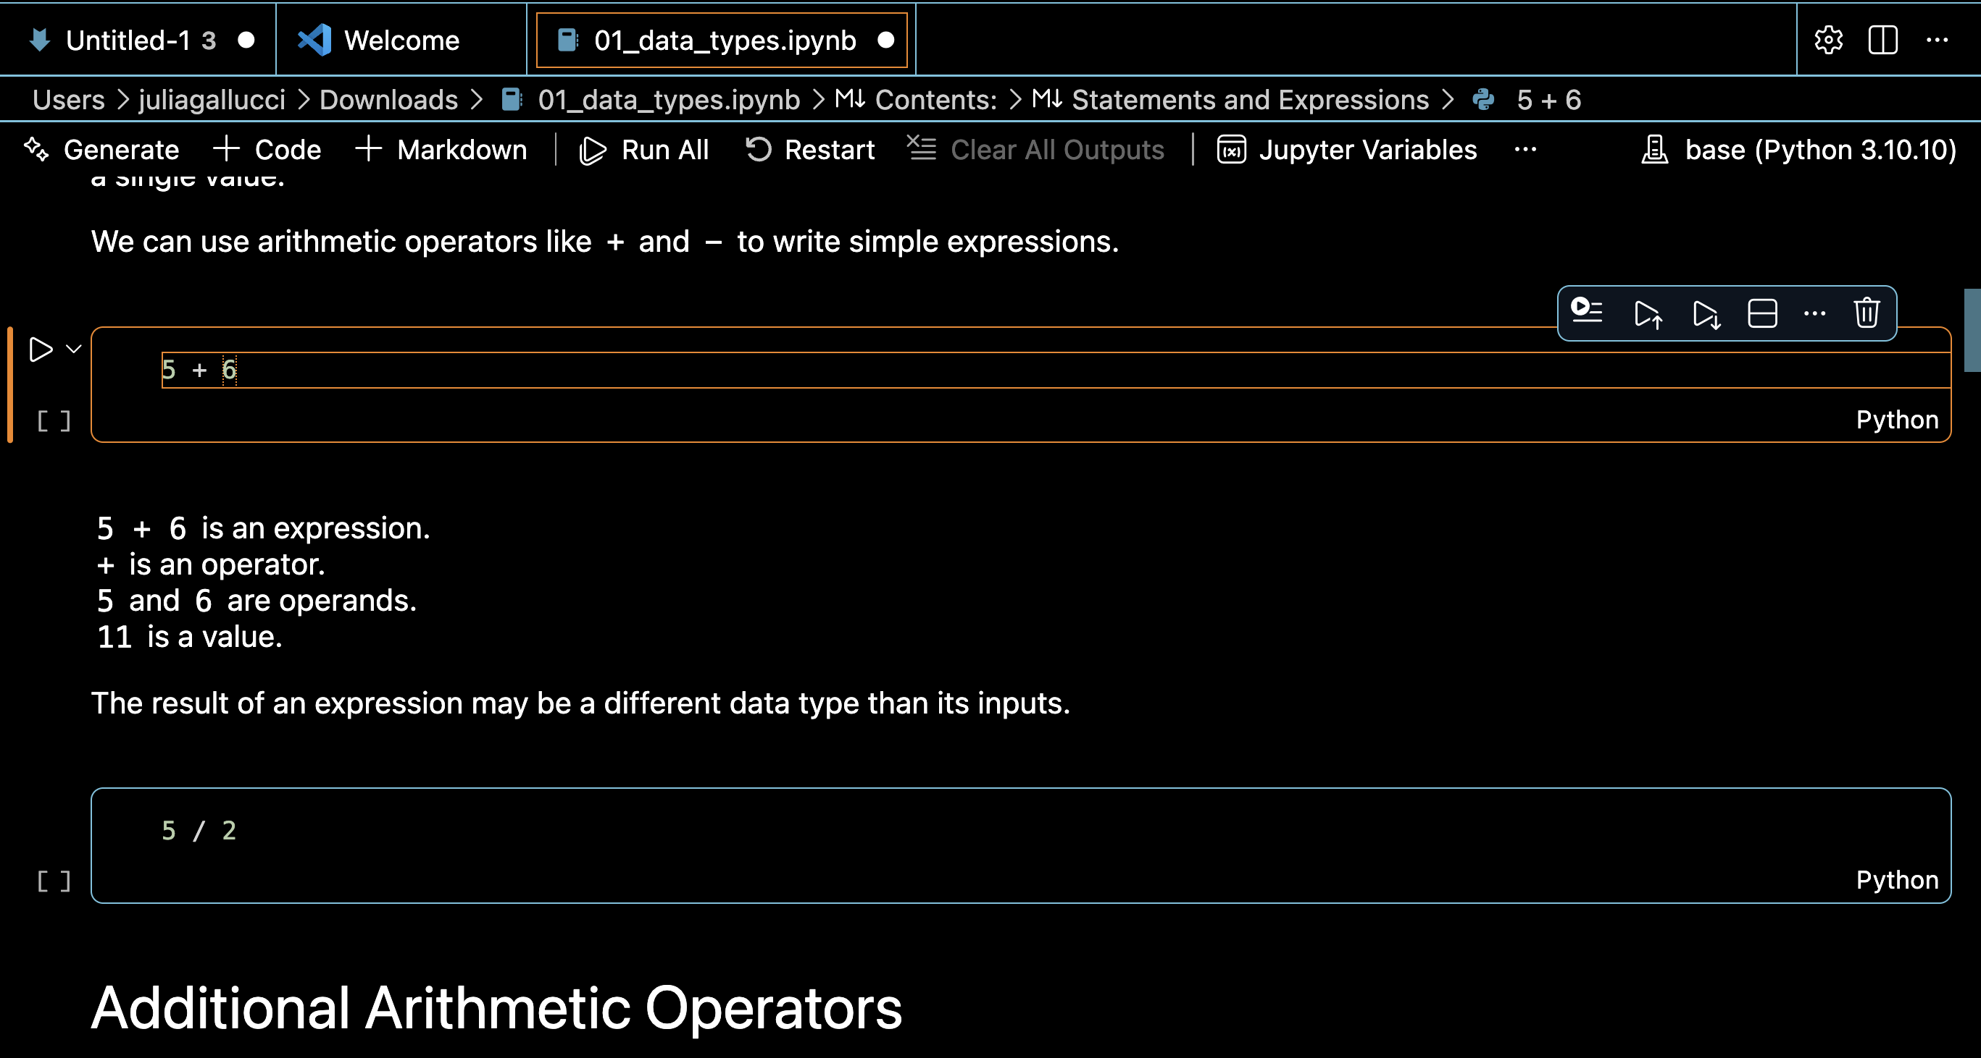
Running Code
Code is written in cells
You can run:
One cell at a time (Click the ▶ button, or Press Shift + Enter/Return
or
All cells from top to bottom (Click Run all)
Results will appear right below the code

Slide 5
Writing Notes and Explanations
You can add text cells to write explanations, titles, or instructions
This helps you remember what your code does!

Slide 6
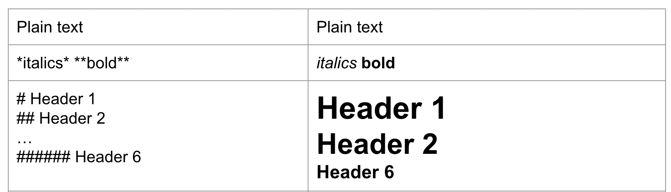
Text syntax
Syntax on left → Output on right

Slide 7
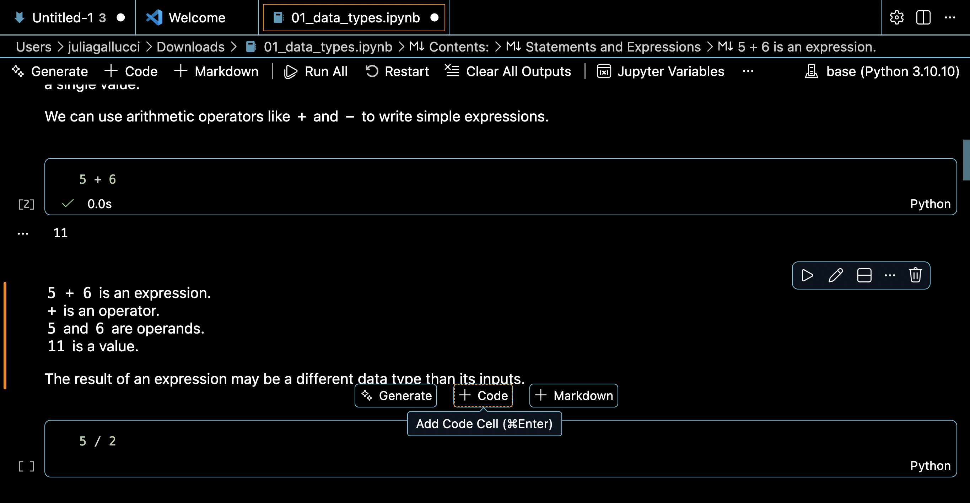
Adding New Code or Text
Click + Code to add a new code cell
Click + Text to add a new text (Markdown) cell
The new cell appears below the current cell

Slide 8
Data types
Every value in Python has a data type, which tells the computer:
How the value is stored, and
What kinds of operations you can perform with it
Here are a few basic types you will encounter:
Type | Description | Example
Integer number (or Int) | Whole number | 10, -3, 42
Floating point number (or Float) | Decimal number | 3.14, 0.01
String | Text strings | “Hello”, “Python”
Boolean (or Bool) | True/False values | True, False

Slide 9

Statements and expressions
A statement is an instruction that tells the computer to do something.
You can think of statements as the basic building blocks of a program.
An expression is a type of statement that combines operators and operands that produces a value.
Example of an expression:
When you run an expression, Python evaluates it and shows the result.
Operator: A symbol that tells Python to perform a specific action on values.
2 + 3
Operand: The value(s) that the operator acts on.
5

Slide 10
Arithmetic operators
Here are a few basic arithmetic operators you will encounter:
Operator | Description | Example | Result
+ | Addition | 10 + 3 | 13
- | Subtraction | 10 - 3 | 7
* | Multiplication | 10 * 3 | 30
/ | Division | 10 / 3 | 3.333
** | Exponentiation | 10**3 | 1000
% | Modulo or remainder | 10 % 3 | 1
// | Integer division (always rounds down) | 10 // 3 | 3

Slide 11
Boolean operators
Python has a Boolean data type: Bool.
Only two possible values: True or False
Comparison Expressions
Use a comparison operators and produce a Boolean result (True or False)
Here are some common comparison operators:
Operator | Description | Example | Result
> | Greater than | 10 > 3 | True
>= | Greater than or equal to | 10 >= 3 | True
< | Less than | 10 < 3 | False
<= | Less than or equal to | 10 <= 3 | False
== | Equal to | 10 == 3 | False
!= | Not equal to | 10 != 3 | True

Slide 12
Order of operation
Python follows a specific order when evaluating expressions. This is called operator precedence.
Examples
Order | Operator | Description
1 | ** | Exponentiation
2 | - | Negation
3 | *, /, //, % | Multiplication, division, integer division, and modulo
4 | +, - | Addition and subtraction
5 | <, <=, >, >=, ==, != | Less than, less than or equal to, greater than, greater than or equal to, equal, not equal
Multiplication first: 3*2 = 6 → 10 + 6 = 16
10 + 3 * 2
Parentheses first: 10+3 = 13 → 13*2 = 26
(10 + 3) * 2

Slide 13

Variables
A variable is a name that stores a piece of information — like labeling a box so you remember what’s inside.
In Python:
Variable names can include letters, numbers, and underscores
Variable names cannot begin with a number
Variable names are case-sensitive (age and Age are different variables)
Creating a Variable
Use the assignment operator =
This is called an assignment statement!
degrees_celsius = 25

Slide 14
Reassigning a variable
You can use the value stored in one variable to calculate and create another variable.
A variable stores a value, but you can change the value by reassigning it.
Reassigning a variable changes only that variable
Other variables that were assigned the old value do not change
degrees_fahrenheit = (9 / 5) * degrees_celsius + 32
degrees_celsius = 30
Reassigning degrees Celsius to 30 will not change the value of degrees Fahrenheit!

Slide 15

Using a Variable in Its Own Assignment
You can update a variable based on its current value
This is useful for running totals, counters, or updating values dynamically
degrees_celsius = degrees_celsius + 10
This would add 10 to the current value of degrees_celsius
degrees_celsius
degrees_celsius
degrees_celsius
degrees_celsius
30 40 50 60 …

Slide 16
Augmented assignment
Instead of writing:
You can use a shorthand operator called an augmented assignment:
Similarly, subtraction, multiplication, division, exponentiation, integer division, and modulo can be used as an augmented assignment.
degrees_celsius = degrees_celsius + 10
degrees_celsius += 10
This reads as, take the current value of degrees_celsius, add 10, and store the result back in degrees_celsius

Slide 17
Exercises
Try these on your own:
Create three variables:
name,
age,
favorite_number
Run the code cells to see your results!

