Slide 1
03. functions
Data Science Institute | Python
Notes:
Hi everyone, I’m Julia — a PhD candidate at the Institute of Medical Science here at the University of Toronto.

Slide 2
Learning objectives
Understand what functions are and why they are useful
Use common built-in functions
Nest and combine functions
Write your own functions
Document functions using docstrings
Understand function structure and variable scope
Apply a basic function design recipe
Notes:
Just to orient everyone, here are our learning objectives for today’s session.

Slide 3
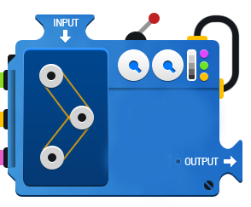
What is a function?
A function is a block of code that performs a task.
It can take inputs and return outputs.
Functions help make code organized and reusable.
Functions can have zero or more inputs.
Inputs are called arguments.
Functions usually return a value after processing

Slide 4
How to call a function
To use a function, we call it.
Syntax: function_name()
Python comes with several functions already built-in.
To display information, for example, we can call the `print()` function.
print(42) # Output: 42
Here, print is the function being called
print(10 ** 2) # Output: 100
Note, we can also pass an expression as an argument!

Slide 5
More built-in functions
Python has many other built-in functions you can use right away.
These functions make common tasks easier.
Use abs()to get the absolute value of a number.
Use round()to round a number to the nearest integer (or specified decimal places).
Convert values using int()(integer) or float()(decimal)
abs(-42) # Output: 42
round(3.7) # Output: 4
round(3.14159, 2) # Output: 3.14
int(3.7) # Output: 3
float(5) # Output: 5.0

Slide 6
Nesting functions
You can use functions inside other functions—this is called nesting.
Nested functions are evaluated from the inside out.
print(abs(round(-2 * 1.75)))
This allows us to perform multiple operations in a single line making code compact and efficient!
Evaluation order:
1. -2 * 1.75 → multiplication happens first
Result: -3.5
2. round()→ rounds the result
Result: -4
3. abs()→ converts to absolute value
Result: 4
4. print()→ displays the final output
Output: 4

Slide 7
How to Learn About a Function
Sometimes we need to know:
What a function does
What arguments it can take
Two main ways to find out:
Online documentation https://docs.python.org/3/library/functions.html
Built-in help function
help()shows information about a function directly in Python.
help(function_name)

Slide 8
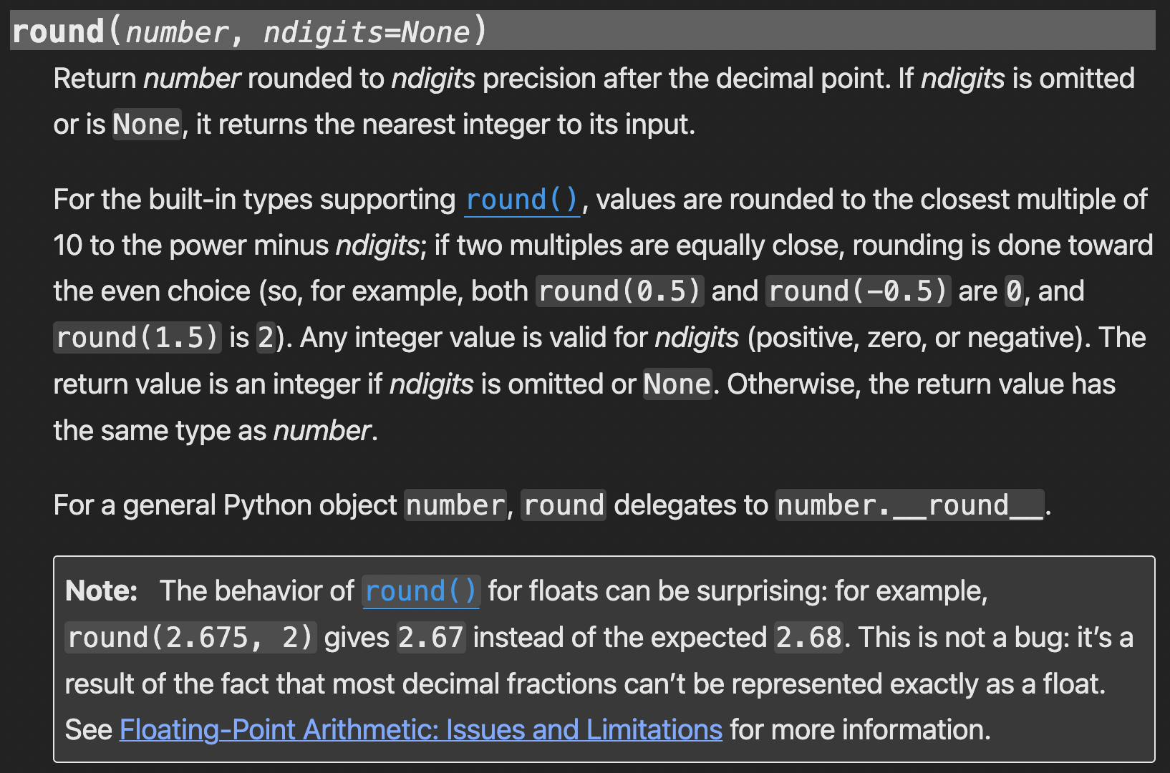
Example of online documentation
This tells us what the function does and what arguments it takes!

Slide 9
Example of help function
help(round)
Help on built-in function round in module builtins:
round(number, ndigits=None)
Round a number to a given precision in decimal
digits.
The return value is an integer if ndigits is
omitted or None. Otherwise, the return value has
the same type as the number. ndigits may be
negative.
This also tells us what the function does and what arguments it takes, without having to leave Python!

Slide 10
Writing your own function
We can also create our own functions, which allows us to reuse code without copying and pasting!
In Python, we define a function using the def keyword. This tells Python that we are creating a new function.
Function name comes right after def.
Function names:
Can include letters, numbers, and underscores
Cannot start with a number
Are case sensitive
Usually start with a lowercase letter
def function_name

Slide 11
Writing your own function
3. After the function name, we list any parameters inside parentheses.
A parameter is a variable that exists only inside the function. When we call a function and pass in values (called arguments), those values are assigned to the parameters.
4. The line defining the function ends with a colon (:).
The function body is the indented block of code that follows. This code:
Runs only when the function is called, not when it is defined
Can include comments and multiple statements
def function_name(parameter = argument)
def function_name(parameter = argument):
code to execute when function is called

Slide 12
Writing your own function
5. The function usually ends with a return statement.
A return statement specifies what value the function will send back when it’s called
Note. If you don’t write a return statement, Python automatically returns None (a special value that represents “no data”)
def function_name(parameter = argument):
code to execute when function is called
return

Slide 13
Example
Let’s create a function that converts degrees from Celsius to Fahrenheit
The formula is (°C × 9/5) + 32 = °F
def c_to_f(degrees_c):
#convert degrees from Celsius to Fahrenheit
return (degrees_c * (9/5)) + 32
defines the function name with 1 parameter, degrees_c
degrees_c only exists inside the function
converts the Celsius value from degrees_c to farenheit using the standard formula and returns the result!

Slide 14
Example
Once we’ve defined our variable, we can use it!
c_to_f(0) # returns 32.0
c_to_f(100) # returns 212.0
The function does nothing until it is called. When called, it takes the input value, performs the calculation, and returns the converted temperature.

Slide 15
Example
We can save the output of a function by assigning it to a variable
freezing_f = c_to_f(0)
freezing_f # output 32.0
This allows us to store the returned value (32.0) in the variable freezing_f

Slide 16
Exercise # 1
Try this on your own:
Write a function that converts Fahrenheit to Celsius
The formula is (°F – 32) × 5/9 = °C

Slide 17
Multiple parameters
So far, the functions we’ve seen have had a single parameter. However, functions can have multiple parameters.
When a function has more than one parameter, the order of the arguments matters.
The first argument is assigned to the first parameter
The second argument is assigned to the second parameter
And so, on
Because Python matches arguments to parameters by position, passing values in the wrong order can lead to incorrect results.

Slide 18
Example
Let’s create a function that has two parameters: a divisor and a dividend.
def divide(dividend, divisor):
return dividend / divisor
This function:
Takes two parameters
Divides the dividend by the divisor
Returns the result
divide(0,2)# output 0
divide(2,0)# output error division by zero

Slide 19
Optional parameters and default arguments
Functions can have default values for their parameters.
This is useful when a value is commonly used, because it allows us to omit that argument when the default works for our needs.
If we want to use a different value, we can override the default by explicitly passing in an argument.

Slide 20
Example
Let’s create a function that calculates the sale tax on a price.
def calc_sales_tax(price, tax_rate=0.13):
return price * tax_rate
price is a required parameter → you must always provide it.
tax_rate is an optional parameter with a default value of 0.13 (Ontario’s sales tax rate).
If no value is given for tax_rate, Python automatically uses 0.13.
calc_sales_tax(100)# default rate 13%, returns 13.0
calc_sales_tax(100, .05)# rate of 5%, returns 5.0

Slide 21
Keyword arguments
When a function has multiple optional parameters, we can use keyword arguments to specify exactly which parameter a value should be applied to.
Using a keyword argument looks like assigning a value to a parameter name
This makes the code easier to read and avoids mistakes from incorrect argument order

Slide 22
Example
Let’s create a function that calculates the total bill cost with price, tax rate and tip rate.
def calc_total_bill(price, tax_rate=0.13, tip_rate=0.2):
tax = price * tax_rate
tip = price * tip_rate
return price + tax + tip
price is a required parameter → you must always provide it.
tax_rate is an optional parameter with a default value of 0.13
tip_rate is an optional parameter with a default value of 0.20
If no value is given for tax_rate and tip_rate, Python automatically uses 0.13 and 0.20, respectively.

Slide 23
Example
default tax and tip rate
calc_total_bill(100)# returns 133.0
default tax but specify tip rate
calc_total_bill(100, tip_rate = 0.22)# returns 135.0
Here, we use the tip_rate keyword argument to specify that the second argument is not tax rate, but tip rate!
If we didn’t, it would assume we were setting the tax_rate to 0.22
calc_total_bill(100, 0.22)# returns 142.0

Slide 24
Documenting functions
We can use the built-in help() function to see information about both built-in and user-defined functions.
Docstrings
To get useful information for user-defined functions, we add a docstring.
A docstring is a special string that describes what a function does.
It is placed immediately after the function definition line.
Docstrings are typically written with triple quotes: ''' or """.
When we call help()on a function, Python displays its docstring.

Slide 25
Example
def c_to_f(degrees_c):
"""
Convert a temperature from Celsius to Fahrenheit.
Parameters:
degrees_c (float): Temperature in degrees Celsius.
Returns:
float: Temperature in degrees Fahrenheit.
"""
return (degrees_c * (9/5)) + 32

Slide 26
Example
Now when we call the help function…
help(c_to_f)
Help on function c_to_f in module __main__: c_to_f(degrees_c)
Convert a temperature from Celsius to Fahrenheit. Parameters:
degrees_c (float): Temperature in degrees Celsius. Returns:
float: Temperature in degrees Fahrenheit.

Slide 27
Review of function structure
def function_name(parameters):
"""
docstring
"""
function body
return
function header → tells us the function name and parameters
docstring→ describes what the function does, accepted arguments, what gets returned etc.
function body → code that runs when function is called, ends with a return statement specifying the output

Slide 28

Variable scope
We mentioned earlier that parameters are variables used only inside functions. This means:
If you try to access a parameter like degrees_c outside the function c_to_f(), Python will raise a NameError.
Local score | Global scope
Parameters are locally scoped, meaning they exist only inside the function. | Variables defined outside of any function have global scope.
Scope refers to the context in which a variable can be accessed. | They can be accessed from anywhere in the program, including inside functions (though modifying them inside a function requires extra care).
Local means the variable is accessible only within the function where it is defined.

Slide 29
Local variable example
This is a variable we defined inside a function
def example():
local_var = 10
return local_var
If we tried to call this variable out of the function, we’d get a NameError!
local_var
---------------------------------------------------------
NameError Traceback (most recent call last)
Cell In[1], line 1
----> 1 local_var
NameError: name 'local_var' is not defined

Slide 30
Global variable example
This is a variable we defined outside of a function
global_var = 5
We can access this variable inside and outside of a function
def example():
return global_var
example()# returns 5
global_var # output: 5

Slide 31
Exercise # 2
Create a function on your own:
Think about what your function does. Come up with a few examples of inputs and outputs.
Think of a meaningful function name.
Write thorough function documentation.
Code the function body.
Test the function against the examples from step 1.

