Slide 1
05. converting between types
Data Science Institute | Python
Notes:
Hi everyone, I’m Julia — a PhD candidate at the Institute of Medical Science here at the University of Toronto.

Slide 2
Learning objectives
Be able to convert data between strings, integers, and floats
Understand when type conversion may produce errors.
Notes:
Just to orient everyone, here are our learning objectives for today’s session.

Slide 3
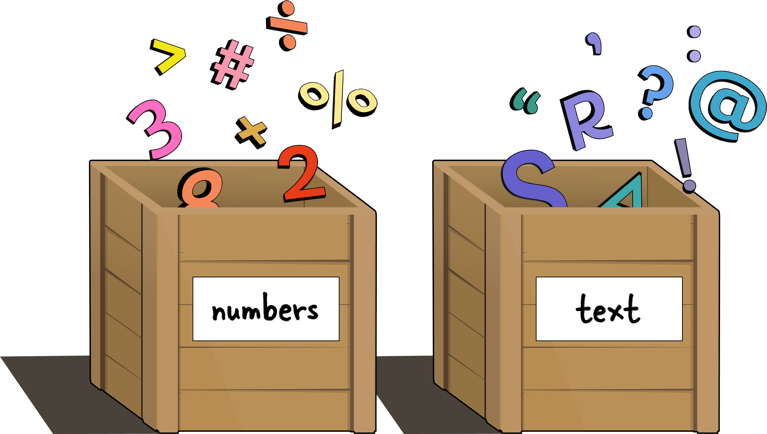
Converting between types
Use Python functions to convert between data types:
str() → convert to string
int() → convert to integer
float() → convert to float
Invalid conversions cause errors
int(’17’) # Output: 17
float(’17’) # Output: 17.0
str(37.5) # Output:‘37.5’
’20’ + str(37.5) # Output:‘2037.5’
int(’me’) # ValueError

Slide 4
Exercise
Try this on your own:
Fix the error
’The year is’ + 2026 # TypeError

