Slide 1
10. numpy
Data Science Institute | Python
Notes:
Hi everyone, I’m Julia — a PhD candidate at the Institute of Medical Science here at the University of Toronto.

Slide 2
Learning objectives
Be able to understand understand the NumPy array
Create and manipulate arrays in multiple ways
Perform computations on arrays and avoid unnecessary loops by leveraging array operations
Notes:
Just to orient everyone, here are our learning objectives for today’s session.

Slide 3
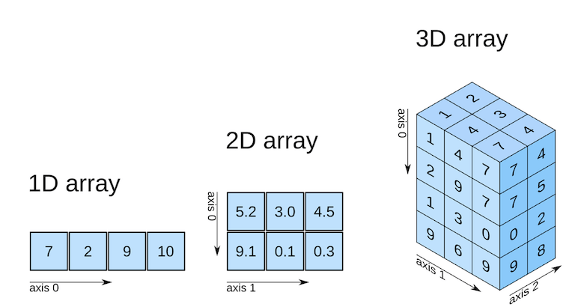
What is a NumPy array?
numpy is a Python package used for scientific and numerical computing.
It introduces a powerful data structure called an array, which is designed to store and work with numbers efficiently.
A NumPy array is:
A grid of values
All values are the same data type
Can have one or more dimensions (1D, 2D, 3D, …)
Think of it as a more efficient list for numbers.

Slide 4
Loading NumPy
We usually import NumPy with an alias:
This lets us write np instead of numpy, which is shorter and easier to read.
import numpy as np

Slide 5
Arrays vs lists
NumPy Arrays | Python lists
All elements must be the same data type | Elements can be different types
Fixed size | Can grow or shrink
Can be multidimensional | Usually, 1D
Very fast for math operations | Slower for math
Uses less memory | Uses more memory

Slide 6
Arrays vs lists
NumPy Arrays | Python lists
All elements must be the same data type | Elements can be different types
Fixed size | Can grow or shrink
Can be multidimensional | Usually, 1D
Very fast for math operations | Slower for math
Uses less memory | Uses more memory
# Python list
numbers_list = [1, 2, 3, 4, 5]
# NumPy array
numbers_array = np.array([1, 2, 3, 4, 5])
1 | 2 | 3 | 4 | 5
1 | 2 | 3 | 4 | 5

Slide 7
Creating NumPy arrays
Most arrays we'll work with will be one-dimensional vectors and two-dimensional matrices.
ndim attribute indicating the number of its axes
size attribute indicating the number of values it has
shape indicating its size in each dimension.
# 1 row x 5 columns
vector = np.array([1, 2, 3, 4, 5])
# vector.ndim = 1, vector.shape = (5,1), vector.size = 5
1 | 2 | 3 | 4 | 5
# 2 rows x 3 columns
matrix = np.array([[1, 2, 3],
[4, 5, 6]])
matrix
# matrix.ndim = 2, matrix.shape = (2,3), matrix.size = 6
1 | 2 | 3
4 | 5 | 6

Slide 8
Placeholder Arrays in NumPy
Sometimes we know the size of the array but not the values yet
NumPy arrays have a fixed size, so we often initialize first
We can use 0s as a placeholder
Or 1s
# NumPy array of zeros
np.zeros((2,3))
0 | 0 | 0
0 | 0 | 0
# NumPy array of ones
np.ones((2,3))
1 | 1 | 1
1 | 1 | 1

Slide 9
Specific Number Arrays in NumPy
We can also create a sequence of numbers using arange()
Or generating random numbers through functions like random.randint()
# NumPy array from 1 until 10 in steps of 2
np.arange(1,10,2)
1 | 3 | 5 | 7 | 9
Tip: arrange(start, stop, step)
# NumPy array of 5 random integers between 1 and 10
np.random.randint(1,10,5)
6 | 9 | 6 | 1 | 1
Tip: random functions → generate unpredictable numbers. We use numpy’s random seed function to create a reproducible random example

Slide 10
Repeat Arrays in NumPy
We can repeat values and arrays to create bigger ones using repeat()
tile repeats the whole input array for a specified number
# NumPy array of 10 repeated 5 times
np.repeat(10,5)
10 | 10 | 10 | 10 | 10
Tip: np.repeat(number to repeat, iterations)
# NumPy array repeated x times
np.tile(vector, 2)
1 | 2 | 3 | 4 | 5
1 | 2 | 3 | 4 | 5
Tip: np.tile(array, reps)

Slide 11
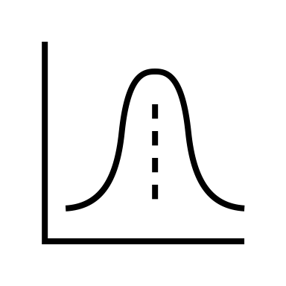
Simulating data in NumPy
Simulating Data with NumPy
Useful for testing analyses or models
NumPy supports drawing random samples from various distributions
Example, creating a random number generator
From this, you can specify the distribution you want to sample from
# Create a Generator
rng = np.random.default_rng()
# 10 data points from normal distributed data with a mean of 0, sd 1
rng.normal(0,1,10)
# can also use uniform distribution, poisson etc

Slide 12
Reshaping arrays
We can change the shape of an array in various ways, while leaving elements the same.
We can transpose an array
# 2 rows x 3 columns
matrix = np.array([[1, 2, 3],
[4, 5, 6]])
# 3 rows x 2 column
matrix.T
1 | 2 | 3
4 | 5 | 6
1 | 4
2 | 5
3 | 6

Slide 13
Reshaping arrays
We can change the shape of an array in various ways, while leaving elements the same.
We can change the dimensions
# 2 rows x 3 columns
matrix = np.array([[1, 2, 3],
[4, 5, 6]])
# 6 rows x 1 column
matrix.reshape(6,1)
1
2
3
4
5
6
1 | 2 | 3
4 | 5 | 6

Slide 14
Reshaping arrays
We can change the shape of an array in various ways, while leaving elements the same.
We can collapse an array to one dimension
# 2 rows x 3 columns
matrix = np.array([[1, 2, 3],
[4, 5, 6]])
# 1 row x 6 columns
matrix.flatten()
1 | 2 | 3
4 | 5 | 6
1 | 2 | 3 | 4 | 5 | 6

Slide 15
Reshaping arrays
We can change the shape of an array in various ways, while leaving elements the same.
If two arrays share the same size along an axis, we can stack them either horizontally or vertically
matrix1 = np.array([[1, 2, 3],
[4, 5, 6]])
matrix2 = np.array([[7, 8, 9],
[10, 11, 12]])
np.vstack((matrix1,matrix2)) #vertical stack
1 | 2 | 3
4 | 5 | 6
1 | 2 | 3
4 | 5 | 6
7 | 8 | 9
10 | 11 | 12
7 | 8 | 9
10 | 11 | 12

Slide 16
Reshaping arrays
We can change the shape of an array in various ways, while leaving elements the same.
If two arrays share the same size along an axis, we can stack them either horizontally or vertically
matrix1 = np.array([[1, 2, 3],
[4, 5, 6]])
matrix2 = np.array([[7, 8, 9],
[10, 11, 12]])
np.hstack((matrix1,matrix2)) #horizontal stack
1 | 2 | 3
4 | 5 | 6
1 | 2 | 3
4 | 5 | 6
7 | 8 | 9
10 | 11 | 12
7 | 8 | 9
10 | 11 | 12

Slide 17
Why NumPy is useful
With NumPy, you can apply operations to all values at once
Doing this with a list requires a loop.
# NumPy array multiplied by 2
numbers_array = np.array([1, 2, 3, 4, 5])
numbers_array * 2
array([ 2, 4, 6, 8, 10])
1 | 2 | 3 | 4 | 5
x 2
2 | 4 | 6 | 8 | 10

Slide 18
Why NumPy is useful
We can also perform operations when arrays are the same length
matrix1 = np.array([[1, 2, 3],
[4, 5, 6]])
matrix2 = np.array([[7, 8, 9],
[10, 11, 12]])
matrix2 – matrix1
1 | 2 | 3
4 | 5 | 6
1 | 2 | 3 | 4 | 5
6 | 6 | 6
6 | 6 | 6
x 2
7 | 8 | 9
10 | 11 | 12
2 | 4 | 6 | 8 | 10

Slide 19
Why NumPy is useful
We can also summarize values in an array
matrix1 = np.array([[1, 2, 3],
[4, 5, 6]])
matrix1.sum() #1 + 2 + 3 + 4 + 5 + 6 = 21
matrix1.max() #6
matrix1.mean() # 1 + 2 + 3 + 4 + 5 + 6 / 6 = 3.5
1 | 2 | 3
4 | 5 | 6

Slide 20
Operations in multiple dimensions
We can be more specific with how we calculate for multidimensional arrays
We use axis to specify the direction (0 → column-wise, 1 row-wise operations)
matrix1 = np.array([[1, 2, 3],
[4, 5, 6]])
matrix1.mean(axis=0)
matrix1.mean(axis=1)
1 | 2 | 3
4 | 5 | 6
2.5 3.5 4.5
1 | 2 | 3
4 | 5 | 6
2
5

Slide 21
Operations in multiple dimensions
We can index and slice arrays similar to a list
Indexing goes [row, column]
matrix1 = np.array([[1, 2, 3],
[4, 5, 6]])
matrix1[0,:] #first row
matrix[:,1] #second column
matrix[1,1] #second row, second column
1 | 2 | 3
4 | 5 | 6
1 | 2 | 3
4 | 5 | 6
1 | 2 | 3
4 | 5 | 6

Slide 22
Operations in multiple dimensions
We can mutate or update elements in an array
We can also make a copy to ensure the original does not get modified
matrix1 = np.array([[1, 2, 3],
[4, 5, 6]])
matrix3 = matrix1.copy()
matrix3[1,1] = 50 #replace 5 with 50, original not changed
1 | 2 | 3
4 | 50 | 6

Slide 23
Operations in multiple dimensions
E.g. Evaluate whether each element is divisible by 3
To filter, use a Boolean expression as a mask, pass it into square brackets after the array to mask.
matrix3 % 3 == 0
array([[False, False, True],
[False, False, True]])
1 | 2 | 3
4 | 50 | 6
F | F | T
F | F | T
matrix3[matrix3 % 3 == 0]
array([3,6])

Slide 24
Operations in multiple dimensions
We can even use masks to generate new arrays with conditionals.
np.where()takes as its arguments a Boolean expression, an expression to evaluate if `True`, and an expression to evaluate elsewise.
This is analogous to creating a new array based on an old one with a `for` loop and `if`/`else` statements, but much faster.
np.where(matrix3 % 3 == 0, # condition
matrix3, # return the element if True
0) # return 0 if False
array([[ 0, 0, 3], [ 0, 0, 6]])
1 | 2 | 3
4 | 50 | 6
0 | 0 | 3
0 | 0 | 6

Slide 25
Quiz: Arrays
What is the shape of this array?
(3,2)
(2,3)
(6,)
(3,3)
np.array([[1, 2, 3], [4, 5, 6]])

Slide 26
Quiz: Arrays
2. What does the following produce?
10
20
30
40
arr = np.array([10,20,30,40])
arr[2]

Slide 27
Quiz: Arrays
3. What does the following produce?
2,4,6
1,2,3,2,4,6
3,4,5
Error
arr = np.array([1,2,3])
arr* 2

Slide 28
Quiz: Arrays
4. What does the following produce?
2x3 array of zeros
3x2 array of zeros
Array [0,0,0]
Error
arr = np.zeros((2,3))
arr

Slide 29
Quiz: Arrays
5. What does the following produce?
arr = np.array([1,2,3,4,5,6])
arr.reshape((2,3))
1 | 2 | 3
4 | 5 | 6
1 | 2 | 3 | 4 | 5 | 6
1 | 2
3 | 4
5 | 6
1 | 3 | 5
2 | 4 | 6

Slide 30
Exercise # 1
Try this on your own:
Create a 1D array of numbers from 1 to 20.
Compute the sum, mean, and standard deviation of the array (Note, these are all numpy methods!)

Slide 31
Exercise # 2
Try this on your own:
From the following 2D array
arr = np.array([[2, 7, 12],
[4, 15, 3],
[8, 1, 20]])
Select all elements greater than 10
Replace all elements less than 5 with 0

Slide 32
Exercise # 3
Try this on your own:
From the following 2D array
arr = np.array([[2, 7, 12],
[4, 15, 3],
[8, 1, 20]])
Print the first column
Print the last row
Print the element in the 2nd row, 3rd column

Slide 33
Exercise # 4
Try this on your own:
From the following 2D array
arr = np.array([[2, 7, 12],
[4, 15, 3],
[8, 1, 20]])
Compute the sum of each column
Compute the mean of each row
Remember:
axis 0 = col,
axis 1 = row

Slide 34
