Slide 1


ICT Challenge 2023
FlexiLink: Wi-Fi to (Multiple) BLE Communication
ChaeYeong Lee, MoonBeom Kim
Chung-Ang University
{cxaexeong,mbkim}@cau.ac.kr
Sep. 21th 2023

Slide 2
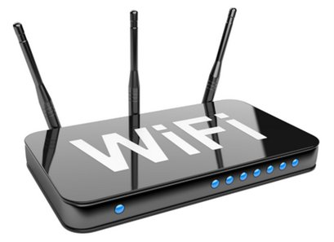



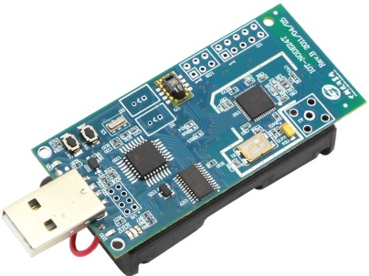
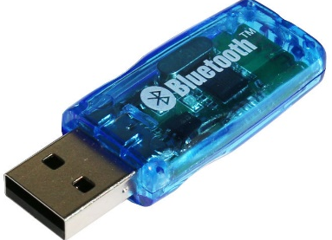

Background
What is the Cross Technology Communication?
Not using a Gateway
Not using a Gateway
Supported
Supported
CTC
Direct communication between heterogeneous wireless networks
Supported
Not using a Gateway

Slide 3
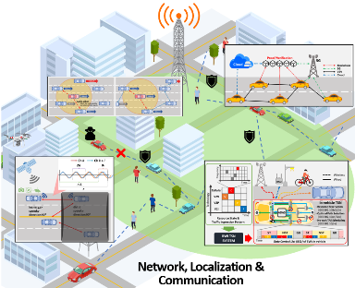
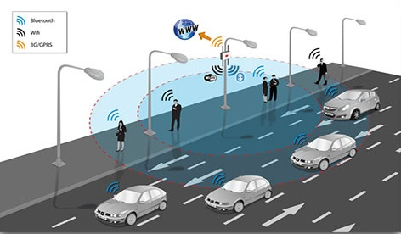
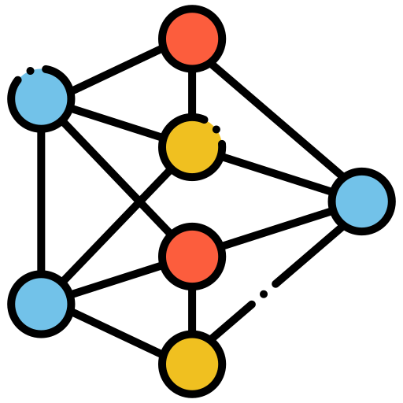

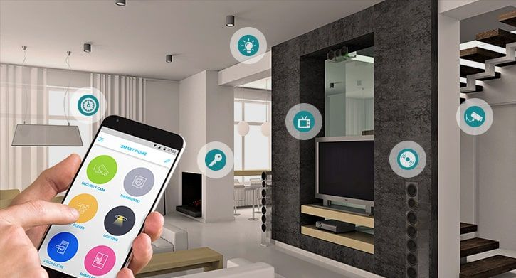


Emerging IoT applications
Smart infrastructure
Transportation
Network
Life
Industrial
Healthcare

Slide 4
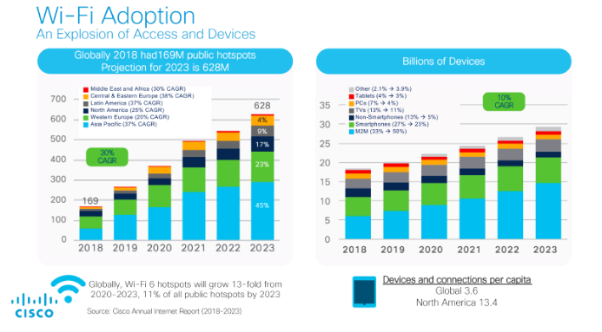
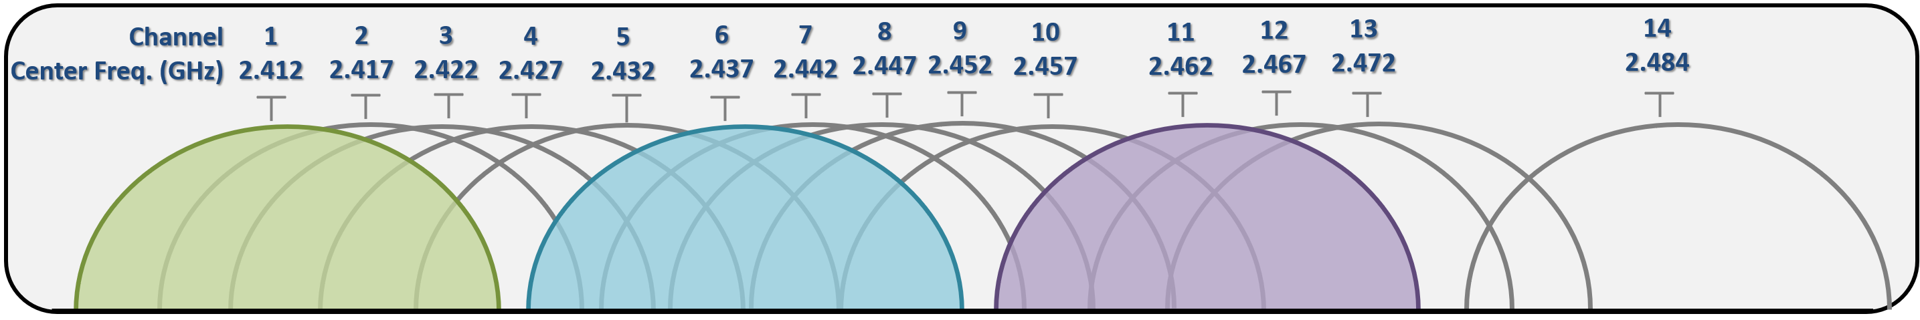

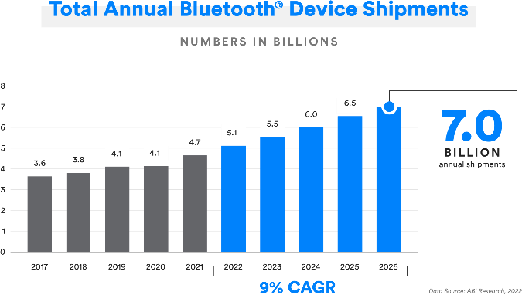

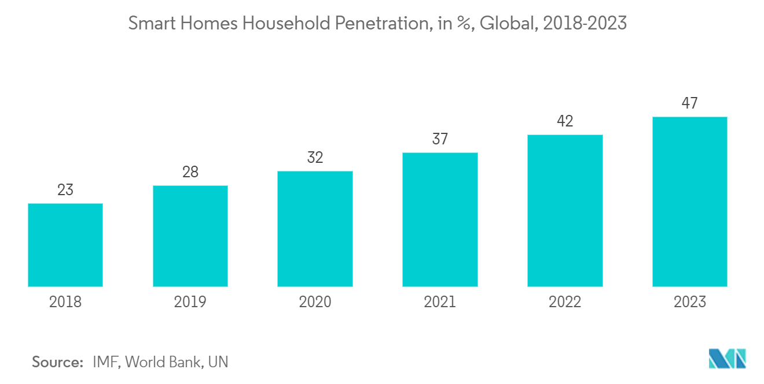
Rapid increasing
2.4 GHz ISM Band channels
IEEE 802.11
Ch 1
IEEE 802.11
Ch 6
IEEE 802.11
Ch 11
IEEE 802.11
Ch 1
IEEE 802.11
Ch 6
IEEE 802.11
Ch 11
Interference occurs due to channel overlap.
1
2402
…..
41
2442
…..
79
2480
IEEE 802.11
Ch 1
IEEE 802.11
Ch 6
IEEE 802.11
Ch 11
Ch
11
Ch
12
Ch
13
Ch
14
Ch
15
Ch
15
Ch
17
Ch
18
Ch
19
Ch
20
Ch
21
Ch
22
Ch
23
Ch
24
Ch
25
Ch
26

Slide 5




Cross Technology Communication (CTC)
Direct communication between heterogeneous wireless networks without passing through a gateway.
Not using a Gateway
Not using a Gateway
Supported
Supported
CTC
Supported
Not using a Gateway

Slide 6
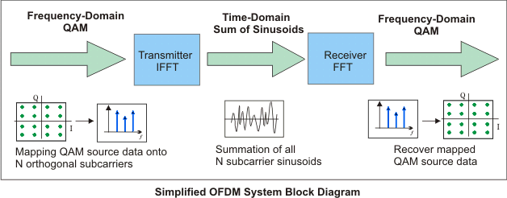
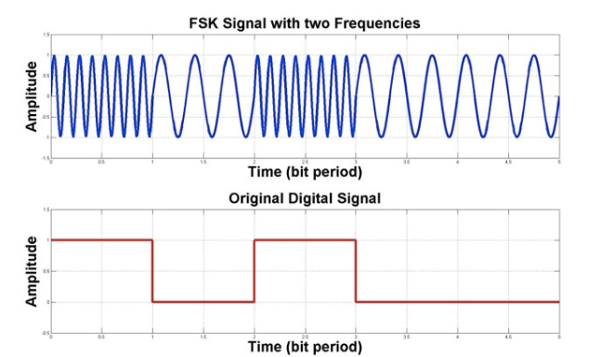
Issue 1 : Different modulation methods
Diverse modulation
Orthogonal Frequency Division Multiplexing (OFDM)
Gaussian frequency-shift keying (GFSK)

Slide 7
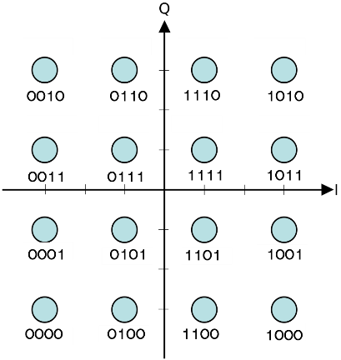
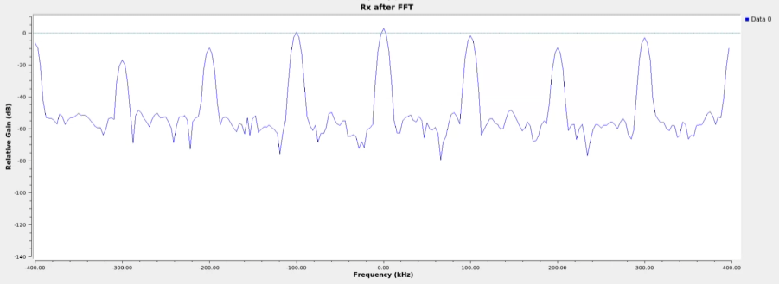
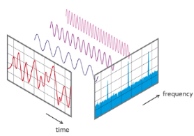
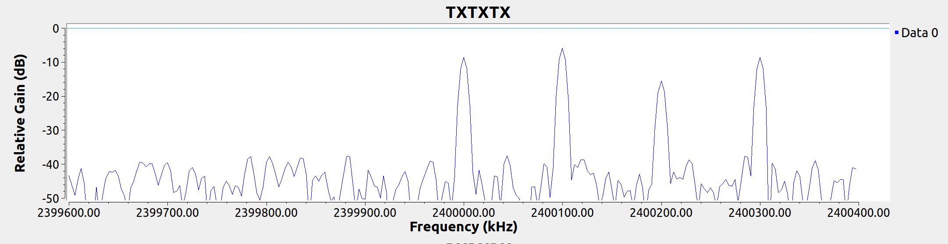
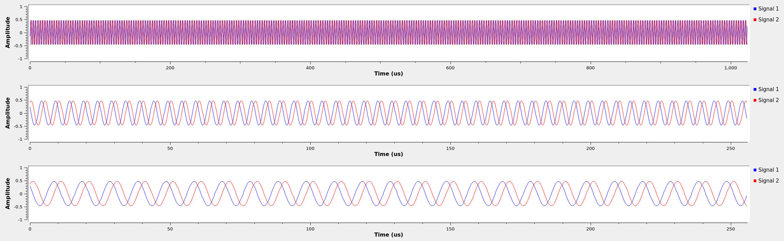
Issue 1 : Different modulation methods
Orthogonal Frequency Division Multiplexing (OFDM)
Recovered mapped QAM data
Interleaving
110111001011…1011..01101001
FFT
X0
X1
Xn-5
Xn
IFFT
(217,200):
1101 1001 1100 1000
Mapping data onto
N Subcarriers

Slide 8
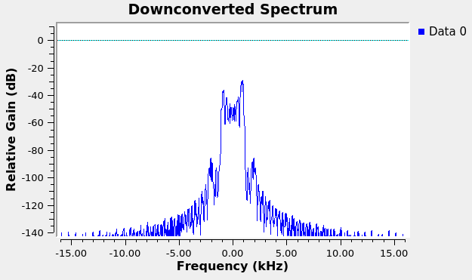
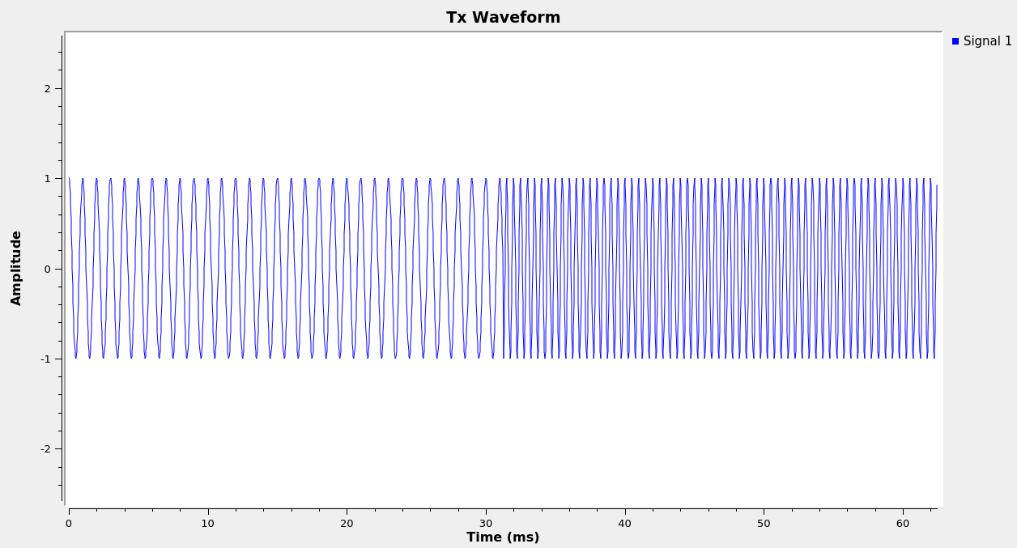
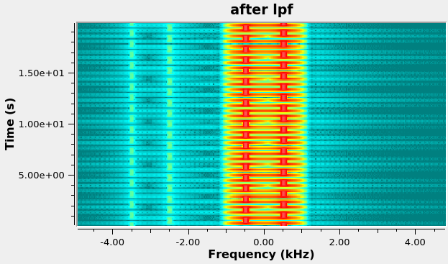
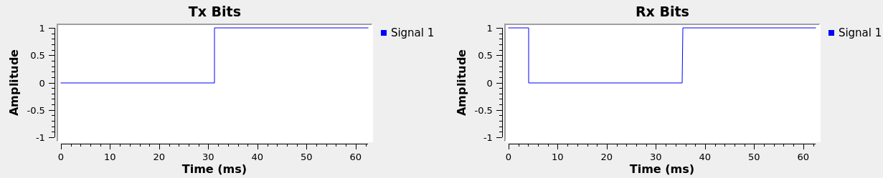
Issue 1 : Different modulation methods
Gaussian frequency-shift keying (GFSK)
‘1’ bits
‘0’ bits
Low speed –> ‘0’ bits
High speed –> ‘1’ bits
‘0’ bits
‘1’ bits
‘0’ bits
‘1’ bits
‘1’ bits

Slide 9
Wi-Fi to Bluetooth Low Energy (BLE) CTC
Wi-Fi to BLE CTC
Negative freq
Low <- High
Quadrature Component
QAM
Wi-Fi CH 11 (20MHz)
1 BLE channel overlapped
5 to 6 subcarriers
0
In-phase Component
N subcarrier (312.5 kHz)
1 BLE channel overlapped
5 to 6 subcarriers
Positive freq
Low -> High
GFSK
24
25
26
27
28
29
30
31
0
1
32
1
1 BLE channel overlapped
5 to 6 subcarriers
Center frequency
9 Bluetooth channel overlapped 1 Wi-Fi channel

Slide 10


Wi-Fi to Bluetooth Low Energy (BLE) CTC
Transmitter
Wi-Fi Subcarrier Manipulation
Receiver
GFSK
1 BLE channel overlapped
5 to 6 subcarriers
1 BLE channel overlapped
5 to 6 subcarriers
1 1 0 1
1 0 0 1
1 1 0 0
‘0’ bits
‘1’ bits
4 bits/ 1 sym
4 bits/ 1 sym
4 bits/ 1 sym
t0
t1
0
0
0
0
0
1
0
0
1
0
0
0
1
1
1
…
…
1
1
1
1
1
0
1
1
0

Slide 11
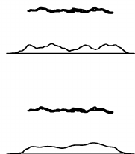
Wi-Fi to Bluetooth Low Energy (BLE) CTC
Wi-Fi Subcarrier Mapping to BLE
A combination for a rough signal
0
0
1
0
0
0
0
0
1
1
1
1
1 BLE channel overlapped
5 to 6 subcarriers
1 BLE channel overlapped
5 to 6 subcarriers
0
1
0
0
1
0
0
1
1
…
0
1
1
1
0
0
1
0
0
…
‘0’ bits
‘1’ bits
1
0
1
1
0
1
1
1
0
0
0
0
1
1
0
1
1
1
t0
t1
0
0
0
0
0
1
0
0
1
0
0
0
1
1
1
=> Intentionally rough signal
1
1
1
…
…
1
1
0
1
1
0

Slide 12
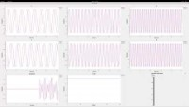
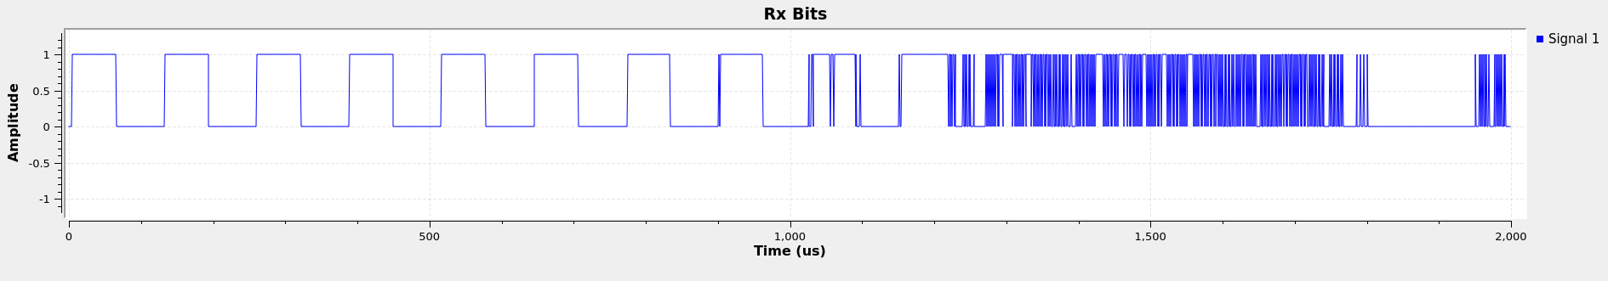
Results 1
Wi-Fi Subcarrier Manipulation
1 1 0 1
1 0 0 1
1 1 0 0
4 bits/ 1 sym
4 bits/ 1 sym
4 bits/ 1 sym
Wrong result

Slide 13
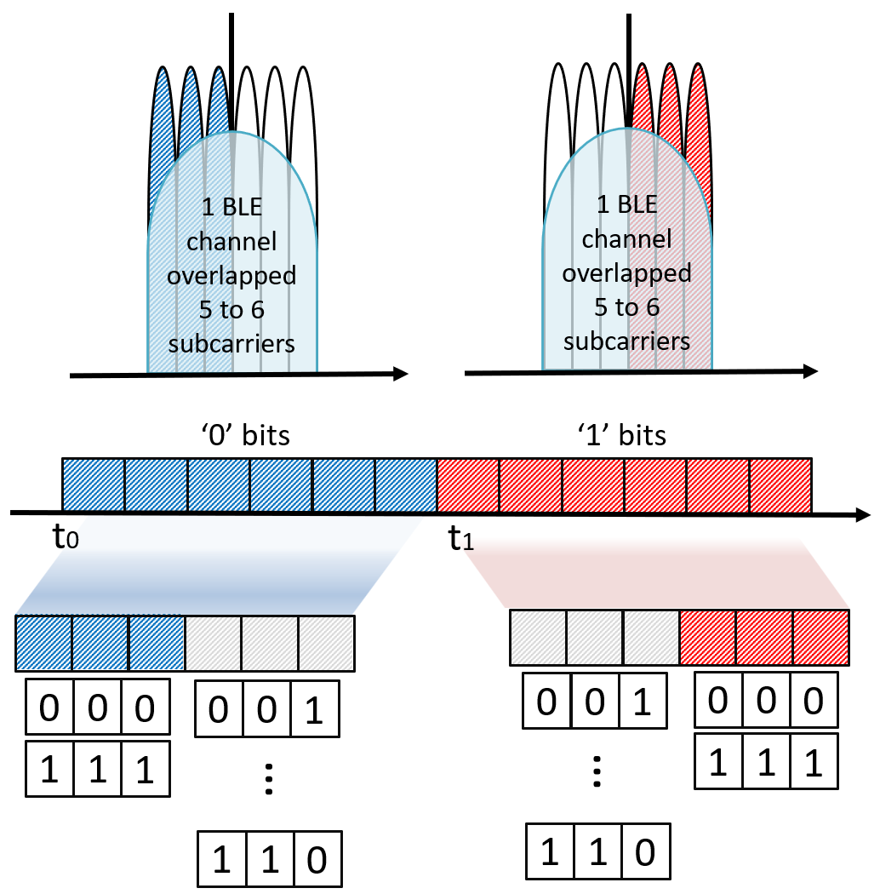
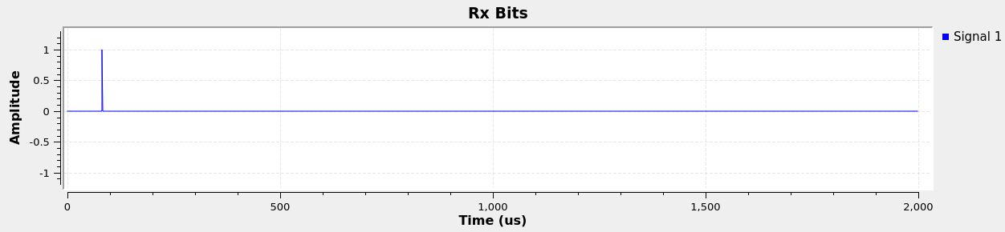
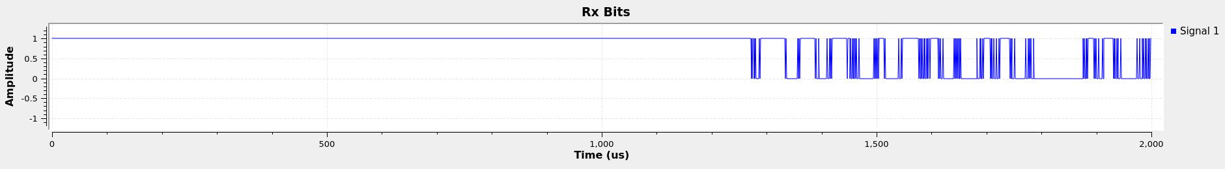
Results 3
Wi-Fi Subcarrier Mapping to BLE
0
1

Slide 14

Issue 2: Difference in data rate
Difference in data rate.
IEEE 802.11g has a maximum data rate of 54 Mbps, which is achieved using MIMO.
The data rate can vary significantly depending on the modulation scheme (ex. BPSK, QPSK, N-QAM and so on.)
BLE standard 5.0 -> 2 Msym/s supported.
Conventional OFDM.
Under the assumption that all conditions are the same, theoretically, each subcarrier would have a data rate of 1.125 Mbps.
Wi-Fi to (Multiple) BLE CTC.
A total of six subcarriers were used under this configuration, resulting in a data rate of 6.75 Mbps.

Slide 15
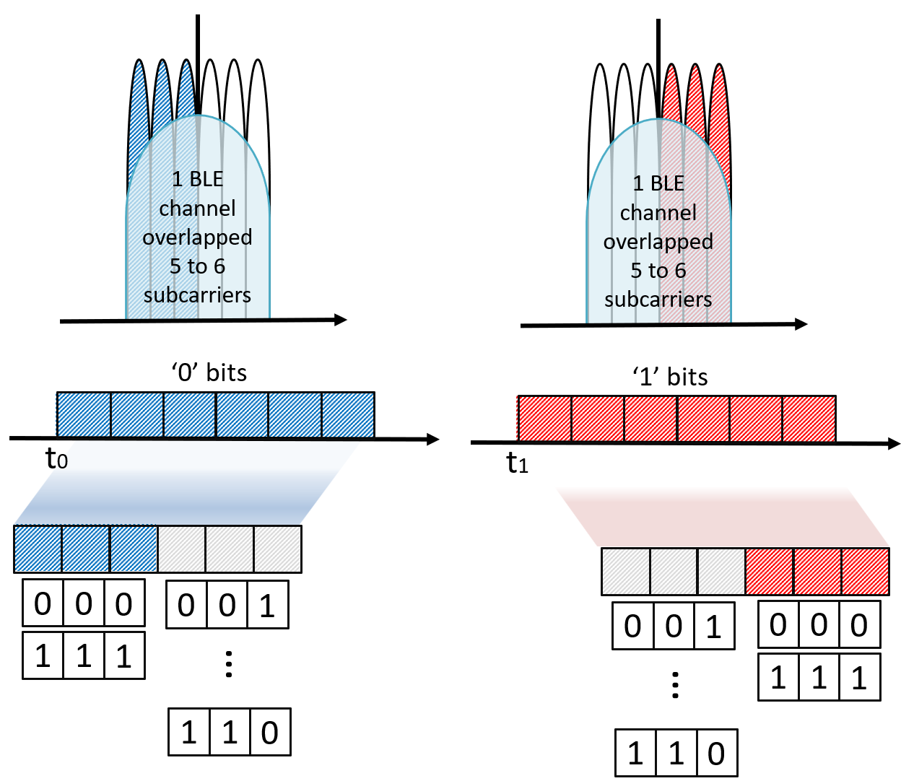
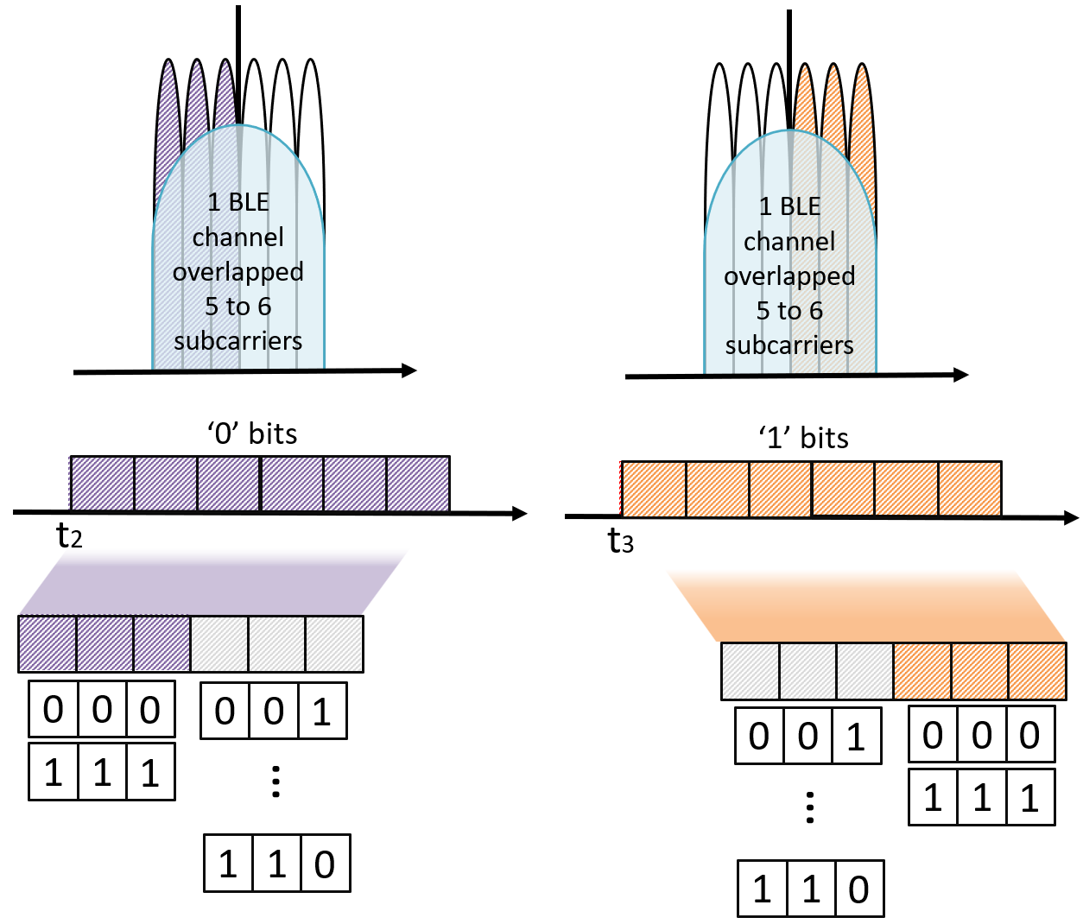
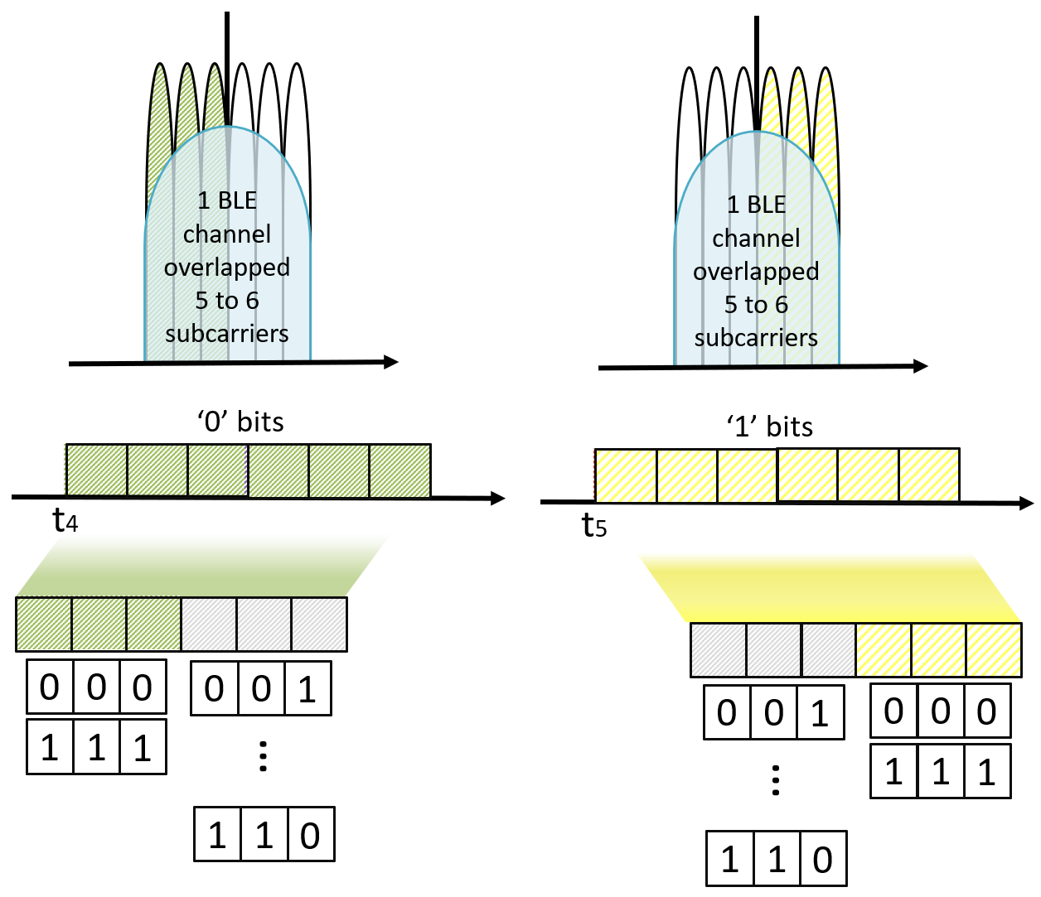
Issue 2: Difference in data rate
Wi-Fi to (Multiple) BLE CTC.
.
A total of six subcarriers were used under this configuration, resulting in a data rate of 6.75 Mbps.

Slide 16
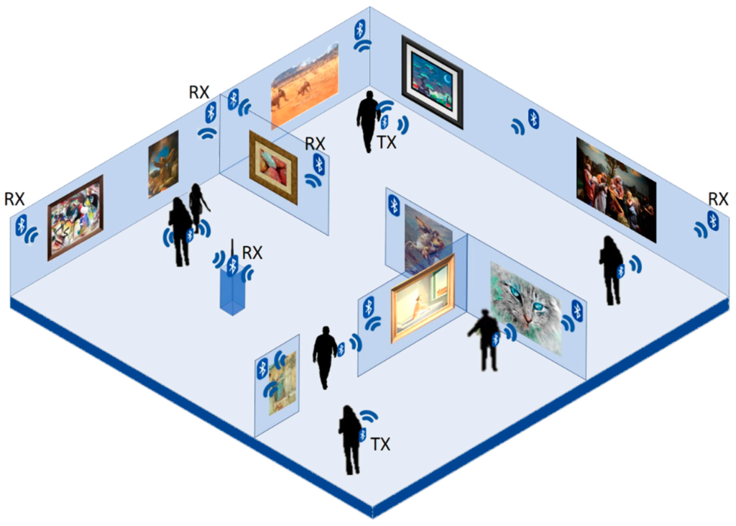

Applicability
Wi-Fi to BLE based informative system.
Localization.
Electronic attendance-absence recording systems.
And so on.
Emergency situations.
Tx
Tx
Tx
Tx
Tx
Rx
Rx
Rx
Rx
Rx

Slide 17
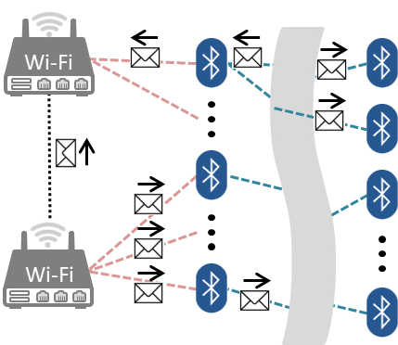
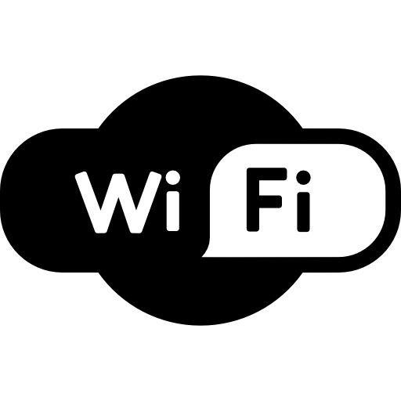
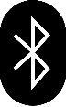
Future Work
PHY Level-based OFDM-GFSK Mutual imitation modulation technology.
Deep Reinforcement Learning-Based Multiple Data Simultaneous Transmission Technique.
Emulated GFSK & OFDM
Network Info.
Available
Subcarrier & Index
Quadrature Component
QAM
Wi-Fi CH 11 (20MHz)
0
1
Inphase Component
64 subcarrier (312.5 kHz)
Wi-Fi
Wi-Fi CH 11 (20MHz)
GFSK
0
1
1 BLE CH (2 MHz) overlaps
Wi-Fi subcarrier (≈ 6 ~ 6.5 )
BLE
24
25
31
32
Center frequency
24
25
26
27
28
29
30
31
32
9 Bluetooth channel overlapped 1 Wi-Fi channel
BLE1
BLE2
BLE5
BLE6
W2W
W2Bs
Empty
High TX PWR
Low TX PWR

Slide 18



Thank you!
Questions?

