Slide 1
Anger-release
Milestone
Cylia: Arduino setup and coding for nonverbal expression
Jiahua: conversation design and coding / FSM
Gabbie: conversation design, marketing research and coding / demo recording

Slide 2
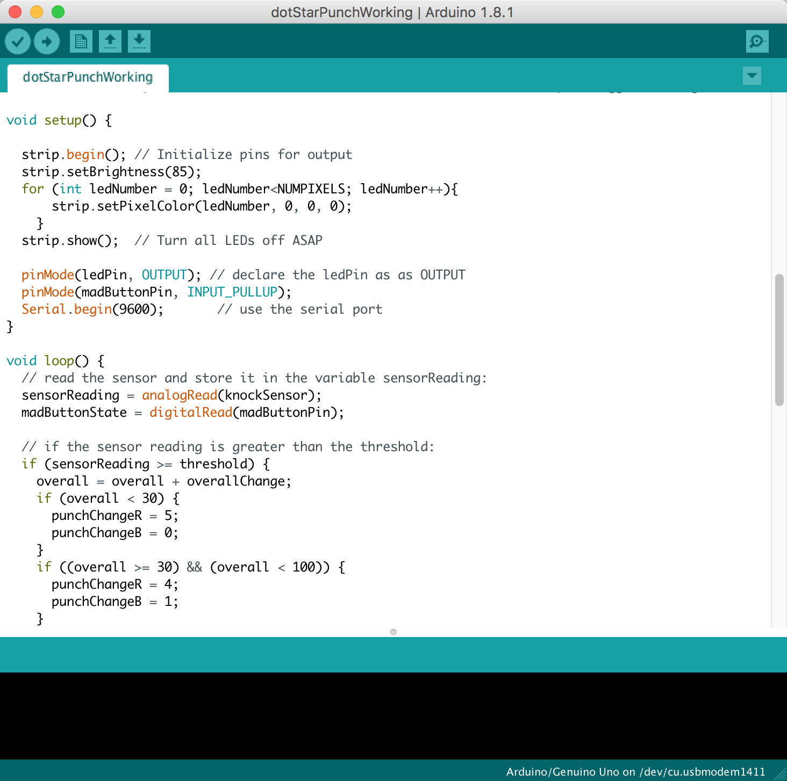
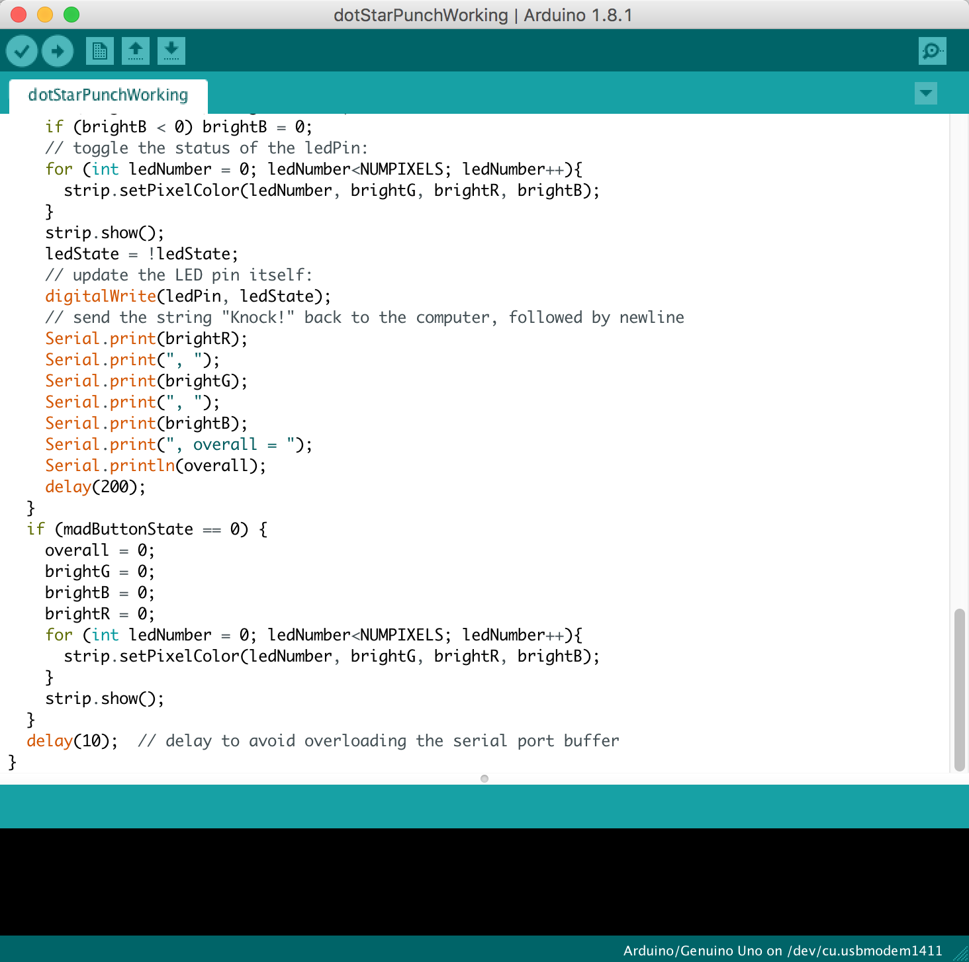
Coding-Arduino

Slide 3
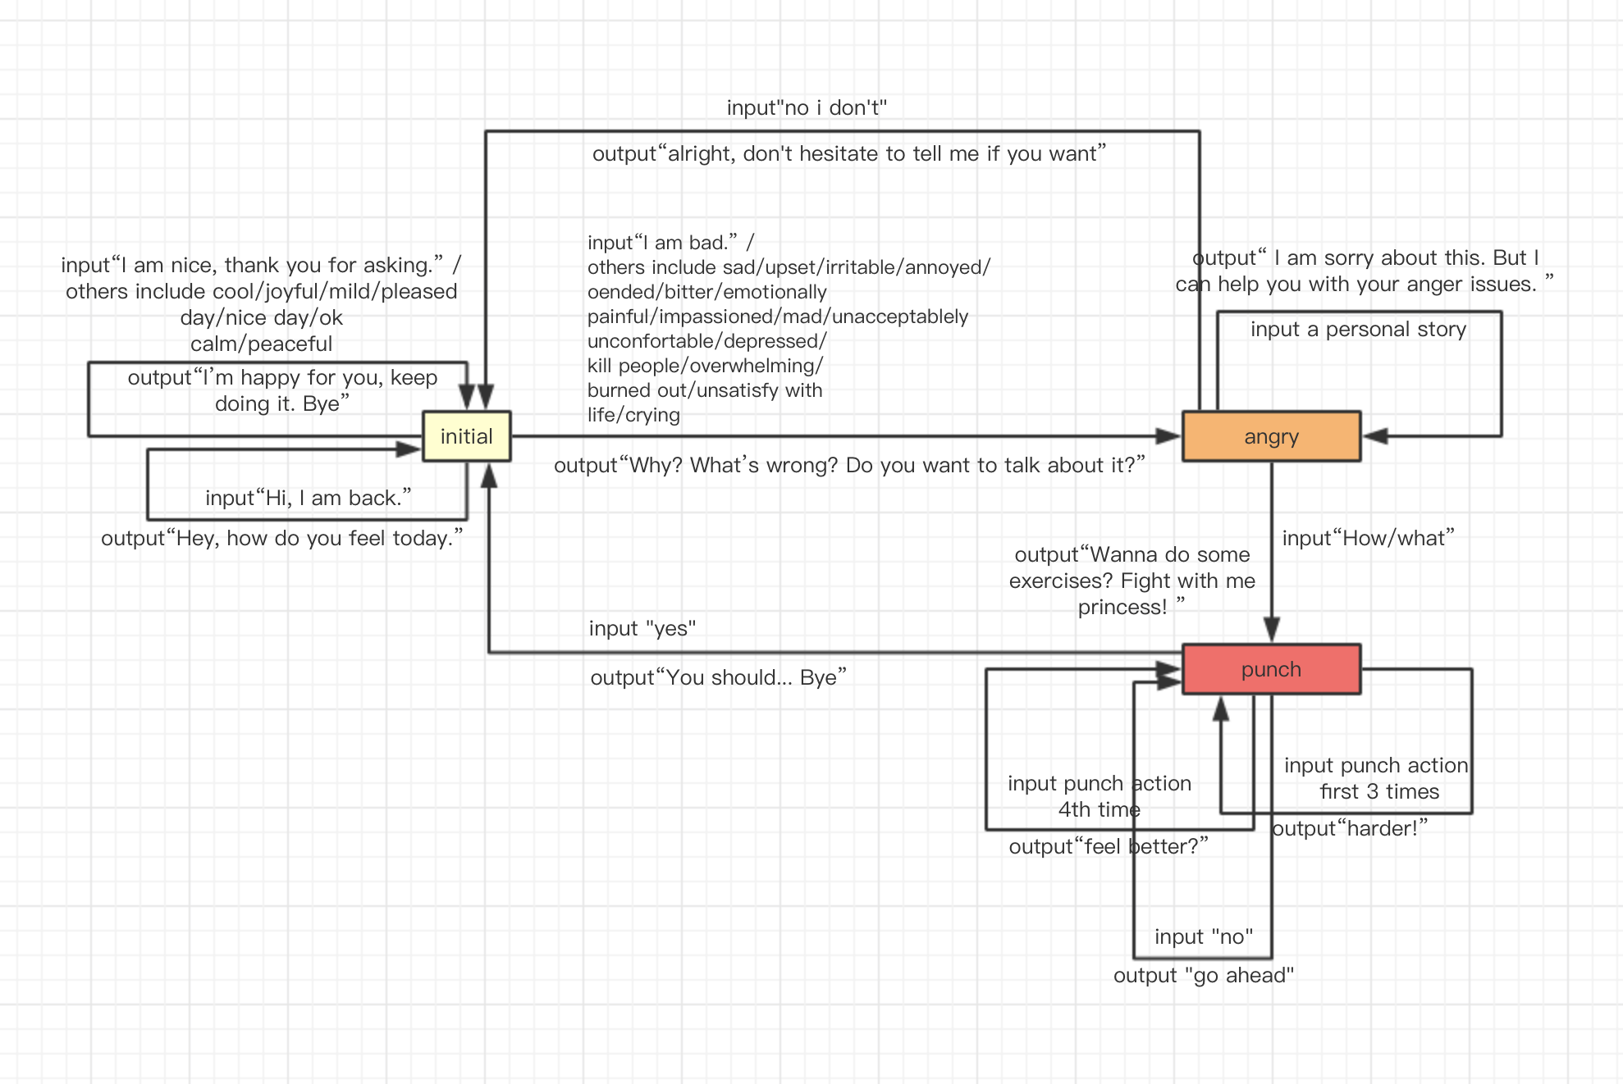
FSM

Slide 4
Demo

