Slide 1
MACHINE LEARNING FINAL PROJECT HANDWRITTEN FORMULA RECOGNITION
An Duc Pham (0450296)
Chien-Yu Lin (0450225)

Slide 2
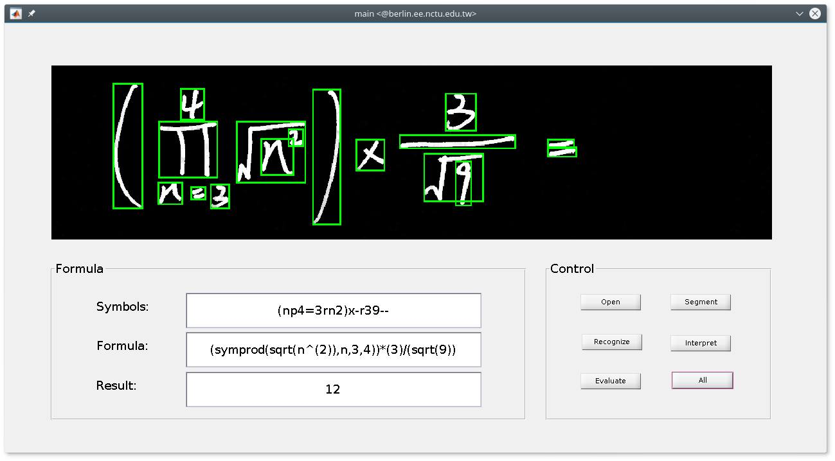
Project: DICAR

Slide 3
Proposed System

Slide 4
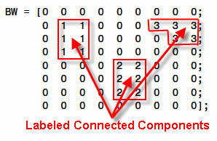



Symbol Segmentation
Convert image to binary
Remove noises (component less than 100 pixels)
Segment symbol using Connected Component Labeling (CCL) algorithm
Pad segmented symbols to improve the recognition process

Slide 5
Symbol Recognition
Resize image to 40x40 to improve training process
Use SVM as classifiers with open source library - libSVM
Use three different classifiers with different kernels (linear, polynomial and RBF)
Histogram of Oriented Gradients (HOG) is considered when getting the features form images
For testing phase, both classifiers with HOG and no-HOG are chosen, and the output is picked from the models which has highest probability

Slide 6
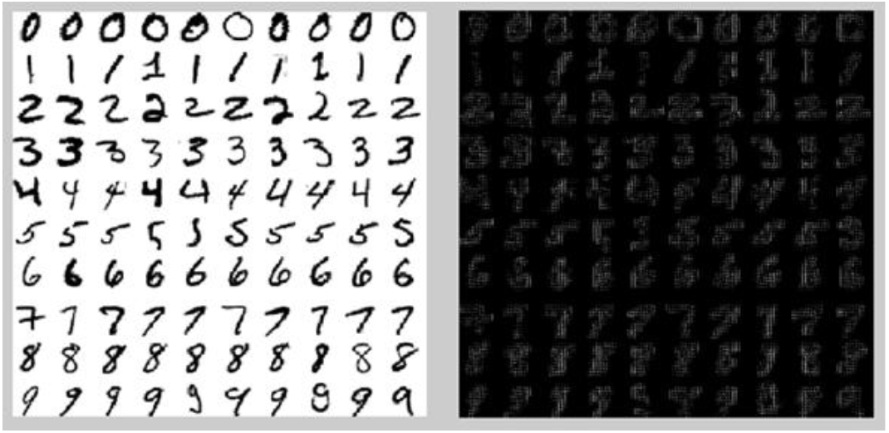
Symbol Recognition
HOG for digits

Slide 7
Symbol Recognition
nuSVM | Radial | linear | Poly2 | Poly3 | Poly4 | Poly5
0.001 | 97.597 | 96.6728 | 89.1867 | 15.5268 | 19.4085 | 10.9057
0.01 | 97.5046 | 96.6728 | 97.6895 | 86.3216 | 30.8688 | 16.2662
0.05 | 97.6895 | 96.8577 | 97.9667 | 97.2274 | 85.7671 | 56.7468
0.1 | 97.597 | 96.6728 | 97.3198 | 97.1349 | 88.7246 | 54.2514
0.25 | 94.9168 | 94.9168 | 96.488 | 96.3956 | 95.4713 | 79.9445
v-SVM training table

Slide 8
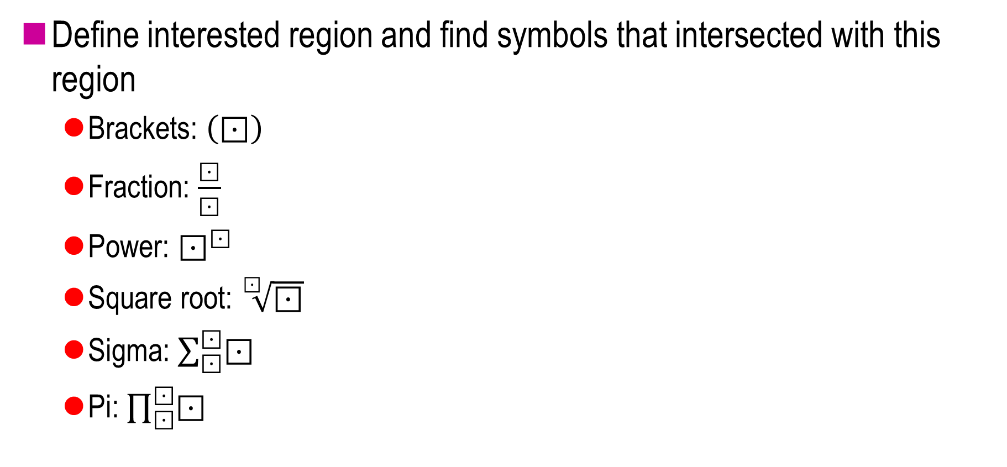
Formula Parsing
Define interested region and find symbols that intersected with this region
Brackets: $\left(⊡\right)$
Fraction: $\frac{⊡}{⊡}$
Power: $⊡^{⊡}$
Square root: $\sqrt[⊡]{⊡}$
Sigma: $\sum_{⊡}^{⊡}{⊡}$
Pi: $\prod_{⊡}^{⊡}{⊡}$

Slide 9
Formula Parsing
Use recursive function to update symbol data
Repeat until the data converge
N
Symbols
Special symbols
Y
Extract interested region
Recursive interpret
N
Y
Merge symbols
Converge
Merge interested region

Slide 10

Interpreter and Evaluation
Convert to matlab code
Use matlab symbolic toolbox to deal with symbolic formulas ($\sum{}, \prod{}, m, n$)

Slide 11
Limitations
CCL cannot segment some symbols which accidentally connected together
There is a small ratio of misclassification
Formula parsing is limited
Cannot correct wrong formulas

Slide 12
Proposed Solutions
Use Histogram of Oriented Gradients (HOG) and PCA to extract features. Handwritten characters are based on strokes, so it could improve the recognition process
Use feedback system to improve the segmentation process: if the symbol has low probability, it will be sent back to segmentation block. A new segmentation algorithm will be applied to solve this case
Apply the symbols filter to the image
Calculate the covariance between the filter pattern and the processing region and chose the highest one

