Slide 1


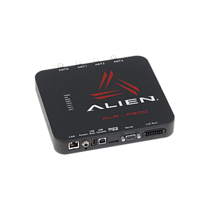
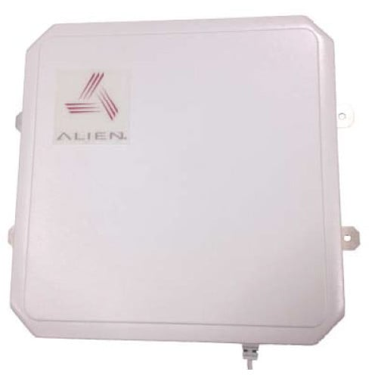
Alien P.R.O.B.E RFID Reader/Scanner App
Cy Dixon, Nicholas Johnson, Alex Godsey, Michael Lynch
Western Kentucky University/WKU Parking and Transportation/Computer Science Department
What is this Project?
This project is a team effort done in conjunction with the WKU PTS services for our teams CS 496 senior project course.
This app, Alien P.R.O.B.E., was created in order to offer PTS employees a simple app for use in their daily tasks. This app connects to the Alien ALR F800 RFID reader along with the picture antenna.
The PTS employees aim to use this app to scan a vehicles’ RFID parking tag, and then determine if that tag is on the correct vehicle and in the correct parking lot based on GPS location. This is all done within the app and or the connected databases’ and RFID equipment.
Blah Blah Blah
Helo
asdfadf
Extra Content
hhhasdf
Equipment Android App CRRL BMTN
Details
Pictured above is the Alien RFID ALR-f800 reader and below if the Alien RFID Ultra-band antenna.
Discussion
GRDR in located in South Central Kentucky in the flood plain of a Cumberland River and a tributary.
Data range: 01/01/2010-12/31/2020
The temperature and near-surface moisture indices mimic those of HCKM, a result unsurprising given the sun-tropical, low-elevation climate of both sites.
Unlike HCKM, warm season net precipitation has been decreasing over the last decade.
Overall, the diurnal temperature range is larger than at HCKM due to the site being surrounded by tall bluffs, inviting drainage flows promote smaller minimum temperatures.
Like HCKM, the magnitude of the Precipitation – Evapotranspiration (P-E) increases in magnitude as time advances over the past decade, indicative of a “wet get wetter” scenario.
The number of very heavy precipitation days are slightly larger than that at HCKM but the fractional increase has been smaller.
Discussion
CRRL in located adjacent to the Ohio River in the North Central portion of close to Cincinnati, OH.
Data range: 01/01/2010-12/31/2020
Mean temperatures and dew points have a similar evolution to the sub-tropical counterparts.
Annual, warm, and cold season precipitation sums also follow a similar pattern to HCKM and GRDR.
Very heavy precipitation days on seasonal aggregation scales also follow that of HCKM and GRDR
Unlike the sub-tropical sites, the diurnal temperature range at CRRL in winter has a fractional increase of ~14%.
The increase is due to a significant increase in winter diurnal maximum temperatures as the diurnal minimum displays a steady, but smaller magnitude increase (not shown).
Future work will consider the proximity of the site to the Ohio River on the temperature, moisture, and precipitation characteristics of this site compared with other sites in the continental humid climate that are more distant from the Ohio (e.g. SWON in Mesonet site map).
Discussion
BMTN is located immediately adjacent to the highest elevation location of the state in SE KY.
Data range: 01/01/2015-12/31/2020
As seen in the land cover and aerial photography, BMTN is unique in that it is largely barren and deciduous forest.
Like the other sites, BMTN shows a fractional decrease in temperatures during the spring and to a lesser extent, the summer, though temperature magnitudes are reduced due to elevation.
Despite only moderate increases in moisture content, precipitation sums and very heavy precipitation days have increased significantly in just 6 years, particularly during the cold season.
The diurnal temperature range remains constant and comparatively small during this short record, unlike other sites, due in large part due to the frequent cloud cover of the complex terrain.
.
Please contact eric.rappin@wku.edu for a full list of indices under development.
Visit kymesonet.org in the near future to investigate the plethora of climate information being developed by the Kentucky Climate Center and Kentucky Mesonet.

