Slide 1

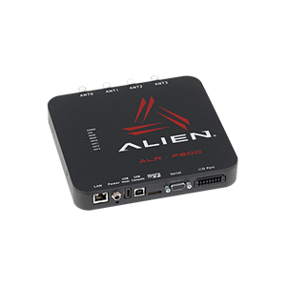
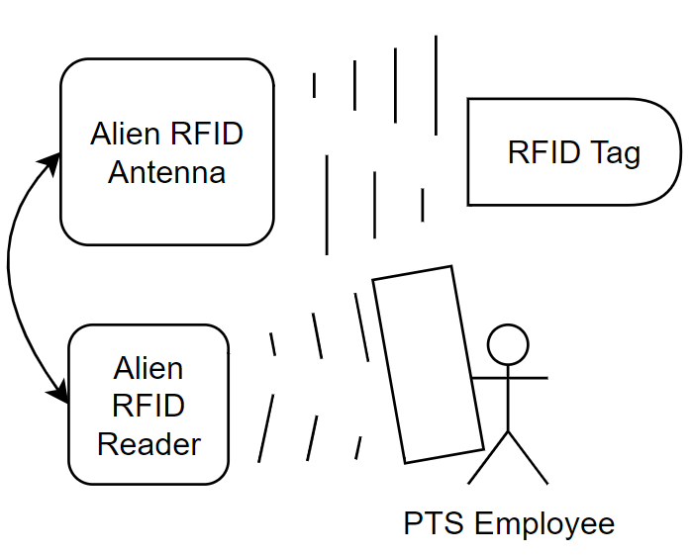
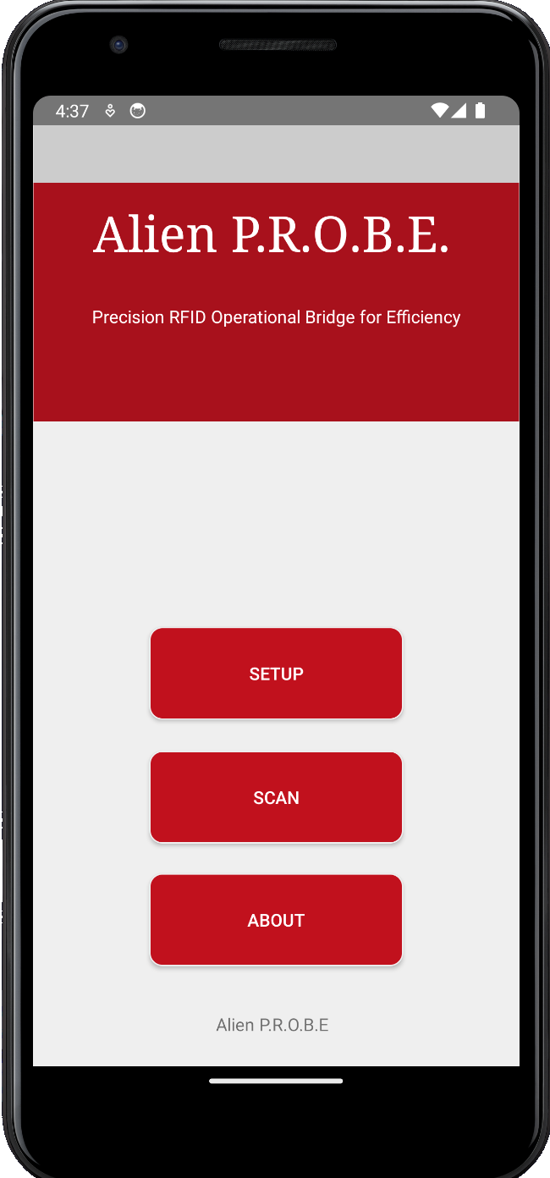
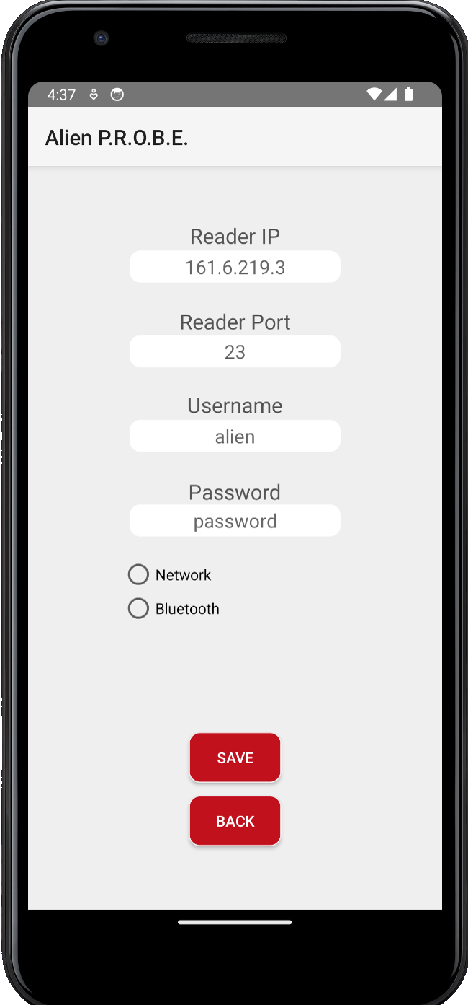
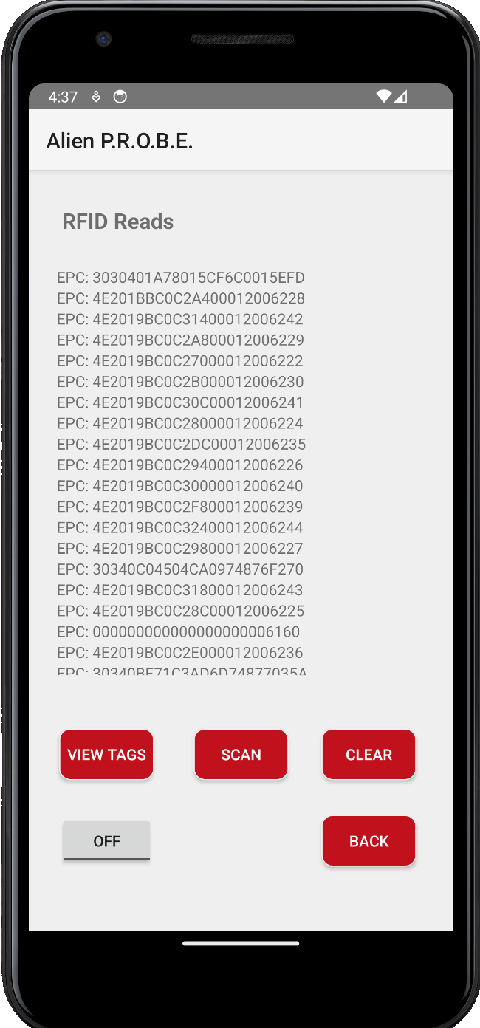
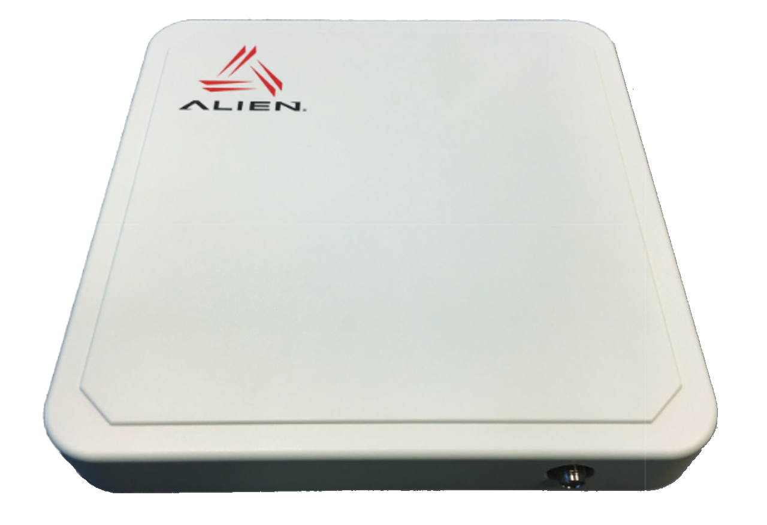
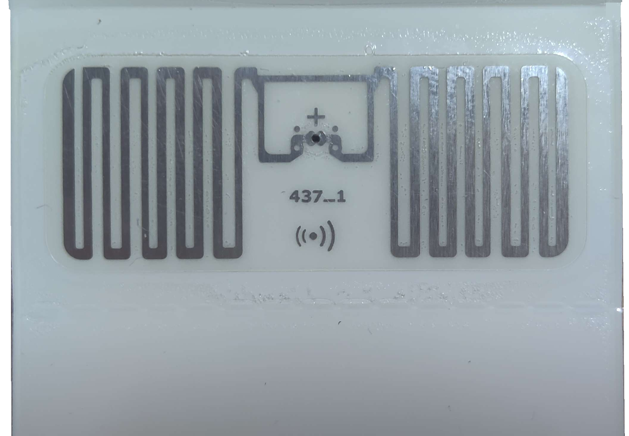
Alien P.R.O.B.E RFID Reader/Scanner App Precision RFID Operational Bridge for Efficiency
Abstract
Cy Dixon, Nicholas Johnson, Alex Godsey, Michael Lynch
Western Kentucky University/WKU Parking and Transportation/Computer Science Department
App
This project introduces a mobile application that utilizes RFID technology to optimize parking management at WKU Parking and Transportation Services (WKU PTS). The "Alien P.R.O.B.E." mobile application aims to automate parking verification processes, enhancing operational efficiency and user experience for WKU Parking and Transportation workers. Utilizing an Alien F800 RFID reader and ALR-8698 RFID antenna, the mobile app's backend system scans parking permits' RFID. tags. Our app will then cross-reference the RFID tags with WKU's servers to check permissions and verify the tags. Our goal for this app is to reduce manual verification time and address unauthorized parking issues that the WKU PTS employees' encounter. By automating these processes, the project will streamline operations and improve overall parking experiences for users and Transportation service employees. The primary audience comprises WKU parking management teams, with the Senior Information Technology Consultant at WKU Parking and Transportation Services as the client. This project employs a systematic approach, emphasizing clear documentation, client engagement, and RFID technology application. The development follows distinct phases aligned with a modified waterfall model, ensuring adaptability and continuous improvement. The system offers a scalable, secure, and efficient solution for parking resource management at WKU.
Insert Image of
Parking Pass
What is this Project?
Reader and Antenna Connection
Alien P.R.O.B.E. App
This project is a team effort done in conjunction with the WKU Parking and Transportation Services for our team’s CS 496 Senior Project course.
This app, Alien P.R.O.B.E., was created in order to offer PTS employees a simple app for use in their daily tasks. This app connects to the Alien ALR-F800 RFID Reader along with the Alien ALR-8689 RFID Antenna, both pictured to the right.
WKU Parking and Transportation Services plan to use this app to scan a vehicles’ RFID parking tag, and then determine if that tag is on the correct vehicle and in the correct parking lot based on the GPS location. This is all done within the app, through its connection with databases and the RFID equipment.
Requirements
The Alien P.R.O.B.E. app is developed for Android devices with Android OS 11.0 and later, as this meets the requirements of the phones provided to the parking enforcement employees at WKU Parking and Transportation Services.
The app requires a connection to the RFID Reader through either a network or through a Bluetooth connection. This allows the app to retrieve tags the RFID Reader picks up and decodes.
The app has a small hardware usage and only takes up ~30 MB of storage space so it should be able to be easily installed on all or most phones that PTS provides their employees.
Pictured above is the Alien RFID ALR-F800 Reader and below it is the Alien ALR-8698 RFID Ultra-band Antenna.
The RFID Antenna broadcasts radio frequency (RF) signal, the passive RFID tags stored in the parking tags receive this energy and become activated. These tags utilize the energy from the RF signals to send back their own signals, which contain the information stored in the tags' microchips.
The RFID Reader receives these signals through the antenna. It then processes and decodes the information encoded within the signal.
Once decoded, the information gathered from the tags can be sent to our Alien P.R.O.B.E. app via network or Bluetooth connection. The application stores this data and sends the information to a database along with the phone’s current GPS location. The database verifies if the permissions that belong to that RFID tag give authority to park in the current location. If unauthorized, the application alerts the user of the invalid parking.
The app also maintains an internal database of the scanned tags for the user to view later, storing the tag info, the GPS coordinates of the phone location when the tag was scanned, as well as the time when the tag was scanned. This allows the user to have a reference to determine the validity of the car’s parking permissions in a way that can be called back to.
The WKU Parking and Transportation Services team has a van with the antennae mounted on the sides, allowing for continuous scanning while driving through the parking zones.
The Alien P.R.O.B.E. app has multiple screens as pictured above.
The ”Setup Screen” is used to apply the correct settings to connect to the reader. These settings include the reader IP and Port to establish a network socket with the reader, and the reader’s username and password to login to allow communication with the reader. Once the “Save” button is clicked, these settings are saved into the app’s shared preferences to later be loaded for use in connection.
The ”Scan Screen” is used to issue commands to the reader to retrieve a list of RFID tags that were scanned in the surrounding area. These tags are then saved to the local database with current GPS and time data.
From the ”Scan Screen” we can access the “View Tags” screen. This screen displays the stored tags accessed from the local SQLite database.
The “About Screen” is just a simple document screen that gives basic information about how to use the app and lists the developers’ names.
Requirements
.

